Slide 1
MDPR Theme and Decoration Review
Actual PPTX review deck generated from theme matrix renders, object shape catalog, and deterministic coverage audit.
OBJECT KINDS
TOKEN-READY
THEME COMBOS
ASSESSMENT
68
68
10
sufficient
Pass criteria: at least 30 distinct object shape kinds, every counted kind bound to theme tokens, and actual PowerPoint-exported theme previews passing style/color checks.
This deck is itself a verification artifact: it contains the rendered contact sheets, editable pattern preview objects, and the audit summary path.
artifacts/theme-decoration-review/theme-decoration-coverage-report.json

Slide 2
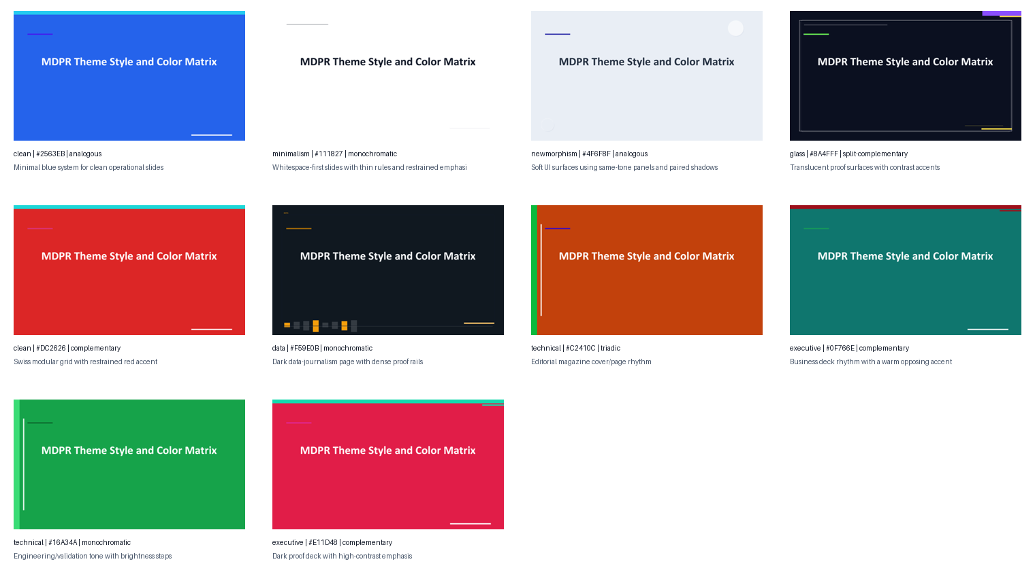
Theme Cover Matrix
PowerPoint-exported cover previews for style/color/harmony combinations.

Slide 3
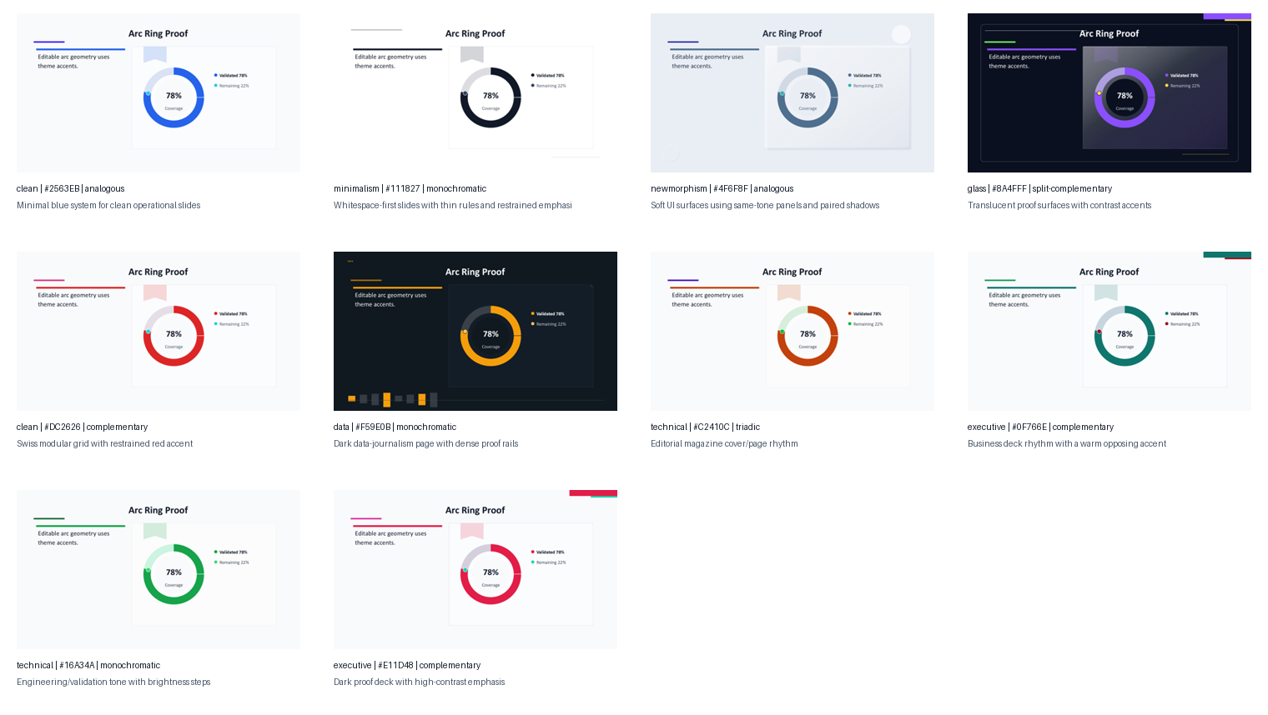
Theme Proof Object Matrix
PowerPoint-exported arc-ring proof slides using each resolved theme palette.

Slide 4
Reference Corpus Expansion
Only source-neutral structure counts and derived grammar are kept in the repository.
PPT FILES
SLIDES
RENDERED PNGS
PNG SAMPLES
DERIVED PATTERNS
80
797
1,594
160
60
Corpus assets stay local. Public artifacts store counts, object families, and coherence guards only.
Diversity is measured by structural archetype count and family spread, not by repeated card variants.

Slide 5
Structural Archetype Atlas
Representative non-card object grammars from the source-neutral 60-pattern catalog.
1
2
3
center-hub-spokes
loop-arrow-cycle
axis-quadrant-map
vertical-timeline-cards
78
donut-label-ring
gauge-score-card
risk-heat-grid
status-dot-table
image-caption-split
pictorial-anchor-labels
stacked-paper-cards
tag-cloud-strip

Slide 6
Layout Diversity Review
The review deck exercises non-card layouts: timeline, split comparison, data proof, and editorial image framing.
Sequence rail
Split comparison
Rule base owns geometry
LLM hint adds intent
Parse
Plan
Render
Review
Data proof
Editorial frame
98 slides
exported through PowerPoint before review
Image-aware layouts keep caption and proof text in separate regions.

Slide 7
Connected Process Layout
Arrows connect aligned parent regions; inner labels remain centered inside their own marker shapes.
Markdown semantics
Rule-based layout
Editable PPT objects
Visual validation
A
B
C
D
Validation target: markers and labels share vertical centers; arrows touch parent-region edges without crossing text.

Slide 8
Mixed Object Stress Layout
Tables, metrics, chart-like marks, icon markers, and callouts are composed without forcing empty-space filler.
68
object kinds
Cards
14
18
Diagrams
11
object families checked
Metrics
6
Images
6
a
No text crosses shape boundary
Review note: layout variation is checked by slide families, not by card-count alone.
b
Decoration lives outside text box
c
Minimum font stays readable

Slide 9
Theme Style Primitive Matrix
The same card, table, chart, and marker primitives change decoration grammar under each theme style.
SIMPLE
none
MINIMALISM
none
NEWMORPHISM
newmorphic
GLASS
glass
CARD
CARD
CARD
CARD
A
mark
B
mark
C
mark
D
mark
GRID
none
DATA
none
MAGAZINE
soft
EXECUTIVE
soft
CARD
CARD
CARD
CARD
E
mark
F
mark
G
mark
H
mark

Slide 10
Object Shape Grammar Catalog 1
Editable preview objects generated from the 60+ structural archetype catalog.
accent-rail-card
top-rule-card
number-tab-card
vertical rail; title/body block
hairline rule; quiet surface
3
small tab; number; aligned title
theme-token driven
theme-token driven
theme-token driven
corner-chip-card
bracket-note-card
dot-marker-row
corner chip; compact label
thin bracket; label; indented body
small dot; first-line alignment
theme-token driven
theme-token driven
theme-token driven
split-tone-row
proof-chip-inline
thin-outline-card
label zone; body zone
small chip; metric text
outline; plain surface
theme-token driven
theme-token driven
theme-token driven
bottom-meter-card
side-notch-card
floating-label-pin
bottom meter; short label
side notch; aligned text
small pin; image edge
theme-token driven
theme-token driven
theme-token driven

Slide 11
Object Shape Grammar Catalog 2
Editable preview objects generated from the 60+ structural archetype catalog.
caption-underlay
rank-ribbon-card
micro-icon-marker
caption band; single line label
5
rank ribbon; large number
one monotone icon; left gutter
theme-token driven
theme-token driven
theme-token driven
double-rule-header
soft-shadow-lift
inset-label-bar
two rules; header label
shallow shadow; plain surface
inset bar; category label
theme-token driven
theme-token driven
theme-token driven
vertical-step-rail
horizontal-step-rail
paired-contrast-edge
vertical rail; node dot; wrapped text
horizontal rail; number nodes
two edge colors; split label
theme-token driven
theme-token driven
theme-token driven
quote-rule-card
metric-lead-card
checklist-grid-card
left quote rule; body
large number; unit; caption
check marker; two-column grid
theme-token driven
theme-token driven
theme-token driven

Slide 12
Object Shape Grammar Catalog 3
Editable preview objects generated from the 60+ structural archetype catalog.
constraint-stack-card
label-overline-card
subtle-band-card
MUST
bold label; indented description
overline; title; body
surface band; text group
theme-token driven
theme-token driven
theme-token driven
arc-corner-emphasis
target-ring-badge
image-sidecar-card
arc corner; label
ring badge; metric
reserved image sidecar; text block
78%
theme-token driven
theme-token driven
theme-token driven
table-summary-card
connector-dot-card
plain-safe-card
42
header label; two compact facts
edge dot; connector anchor
minimal padding; no ornament
18
theme-token driven
theme-token driven
theme-token driven
rounded-ticket-panel
paperclip-corner
binder-hole-strip
large rounded ticket; punched corner cue
small clip mark; corner overlap
hole strip; ruled background
theme-token driven
theme-token driven
theme-token driven

Slide 13
Object Shape Grammar Catalog 4
Editable preview objects generated from the 60+ structural archetype catalog.
tape-label
speech-bubble-callout
diagonal-sash-label
short tape surface; caption
bubble; tail; short text
diagonal sash; short word
theme-token driven
theme-token driven
theme-token driven
pill-step-node
folded-corner-card
stacked-paper-cards
pill node; short label
fold mark; body
offset sheets; front card
theme-token driven
theme-token driven
theme-token driven
overlap-lens-diagram
axis-quadrant-map
ladder-step-diagram
two translucent shapes; center label
cross axes; quadrant labels
stepped blocks; ascending labels
theme-token driven
theme-token driven
theme-token driven
loop-arrow-cycle
center-hub-spokes
timeline-marker-strip
curved arrows; nodes
center node; spokes; outer nodes
horizontal line; markers
theme-token driven
theme-token driven
theme-token driven

Slide 14
Object Shape Grammar Catalog 5
Editable preview objects generated from the 60+ structural archetype catalog.
vertical-timeline-cards
stair-progress-meter
donut-label-ring
vertical line; side cards
step blocks; current highlight
donut ring; outside labels
theme-token driven
theme-token driven
theme-token driven
gauge-score-card
small-multiple-bars
trend-line-backdrop
78
semi gauge; score; caption
equal mini bars; shared labels
trend
low contrast line; foreground statement
theme-token driven
theme-token driven
theme-token driven
pictorial-anchor-labels
photo-window-mask
image-caption-split
image anchor; attached labels
cropped window; caption
image region; caption rail
theme-token driven
theme-token driven
theme-token driven
tag-cloud-strip
status-dot-table
risk-heat-grid
small chips; wrap row
dot status column; row labels
grid; severity tint
theme-token driven
theme-token driven
theme-token driven

Slide 15
Object Shape Grammar Catalog 6
Editable preview objects generated from the 60+ structural archetype catalog.
left-accent-rail
top-hairline-rule
number-tab
vertical rail; title/body block
hairline rule; quiet surface
9
small tab; number; aligned title
theme-token driven
theme-token driven
theme-token driven
corner-chip
bracket-callout
bottom-meter
corner chip; compact label
thin bracket; label; indented body
bottom meter; short label
theme-token driven
theme-token driven
theme-token driven
side-notch
rank-ribbon
side notch; aligned text
5
rank ribbon; large number
theme-token driven
theme-token driven

Slide 16
Coverage Audit Summary
Theme feel and object diversity are verified from generated PPTX and PNG artifacts, not from documentation alone.
Catalog patterns
68
Families
callout, card, chart, comparison, constraint, decoration, diagram, fallback, header, icon, image, label, list, metric, quote, ranking, surface, table
Unique shape kinds
68
Archetypes
68
Average theme RGB distance: 206.77
Theme-token ready
68
Manual visual review note
Diversity is now judged by 60+ structural archetypes across 18 object families, not by repeated card decoration variants.

