Slide 1
BPMN2Asbru: Transforming condition-terms of CPG into Asbru
Christian Hinterer
Project/Seminar @ Information Engineering Group
WS2012 – University of Technology Vienna

Slide 2
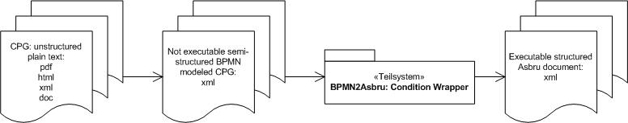
Introduction
CPG: unstructered plain-text -> not executable
A need to execute the described processes
Asgaard/Asbru: execute skeletal plans; structured and defined, using XML

Slide 3
Existing Work
Many different approaches for information extraction in general
Supporting the Abstraction of Clinical Practice Guidelines Using Information Extraction
Information Extraction Approach for Clinical Practice Guidelines Representation in a Medical Decision Support System
Medical practice guidelines and protocols: the Asgaard/Asbru project

Slide 4
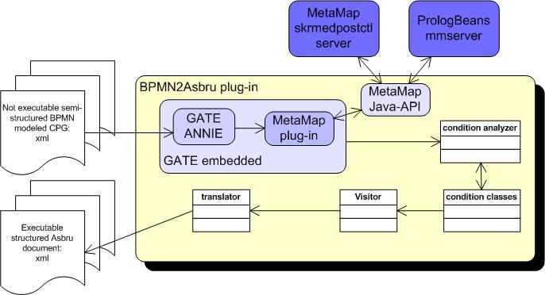
Design I

Slide 5
Design II
Java plug-in using the IDE Eclipse
Console Application for Testing
Input & Output: each a file
GATE embedded
MetaMap (2 servers): process the conditions using UMLS
Choose results -> arrange in different classes
Visitor pattern
Translator -> creates Asbru conditions

Slide 6
Results I
Input
<!-- ... -->
<conditionExpression id="sid-5023436a-4626-4cc2-b79e-27d5dad70e70"
xsi:type="tFormalExpression">For patients who have 1 of
the following less well-validated risk factors (age 65 to 74 y, female gender, or CAD)
</conditionExpression>
<!-- ... -->

Slide 7
Results II
Output
<!-- ... -->
<simple-condition>
<simple-condition-combination type="or">
<is-within-range>
<expression>
<!--...--><parameter-ref name="age" />
</expression>
<value-range>
<lower-bound>
<expression><!--...--><numerical-constant value="65" /></expression>
</lower-bound>
<!--...<upper-bound>...conditions for gender and CAD -->
</value-range>
</is-within-range>
</simple-condition-combination>
</simple-condition>
<!--...-->

Slide 8
Discussion
weakness: not all condition semantics are identified, especially not the complex ones
future work: improve the weaknesses (better usage of the MetaMap results)
Experiences:
Java/Eclipse: unfamiliar → I am used to VS .net
GATE embedded: easy to set up / well documented
MetaMap: 2 servers; plug-in for gate; results are difficult to process

Slide 9

Thank you!
Q & A

