Slide 1

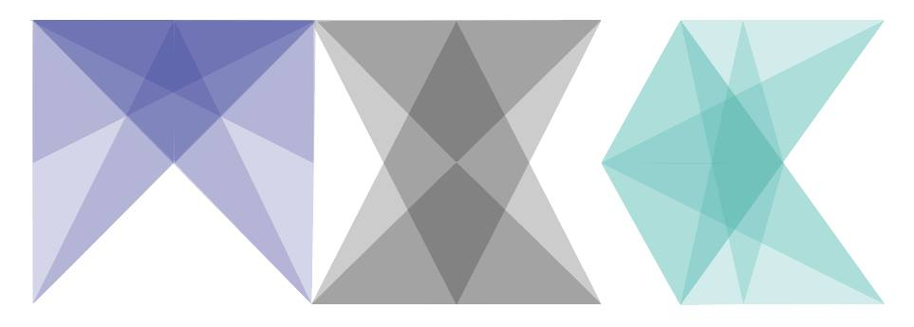
Secure Multi-Party Learning
Justin Chen
7.29.17
Notes:
SMPL (pronounced simple)
Black = encryption
Colors = slice of parameters
Triangle = connected neurons
White = parameter space
Circle = gradient
Size of circles = stochasticity

Slide 2
Democratizing AI
Security, Privacy, and Machine Learning

Slide 3
Motivation
Provide equal access to AI
Protect user data when using AI services
Ensure integrity of trained models

Slide 4
Types of Machine Learning Vulnerabilities
Confidentiality
Leaking information to unintended users
e.g. Reconstructing input from gradients
Integrity
Producing unintended outputs
e.g. Predicting the wrong object in the scene
Availability
Denial of service
e.g Unable to recognize input

Slide 5
Examples of Vulnerabilities
Training Set Poisoning
Inject bad training examples during training
Adversarial Example Construction
Forge inputs that model will interpret by observing outputs
Membership Inference
Determine which training points were used for training

Slide 6
Background
Deep Learning, Data, Gradients

Slide 7

What is Deep Learning?
Artificial neuron - single unit of computation
Artificial neural network – graph of connected artificial neurons
Deep neural network – artificial neural network with more than 2 hidden layers
Deeply nested composite functions for approximating functions from data
Applications: Object recognition, speech synthesis, videogame agents…

Slide 8
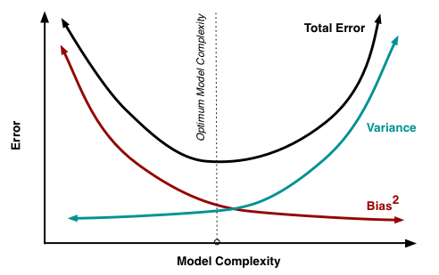
Data Hungry
Deep learning algorithms typically need vast amounts of data to perform well in practice
Order of millions of data points depending on nonlinearity of data
More data = better accuracy
Balance bias-variance tradeoff
[1]

Slide 9
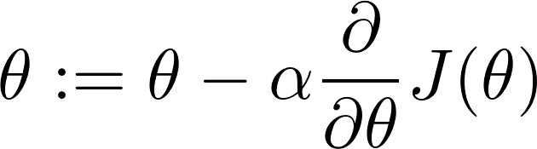
Gradient Descent
Model Parameters
Learning Rate
Cost function

Slide 10
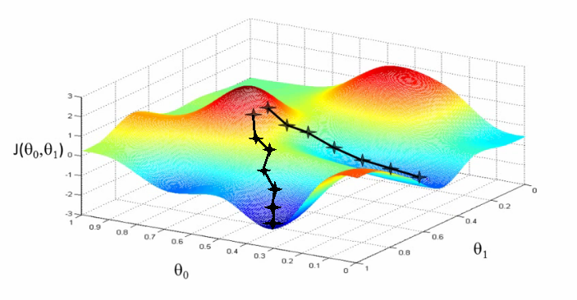
Gradient Descent
https://s3-ap-south-1.amazonaws.com/av-blog-media/wp-content/uploads/2017/03/06100746/grad.png

Slide 11
Gradient Descent
Take derivative of cost function w.r.t. parameters using Backpropagation
Gradient (multi-dimensional vector of partial derivatives)
Adjust weights in the network according to error signal
Variations of GD: Batch GD, Stochastic GD, Adagrad, Adadelta, ADAM, Hogwild!, Downpour, Selective SGD, Decoupled Neural Interfaces

Slide 12
Privacy-Preserving Deep Learning
Shokri and Shmatikov 2015
How can we share data to train deep models without revealing information?

Slide 13
Objectives
Concealing information while leveraging ensemble
Control over data and inference
Access to trained model

Slide 14
Distributed Selective SGD
Distributed Selective Stochastic Gradient Descent
3 main observations:
Gradients update independently
Different points contribute to different parameters
Each feature contributes different amounts to different parameters
1 to 2 orders of magnitude fewer parameters to update each iteration
User can choose the gradients they share and take from other members
Assumes at least 3 members

Slide 15
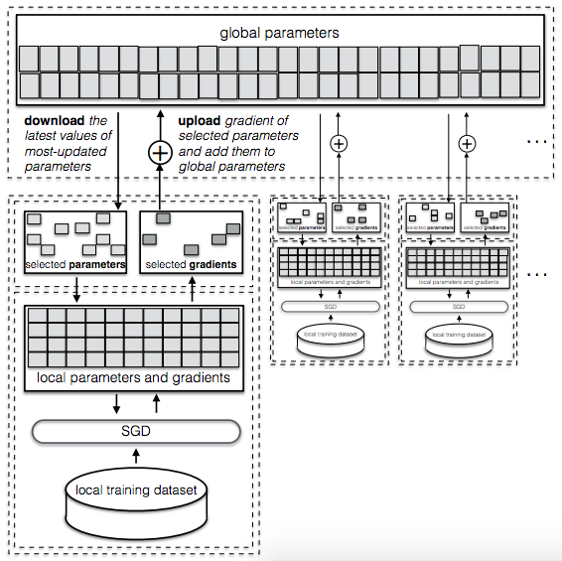
Parameter Updates
1
5
Pull parameters:
Frequency, recency, or moving average, etc.
Subset of parameters
Update local parameters
Compute vector of changes △w
Select parameters to share:
Random or largest gradients
Push to global parameter server
Truncate △w to range [-𝛾, 𝛾] to prevent information leakage
4
2
3
[2]

Slide 16
Parameter Server

Slide 17
Distributed Training
Asynchronous
Parameter server maintains a global copy of the model
Sum gradients for a given parameter
Implicitly assumes all networks are at similar points in parameter space

Slide 18
Experiments
MNIST and SVHN datasets
Baselines:
Centralized SGD on entire dataset (combine all datasets)
Standalone SGD (no collaboration)
Parameter exchange protocols:
Round robin, random order, asynchronous
Parameter sharing policies:
Largest values, random with threshold, most recent
Varying number of party members
Fraction of shared parameters

Slide 19
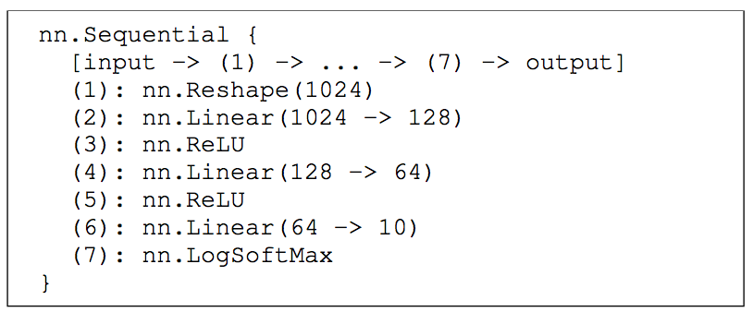
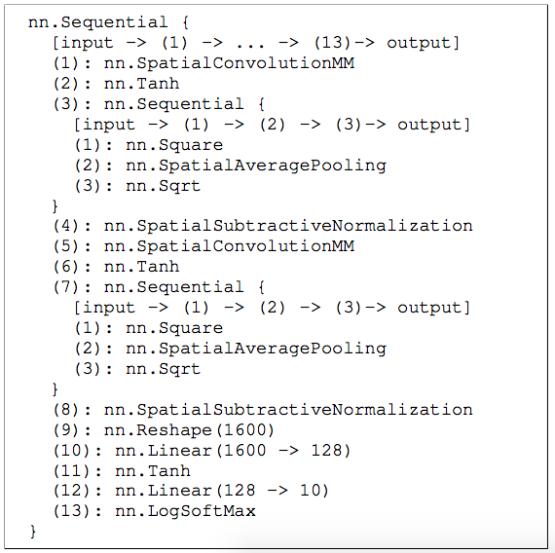
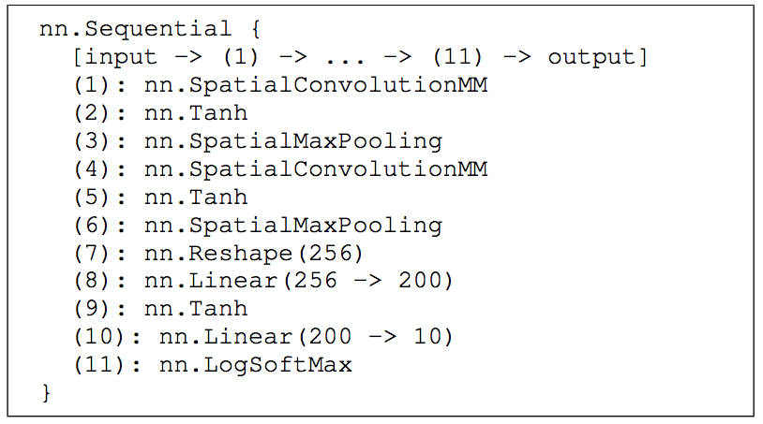
Network architectures

Slide 20
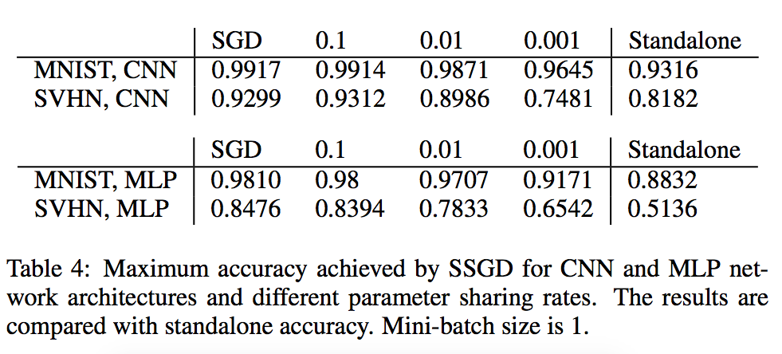
Notes:
Even sharing only .1% of data generally increases accuracy according to experiments

Slide 21
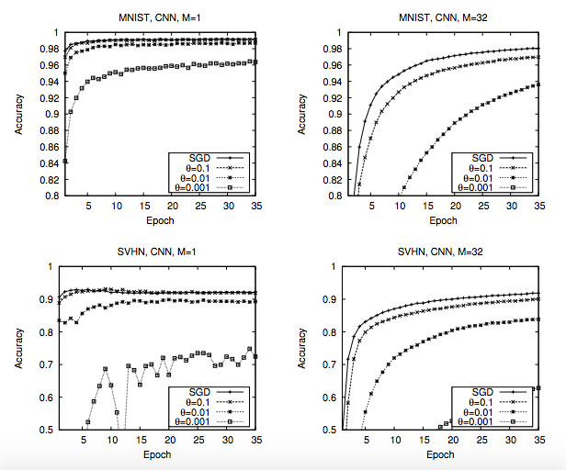
Notes:
M = mini-batch size
SGD = sharing everything as with normal SGD instead of being selective
In every case, SGD converges the fastest and attains the greatest accuracy
As you share less, accuracy gets worse, as expected

Slide 22
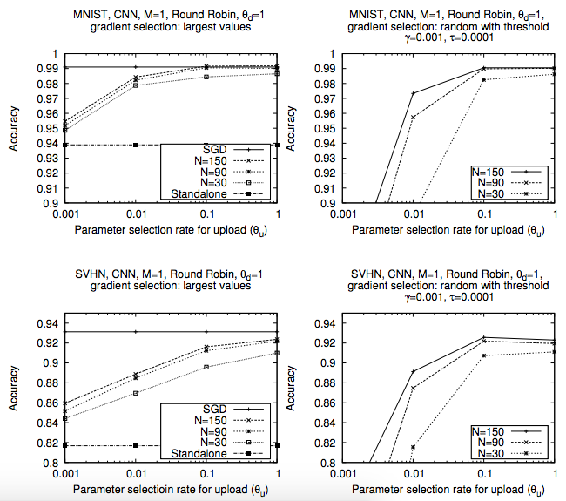

Slide 23
Sparse Vector Technique
Differential Privacy technique for mitigating information leakage of
Gradient selection
Gradient values
Random subset of gradients above threshold
Mask selected gradients

Slide 24
Privacy Budget
Standard differential privacy technique for encrypting data is adding random noise
To determine original value by sampling multiple times and averaging
Privacy budget limits number of queries allowed to prevent too much information from leaking

Slide 25
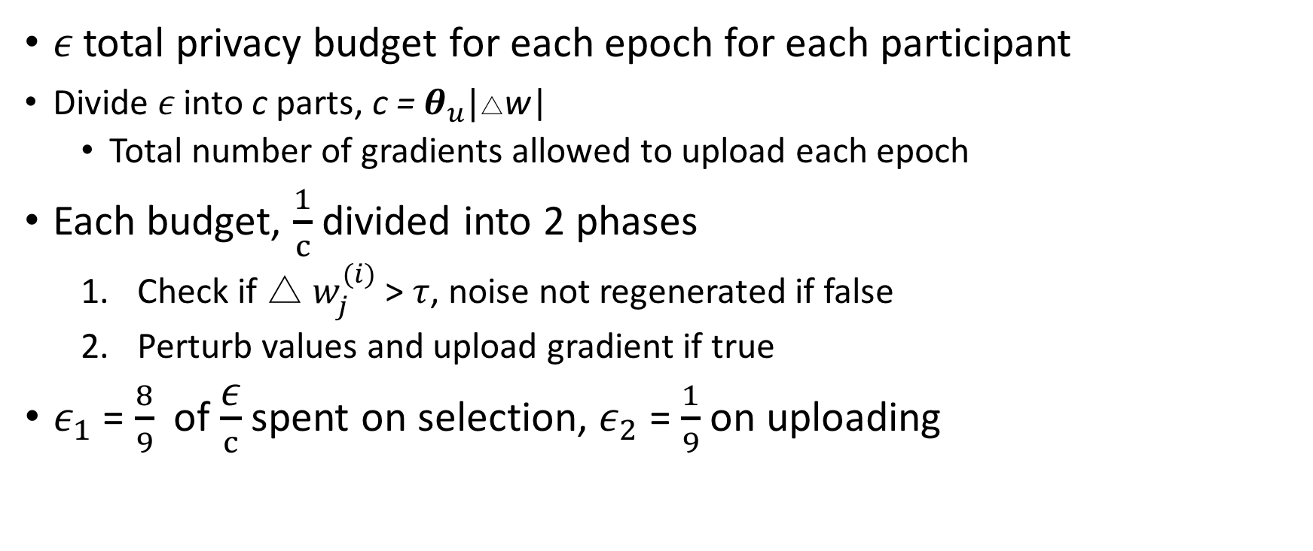
Select Random Subset
𝜖 total privacy budget for each epoch for each participant
Divide 𝜖 into c parts, c = $θ_{u}|$△w|
Total number of gradients allowed to upload each epoch
Each budget, $\frac{1}{c}$ divided into 2 phases
Check if △ $w_{j}^{(i)}$ > $τ$, noise not regenerated if false
Perturb values and upload gradient if true
${\text{ε}}_{1}$ = $\frac{8}{9}$ of $\frac{\text{ε}}{c}$ spent on selection, ${\text{ε}}_{2}$ = $\frac{1}{9}$ on uploading

Slide 26
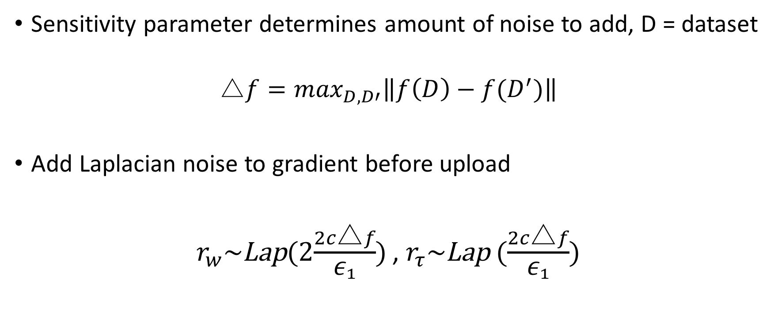
Perturb Values
Sensitivity parameter determines amount of noise to add, D = dataset
$$\text{△}f=\max_{D,D′}\left\|f\left(D\right)−f(D^{′})\right\|$$
Add Laplacian noise to gradient before upload
$r_{w}\sim$Lap(2$\frac{2c\text{△}f}{{\text{ε}}_{1}}$) , $r_{τ}\sim$Lap ($\frac{2c\text{△}f}{{\text{ε}}_{1}}$)

Slide 27
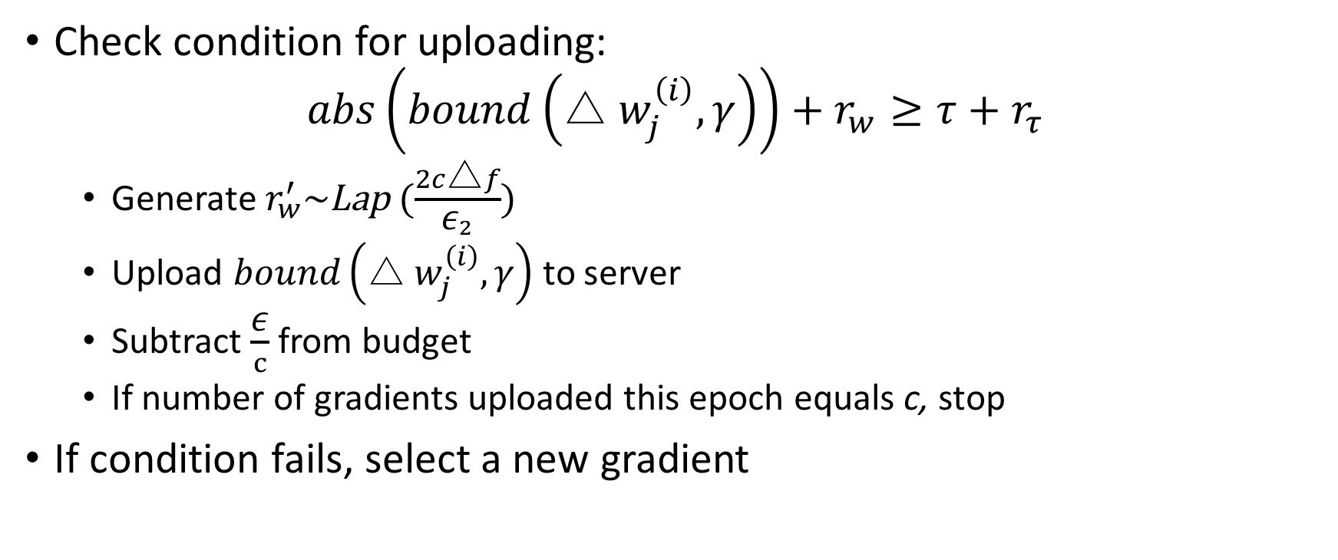
Perturb Values
Check condition for uploading:
$$abs\left(bound\left(\text{△ }w_{j}^{\left(i\right)}, γ\right)\right)+r_{w}≥τ+r_{τ}$$
Generate $r_{w}^{′}\sim$Lap ($\frac{2c\text{△}f}{{\text{ε}}_{2}}$)
Upload $bound\left(\text{△ }w_{j}^{\left(i\right)}, γ\right)$ to server
Subtract $\frac{\text{ε}}{c}$ from budget
If number of gradients uploaded this epoch equals c, stop
If condition fails, select a new gradient

Slide 28
Basic Differences between MPC & DP
Similarities:
Both require multiple party members
Both mask input with randomly generate numbers
Differences:
MPC does not leak any information
DP trades off privacy for usability

Slide 29
Adversarial Example Construction
Adversarial Training, Blackbox Attacks

Slide 30
Adversarial Training
Generative adversarial nets
Generate counterfeit examples
Fool discriminator learning algorithm to misclassifying
Can use this to attack trained systems
[2]

Slide 31
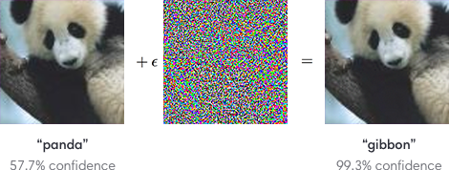
Adversarial Example Construction
[3]

Slide 32
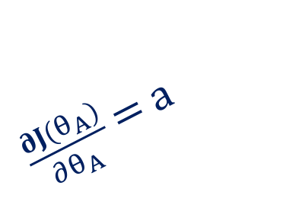
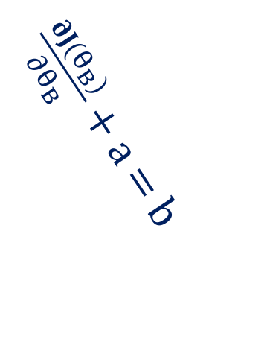
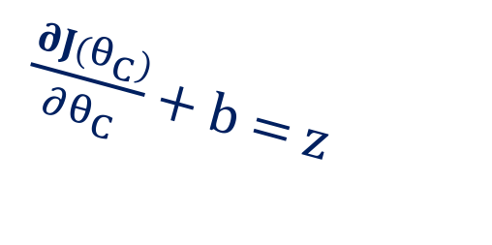
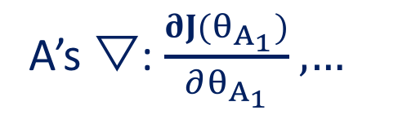
Naïve Distributed Deep Learning
A’s ▽: $\frac{∂J(θ_{A_{1}})}{∂θ_{A_{1}}}$ ,…
$\frac{∂J(θ_{A})}{∂θ_{A}}$ = a
$\frac{∂J(θ_{B})}{∂θ_{B}}$ + a = b
$\frac{∂J(θ_{C})}{∂θ_{C}}$ + b = $z$
Notes:
Motivational experiment

Slide 33

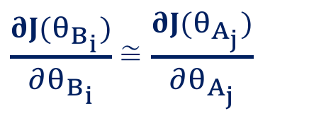
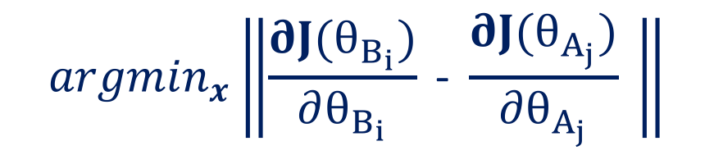
Adversarial Input Reconstruction
Assume N-way classification
A’s ▽: $\frac{∂J(θ_{A_{1}})}{∂θ_{A_{1}}}$ ,…
1
2
.
.
.
N
$\frac{∂J(θ_{B_{i}})}{∂θ_{B_{i}}}$ ≅ $\frac{∂J(θ_{A_{j}})}{∂θ_{A_{j}}}$
x
$${argmin}_{x}\left\|\frac{∂J(θ_{B_{i}})}{∂θ_{B_{i}}} \text{−} \frac{∂J(θ_{A_{j}})}{∂θ_{A_{j}}} \right\|$$
B’s Dataset
Notes:
Motivational experiment

Slide 34
Adversarial Input Reconstruction
Similar input
Adjusted values
Original image

Slide 35
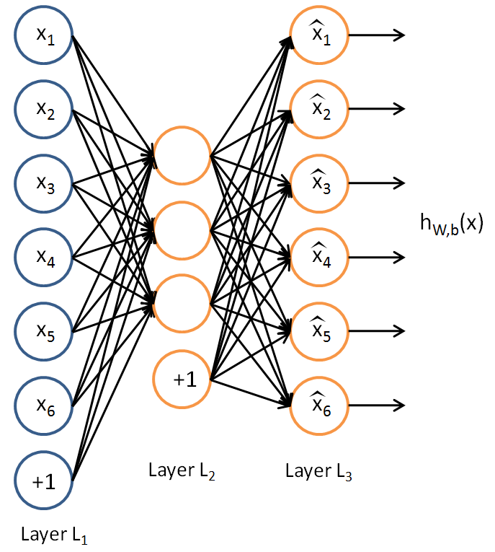
Hypothetical Autoencoder Attack
Unsupervised learning technique for learning features by reconstructing original image
Could use to reconstruct image from gradient
Input – target gradient
Hidden representation – parameters of input vector that mostly closely resemble the input gradient
[4]

Slide 36
Secure Multi-Party Learning
(SMPL) [sim-puh l]
MPC + Distributed Training with Deep Learning

Slide 37
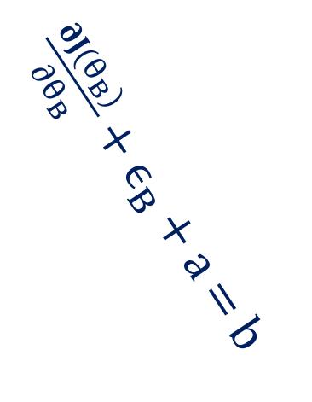
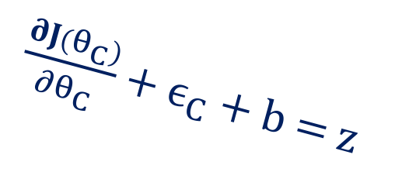
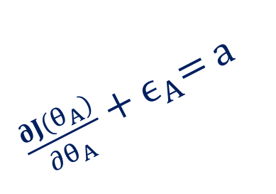
Naïve MPC for Deep Learning: Round 1
$\frac{∂J(θ_{A})}{∂θ_{A}}$ + $ϵ_{A}$= a
$\frac{∂J(θ_{B})}{∂θ_{B}}$ + $ϵ_{B}$ + a = b
$\frac{∂J(θ_{C})}{∂θ_{C}}$ + $ϵ_{C}$ + b = $z$

Slide 38
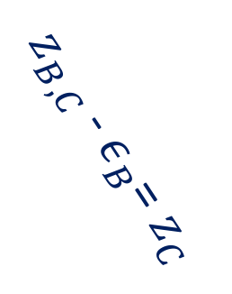
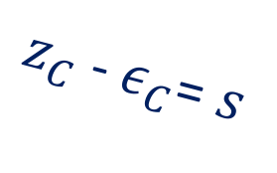
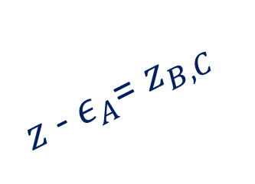
Naïve MPC for Deep Learning: Round 2
$z$- $ε_{A}$= $z_{B,C}$
$z_{B,C}$- $ε_{B}$= $z_{C}$
$z_{C}$- $ε_{C}$= $s$

Slide 39
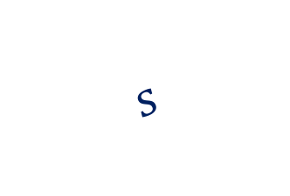

Naïve MPC for Deep Learning: Round 3
$$s$$
$$s$$
Notes:
Each member gets the gradient and sends it to complete the protocol to ensure everyone received the gradient

Slide 40


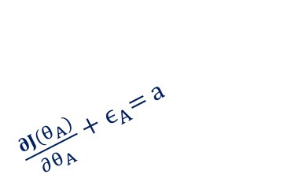
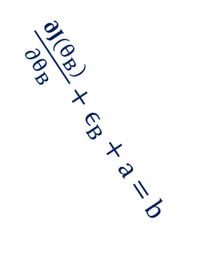
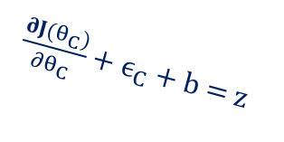
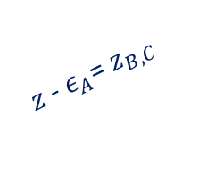
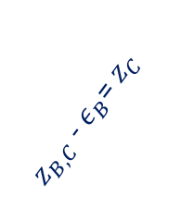
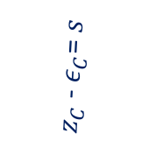
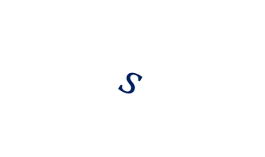
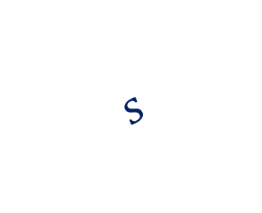
SMPL
$$s$$
$\frac{∂J(θ_{A})}{∂θ_{A}}$ + $ϵ_{A}$= a
$z$- $ε_{A}$= $z_{B,C}$
$\frac{∂J(θ_{B})}{∂θ_{B}}$ + $ϵ_{B}$ + a = b
$z_{B,C}$- $ε_{B}$= $z_{C}$
$$s$$
$$s$$
$z_{C}$- $ε_{C}$= $s$
$\frac{∂J(θ_{C})}{∂θ_{C}}$ + $ϵ_{C}$ + b = $z$
$$s$$
Notes:
Each member gets the gradient and sends it to complete the protocol to ensure everyone received the gradient

Slide 41
References
[1] http://scott.fortmann-roe.com/docs/BiasVariance.html
[2] Shokri, Reza, and Vitaly Shmatikov. "Privacy-preserving deep learning." Proceedings of the 22nd ACM SIGSAC conference on computer and communications security. ACM, 2015.
[2] Goodfellow, Ian, et al. "Generative adversarial nets." Advances in neural information processing systems. 2014.
[3] https://blog.openai.com/adversarial-example-research/
[4] Ng, Andrew. "Sparse autoencoder." CS294A Lecture notes 72.2011 (2011): 1-19.

