Slide 1
Online Video Converter
project report on
Bharat Singh Rajput
B.C.A VI Semester
National Post Graduate College

Slide 2
Introduction
The name of my project is “Online Media Converter”
As It’s name says, it is a media converter application for Videos.
It is a Web Application/Cross Platform Native Application.
The web application can be accessed from any device having a modern operating system and capable of handling websites.
It offers a clean and easy to use user interface that facilitates users to convert their videos.
Users can login to their account, upload new videos which will be saved on the web application as long as they like and can convert and download them on the fly.
This web application, thus work as a cloud storage for the videos and a conversion tool at the same time.
This application is also capable of streaming videos and therefore, users can also watch their videos when and wherever they want.

Slide 3
Abstract Of The Project
There are many times when we have to change the attributes of a video such as its resolution, it’s format or compress it to decrease it’s size.
There are specialized software built to perform this task but these software are platform dependent. Therefore, a conversion tool built for one operating system cannot work on the other operating system.
Keeping this drawback in mind, I have developed a web based solution to this problem.
As we all know, when an application is a “web application”, it becomes platform agnostic. Since web can be accessed from any platform, therefore, this conversion tool can work on any platform that supports a modern web browser.
Apart from being a platform independent conversion tool, this web application also work as a cloud storage for videos.
The native client for this application is built upon “electron.js” which provides cross platform support including Window, Linux, Mac, etc.

Slide 4
Scope Of The Project
This project aims to provide a platform agnostic application for the users to convert their videos, store them in a secure manner, and get additional information regarding their videos.
Since there are numerous formats and resolution available for the videos, this application aims to support uploading and conversion of most commonly used video formats such as .mp4, .avi, .flv and so on.
The applications aims to provide a user friendly UI that can be easily understood.
The application provides streaming platform for the uploaded videos.

Slide 5
Online Media Converter v/s The World
Other Applications
Online Media Converter
Other video conversion tool are often in the form of binaries complied to their specific platforms.
Often they are complex and hard to understand.
Do not provide any cloud storage for videos.
Use client’s resources for video conversion.
No concept of video streaming.
Converted videos are stored on local computer and thus, can’t be accessed from anywhere.
The client and conversion service are platform dependent.
Being a Web Application/Cross Platform Native Application, online media converter is platform agnostic.
Easy to use and understand.
Do provide a cloud storage for videos.
Uses server’s resources for video conversion.
Provides streaming support.
Converted videos are stored on cloud storage and thus, can be accessed from anywhere
The client is platform agnostic and separated from conversion service via REST interface.

Slide 6
Project Modules/Services
Server’s Side
Users
The user’s module on the server-side is REST API that provides services for the frontend application to perform CRUD operations on the user’s collection . The modules support HTTP operations to POST, PATCH, and GET the data from the user’s collection.
Uploads
Uploads are videos that users upload on the server. The uploads’ module on the server-side is a REST API that provides services for the frontend application to perform CRUD operations on the user’s upload collection.
Convert
Convert are videos that users convert on the server using their original uploads. The converted videos are also available on the server as long as the users want. The ’convert’ module on the server-side is a REST API that provides services for the frontend application to perform CRUD operations on the covert collection and also to request server to perform conversion.

Slide 7
Project Modules/Services
Server’s Side(Continued)
Streams
Streams service allows users to stream their uploaded videos. It does not support any database operations. The ’stream’ module on the server-side is a REST API that provides services for the frontend application to perform GET operation on video files uploaded by the user.
Thumbs
Thumbs service allows users to request thumbnails of their uploaded videos. The thumbnails provide visual assistance when the user is trimming a video. It does not support any database operations. The ’thumbs’ module on the server-side is a REST API that provides services for the frontend application to perform GET operation on thumbnail files generated by the server when users upload their videos.

Slide 8
Project Modules/Services
Server’s Side(Continued)
Authmanagement
AuthManagement service manages the e-mails sent to the user. When ever the user registers on the web application, a confirmation email is sent to the user. And also if the user forgets his/her password or if he/she wants to change his/her password, a password reset e-mail is sent to the user to confirm his/her identity. All these operations are managed by the “authmanagement” service.
Authentication
The Authentication module manages the authentication of the user. It uses token-based authentication i.e., JWT5(JSON Web Tokens) to authenticate users before they use any services. It also acts as a session management service. The ’authentication’ module on the server-side is a REST API provides services for the frontend application to perform HTTP operations such as POST and DELETE to create token when logging in, get token after successful login, and delete token when users are logging out.

Slide 9
Project Modules/Services
Client’s Side
App.vue
App.vue is a container module for all other modules. It contains a header, navigation bar, footer, side-panel to quickly jump from one page to another.
Login.vue
Login.vue is a frontend module that manages user login. It provides a user interface for the user to perform operations such as logging in and request password change e-mail in case he forgets his/her password.
SignUp.vue
SignUp.vue is a frontend module that manages user sign up. It provides a user interface for the user to perform sign up operation. It validates all the data before sign up.
Account.vue
Account.vue is a frontend module that manages the user’s information. It provides a user interface for the user to perform changes in his information and requests a password e-mail. It validates all the data before changing it. Users can also view their profiles using this module.

Slide 10
Project Modules/Services
Client’s Side(Continued)
Videos.vue
Videos.vue is the main module. It is a frontend module that manages user’s videos and it’s conversion. It provides a user interface for the user to perform operations such as:
Upload a new video.
Stream a uploaded video and directly play it on the browser.
View information about the uploaded video such as it’s resolution, frame rate, bitrate, size and so on.
Open the conversion dialog in order to perform conversion.
Delete a uploaded video.
Search a uploaded video by date or a search string or both.
Change the view to either List View or Card View.
Video Conversion Dialog
This dialog provides various parameters to tweak when a user is performing the conversion. These parameters include file format, video quality, trim duration, and so on. Users can initiate conversion using this dialog.

Slide 11
Project Modules/Services
Client’s Side(Continued)
ConversionHistory.vue
ConversionHistory.vue is also one of the main module. It is a frontend module that manages user’s already converted videos. It provides a user interface for the user to perform operations such as:
List all converted videos.
Download a converted video.
View information about the uploaded video such as it’s resolution, frame rate, bitrate, size and so on.
Delete a converted video.
Search a uploaded video by date or a search string or both.
Change the view to either List View or Card View.
Reset.vue
Reset.vue is a frontend module that provides a user interface for the user to change their password. It validates the password before changing it.

Slide 12
Project Modules/Services
Client’s Side(Continued)
Verify.vue
Verify.vue is a frontend module that verifies user’s e-mail after their signup. It is only useful for unverified users.

Slide 13
Software Requirements
Server
Software Type | Requirements
Operating System | Windows 7 Service Pack 1 Or Higher
Database | Mongo DB v4.0.4+
Server | Node.js (feathers.js + Express.js) along with ffmpeg
Client
Software Type | Requirements
Operating System | Windows 7+, Android, Any GUI Linux Distro etc.
Web Browser | Google Chrome 60+, Edge, Mozilla Firefox, Safari or any modern web browser supporting HTML 5 and JavaScript ES5
Display | 800x600 or higher

Slide 14
Software Requirements
(Continued)
Developer
Software Type | Requirements
Operating System | Windows 7 Service Pack 1 Or Higher
Database | Mongo DB v4.0.4+
Server | Backend: Node.js (feathers.js + Express.js) along with ffmpeg Frontend: Vue.js, Node.js, Vuetify, feathers-vuex, electron.js
Display | 1024 x 768 32-Bit Color Depth or higher
IDE | Microsoft Visual Studio Code
Version Control | Git

Slide 15
Hardware Requirements
Component | Requirements
Processor | Quad Core Multi-threaded CPU or better
RAM | 4 GB+
Hard Disk Space | At least 80GB for OS and server application and additional storage for cloud
Server
Client
Component | Requirements
Processor | Any Processor Capable Of Handling Modern Website. (Performance >= Intel Pentium 4)
RAM | 1 GB+
Display | 800x600 or higher
Hard Disk Space | Storage for OS And Videos For X86 Based OS >= 40 GB (Windows And Linux) For ARM Based OS >= 8 GB (Android)

Slide 16
Hardware Requirements
Component | Requirements
Processor | Quad Core Multi-threaded CPU or better
RAM | 8 GB+
Hard Disk Space | At least 500GB for OS and server application, IDEs and additional storage for testing cloud storage
Display | 1080p Display. More than one display preferred
Developer

Slide 17
Technologies Used
Front End
Back End
HTML, CSS, JavaScript
Vue.js
Vuetify
Feathers-Vuex
Electron.js
Git Version Control
Node.js
Express.js
Feathers.js
ffmpeg
Mongo DB
Git Version Control

Slide 18
Cost Estimation Of The Project
Since, this is an organic project, we’ll take the respective values for the coefficients. Lines of code(LOC) = 2700 Thus, KLOC = 2700/1000 = 2.7
Taking the values of the coefficients as
a_{b} | b_{b} | c_{b} | d_{b}
2.4 | 1.05 | 2.5 | 0.38

Slide 19
Cost Estimation Of The Project
Development Time (D)
= c_{b} . (Effort Applied) . d_{b} [months]
= 2.5(13.120312)^{0.38}
= 6.65 [months]
People Required (P)
= Effort Applied / Development Time
= 13.120313/6.65
≈ 2
Effort Applied (E)
= a_{b} . (KLOC) . b_{b} [man-months]
= 2.4(5.042)^{1.05}
= 13.120313 [man-months]

Slide 20
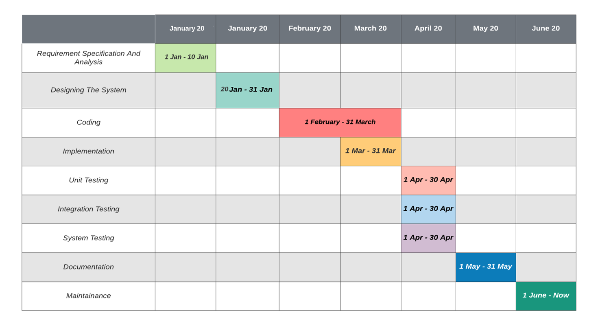
Gantt Chart

Slide 21
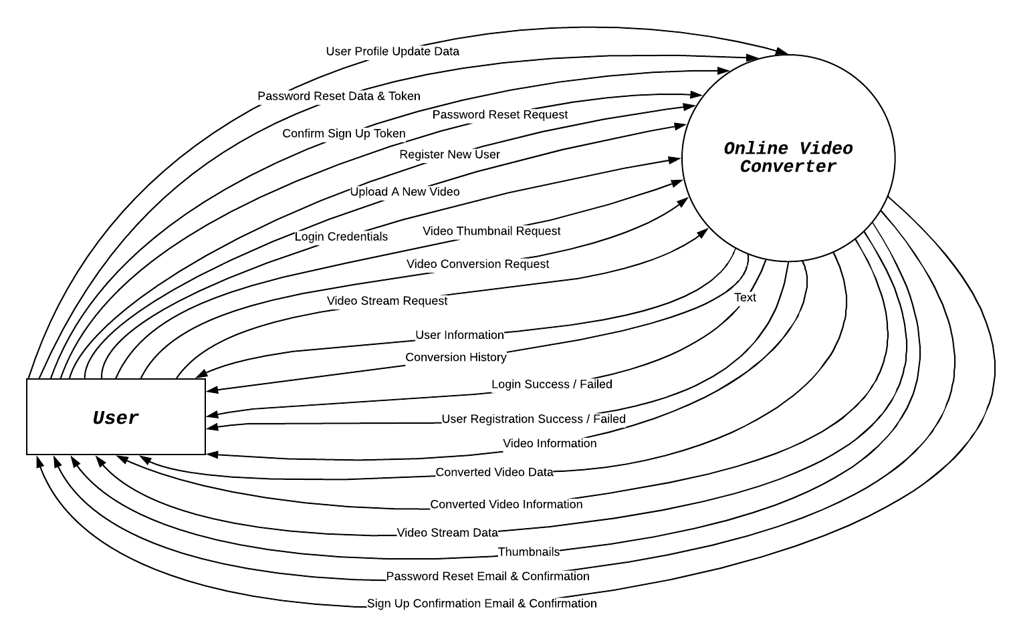
Context Diagram

Slide 22
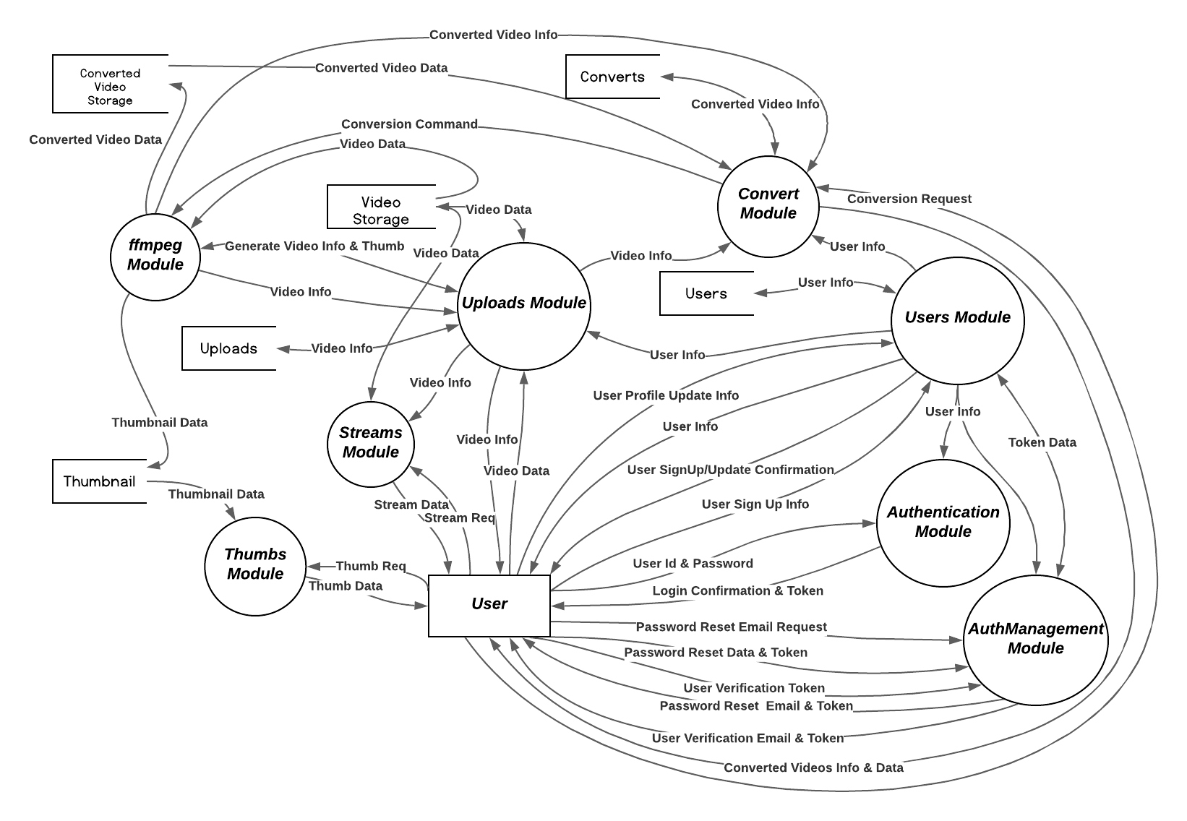
Level 1 DFD

Slide 23
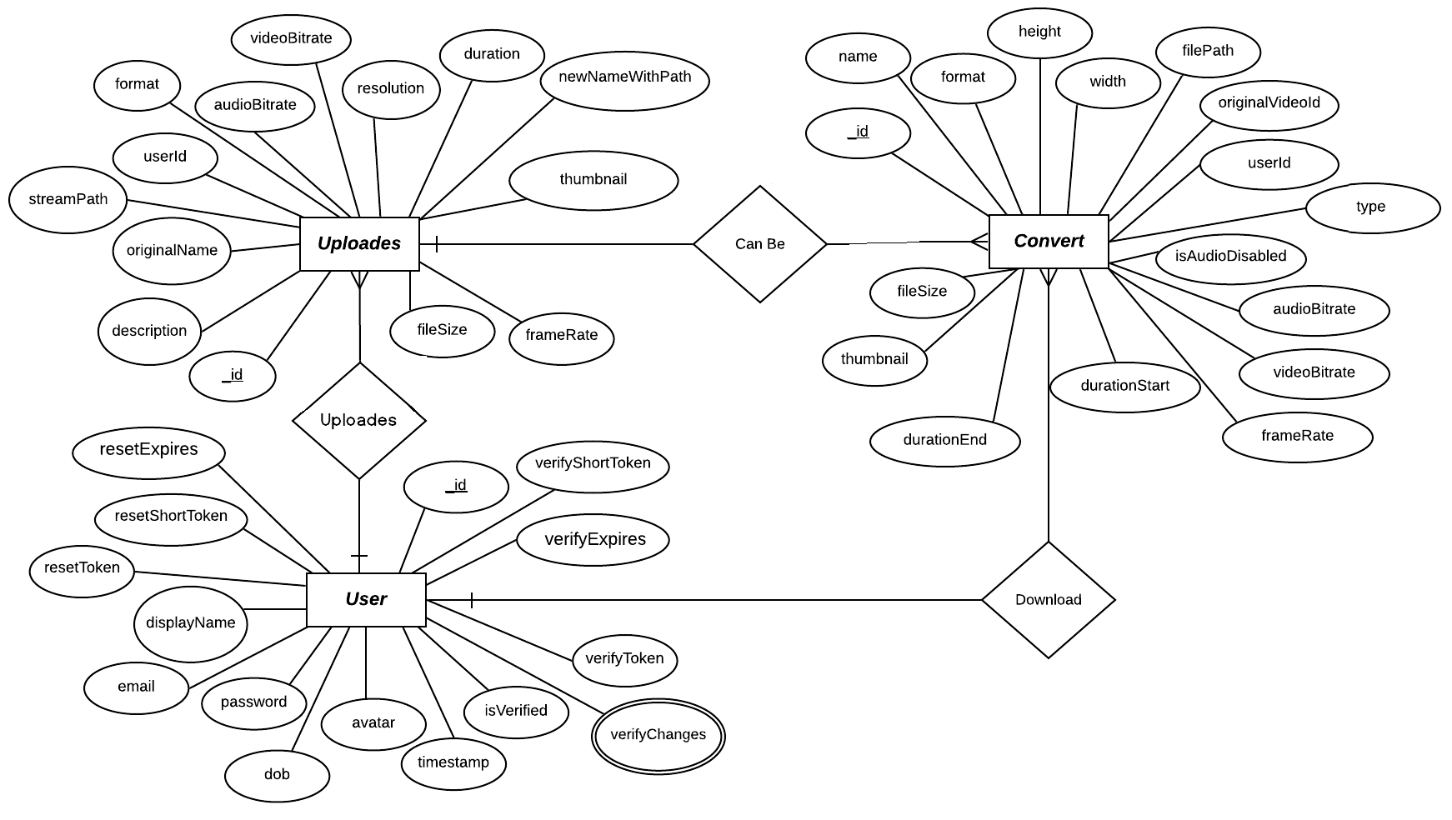
Entity Relationship Diagram

Slide 24
Thank You

