Slide 1
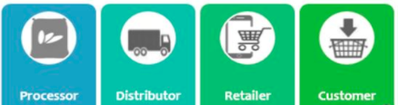
Newton Europe Food
Supply Chain Analytics
Christopher Hughes
Data Scientist

Slide 2






Agenda
Background
Key findings
Additional steps
Summary
Next Steps
Questions

Slide 3
You wanted to identify the common causes
of waste and availability in your supply chain
This project was to assess the important areas that management should consider in focussing their attention to improve waste and availability in the supply chain
We focussed on two main questions:
Can we accurately attribute the causes of waste and availability?
Which causes of waste and availability are most common?
With sub questions of:
How feasible is it to make effective changes?
Are there regional or store-specific issues?

Slide 4
We found the 98% of waste and stockouts* result from sales and waste forecasting
We believe this because…
Key Findings
Proportion waste/stockout Occurrences
Waste Forecasting contributes over 60% of all waste and stockouts. Waste is often 0 in real cases but predicted higher (95%).
Under forecasting sales drives second largest area for improvement.
Forecast Waste is the third largest area and this is a lower bound. It does not factor in lost sales.
Metric** | Occurrence | Percentage (%)
Waste Prediction Waste | 787,474 | 47.8
Forecast Stockout | 342,096 | 20.8
Forecast Waste | 248,706 | 15.1
Waste Prediction Stockout | 232,894 | 14.1
Depot Waste | 36,109 | 2.2
Stock Stockout | 353 | 0
Stock Waste | 196 | 0
Product Waste | 137 | 0
Product Stockout | 0 | 0
Negative Stockfile | 0 | 0
*Results from cleaned data set of 100 top products are stores with more than 2000 entries (final_data Set).
**Metric dictionary in appendix.

Slide 5
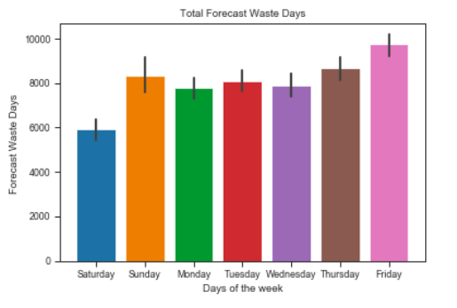
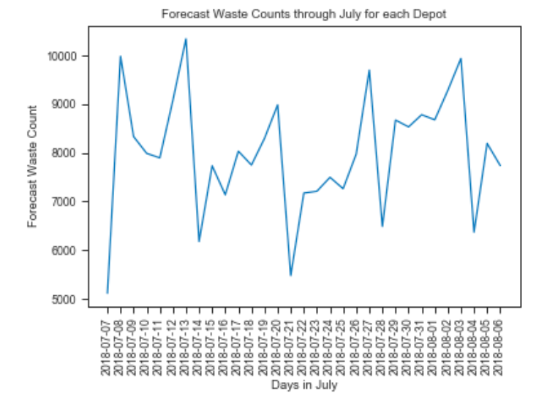
Stores see periodic error in their sales daily
forecasts
Key Findings
Highest forecast wastes occur on Thursdays and Sundays. We are best at forecasting sales for Saturday. This may be as there are higher stockouts.
There is a periodic trend in over-forecasting. We should be able to improve the model with this fact to reduce sales forecast waste.

Slide 6
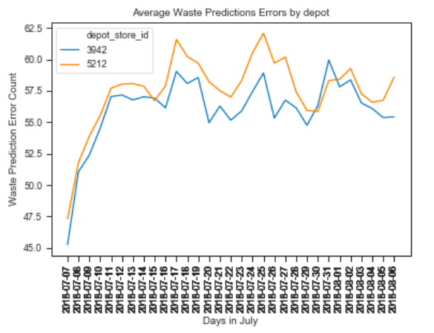
Stores served by depot 3942 record the
fewest Waste Prediction Wastes
Key Findings
There is variability in the average store waste when viewing the depot groups of stores.
Depot 3942 performs the best. This may be a result of :
better condition of produce on arrival
More accurate picking
*two depots of eight shown for clarity

Slide 7

Summary
You asked:
Answer:
Can we attribute the causes of waste
and availability?
Yes – We can attribute causes though there is a lot of missing data that we can look to address.
Which causes of waste and availability
are most common?
Waste Forecasting is the highest cause of waste and availability (over 60%)
How feasible is it to make effective
changes?
Feasible – We can design and test a new waste forecasting system using the existing data.
Are there regional or time-specific
issues?
We see that we are consistently over-estimating for Sundays and Thursday in our forecast and that depot-cohort perform differently.

Slide 8
We must first review cost impact of stockouts
and waste
Key Influencer | Situation and Result | Suggested Use
Sales data | Without sales data, it is hard to see the true value of each metric | Adding sales data to the analysis will give a value to each of the waste and stockout types.

Slide 9


Next steps for waste forecasting

Slide 10
Improving the Forecasting models can reduce waste and stockouts
Key Influencer | Situation and Result | Suggested Use
Waste Forecasting | Waste forecasting is currently inaccurate leading to both high waste of product and product stockouts | Modernise forecast modelling to reduce error
Sales Forecasting | Sales forecasting is underpredicting sales leading to stockouts There are also a large amount of waste events. | Modernise forecast modelling to reduce error

Slide 11
Potential next steps
Review process to Production
Create and run Waste Forecasting strategy
Other projects
The clear next step is to work with the forecasting team to understand the current approach and enhance and test a new model
Establishing a stable model production infrastructure to enable this can be as challenging as the creation of model code.
Work with Forecasting to create a customer “save strategy” driven by model features and additional customer segmentation
Design live test for churn model and save strategy.
Implement strategy in live test
Bespoke regional modelling
Pre-waste price modelling

Slide 12
Questions?

Slide 13
Appendix

Slide 14
Data dictionary
Metric** | Definition
Waste Prediction Waste | We predicted we would waste more than we did
Forecast Stockout | We predicted we would sell less than we did
Forecast Waste | We predicted we would sell more than we did
Waste Prediction Stockout | We predicted we would waste less than we did
Depot Waste | Store receives more from the depot than the amount allocated to them
Stock Stockout | Store had less stock than reported
Stock Waste | Store had more stock than it reported
Product Waste | Product no longer ranged so stock wasted
Product Stockout | Product is no longer ranged so not available
Negative Stockfile | Store had more stock than it reported

Slide 15
Questions, Notes and Next Steps
Sign off data dictionary – I’ve written a data dictionary and worked with data that is new to me. I’d speak to a member in each of the teams to see if there’s anything I’ve misunderstood about the data. E.g.
Depot stockout – missing variable “allocation_qty_over_lead_time”- variable was excluded
Sales Waste – sum of “lost sales” not available but calculation included. Is it in the data? If not, we could mode it using “sales on days without stockout”
Investigate missing data – I would do more analysis to try to figure out why so much data is missing. Lots is missing from the In Store data so I would speak to the team that manages that data and a user of the system.
Sales data – I don’t have a record of sales data. I know if there’s a waste or a stockout event but not how much this event is actually worth. I have no record of reduced price on the final day and the cost of a unit/tray (produce, ship, etc.). With this, I can:
Cost up which issues could see the greatest benefit
Ideally, some ‘survival analysis’ on the pricing and decay. This could help model ”lost sales”

