Slide 1
The CD4+ T cell regulatory network and the effect of hyperinsulinemia: a simulation study
Behavior of immune response and network features under various conditions
Ref. 1

Slide 2
Contents
Introduction
HowisthemodelModeled
Reduction
Reproduction
Asynchronous Update
Curing the world of fatness
Curing AIDS

Slide 3
Obesity-associated chronic inflammation
Excessive nutrient intake
Fat cell response (VAT: visceral adipose tissue)
  Release inflammatory cytokines
Macrophages and altered T helper cell
Insulin resistance of cells
Increased insulin production (Hyperinsulinemia)
Chronic Inflammation:
  Permanent T helper cell effector response
Type-2 diabetes & Metabolic Syndrom

Slide 4
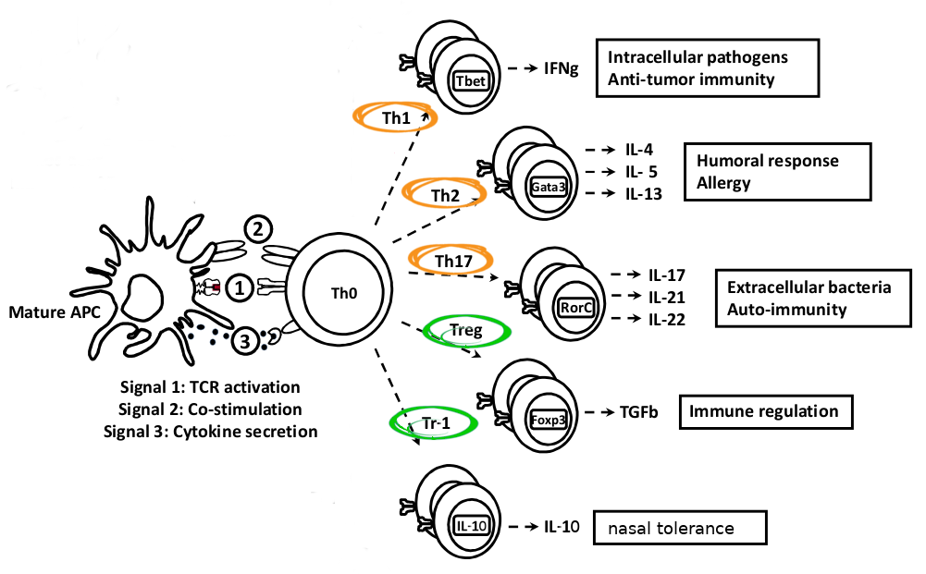
Looking for Volun-T-eer Helper Cells
Ref. 2

Slide 5
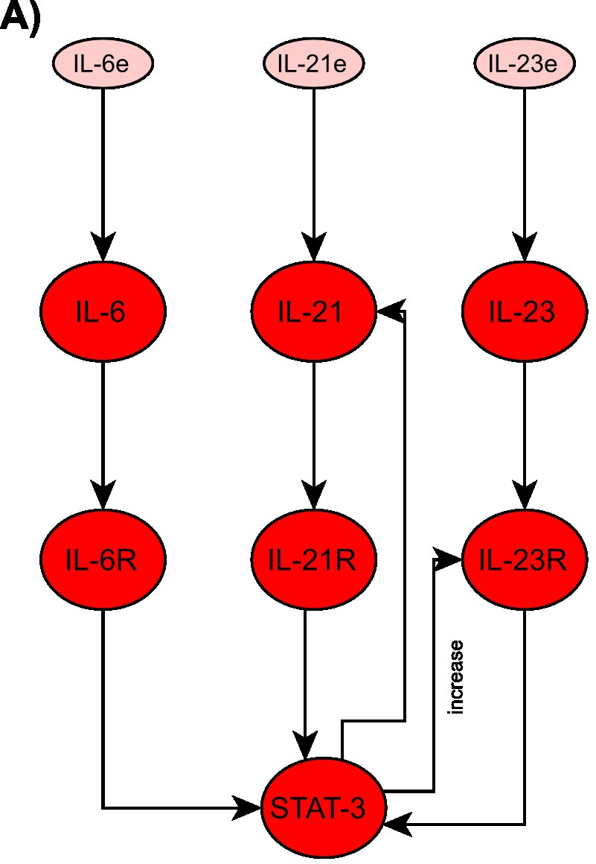
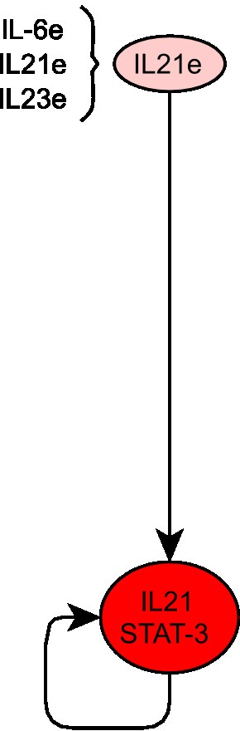
Reduction and Modification
85 nodes model reduced to 18 nodes
By ignoring weak interactions
Axioms of Boolean algebra (Villarreal et al. [5])
Ref. 1, 5

Slide 6
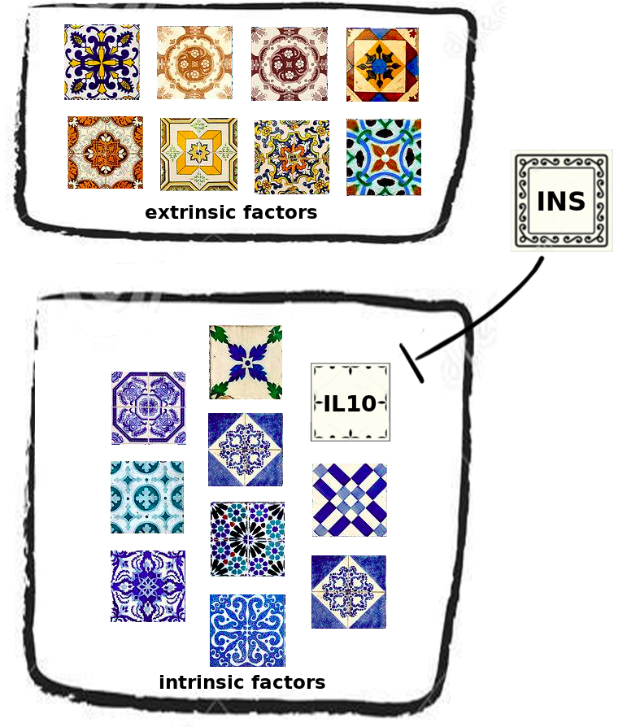
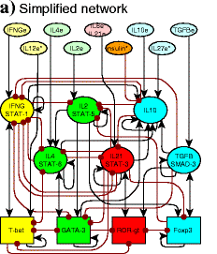
Model:
Ref. 1, I, II, III

Slide 7
Boolean next top-model
Microenvironment (compulation of extrinsic Transcription Factors (TFs))
Intrinsic factors (highly connected)
  Determine Cell Type By Rule set
Insulin -| IL10
2 figures (theirs + ours simplified)

Slide 8
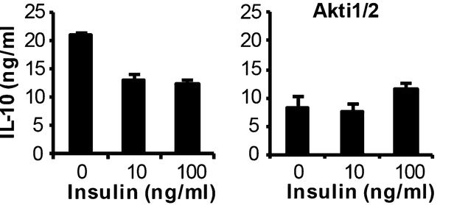
Where does the data come from?
“high concentrations of insulin inhibit IL-10 by overactivating the AKT/mTOR pathway” [1]
Expression | Concentration | Phenotype | Value
No insulin | 0 | Cell death | -
Basal insulin | 0.002 ng/ml | Survival | 0
Hyperinsulinemia | 10-100 ng/ml | Inhibition IL-10 | 1
Ref. 1, 6

Slide 9
Hypothesis
“in effector polarizing environments [...] like pro-Th1, pro-Th2 and pro-Th17, effector and regulatory cells coexist”
“high levels of insulin severely diminish regulatory cells”
“TGFβ can promote both inflammatory Th17 cells and regulatory Tregs”
Ref. 1

Slide 10
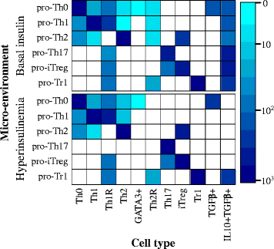
Regulatory vs Effector Cells

Slide 11
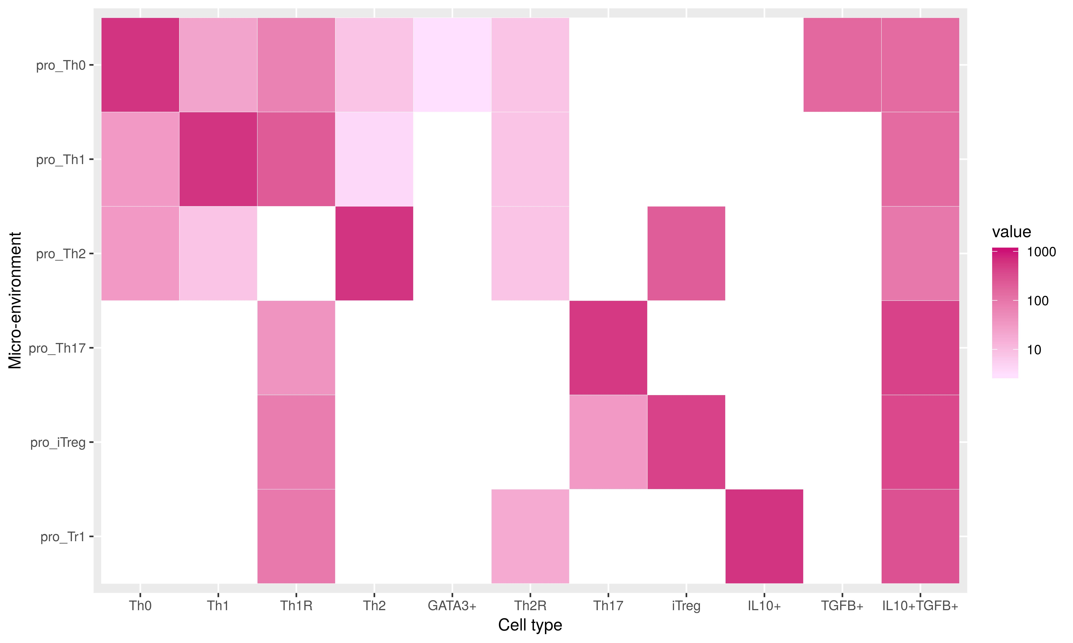
Regulatory vs Effector Cells

Slide 12


Regulatory vs Effector Cells
“in effector polarizing environments [...] like pro-Th1, pro-Th2 and pro-Th17, effector and regulatory cells coexist”

Slide 13
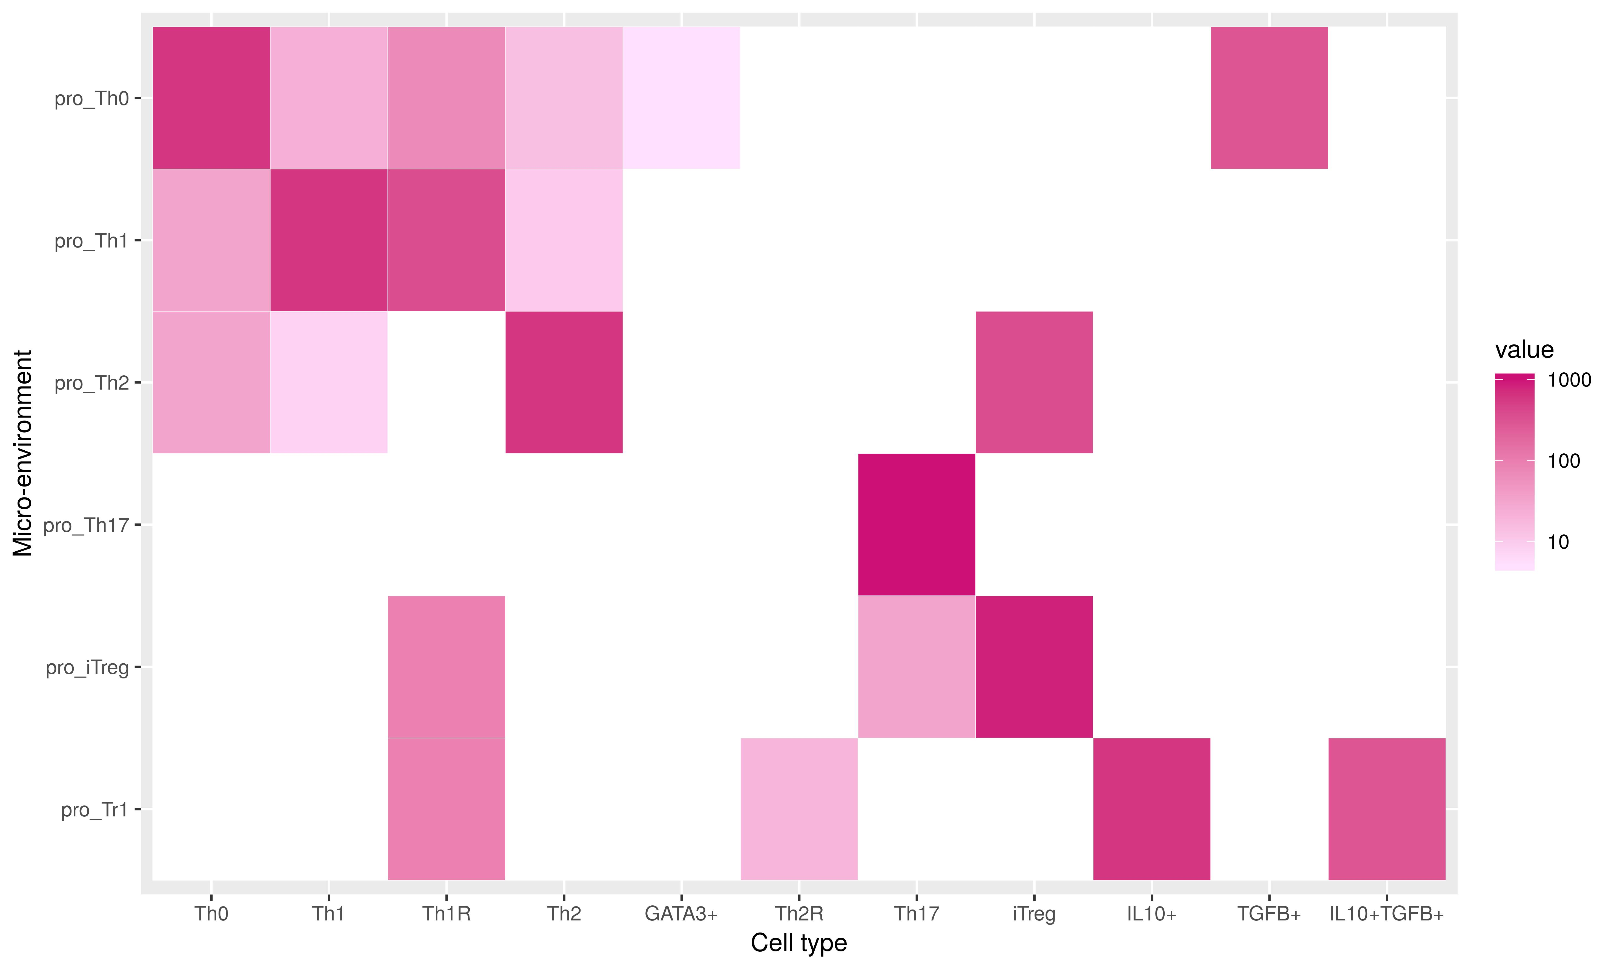
Effect of Insulin

Slide 14
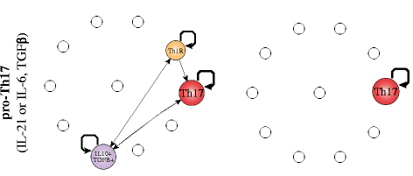
Effect of Insulin
From any attractor, flip one gene (node) for one time step => observe possible change in attractor
Reflects stability of the attractor
Basal Insulin
Hyperinsulinemia

Slide 15
Effect of Insulin
Reproduction

Slide 16
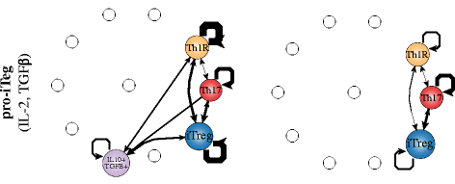
Effect of Insulin
[…] Edges represent transitions from one cell type to another, their width represents the number of times the transition occurred (from plot description, Ref. 1)

Slide 17
TGFβ
Paradoxical Behavior:
  TGFβ is present in adipose tissues
  Transfer and depletion of adipose tissue has been report to improve and worsen insulin sensitivity / chronic inflammation
Link to multi-stable system (Th17 and Treg cells)
“TGFβ can promote both inflammatory Th17 cells and regulatory Tregs, and transitions between both subsets have been observed”

Slide 18
TGFβ
Paradoxical Behavior:
  “While TGFβ is present in adipose tissue, its role in regulating Treg cells is still unclear, because the typical alterations caused by TGFβ are not observed in these cells [39]. Paradoxically, it has been reported that the reduction of adipose tissue Treg cells seems to both, improve and worsen insulin resistance”
  “Transfer and depletion of adipose Treg cells have been reported to both, improve or worsen insulin sensitivity, depending on the model and the population studied”
“This kind of behavior could be linked to an underlying multi-stable dynamic mechanism”
“TGFβ can promote both inflammatory Th17 cells and regulatory Tregs, and transitions between both subsets have been observed”
“TGFβ is necessary for the differentiation of regulatory Tregs and effector Th17 cells.”
“Th17 cells and iTregs are closely related and that Th17 cells can be observed sometimes during the iTreg response”

Slide 19
Asynchronous
000000 → same final states sync vs async.
Helper figures

Slide 20
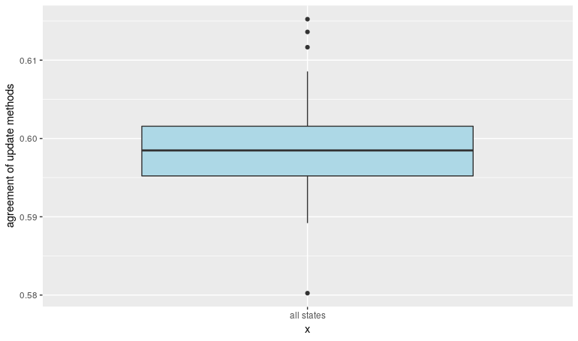
Asynchronous
BUT: all states, only 60% agreement
Boxplot 58 , 59 , 60
Boolnet critics

Slide 21
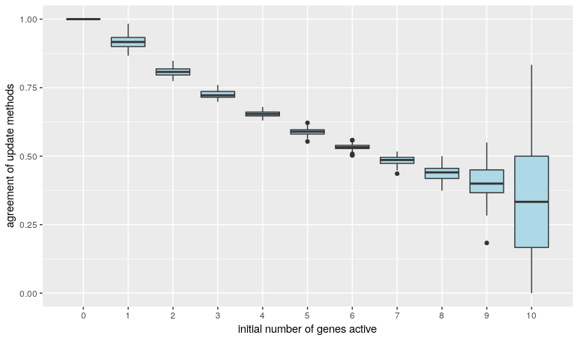
Asynchronous
Trend discovered … good for few genes activated
Bad for (almost) all genes activated

Slide 22
Knock-Out/In Medication
Try: Microenvironment + Insulin + Knock-Out = normal Cell type distribution
Show effector / regulatory Ratio = 0.55
Figure:
Knock-In disturbs network alllot

Slide 23
References
[1] Martinez-Sanchez, M. E., Hiriart, M., & Alvarez-Buylla, E. R. (2017). The CD4 T cell regulatory network mediates inflammatory responses during acute hyperinsulinemia: A simulation study. BMC Systems Biology, 11(1). doi:10.1186/s12918-017-0436-y
[2] Abou-Jaoudé W, Monteiro PT, Naldi A, Grandclaudon M, Soumelis V, Chaouiya C, et al. Model checking to assess T-helper cell plasticity. Front Bioeng Biotechnol. 2014;2:86
[3] Martinez-Sanchez ME, Mendoza L, Villarreal C, Alvarez-Buylla ER. A minimal regulatory network of extrinsic and intrinsic factors recovers observed patterns of CD4+ T cell differentiation and plasticity. PLoS Comput Biol. 2015;11(6):e1004324
[4] (11.) Carbo A, Hontecillas R, Kronsteiner B, Viladomiu M, Pedragosa M, Lu P, et al. Systems modeling of molecular mechanisms controlling cytokine-driven CD4+ T cell differentiation and phenotype plasticity. PLoS Comput Biol. 2013;9(4):E1003027.
[5] Villarreal C, Padilla-Longoria P, Alvarez-Buylla ER. General Theory of Genotype to Phenotype Mapping: Derivation of Epigenetic Landscapes from N-Node Complex Gene Regulatory Networks. Physical Review Letters. 2012 Sep;118102(September):1–5.
[6] Han JM, Patterson SJ, Speck M, Ehses J a, Levings MK. Insulin inhibits IL-10-mediated regulatory T cell function: implications for obesity. J Immunol. 2014;192(2):623–9.

Slide 24
Image References
Image references obtained from the paper on the previous page are not named here explicitly. Most images have been altered / adjusted manually.
[I] https://i.pinimg.com/736x/fe/f5/c0/fef5c0befb04e05dd7365c91d73310c4.jpg
[II] https://i.stack.imgur.com/M8X6e.png
[III] https://c8.alamy.com/comp/KRK1KE/portuguese-tiles-pattern-lisbon-seamless-black-and-white-tiles-azulejos-KRK1KE.jpg
[IV]
[V]

Slide 26
Additional: Transient Pertubations

