Slide 1

Pink Tax in Fragrances?
Marketing Department
Kenza Chaabouni
Supervised by Dr. Kamel Jedidi
Investigating Gender-Based Pricing Differences in Fragrances

Slide 2
Overview
Motivation
Study description
Data
Regression analysis results
Conclusion
Limitations

Slide 3
Women are charged 13.5 % more per milliliter than men for identical fragrances
Exploratory analysis of the prices of 50 fragrances in both men's and women's versions across five European countries.
The study compared the average price per milliliter for identical fragrances.

Slide 4
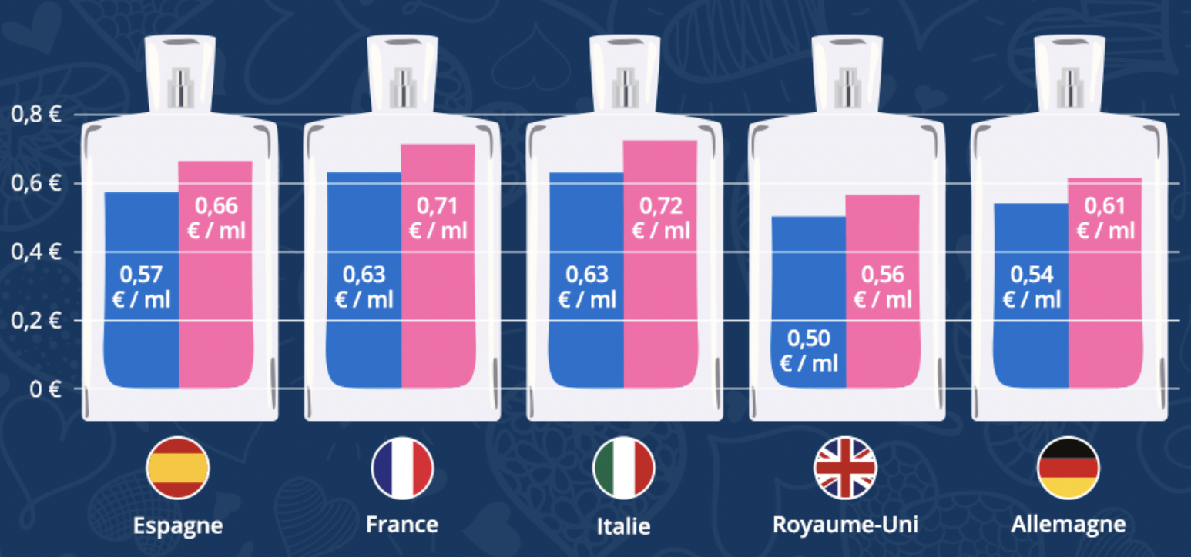
Women are charged 13.5 % more per milliliter than men for identical fragrances
Exploratory analysis of the prices of 50 fragrances in both men's and women's versions across five European countries.
The study compared the average price per milliliter for identical fragrances.
Difference in pricing in perfumes across european countries
idealo. (March 7, 2019). In Statista. Retrieved July 19, 2024, from
https://www.statista.com/statistics/1182913/share-fragrances-higher-prices-women-men-versions-france/

Slide 5
Women are charged 13.5 % more per milliliter than men for identical fragrances
Exploratory analysis of the prices of 50 fragrances in both men's and women's versions across five European countries.
The study compared the average price per milliliter for identical fragrances.
Difference in pricing in perfumes across european countries
idealo. (March 7, 2019). In Statista. Retrieved July 19, 2024, from
https://www.statista.com/statistics/1182913/share-fragrances-higher-prices-women-men-versions-france/

Slide 6
The pink tax phenomenon is prevalent in many product categories
Retail goods (NYC Department of Consumer Affairs 2015)
Personal care products (Moshary et al. 2023, Gonzalez Guittar et al. 2022)​​
Real estate (Goldsmith-Pinkham and Shue 2023)
Automotive vehicles (Ayres 1991, Ayres and Siegelman 1995)

Slide 7
Our study
Objective: Systematically study the pink tax phenomenon in the fragrance category
We control for:
brand fixed effect
seller fixed effect
base and middle notes effects
volume effect
concentration effect (EDT vs. EDP)
We use a publicly available dataset with:
549 observations
25 brands
more than 7 sellers

Slide 8
Our findings
We find a pink tax effect on the brand list price but not on the net price paid after store discount
The average list price per ml for women is higher than men’s
The average discount per ml for women is higher than men’s

Slide 9
Data (one observation)
 |  |  |  |  |  |  |  |  | Base notes |  |  | Middle notes
Price per ml (SAR) | Discount per ml (SAR) | Net price per ml (SAR) | Brand | Perfume name | Volume (ml) | Concentration | Department | Seller | Patchouli | … | Wood | Jasmine | … | Orange
3.95 | 1.5045 | 2.4455 | Paco Rabanne | 1 Million Lucky | 100 | EDT | Men | Noon | 1 |  | 0 | 1 |  | 0
source: https://www.kaggle.com/datasets/monirahabdulaziz/noon-perfume

Slide 10
Regression Analysis Results
 | List price per ml (SAR)
𝛃.Women | .59*** (.23)
Brand FE | Y
Seller FE | Y
Volume | Y
Concentration | Y
Base notes | Y
Middle notes | Y
Observations | 549
Adj. R squared | .70
Notes: The first row reports the coefficient, and the second row reports the standard error.
∗p < 0.1; ∗∗p < 0.05; ∗∗∗p < 0.01

Slide 11
Regression Analysis Results
 | List price per ml (SAR) | Discount per ml (SAR)
𝛃.Women | .59*** (.23) | .54** (.22)
Brand FE | Y | Y
Seller FE | Y | Y
Volume | Y | Y
Concentration | Y | Y
Base notes | Y | Y
Middle notes | Y | Y
Observations | 549 | 549
Adj. R squared | .70 | .44
Notes: The first row reports the coefficient, and the second row reports the standard error.
∗p < 0.1; ∗∗p < 0.05; ∗∗∗p < 0.01

Slide 12
Regression Analysis Results
 | List price per ml (SAR) | Discount per ml (SAR) | Net price per ml (SAR)
𝛃.Women | .59*** (.23) | .54** (.22) | .05 (.10)
Brand FE | Y | Y | Y
Seller FE | Y | Y | Y
Volume | Y | Y | Y
Concentration | Y | Y | Y
Base notes | Y | Y | Y
Middle notes | Y | Y | Y
Observations | 549 | 549 | 549
Adj. R squared | .70 | .44 | .71
Notes: The first row reports the coefficient, and the second row reports the standard error.
∗p < 0.1; ∗∗p < 0.05; ∗∗∗p < 0.01

Slide 13
Conclusion
Our analysis reveals a pink tax effect on brand list prices, though it does not persist after store discounts. Specifically:
Women's average list price per ml is 0.59 SAR higher than men's.
Women receive an average discount of 0.54 SAR more per ml compared to men.
The price difference vanishes on the net price paid.

Slide 14
Limitations
Temporal and Spatial Variability
Aggregated Data

Slide 15
Thank You for Your Attention!
Do you have any questions?

Slide 16
Appendix

Slide 17
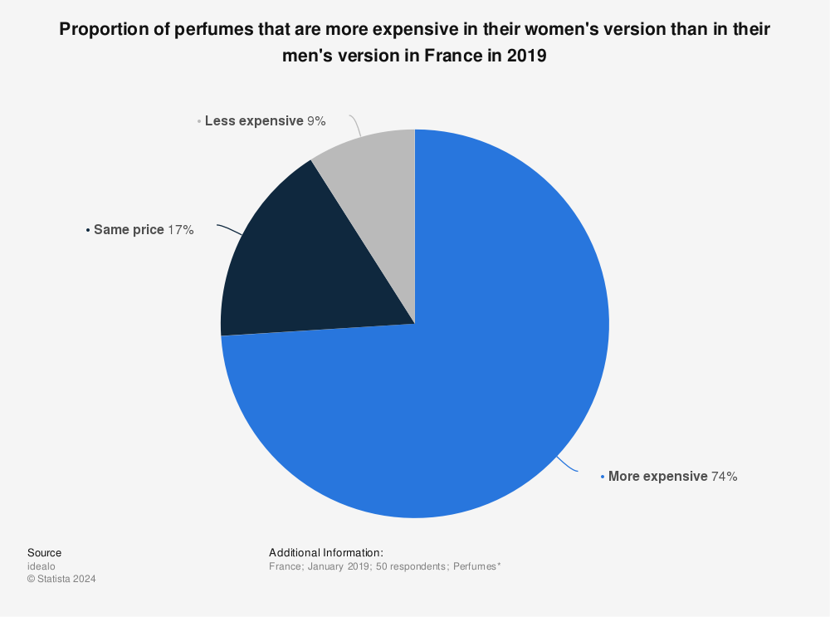
Motivation
Proportion of perfumes that are more expensive in their women's version than in their men's version in France in 2019.
idealo. (March 7, 2019). In Statista. Retrieved July 19, 2024, from
https://www.statista.com/statistics/1182913/share-fragrances-higher-prices-women-men-versions-france/

Slide 18
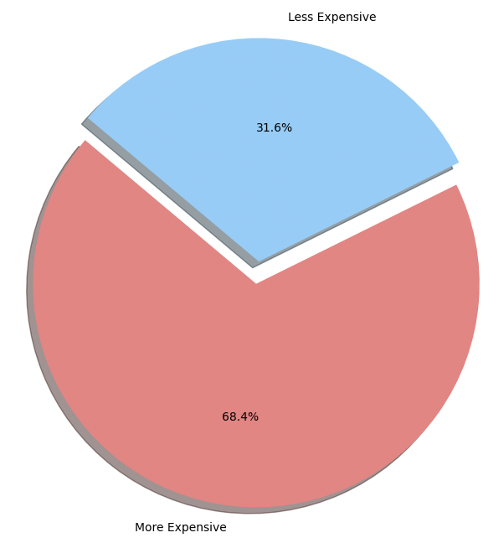
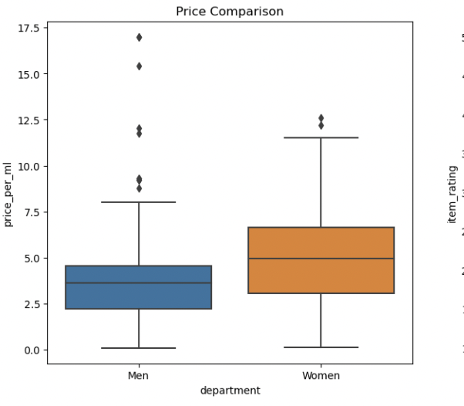
Descriptive Analysis
On average, the list price for women for fragrances is 27.7 % higher than men's perfumes
Proportion of Perfumes with Higher Prices for Women vs. Men
Distribution of Perfume Prices by Gender

Slide 19
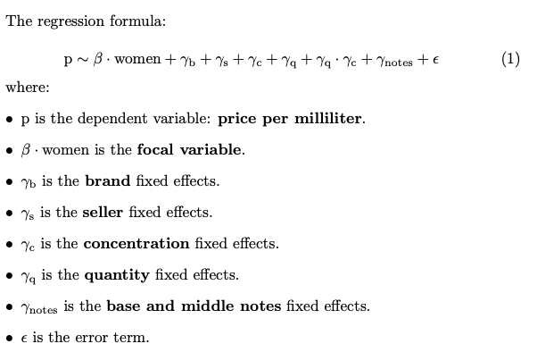
Regression Analysis : gender-based price difference

