Slide 1
MEDICAL IMAGE CLASSIFICATION
gg
TEAM :- 4AM
HARSHIT SHARMA
PIYUSH PRATAP SINGH
VANSH TOMAR

Slide 2


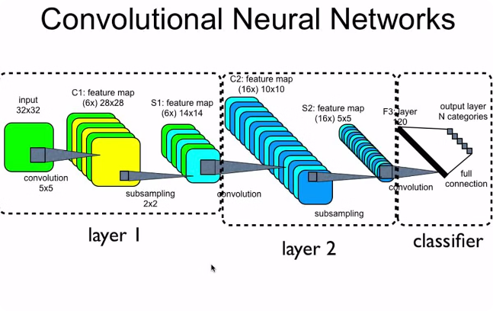
Introduction to Image Processing with Machine Learning
Discover the power of marrying image processing techniques with the latest advancements in machine learning. Explore how these innovative approaches enable enhanced image analysis, classification, and transformation for a wide range of applications.

Slide 3
Fundamentals of Digital Images
1
Pixels and Resolution
2
Color Spaces
3
Image Formats
Explore the different color models, such as RGB and HSV, and their role in digital image representation.
Learn about common image file formats, their characteristics, and when to use each one for optimal performance.
Understand the building blocks of digital images and how pixel density and resolution impact image quality.

Slide 4
Image Preprocessing Techniques
Noise Reduction
Contrast Enhancement
Geometric Transformations
Apply filters to remove unwanted noise and artifacts, improving image quality for further analysis.
Utilize histogram equalization and other techniques to enhance the contrast and visibility of important image features.
Perform operations like resizing, rotation, and cropping to prepare images for consistent processing and analysis.

Slide 5
Feature Extraction and Representation
Low-Level Features
High-Level Features
Identify and extract basic visual features like edges, corners, and textures from images.
Apply advanced feature engineering to capture semantic and contextual information in images.
1
2
3
Mid-Level Features
Discover more complex patterns and shapes through techniques like segmentation and region analysis.

Slide 6
Machine Learning Algorithms for Image Classification
Supervised Learning
Unsupervised Learning
Train models like Support Vector Machines and Decision Trees to classify images into predefined categories.
Leverage clustering algorithms to discover hidden patterns and groups within image datasets.
Transfer Learning
Ensemble Methods
Adapt pre-trained models to new image classification tasks, accelerating the learning process.
Combine multiple models to improve classification accuracy and robustness.

Slide 7




Deep Learning Architectures for Image Analysis
Convolutional
Recurrent
Autoencoder
Generative Adversarial
Leverage the spatial structure of images through convolutional neural networks.
Capture temporal dependencies in dynamic image sequences using recurrent neural networks.
Train unsupervised models to learn compact representations and perform image reconstruction.
Generate realistic synthetic images using adversarial training techniques.

Slide 8



Applications of Image Processing in Various Domains
Medical Imaging
Autonomous Vehicles
Satellite Imagery
Assist in the analysis of medical scans, such as X-rays and MRI, for disease detection and diagnosis.
Enable self-driving cars to perceive their surroundings and make informed decisions based on visual input.
Extract valuable insights from satellite and aerial imagery for applications like urban planning and environmental monitoring.

Slide 9
Challenges and Future Directions in Image Processing with ML
Real-Time Performance
Developing efficient algorithms to enable real-time processing of images for time-critical applications.
Interpretability
Improving the transparency and explainability of machine learning models for better understanding and trust.
Generalization
Addressing the challenge of building models that can effectively generalize to diverse image datasets and domains.
Data Scarcity
Exploring techniques to train robust models with limited annotated data, such as transfer learning and data augmentation.

