Slide 1
PharmaCore — Medicine Inventory Management System
A web-based inventory management system designed for pharmacies to automate daily stock control, eliminate the
risks of selling expired medicines, and generate alert for low stock, expiring and expired medicines.

Slide 2
Problem Statement
Poor Stock Management
Lack of Timely Alert
Difficulty in stock management using Notebooks & Spreadsheet
Loss of sales due to low or no stock
Medicine Expiration
Error Prone
Risk of selling expiring or expired medicine
Manual entry is tedious and error prone

Slide 3
Solutions
Centralized Record Keeping
Automated Stock Monitoring
To maintain accurate medicine inventory records through a computerized system.
To automate stock quantity monitoring and inventory updates.
Expiry Date & Quality Control
Reorder & Low Stock Alerts
To monitor medicine expiry dates and generate alerts for near-expiry and expired medicines.
To provide low-stock alerts when medicine quantity falls below the reorder level.

Slide 4
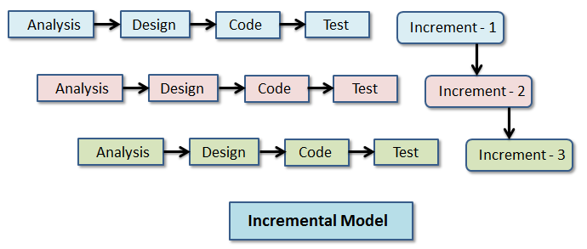
Methodology
Incremental Software Development Model
This approach was chosen because it permits constant improvement and addition of supervisor’s comments after each increment without breaking the whole system.

Slide 5
Requirement Collection
Functional Requirements
Authentication: User should be able to securely login and logout.
Inventory CRUD: User should be able to add, edit, delete, search and categorize medicines.
Stock & Expiry Tracking: User should be able to track and update medicine quantities and expiry dates.
Automated System Alerts: System should automatically update stock and generate timely alerts for low stock and expiration status.

Slide 6
Requirement Collection
Non-Functional Requirements
Usability: Interface should be user-friendly.
Performance & Scalability: System should have fast response time and be fully scalable to handle future growth.
Security & Integrity: System should ensure secure authentication and maintain strict data integrity.
Maintainability: System architecture should be easily maintainable over time.

Slide 7
Feasibility Study
Technical Feasibility
Highly feasible as development relies on open-source web technologies (PHP, MySQL, Javascript) and local development using XAMPP stack. Developer has sufficient knowledge for documentation and development. Hardware requirements are also minimal.
Operational Feasibility
Feasible as project includes user-friendly interface, automated inventory management and reduced human errors.
Economic Feasibility
Feasible as all tools used are free and open-source.

Slide 8
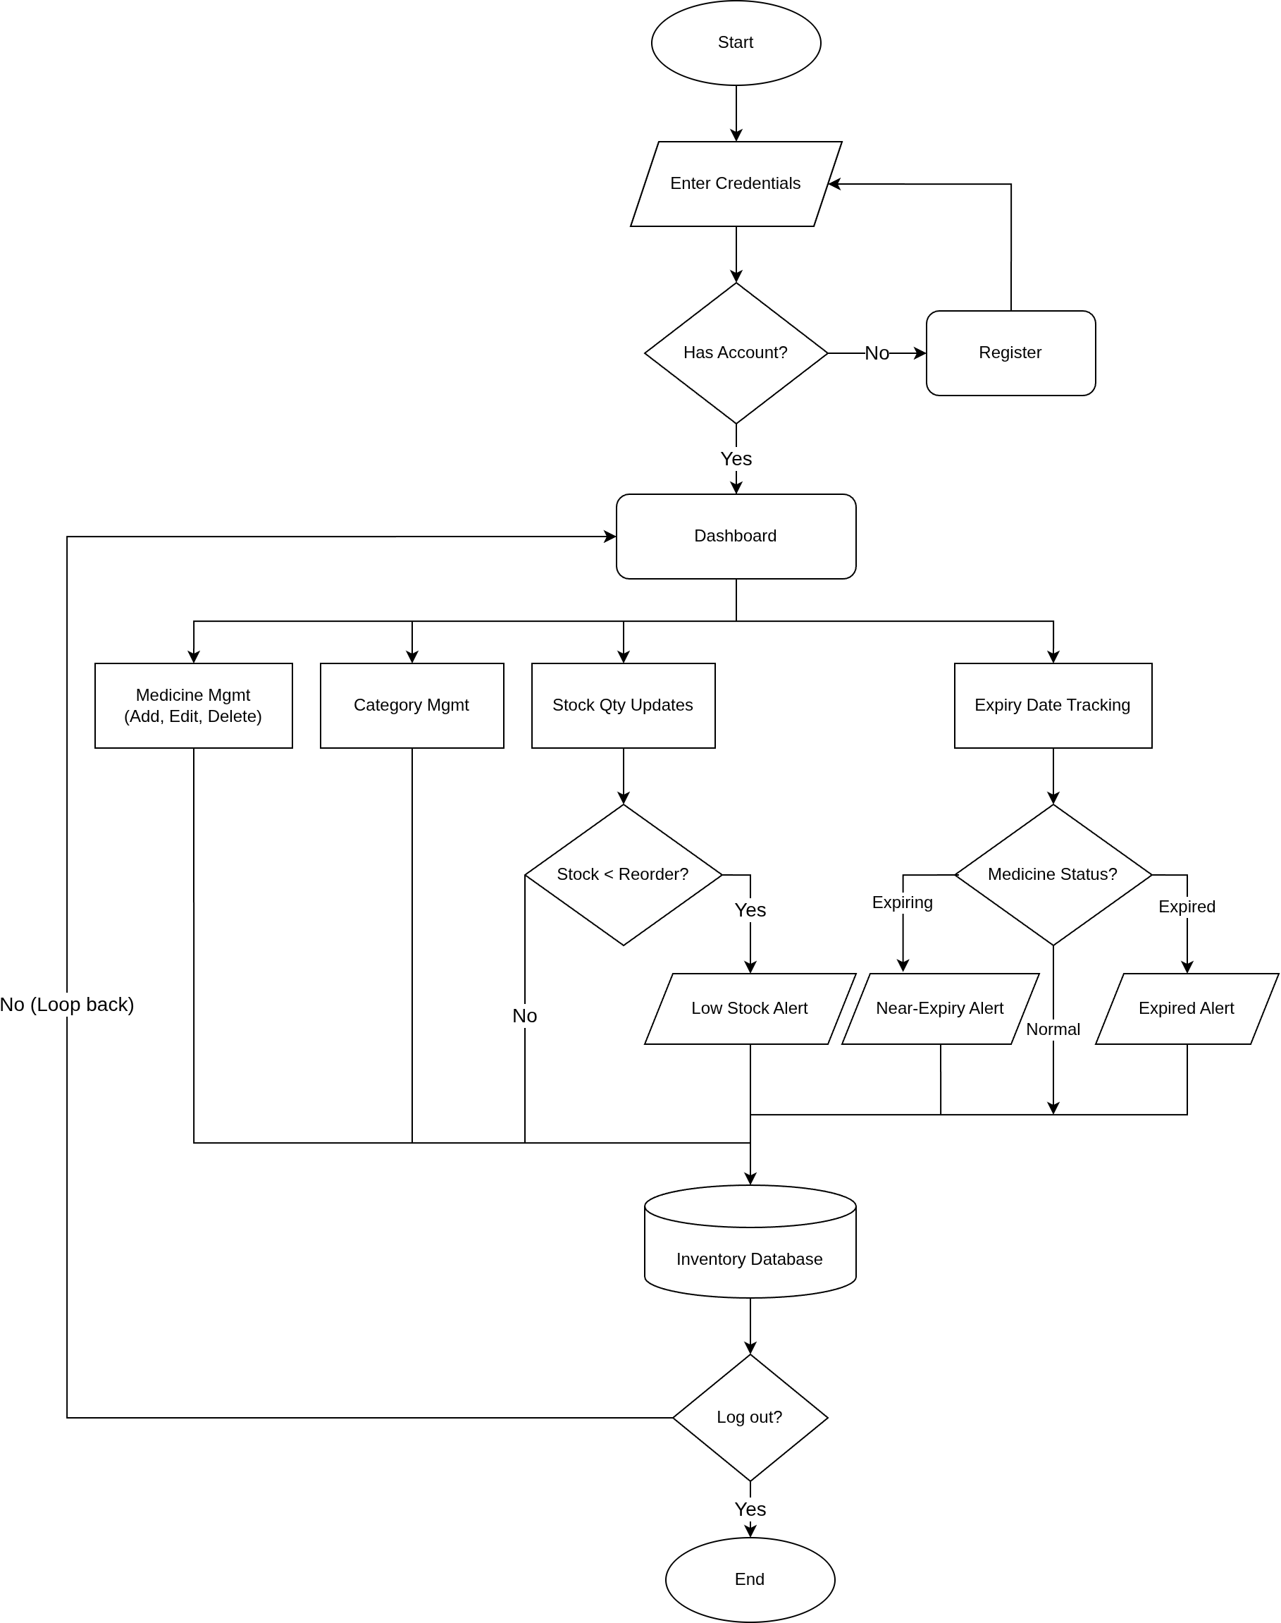
Flowchart

Slide 9
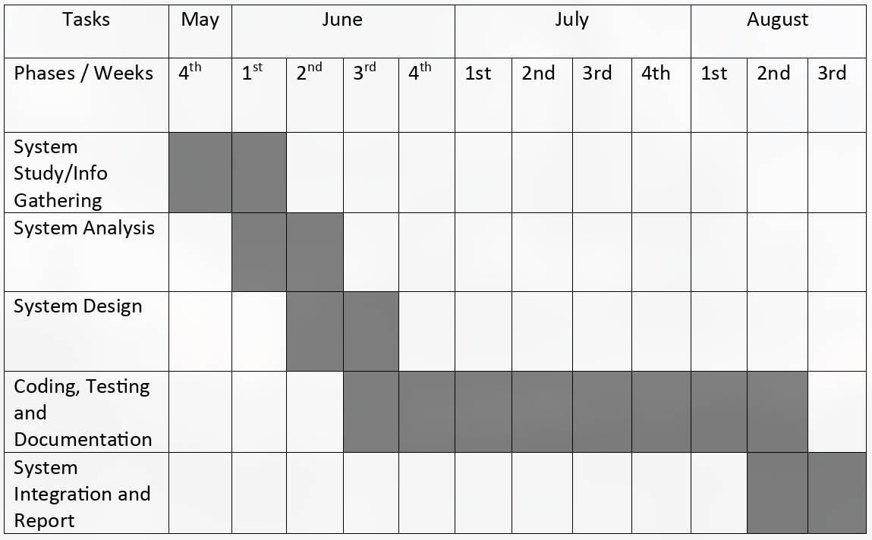
Gantt Chart

Slide 10
Expected Outcomes
Accurate Inventory Management: Maintains organized and up-to-date medicine records.
Automated Stock Monitoring: Helps prevent inventory shortages through low-stock alerts.
Expiry Date Tracking: Reduces medicine wastage by identifying near-expiry and expired medicines.
Improved Operational Efficiency: Reduces manual record keeping and minimizes human erros.

Slide 11
References
Design: https://www.figma.com/.
HTML: https://www.w3schools.com/Html/
CSS: https://www.w3schools.com/css/
Javascript: https://www.w3schools.com/js/
PHP Official Documentation: https://www.php.net/docs.php
MySQL Reference Manual: https://dev.mysql.com/doc/
XAMPP: https://www.apachefriends.org/
MDN Web Docs: https://developer.mozilla.org/
Use Case Diagram & Flowchart: https://app.diagrams.net/

