Slide 1
2024 Deep Learning
Hardware Design Competition:
Final Presentation
Dongmin Han, Changwoo Lee, Donghwee Son
ChipChamps, Seoul National University

Slide 2
Contents
Outline
Idea and Novelty
Hardware Design
Team Plan
Others

Slide 3
1. Outline
Objective
Appropriately quantize the model so that all computations can be done in integer, without significant accuracy loss.
Design CNN inference accelerator considering accuracy, time, power, and resource utilization.
Implement the designed modules on actual HW, like FPGA.

Slide 4
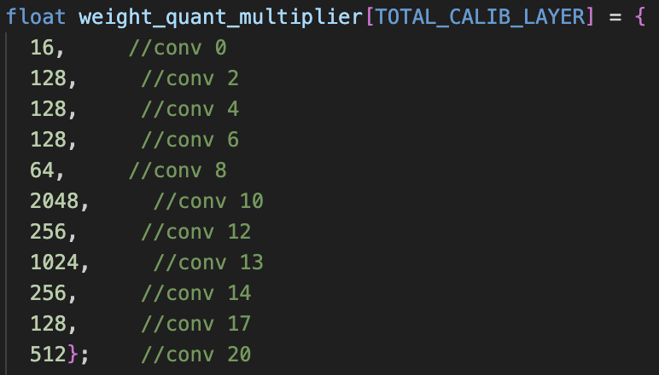
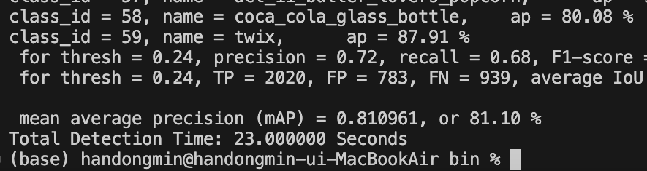
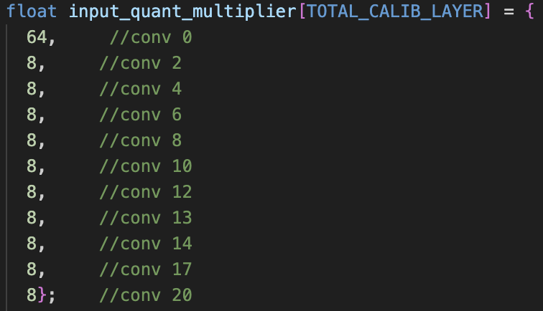
1. Outline
Final Result
Quantization (mAP) : 81.10%

Slide 5
1. Outline
Final Result
Simulation completed for all layers (conv0 ~ conv20)
This was implemented only with regs, and assuming all ifmaps/weights for each layer can fit into the regs. (Impractical on HW)
Therefore, ifmap tiling was implemented to put practical sizes of data can fit into the limited reg/bram of FPGA.

Slide 6
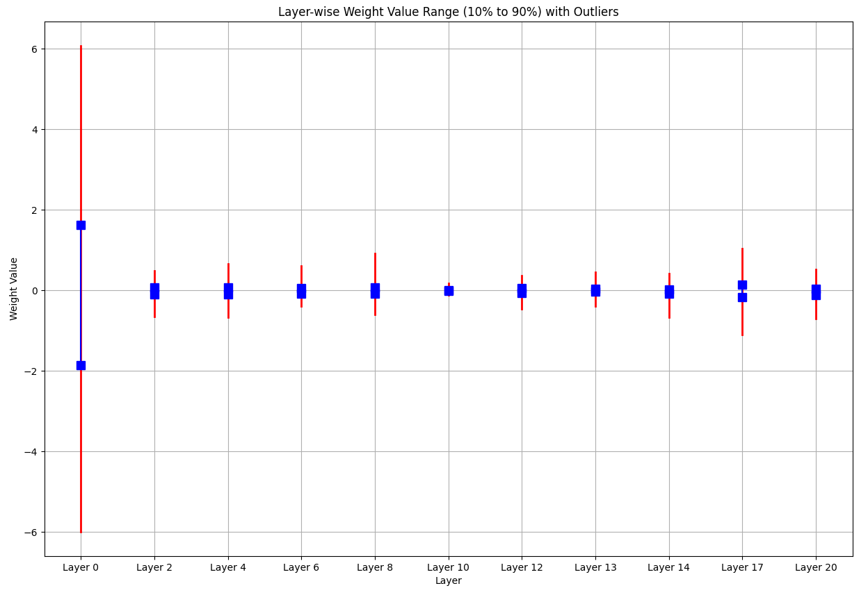
2. Idea and Novelty: Quantization Method
Weight Distribution
Overall layer-wise view
Min/Max ranges are quite limited!

Slide 7
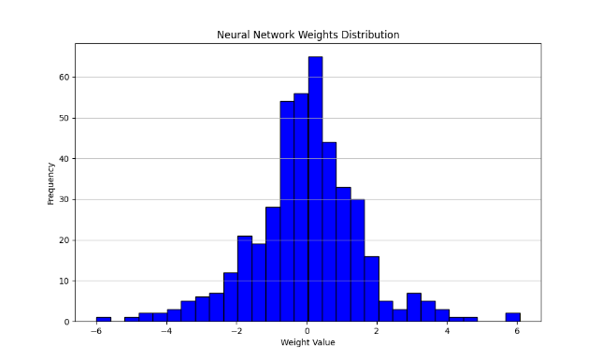
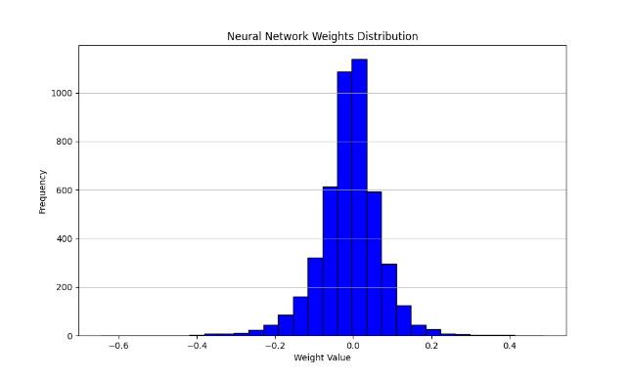
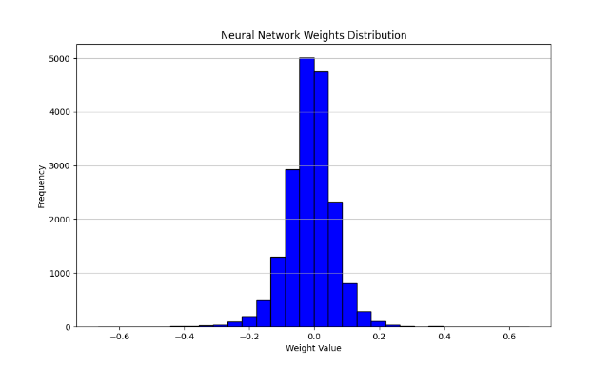
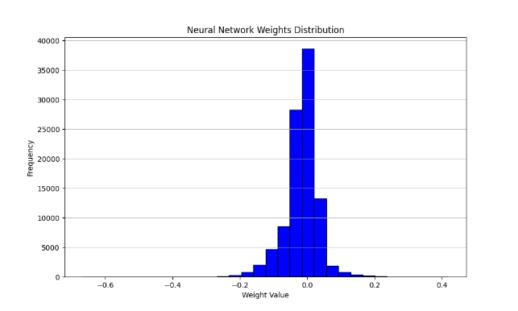
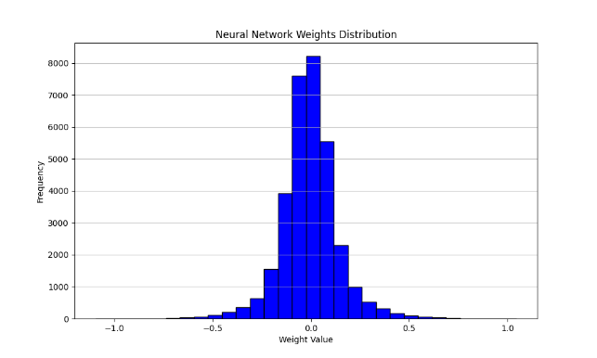
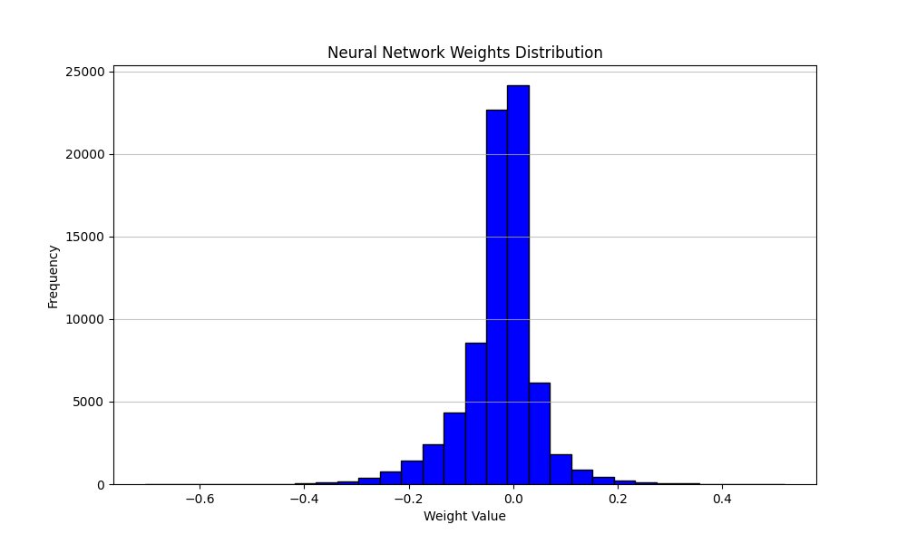
2. Idea and Novelty: Quantization Method
Weight Distribution
Extracted weight values to get the best scaling factor empirically
Layer 0
Layer 2
Layer 4
Layer 14
Layer 17
Layer 20

Slide 8

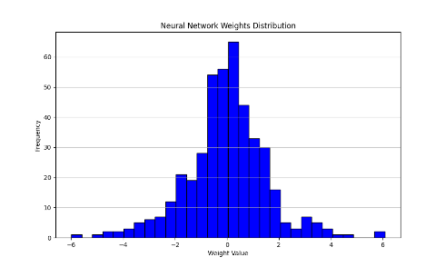

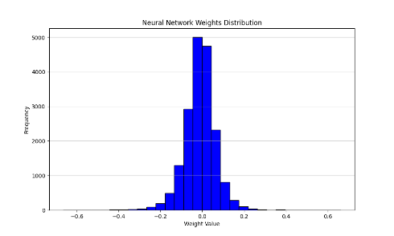


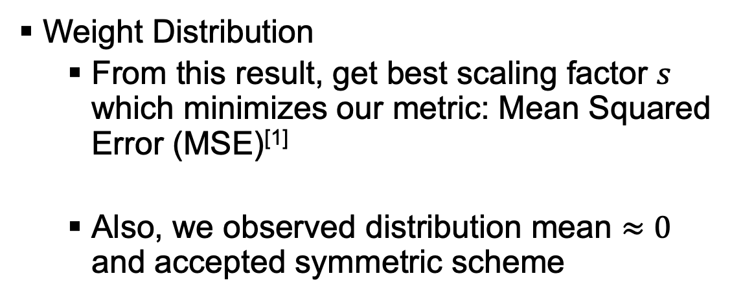
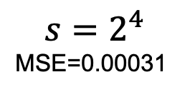
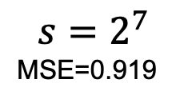

2. Idea and Novelty: Quantization Method
Weight Distribution
From this result, get best scaling factor $s$ which minimizes our metric: Mean Squared Error (MSE)^{[1]}
Also, we observed distribution mean $≈0$ and accepted symmetric scheme
$$s=2^{7}$$
MSE=0.919
$s$ gives
quantization
standpoints
$$s=2^{4}$$
MSE=0.00031
[1] Minsik Kim, Kyoungseok Oh, Youngmock Cho, Hojin Seo, Xuan Truong Nguyen, and Hyuk-Jae Lee. 2024. A Low-Latency FPGA Accelerator for YOLOv3-Tiny With Flexible Layerwise Mapping and Dataflow. IEEE Transactions on Circuits and Systems I: Regular Papers 71, 3 (2024), 1158-1171. DOI:https://doi.org/10.1109/tcsi.2023.3335949

Slide 9
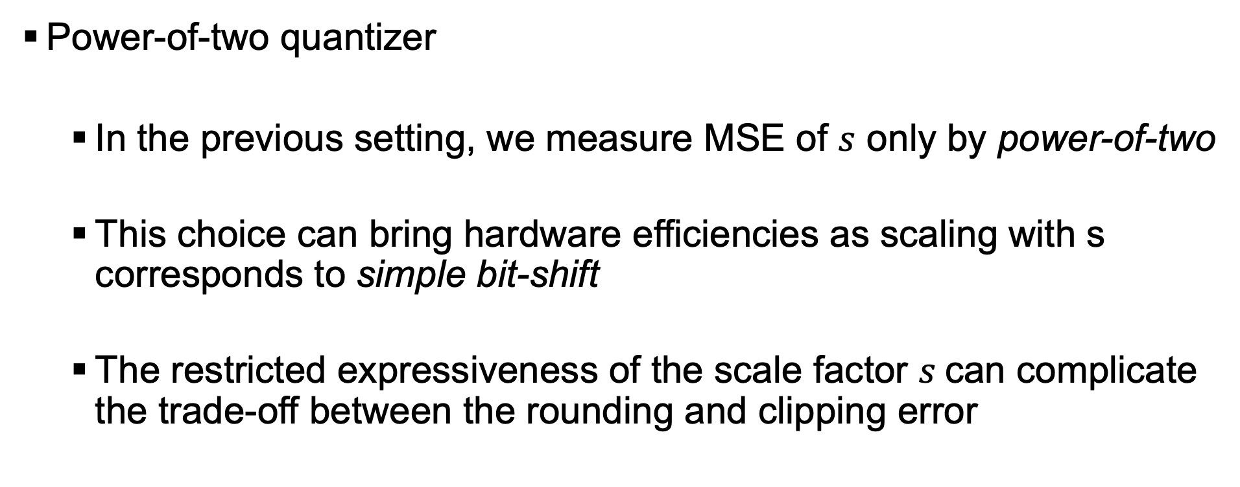
2. Idea and Novelty: Quantization Method
Power-of-two quantizer
In the previous setting, we measure MSE of $s$ only by power-of-two
This choice can bring hardware efficiencies as scaling with s corresponds to simple bit-shift
The restricted expressiveness of the scale factor $s$can complicate the trade-off between the rounding and clipping error

Slide 10
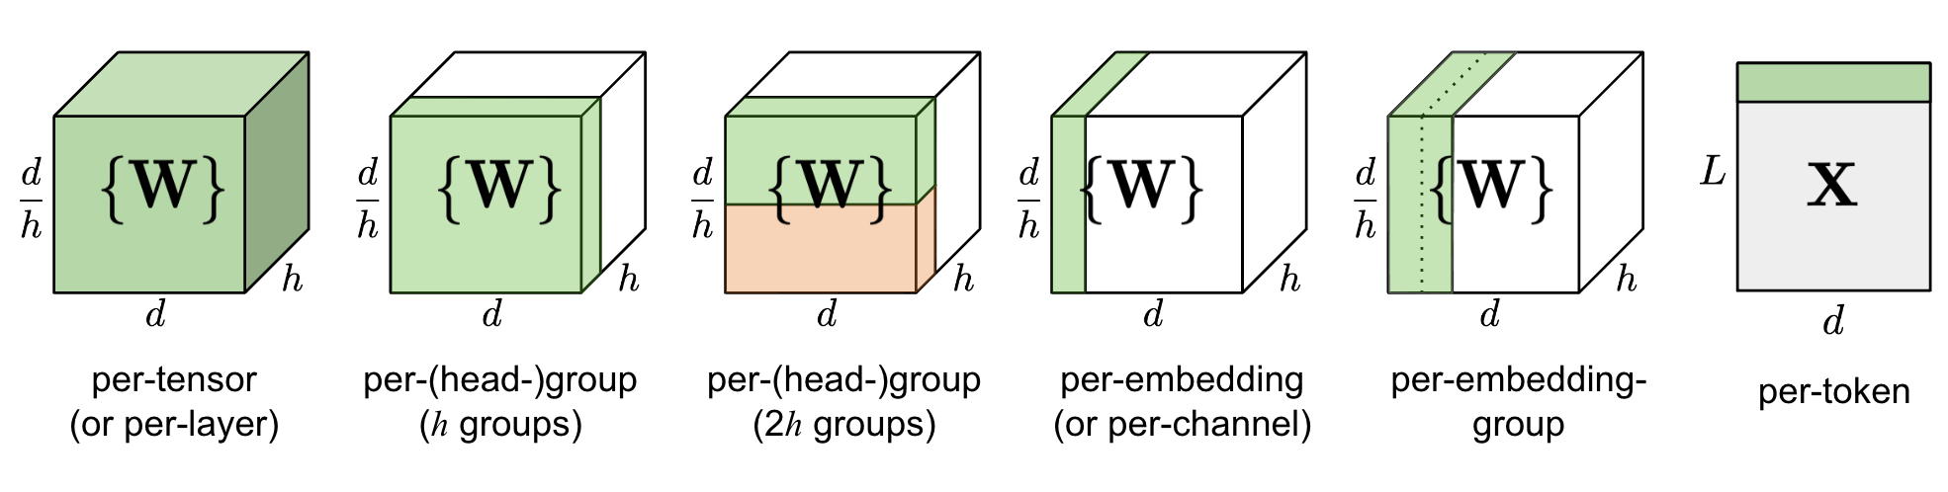
2. Idea and Novelty: Quantization Method
Quantization granularity
Quantization parameters can be set per layer, per channel, … this is called quantization granularity
Our parameters are shared per layer, for the sake of simplicity and hardware efficiency

Slide 11
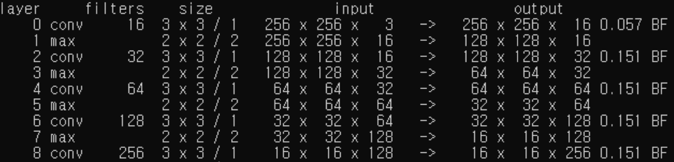
2. Idea and Novelty: CONV Layers
Three distinct computation methods each for CONV00, 3x3, and 1x1 conv.
CONV00
The only layer with ifmap channel of 3.
Needs separate dataflow compared to ordinary 3x3 convolution.

Slide 12
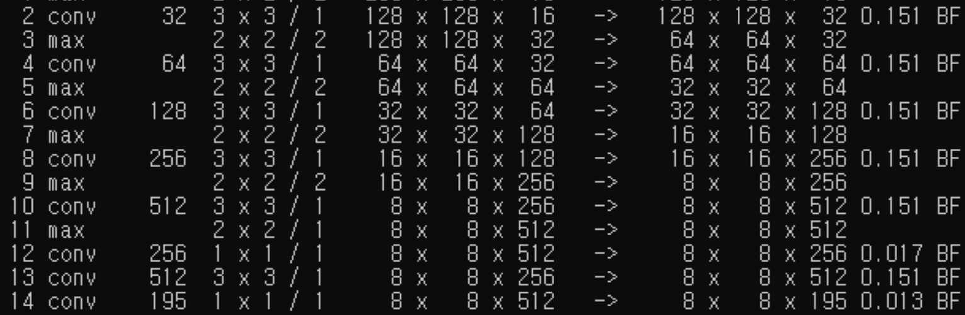
2. Idea and Novelty: CONV Layers
Three distinct computation methods each for CONV00, 3x3, and 1x1 conv.
3x3 convolution (except CONV00)
All ifmap and ofmap channels are multiple of 16.
All layers except CONV13 are followed by ReLU and maxpool.
→ Integrated!

Slide 13
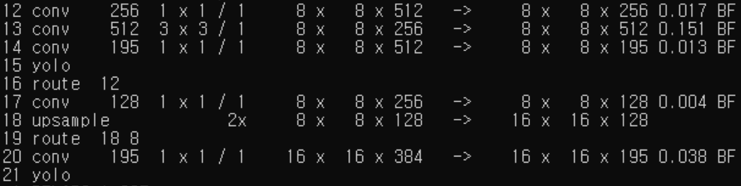
2. Idea and Novelty: CONV Layers
Three distinct computation methods each for CONV00, 3x3, and 1x1 conv.
1x1 convolution
All layers except CONV14 and CONV20 have ofmap channels with multiple of 16.
All layers except CONV14 and CONV20 are followed with ReLU.
No maxpool!

Slide 14
3. Hardware Design
Terminology
Ni: ifmap channel dimension
No: ofmap channel dimension
Fx, Fy: filter dimension
Tr: row-wise factor, always set to 2
Tc: column-wise factor, always set to 2
Ti: ifmap channel-wise factor
To: ofmap channel-wise factor
CONV module consumes (Tr x Tc) x (Fx x Fy x Ti) ifmap pixels and produces (Tr x Tc x To) ofmap pixels every cycle!

Slide 15
3. Hardware Design
PE utilization
Total 4 mac_arrays
Each mac_array contains 9 mac_modules
Each mac_module contains 16 multipliers and an adder_tree
Total 4 x 9 x 16 = 576 multipliers!
Nexys A7-100T FPGA board contains 240 DSPs which can map to 480 multipliers.
Remaining 96 multipliers are mapped to LUTs.

Slide 16
3. Hardware Design
conv mode
mac_array
Total 9 mac_modules.
Last mac utilized for 3x3 CONV only!
+
1x1x1
conv 3x3
MUX
OFM
+
1x1x4
mac16
layer 0
IFM
1x1x8
Weight
conv 1x1

Slide 17
3. Hardware Design
Module FSM

Slide 18
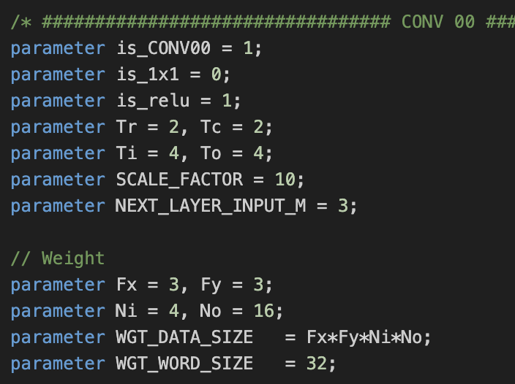
3. Hardware Design: CONV00
CONV00 parameters:
Ni = 4 (actually 3)
No = 16
Fx, Fy = 3
Tr, Tc = 2
Ti, To = 4

Slide 19
3. Hardware Design: CONV00
Data Processing of CONV00
Every cycle, consumes 4x4x3 IFM (window) and produces 2x2x4 OFM
Each mac_array using 8 mac_modules, and 2 mac_modules working as a pair to process 3x3x3 ifm!
paired mac_modules
MAC16
MAC16
MAC16
MAC16
MAC16
MAC16
MAC16
MAC16
four 3x3x3 ifm in 4x4x3 window
MAC
Array
MAC
Array
MAC
Array
3x3x3
MAC
Array
1x1x4
1x1x4
IFM
OFM
256 x 256 x 3
3x3x3x4 weight replicated in each mac_array
256 x 256 x 16

Slide 20
3. Hardware Design: CONV00
PE utilization of CONV00
3x3x3x4 = 108 computations done in each mac_array
mac_array has 16x9 = 144 multipliers
PE utilization = 108/144 = 75%
paired mac_modules
MAC16
MAC16
MAC16
MAC16
MAC16
MAC16
MAC16
MAC16
four 3x3x3 ifm in 4x4x3 window
MAC
Array
MAC
Array
MAC
Array
3x3x3
MAC
Array
1x1x4
1x1x4
IFM
OFM
256 x 256 x 3
3x3x3x4 weight replicated in each mac_array
256 x 256 x 16

Slide 21
3. Hardware Design: CONV00
conv mode
mac_array
Total 9 mac_modules.
Last mac utilized for 3x3 CONV only!
+
1x1x1
conv 3x3
MUX
OFM
+
1x1x4
mac16
layer 0
IFM
1x1x8
Weight
conv 1x1

Slide 22
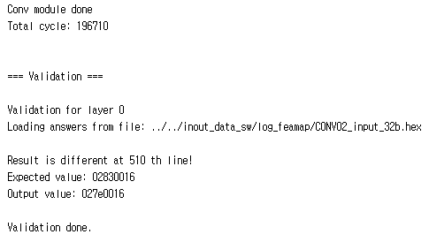
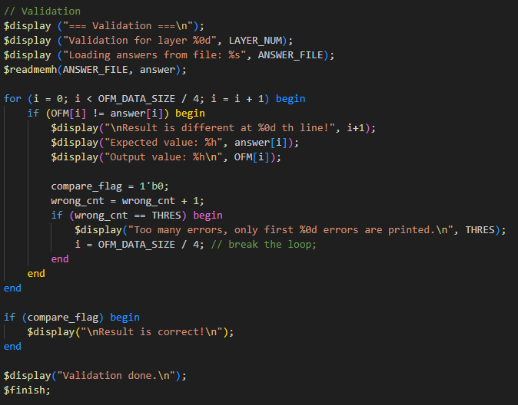
3. Hardware Design: CONV00
Only one output is wrong, however, the expected value is weird
Output after ReLU should be non-negative, but 0x83 is -125.
Note that 2’s complement of 0x83 is 0x7e

Slide 23
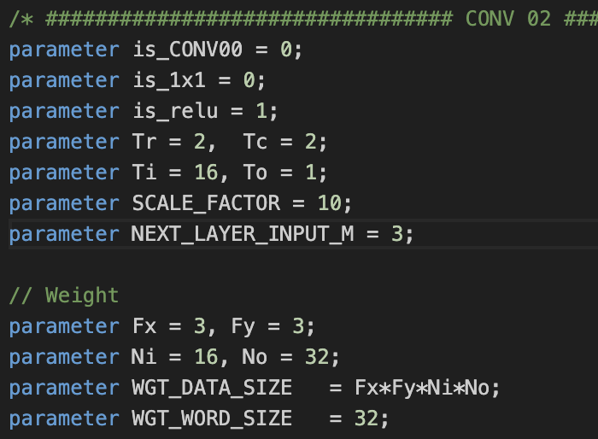
3. Hardware Design: 3x3 conv
3x3 conv parameters:
Fx, Fy = 3
Tr, Tc = 2
Ti = 16
To = 1

Slide 24
3. Hardware Design: 3x3 conv
Data Processing of 3x3 conv
Every cycle, consumes 4x4x16 IFM (window) and produces 2x2x1 OFM
Each mac_array using 9 mac_modules, and the whole dot product results are summed up to produce 1x1x1 output
9 mac_modules
MAC16
MAC16
MAC16
MAC16
MAC16
MAC16
MAC16
MAC16
MAC16
four 3x3x16 ifm in 4x4x16 window
MAC
Array
MAC
Array
MAC
Array
3x3x16
MAC
Array
1x1x1
IFM
OFM
1x1x1
H x W x Ni
3x3x16x1 weight replicated in each mac_array
H x W x No

Slide 25
3. Hardware Design: 3x3 conv
Data Processing of 3x3 conv
Every cycle, consumes 4x4x16 IFM (window) and produces 2x2x1 OFM
Each mac_array using 9 mac_modules, and the whole dot product results are summed up to produce 1x1x1 output
9 mac_modules
MAC16
MAC16
MAC16
MAC16
MAC16
MAC16
MAC16
MAC16
MAC16
four 3x3x16 ifm in 4x4x16 window
MAC
Array
MAC
Array
MAC
Array
3x3x16
MAC
Array
1x1x1
IFM
OFM
1x1x1
H x W x Ni
3x3x16x1 weight replicated in each mac_array
H x W x No

Slide 26
3. Hardware Design: 3x3 conv
PE utilization of 3x3 conv
3x3x16x1 = 144 computations done in each mac_array
mac_array has 16x9 = 144 multipliers
PE utilization = 144/144 = 100%
9 mac_modules
MAC16
MAC16
MAC16
MAC16
MAC16
MAC16
MAC16
MAC16
MAC16
four 3x3x16 ifm in 4x4x16 window
MAC
Array
MAC
Array
MAC
Array
3x3x16
MAC
Array
1x1x1
IFM
OFM
1x1x1
H x W x Ni
3x3x16x1 weight replicated in each mac_array
H x W x No

Slide 27
3. Hardware Design: 3x3 conv
conv mode
mac_array
Total 9 mac_modules.
Last mac utilized for 3x3 CONV only!
+
1x1x1
conv 3x3
MUX
OFM
+
1x1x4
mac16
layer 0
IFM
1x1x8
Weight
conv 1x1

Slide 28
3. Hardware Design: 3x3 conv
For all 3x3 conv layers except 13 are followed by ReLU and maxpool, which is the most common case in the model.
Bias addition, ReLU, quantization for the next layer, and maxpool operations are all integrated at the outputs of each mac_arrays!
Note that the integration is not applied to CONV10, which is followed by maxpool with stride of 1.
No additional modules, since all operations can be pipelined.

Slide 29
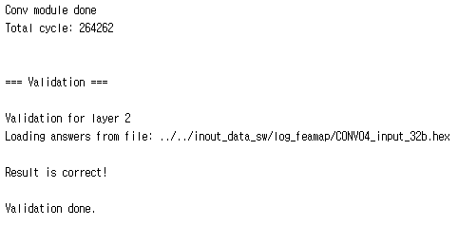
3. Hardware Design: 3x3 conv
Verify the result with the next conv layer’s input hex file.
Note that CONV10 and CONV13 are verified with the current layer’s output file.
All verification results are archived as an image file.
See ‘1_Code/4_Captured_Results (Waveforms, Utilization)/ver_results/’

Slide 30
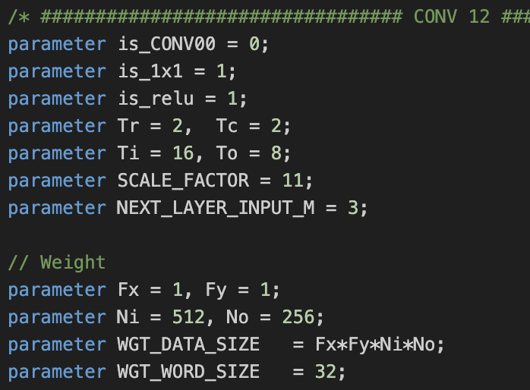
3. Hardware Design: 1x1 conv
1x1 conv parameters:
Fx, Fy = 1
Tr, Tc = 2
Ti = 16
To = 8

Slide 31
3. Hardware Design: 1x1 conv
Data Processing of 1x1 conv
Every cycle, consumes 2x2x16 IFM (window) and produces 2x2x8 OFM
Each mac_array using 8 mac_modules, each processing 1x1x16 dot product!
MAC16
MAC16
MAC16
MAC16
MAC16
MAC16
MAC16
MAC16
four 1x1x16 ifm in 2x2x16 window
MAC
Array
MAC
Array
MAC
Array
1x1x16
MAC
Array
1x1x8
1x1x8
IFM
OFM
H x W x Ni
1x1x16x8 weight replicated in each mac_array
H x W x No

Slide 32
3. Hardware Design: 1x1 conv
PE utilization of 1x1 conv
1x1x16x8 = 128 computations done in each mac_array
mac_array has 16x9 = 144 multipliers
PE utilization = 128/144 = 88.9%
MAC16
MAC16
MAC16
MAC16
MAC16
MAC16
MAC16
MAC16
four 1x1x16 ifm in 2x2x16 window
MAC
Array
MAC
Array
MAC
Array
1x1x16
MAC
Array
1x1x8
1x1x8
IFM
OFM
H x W x Ni
1x1x16x8 weight replicated in each mac_array
H x W x No

Slide 33
3. Hardware Design: 1x1 conv
conv mode
mac_array
Total 9 mac_modules.
Last mac utilized for 3x3 CONV only!
+
1x1x1
conv 3x3
MUX
OFM
+
1x1x4
mac16
layer 0
IFM
1x1x8
Weight
conv 1x1

Slide 34
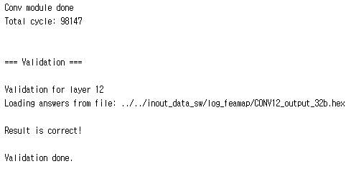
3. Hardware Design: 1x1 conv
Verify the result with the layer output hex file.
All verification results are archived as an image file.
See ‘1_Code/4_Captured_Results (Waveforms, Utilization)/ver_results/’

Slide 35
3. Hardware Design: 3x3 conv with IFM tile
Having all IFMs and weights of the layer within the module is NOT practical.
Leverage 4x4xNi IFM tile and streaming weights.
Since our convolution model is input stationary.

Slide 36
1. 개요
구현 결과
Quantization (mAP)
H/W inference results (@XXXMHz)
Board implementation
Power
LUT
BRAM
DSP
Capture images

Slide 37
2. 아이디어 및 차별성
Concept 1: …

Slide 38
3. 설계 세부내용
Proposed block diagram

Slide 39
3. 설계 세부내용
BRAM configuration …

Slide 40
4. 일정 계획 및 추진방법
추진 일정 및 방법
업무 분장: Algorithm 구현 및 평가 / H/W 설계 및 FPGA 구현 / Test Bench 설계 및 검증
Category | Item | February |  |  |  | March |  |  |  |  | April |  |  |  | May
 |  | w1 | w2 | w3 | w4 | w1 | w2 | w3 | w4 | w5 | w1 | w2 | w3 | w4 | w1 | w2 | w3 | w4
Study | 가속기 관련 논문 Study
Algorithm 구현 및 평가 | Quantization방법 결정
 | quantization 구현
 | Data Reordering
Test Bench 설계 및 검증 | single/multi layer TB
 | TB update w/ fixed C-model
H/W 설계 및 FPGA 구현 | Block Diagram 작성
 | Shared global buffer feasibility 확인
 | RTL 설계
 | RTL 검증 및 FPGA 최적화

Slide 41
5. 기타사항
Any issue

Slide 42
Outline
Background
Page setup
Fonts and colors
General guideline for good slides
Text and figures
Saving and bringing your file

Slide 43
Page setup
Set up the slide for Wide screen(16:9).
Do not use A4 or 35mm slide.
Take 5mm for top, bottom, right and left margins.
All pages should be in horizontal (landscape) format, not vertical.
No logos are permitted except on the title page.
Put page number in the bottom right.

Slide 44
Fonts
Use Arial or Helvetica font in bold type.
Use sans-serif fonts. Don’t use serif fonts, which project poorly.
ex. Times New Roman, Century.
Use 24 points or larger.
Anything less than 20 points is too small (e.g. 18 point).
Think about the audience watching your presentation from the back of a large ballroom.
You have to be innovative to limit and reconfigure the contents of a slide to increase the font size.

Slide 45
Colors
All backgrounds must be white with no pattern.
Basically text must be in black.
Color may be used only when it adds clarity of the presentation.
Use colors with good contrast.
Reds and blues are OK. Avoid yellows and light colors, except as a local background in a boxed area.

Slide 46
Example: color and font choices
This text is clear and standard
but if your font is too thin, it won’t be visible.
This combination has good contrast.
This combination will be impossible to see - no contrast.
This 18-points text is too small.
This combination is not suitable for color-vision deficient people.

Slide 47
General guideline
Keep concepts as simple as possible.
Limit each page to one main idea.
Use several simple figures rather than one complex one.
Make duplicate copies of a page if you plan to refer to it more than once.
Do not plan to go back to a slide.
Rehearse your talk aloud in front of colleagues.

Slide 48
Text slides
Don’t use a lengthy sentence. Use a short phrase and a simple sentence.
- Explain with sentences verbally but don’t write the sentences on a slide.
Use no more than 10 lines of text per page.

Slide 49
Graphs and figures
Use a minimum line width of 2 points for all lines in drawings.
Fonts embedded in figures should also comply with a guideline for text.
Often, graphical data imported from other programs will have
small fonts & thin lines.
- Completely redraw if you can’t fix this.

Slide 50
Example of a good figure
Simple graph, thick, bold axes, large fonts
1.5
Case 1
Case 2
1.0
Case 3
Power (µW)
0.5
0.0
0
1
2
3
4
5
Delay (ps)

Slide 51
Example of a bad figure
Fonts & lines too small
Colors difficult to read

Slide 52
Saving your file
Save your file with the following format
“AIX2023_(Team Name).pptx(.pdf)“

Slide 53
Uploading your presentation
Please submit your slide file with your video file
Bring the slide file to the conference using a USB memory.
Read associated documents for important dates and our program.

Slide 54
Video Guideline
Slide Format: 16:9
Recommended Encoding Settings:
Format: MP4
Compression: H.264 (AAC for Audio)
Resolution: Minimum height of 480 pixels
Frame Rate: Content should be encoded and uploaded in the same frame rate it was recorded. Common frame rates include: 24, 25, 30, 48, 50, 60 fps
Bitrate: Variable
File Size:
10 minutes: 150 MB or less

Slide 55
Video Guideline
File Naming Convention:
Videos should be named AIX2024_(TeamName).mp4
Duration
Lecture: 10 min.
Note: The above Duration is for pre-recording your presentation video, excluding the Q&A time during the real-time presentation

