Slide 1
+ • •
NEXT LEVEL
GAMING & E-SPORTS ADVENTURE
Website and Mobile Application
UX/UI Wireframe Presentation
Johannesburg, South Africa
Low-fidelity wireframes • Functional requirements • User-centred design
Next Level Gaming & Esports Arena | UX/UI Presentation | 1

Slide 2
Purpose
• Create a consistent website and mobile application for Next Level Gaming & Esports Arena.
• Allow customers to explore gaming packages and individual experiences.
• Help users compare options, calculate fees and submit booking enquiries.
• Apply user-centred design principles through clear navigation, responsive layouts and simple actions.
• Provide a strong foundation for development, testing and future improvements.
Next Level Gaming & Esports Arena | UX/UI Proposal
15

Slide 3
Why We Decided on This Project
• Gaming and esports provide a modern, engaging and practical business scenario.
• The project allows us to address real customer needs such as package selection, fee calculation and booking enquiries.
• It gives us an opportunity to design for different customer groups.
• The website and mobile app demonstrate responsive design and consistent navigation.
• The scenario combines business functionality, interactive design and UX/UI skills learned in the project.
Next Level Gaming & Esports Arena | UX/UI Proposal
17

Slide 4
Client Summary and Needs
• Jason Naidoo founded Next Level Gaming & Esports Arena in Johannesburg in 2023.
• The arena provides modern gaming technology, tournaments and social gaming experiences.
• Target users include individual gamers, families, birthday groups, schools, gaming clubs and corporate clients.
• The client needs a platform that promotes the business while supporting a practical booking and quotation journey.
• Important functions include packages, detailed information, fee calculation, contact forms, social links and clear calls-to-action.
Next Level Gaming & Esports Arena | UX/UI Proposal
16

Slide 5
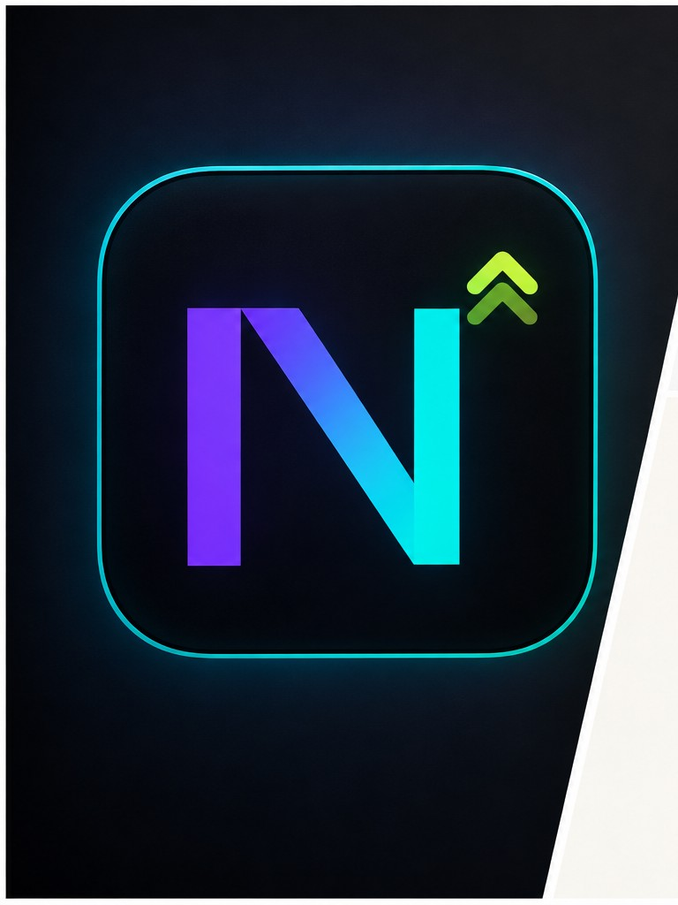


Logo Selection — Logo References
NEXT LEVEL
HIKER / OUTDOOR REFERENCE
ADVENTURE ESCAPE SA
Next Level Gaming & Esports Arena | UX/UI Proposal
19

Slide 6

LOGO We Choose

Slide 7

Why We Chose the Logo
• The hiker logo is our main logo. It sits in the header of every page of the website and the mobile app, and is also the browser tab icon.
• It is a simple one-colour shape, so it stays clear and sharp even when it is small (44 px in the page header) on desktop and mobile.
• The black shape on a white tile gives strong contrast, so it stands out against the dark navy background.
• The hiker suggests exploring and moving up to the next level. It also links to the outdoor and adventure references and the green accent colour.
• The Next Level and Adventure Escape SA logos were kept as visual references for the wider scenario.
Next Level Gaming & Esports Arena | UX/UI Proposal
20

Slide 8
Project Overview
The proposed digital platform for Next Level Gaming & Esports Arena
Client
Purpose
Target Users
Jason Naidoo founded Next Level Gaming & Esports Arena in Johannesburg in 2023. The arena provides modern gaming technology, tournaments and social gaming experiences.
Create a consistent website and mobile app where customers can explore packages, compare experiences, calculate fees and submit booking enquiries.
Individual gamers, families, birthday groups, schools, gaming clubs and corporate clients.
The platform combines marketing content with a practical booking and quotation workflow.
The design focuses on clear navigation, attractive gaming visuals, responsive layouts and simple user actions.
Next Level Gaming & Esports Arena | UX/UI Presentation | 2

Slide 9
Client Requirements
Key functionality required by the client
• Home page with a strong hero section and featured packages
• About Us page explaining the story, mission, vision and services
• Package and individual-experience overview pages
• Detail pages with descriptions, prices and inclusions
• Fee calculator with multi-selection, discount and VAT
• Contact form with validation and customer details
• Contact information, social links and an embedded map
• Drop-down menu, table/list presentation and error handling
Discount Rules
2 bookings = 5%
3 bookings = 10%
More than 3 = 15%
VAT
15% VAT is added to the quoted amount after the applicable discount.
Conversion Goal
Turn interest into a booking enquiry through a clear call-to-action.
Next Level Gaming & Esports Arena | UX/UI Presentation | 4

Slide 10
User-Centred Design
Design decisions are based on users’ needs, goals and limitations
User-centred design places the end user at the centre of the design process. The interface is planned, tested and improved according to how real users complete tasks.
Simplicity
Consistency
Use familiar labels and a short booking flow.
Keep navigation, colours and controls consistent on web and mobile.
Accessibility
Feedback
Use readable text, clear contrast and touch-friendly controls.
Show confirmation messages, errors and live quotation updates.
Next Level Gaming & Esports Arena | UX/UI Presentation | 5

Slide 11
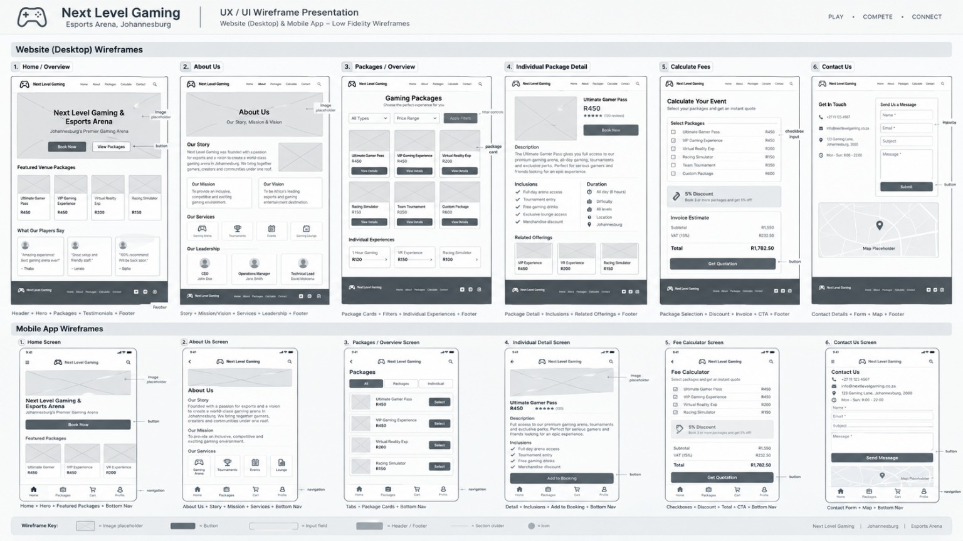
Website and Mobile App Wireframes
Low-fidelity screen structure and navigation planning
Next Level Gaming & Esports Arena | UX/UI Presentation | 7

Slide 12
Website Screen Structure
Desktop website wireframes
1. Home / Overview
2. About Us
3. Packages / Overview
Hero banner, booking CTA, featured packages, testimonials and footer.
Story, mission, vision, services and leadership information.
Package cards, filters, prices and links to details.
4. Individual Package Detail
5. Calculate Fees
6. Contact Us
Package description, inclusions, duration, price and booking CTA.
Checkbox selection, discount, VAT, invoice estimate and quotation button.
Contact details, message form, social links and map.
Website layout: Header + Main Content + Footer
Next Level Gaming & Esports Arena | UX/UI Presentation | 8

Slide 13
Mobile App Screen Structure
Mobile-first layout and bottom navigation
1. Home Screen
2. About Us Screen
3. Packages Screen
Hero area, featured packages and a prominent Book Now button.
Short story, mission, services and accessible content blocks.
Tabs, package list and Select buttons.
4. Individual Detail Screen
5. Fee Calculator Screen
6. Contact Us Screen
Price, rating, inclusions and Add to Booking.
Checkboxes, discount, total and Get Quotation.
Contact form, contact details and map.
Bottom navigation: Home • Packages • Cart • Profile
Next Level Gaming & Esports Arena | UX/UI Presentation | 9

Slide 14
Main User Flow
A simple path from discovering a package to requesting a quotation
1
2
3
4
5
Explore
Select
Calculate
Contact
Confirm
User opens Home or Packages.
User views package details and selects experiences.
System applies discount and 15% VAT.
User completes the form with validated details.
User submits a quotation or booking request.
Expected Result
The customer receives a clear quotation and the consultant can follow up to confirm the booking.
Next Level Gaming & Esports Arena | UX/UI Presentation | 10

Slide 15
Fee Calculator and Validation
Functional logic planned for both platforms
Step 1: Select Packages
Step 2: Apply Discount
Step 3: Add VAT
Customers tick one or more packages or individual experiences from a checklist.
The system counts the selected bookings and applies the correct discount tier.
The system adds 15% VAT and displays the final quoted total.
Example calculation
Error Handling
Subtotal
R1,550.00
Validate names, phone numbers, email addresses and required fields. Display clear messages when data is missing or incorrect.
Discount
5% or 10% or 15%
VAT
15%
Total
Displayed after calculation
Next Level Gaming & Esports Arena | UX/UI Presentation | 11

Slide 16
Technology and Infrastructure
Tools selected for design, development and collaboration
Design
Website
Mobile App
Figma for low-fidelity wireframes and screen planning.
HTML5, CSS3 and JavaScript with responsive layouts.
React Native with Expo Router.
Version Control
Documentation
Communication
GitHub shared repository with branches and pull requests.
Microsoft Word for reports, agreements and evidence.
WhatsApp group and scheduled meetings or voice calls.
Next Level Gaming & Esports Arena | UX/UI Presentation | 12

Slide 17
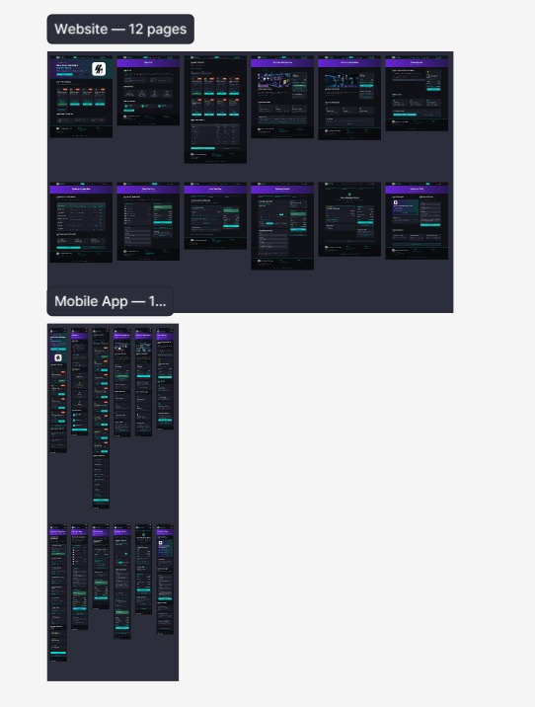
From Design to Code
The Figma screens guided what we built
Same look on web and app
The dark navy background, cyan buttons and purple highlights from the Figma screens were carried into style.css as colour variables.
Website screens
The Figma file shows 12 website screens. In code we built the 7 pages that cover the full journey: Home, About, Packages, Package Detail, Calculate Fees, Booking Summary and Contact.
Mobile app match
The mobile app (React Native with Expo Router) uses the same colours, logo, packages, discount rules and contact details, so both products feel like one brand.
Next Level Gaming & Esports Arena | UX/UI Proposal

Slide 18
How the Code Is Organised
Seven pages, one stylesheet and one script
HTML pages
style.css
script.js
index, about, packages, package-detail, calculate, summary and contact. Each page links the same CSS and JavaScript.
Colours are CSS variables (navy, cyan, white, grey, green, orange). Montserrat font and media queries make it responsive.
Holds the package data, booking cart, discount and VAT logic, validation and the setup code for each page.
assets/logo.png
localStorage
build.js
The hiker logo, used in the header of every page and as the browser tab icon.
Keeps the cart and customer details when the user moves from page to page.
Checks that all files exist and tests the pricing and validation logic. Run it with node build.js.
Next Level Gaming & Esports Arena | UX/UI Proposal

Slide 19
Why We Chose HTML, CSS and JavaScript
Our technology choices and the reason for each
WHAT WE CHOSE
WHY
Plain HTML5
Works in any browser and is easy for the team to read. Each wireframe screen becomes one page.
CSS3 with variables
Colours are set once in :root, so one change updates every page. Media queries and a hamburger menu handle phones.
Vanilla JavaScript
No framework or install needed. Discount, VAT and validation are small functions that are easy to test.
GitHub Pages
Free hosting straight from our shared repository. To run locally, open index.html.
Montserrat font
Bold and clean, and easy to read on a dark background.
Next Level Gaming & Esports Arena | UX/UI Proposal

Slide 20
Fee Calculator Code
The discount is applied first, then 15% VAT
script.js
Discount tiers
function getDiscountRate(count) {
if (count > 3) return 0.15;
if (count === 3) return 0.10;
if (count === 2) return 0.05;
return 0;
}
// VAT is added AFTER the discount
afterDiscount = subtotal - discountAmount;
vat = afterDiscount * 0.15;
total = afterDiscount + vat;
1 booking
0%
2 bookings
5%
3 bookings
10%
More than 3
15%
Worked example: 3 bookings
Ultimate Gaming Day
R1,500.00
VR Arena Adventure
R750.00
Why this order
1 Hour Gaming
R120.00
The brief says VAT is added to the quoted amount after the discount. Keeping it in one function means every page shows the same total.
Discount (10%)
-R237.00
VAT (15%)
R319.95
Total
R2,452.95
Next Level Gaming & Esports Arena | UX/UI Proposal

Slide 21
Validation and Error Handling
Every form checks the input and tells the user what to fix
FIELD
RULE
MESSAGE THE USER SEES
Name
Letters only, at least 2 characters
Name can only contain letters (min 2).
Email
Standard email format
Enter a valid email, e.g. name@example.com.
Phone
0821234567 or +27821234567
Use 10 digits (0821234567) or +27821234567.
Message
At least 10 characters
Message must be at least 10 characters.
Fee calculator
At least one package selected
Please select at least one package or experience.
On the page
Invalid fields are highlighted and marked aria-invalid, and the cursor jumps to the first mistake. Valid customer details are kept between pages.
Next Level Gaming & Esports Arena | UX/UI Proposal

Slide 22
How We Fix Problems in the Code
The problem we planned for and the fix we used
PROBLEM
HOW WE FIXED IT
Cart lost between pages
Cart ids and customer details are saved in localStorage (nl_cart, nl_customer), so choices follow the user from page to page.
Browser blocks storage
load() and save() use try/catch and return a safe default, so the page keeps working instead of crashing.
Wrong totals
One function, calculateQuote(), does subtotal, then discount, then VAT. build.js tests it: R1,550.00 must give R1,782.50.
Bad or missing input
Separate checks for name, email and phone show a clear message and move focus to the first mistake.
Unsafe text on the page
escapeHtml() cleans anything the user typed before it is placed into the page.
Hard to use on a phone
CSS media queries and a hamburger menu adapt the layout. build.js checks every page has the viewport tag.
Next Level Gaming & Esports Arena | UX/UI Proposal

Slide 23
App Flow
• Home → user discovers the arena and sees featured experiences.
• Packages → user browses available options.
• Details → user views price, duration and inclusions.
• Calculator → user selects experiences and the system calculates the quotation.
• Contact → user enters and validates their details.
• Confirm → user submits a quotation or booking request.
Next Level Gaming & Esports Arena | UX/UI Proposal
26

Slide 24
Website Flow
• Home / Overview → user discovers the arena and selects a call-to-action.
• About Us → user learns the story, mission, vision and services.
• Packages / Overview → user compares packages and individual experiences.
• Package Detail → user checks description, inclusions, duration and price.
• Calculate Fees → user selects bookings; the system applies the discount and 15% VAT.
• Contact Us → user submits validated details and requests a quotation.
• Confirmation → the enquiry is ready for the business to follow up.
Next Level Gaming & Esports Arena | UX/UI Proposal
27

Slide 25
Colour Scheme Selection — Detailed Explanation
Dark Navy
Main background: gaming, premium and technology-focused.
Electric Cyan
Primary accent: headings, buttons, highlights and interactive elements.
White
Main text: clear readability against the dark background.
Muted Grey
Secondary text: supporting information without overpowering headings.
Green
Secondary accent: balance and connection to outdoor/adventure references.
Orange
Highlight colour: attention areas and important secondary actions.
Next Level Gaming & Esports Arena | UX/UI Proposal
21

Slide 26
Research
• We considered the needs of gamers and groups who want quick access to experiences, prices and booking information.
• The research direction focuses on simple navigation, clear package information and a short booking journey.
• Users should understand what is offered before they are asked to submit information.
• The interface should support desktop and mobile users with readable text, clear contrast and touch-friendly controls.
• Feedback is important: confirmations, errors and live quotation updates should be visible to the user.
Next Level Gaming & Esports Arena | UX/UI Proposal
22

Slide 27
Desktop / App Structure — Navigation Infrastructure
• Desktop website navigation: Home → About Us → Packages → Package Detail → Calculate Fees → Contact Us.
• Home contains the hero section, featured packages, booking call-to-action, testimonials and footer.
• Packages provide overview cards, filters, prices and links to details.
• Calculate Fees lets users select experiences, apply the correct discount and add 15% VAT.
• Mobile app uses a compact layout with bottom navigation: Home • Packages • Cart • Profile.
• The same information architecture is maintained across web and mobile for consistency.
Next Level Gaming & Esports Arena | UX/UI Proposal
23

Slide 28
GitHub, Task Allocation and Roles
• GitHub is used as the shared repository for project code and version control.
Github usernames: Chabalalamaletsema
ZwakelePanza
MzwakheMkwanazi
• Task allocation:
Masego — wireframes , design and submission
Zwakele — meetings, GitHub names and roles
Mzwakhe — coding
• Roles: Masego — Team Leader
Zwakele — Secretary
Mzwakhe — Deputy Secretary
Next Level Gaming & Esports Arena | UX/UI Proposal
24

Slide 29
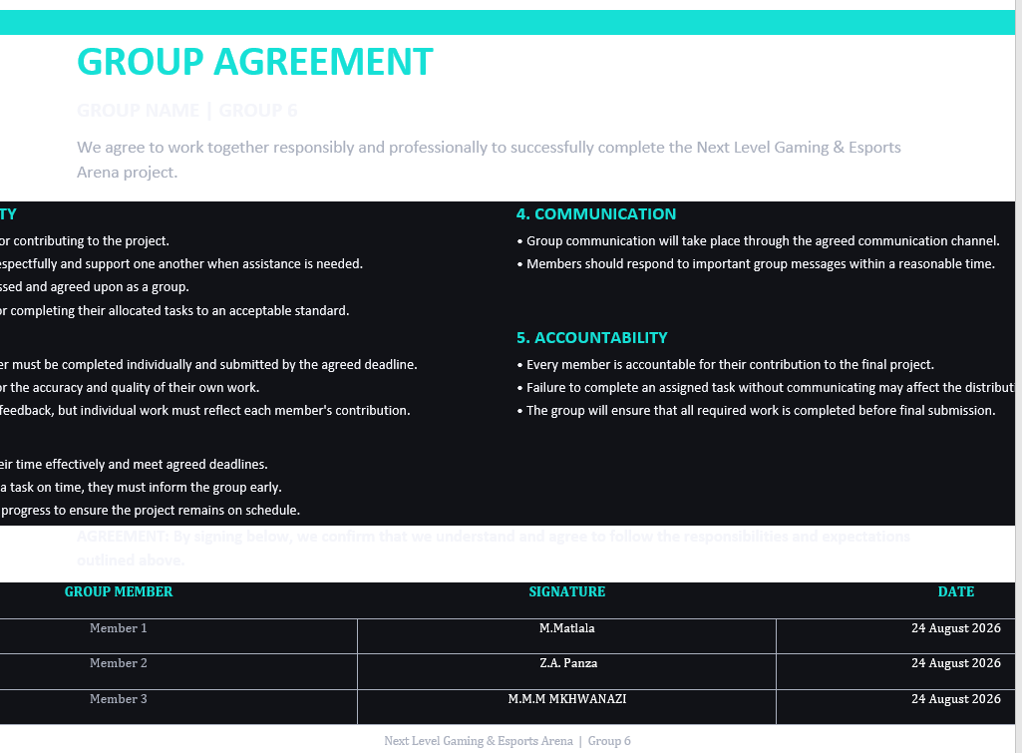

Slide 30
Conclusion
The proposed Next Level Gaming & Esports Arena platform provides a clear, consistent and user-friendly experience across desktop and mobile.
• Combines business promotion with a functional booking journey.
• Uses user-centred design principles to support different customer groups.
• Includes package browsing, detailed information, fee calculation and contact functionality.
• Creates a strong foundation for development, testing and future improvements.
Thank you
Next Level Gaming & Esports Arena | UX/UI Presentation | 14

