Slide 1
MOSFET
(History, Production ,Scaling)
Mania Tahery
Aynaz Chabook

Slide 2
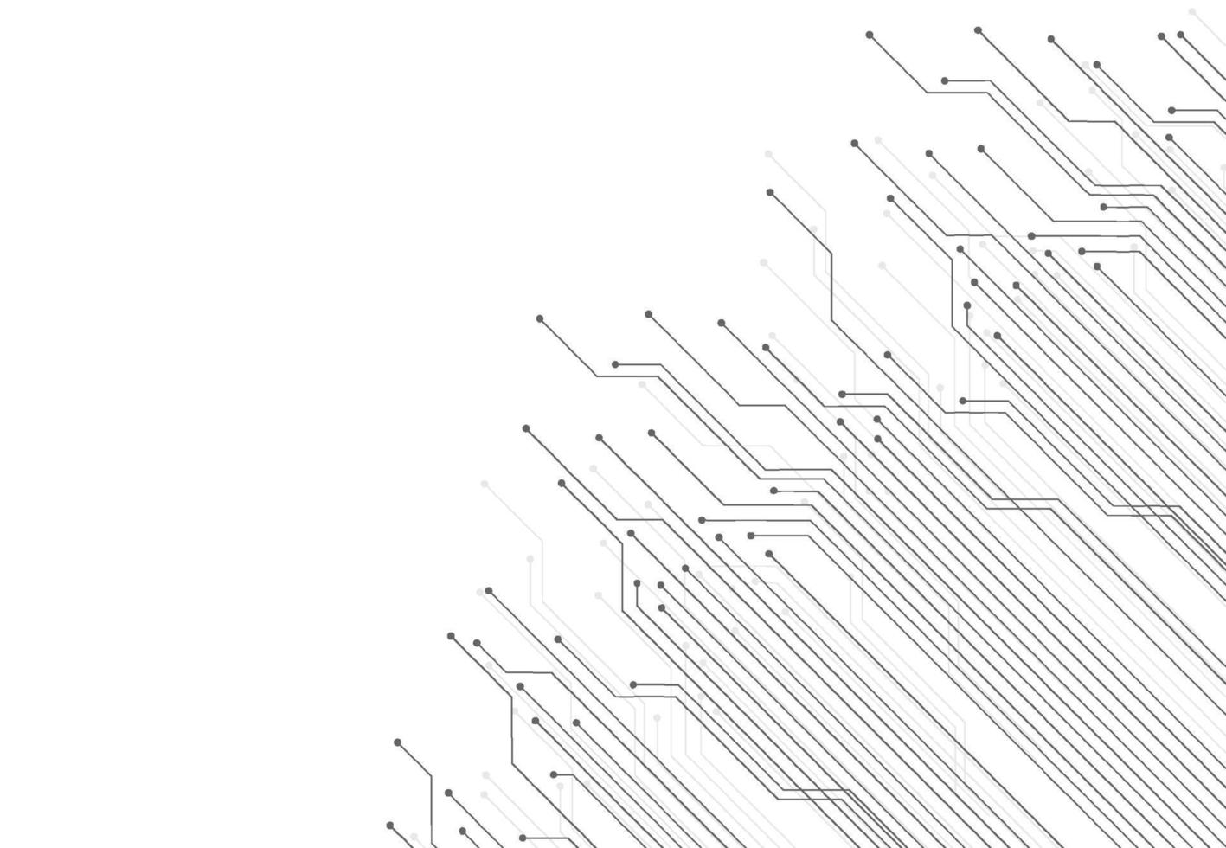
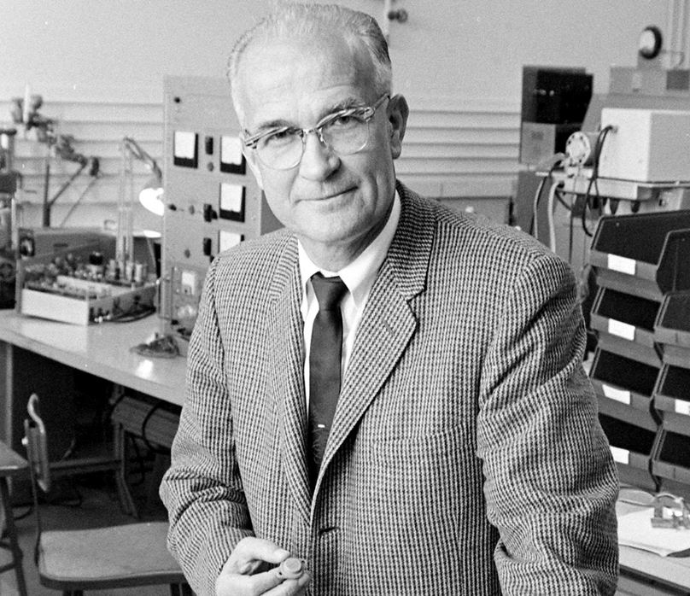
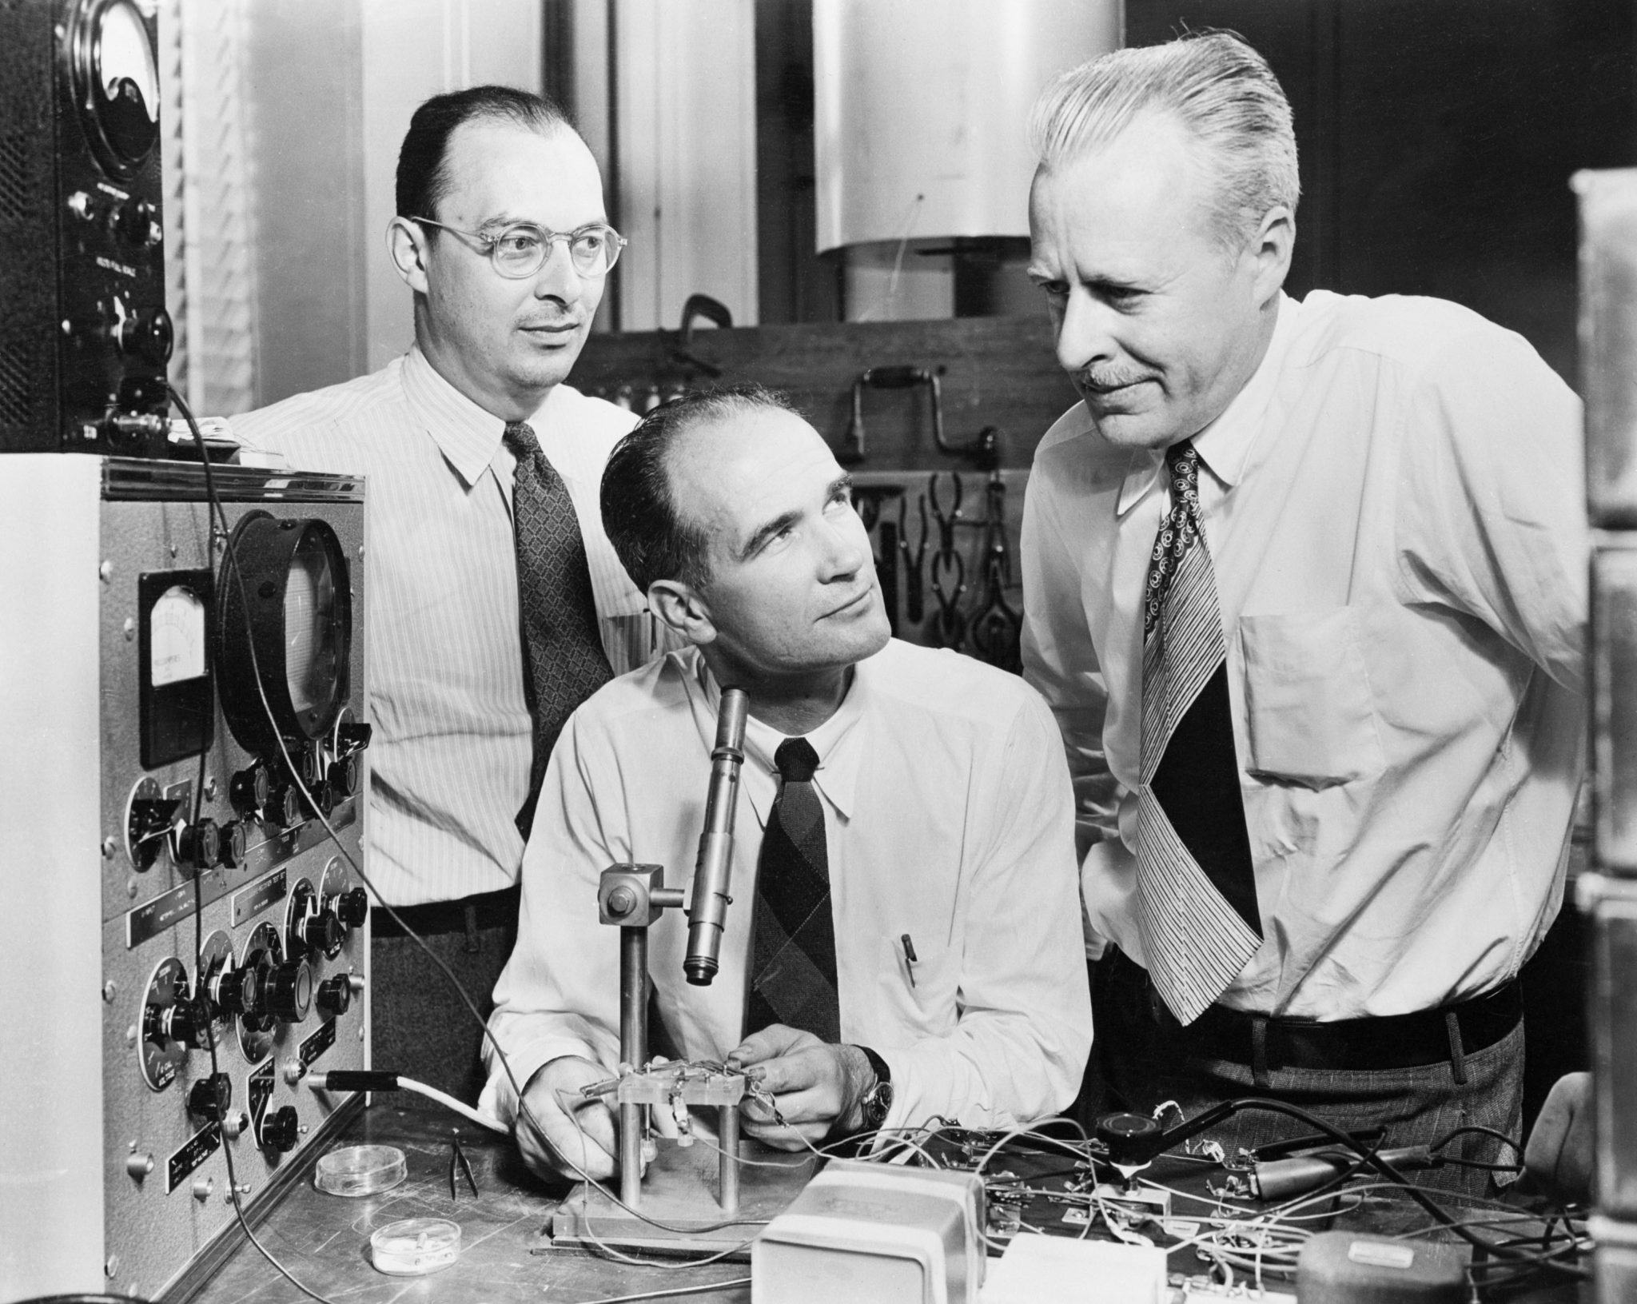
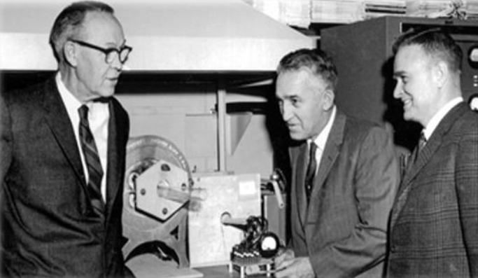
Brief History
1925 __ Julius Edgar Lilienfeld__ the first idea for field effect transistors __ technological limitations
* no proper material*
The idea was developed in 1930s but just the idea!
1947__Bell Labs __ Walter Brattain , William Shockley , John Bardeen __ controllable current __ Semiconductors > Surface defects and contaminations
1952__Pfann__Zone Refining Process __ purity
1955__Bell Labs __ Carl Frosch , Lincoln Derick __ Silicon + heat => Oxide Layer
1959__Bell Labs __Mohammad Atalla , Dawon Kahng

Slide 3

Transistors
BJT
PNP
NPN
FET
JFET
MOSFET

Slide 4
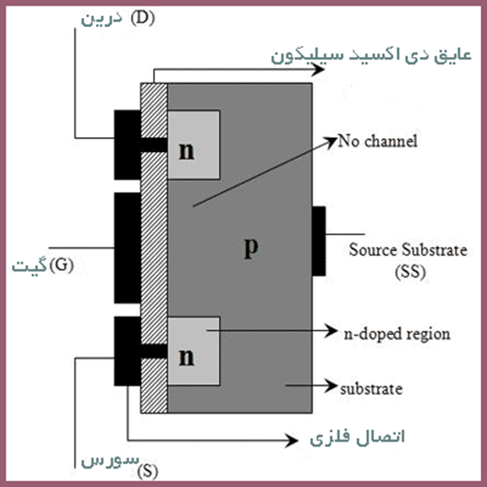
FET
The field-effect transistor (FET) is a type of transistor that uses an electric field to control the current through a semiconductor. It comes in two types: junction FET (JFET) and metal–oxide–semiconductor FET (MOSFET). FETs have three terminals: source, gate, and drain. FETs control the current by the application of a voltage to the gate, which in turn alters the conductivity between the drain and source

Slide 5
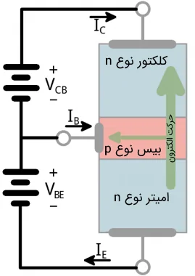
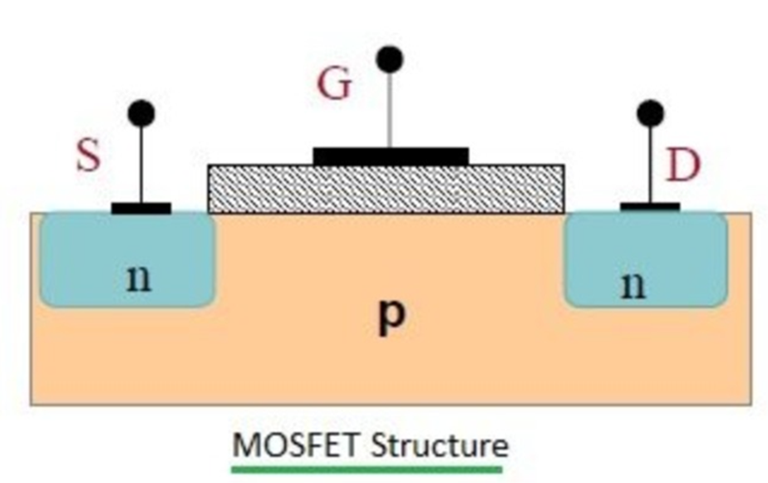
MOSFET vs BJT (concept comparison)
in a BJT, output current is controlled by a base current (a current-driven control). In a MOSFET, output current is controlled mainly by a gate voltage (a field-driven control).

Slide 6
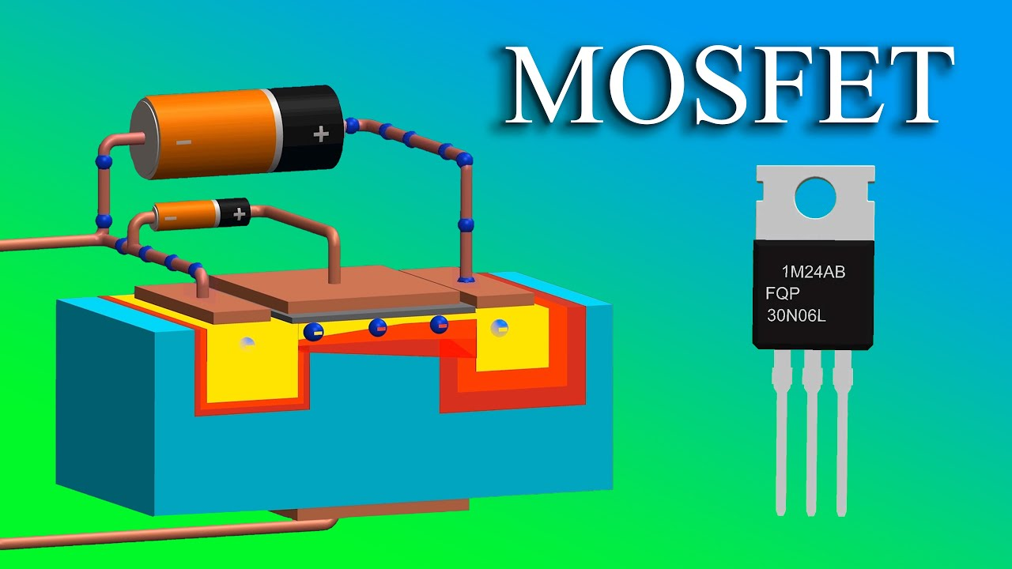
MOSFET
(Metal Oxide Semiconductor Field Effect Transistor)
is one of the most important building blocks of modern electronics. It powers everything from microprocessors (CMOS) to power converters and motor drivers.
In this talk, we explain MOSFET operation using simple physical intuition.

Slide 7
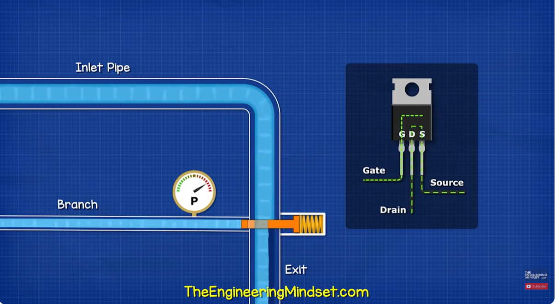
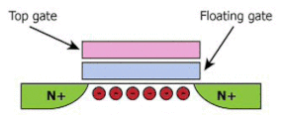
Think of MOSFET as a smart valve: Gate is the handle, Source/Drain are the two ends of the pipe, and the channel is the path that appears only when the Gate voltage is high enough, The Gate is separated from silicon by thin oxide (insulator), so the control is mainly electrostatic.

Slide 8
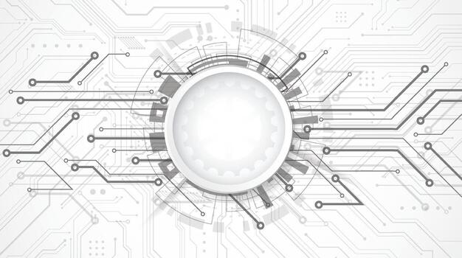
Anatomy

Slide 9
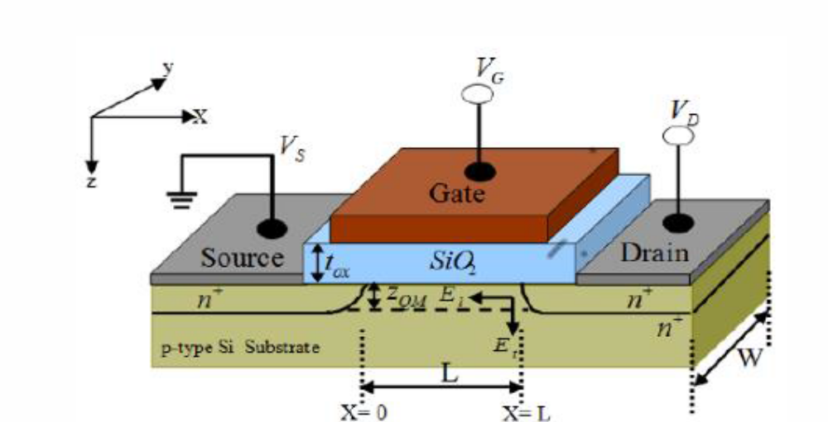
MOS capacitor: the heart of MOSFET
The Gate-Oxide-Silicon stack behaves like a capacitor. Applying gate voltage creates an electric field that controls surface charge. MOSFET is essentially: MOS capacitor + two contacts (source, drain)

Slide 10
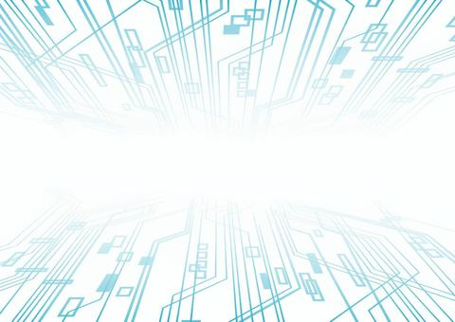
Gate — The Field Controller
The Gate is a conductive electrode (metal gate in modern technologies, polysilicon in older ones) placed above the channel region.
Gate Oxide / Gate Dielectric — The Enabler
A very thin insulating layer between the gate and the semiconductor
(SiO₂ historically, high-k dielectrics like HfO₂ today).
Channel Region — The Induced Conductor
The region under the gate between source and drain where conduction occurs only when induced.
Source — Carrier Reservoir and Reference Node
A heavily doped semiconductor region supplying carriers to the channel.
Drain — Current Collector and High-Field Region
Another heavily doped region that collects carriers from the channel
The 4th terminal (Body) and body effect
The Body terminal changes the depletion region and shifts VTh. When source-body bias increases, turning the MOSFET ON becomes harder (VTh rises). In many circuits the body is tied to the source, but in IC design it can be used deliberately.

Slide 11
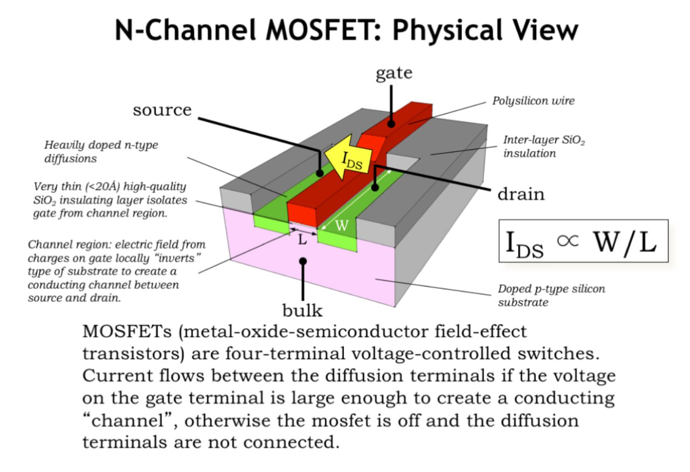

Slide 12
Basic Operation (the real mechanism)
When a voltage is applied to the Gate, the electric field penetrates the oxide and rearranges charge near the silicon surface. If the Gate voltage is large enough, the surface forms a thin conductive layer called the inversion channel, connecting Source to Drain. Drain current is a direct result of this electrostatic channel formation.
Who moves, and what direction?
In NMOS (PMOS), electrons (holes) are the main moving carriers in the channel. Electrons drift from Source to Drain when VDS is applied. Conventional current is drawn in the opposite direction, but the key point is: VDS provides the driving force.

Slide 13
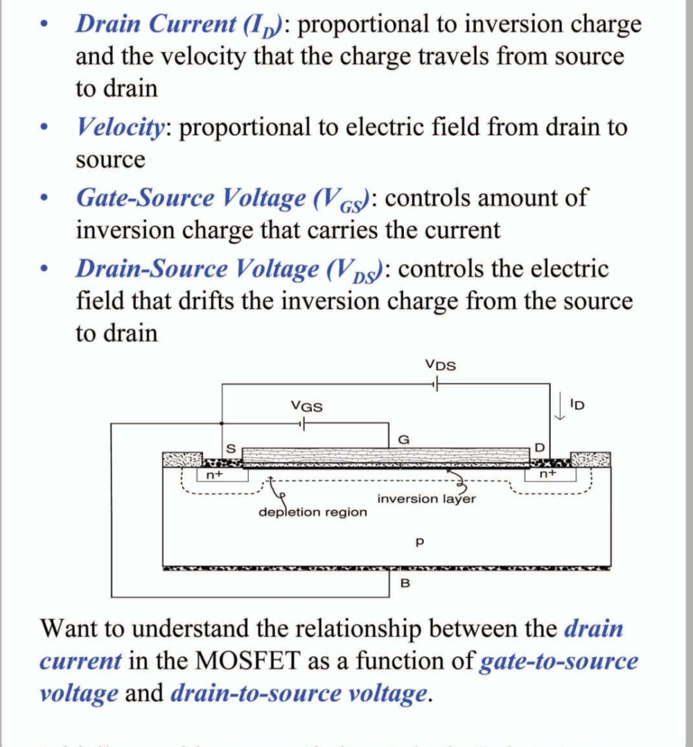
Circuit symbols are simplified drawings of a physical device: Gate contols a channel between Drain and Source , and the Body terminal exists even if not shown. Two standard plots describe MOSFET behavior: Iᴅ–Vᴅs (output) and Iᴅ–Vɢs (transfer). These plots reveal the operating regions and the threshold concept.

Slide 14
Key Parameters
A few parameters capture MOSFET behavior:
VTh (threshold voltage): when a strong channel begins
RDS(on): resistance when ON (critical in power MOSFETs)
Capacitances / gate charge (Cgs, Cgd, Qg): how fast it can switch

Slide 15
Threshold voltage
VTh marks the gate voltage where strong inversion begins and the channel becomes conductive. VTh depends on materials and structure: doping, oxide thickness, work functions, and oxide/interface charges.
The field penetrates the semiconductor (not uniformly) and voltage drops in that region (Vsc , it is not a constant value)
E= -dV/dX
Applied Voltage = Voltage drop in semiconductor + Voltage drop in the oxide layer
There are no charges in the oxide layer so Vox is constant.

Slide 16





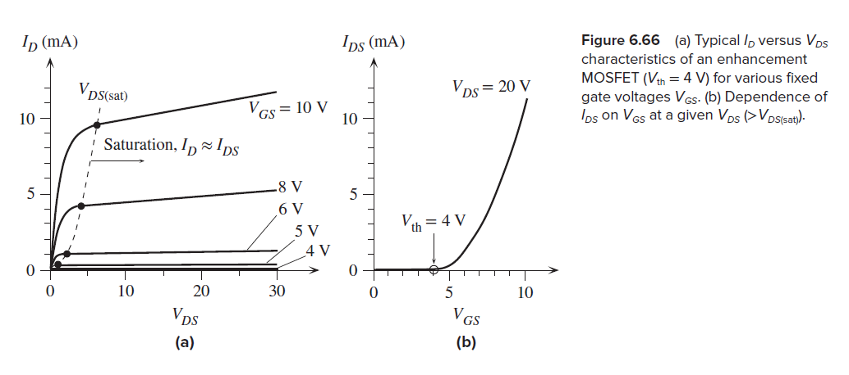
constant
slopes of the ID versus VDS lines beyond VDS(sat)
L , Z : the length and
width of the gate controlling the channel
μe : the electron drift mobility in the channel
ε , tox : the permittivity (εrεo)
and thickness of the oxide insulation under the gate
λ : a constant that is typically 0.01 V−1

Slide 17
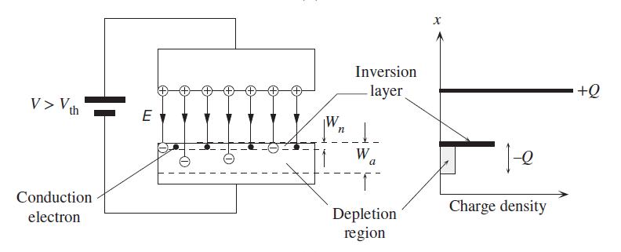
Accumulation, depletion, inversion
As gate voltage changes, the silicon surface goes through three states:
Accumulation: majority carriers gather at the surface
Depletion: majority carriers pushed away → depleted region
Inversion: minority carriers dominate at the surface → conductive channel

Slide 18
Pinch-off
Pinch-off means the channel becomes very thin near the drain when VDS is high. Current still flows because carriers travel through a high-field region. Saturation means gate control dominates, not that current is “maximum forever.”

Slide 19
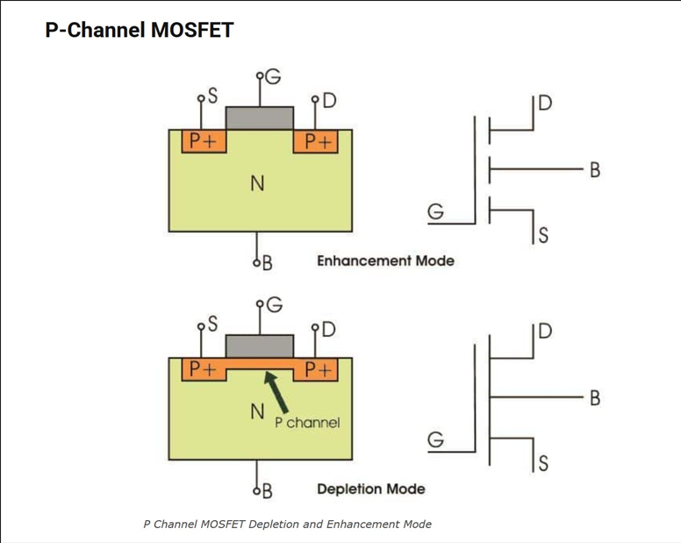
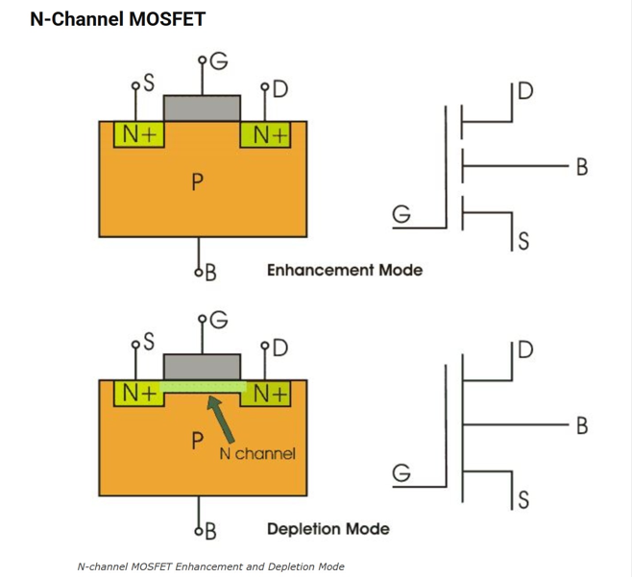
Types of MOSFET
MOSFETs are classified by carrier type and default bahavior. NMOS uses electrons as main carriers; PMOS uses holes . Most modern devices are enhancement-mode (normally OFF, turns ON by gate voltage). In power electronics we use power MOSFETs, optimized for low loss and high current.

Slide 20
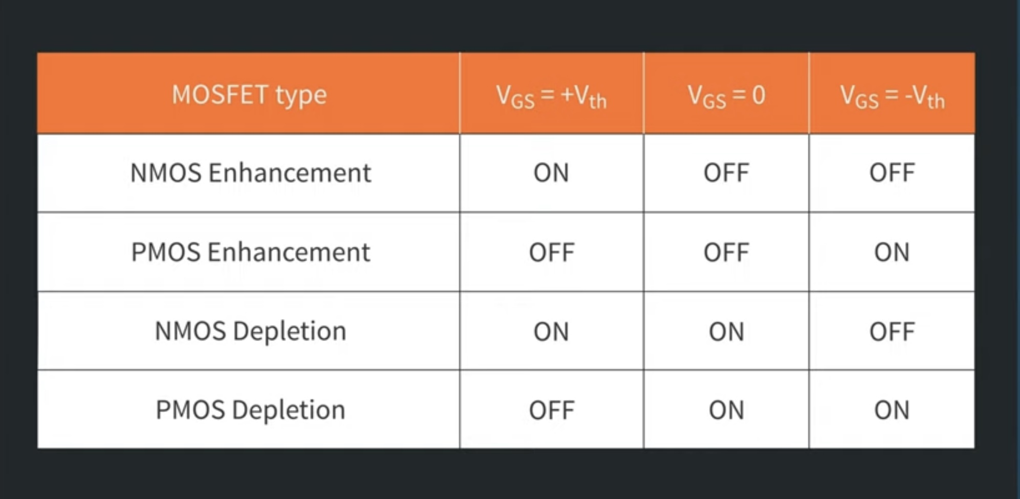

Slide 21
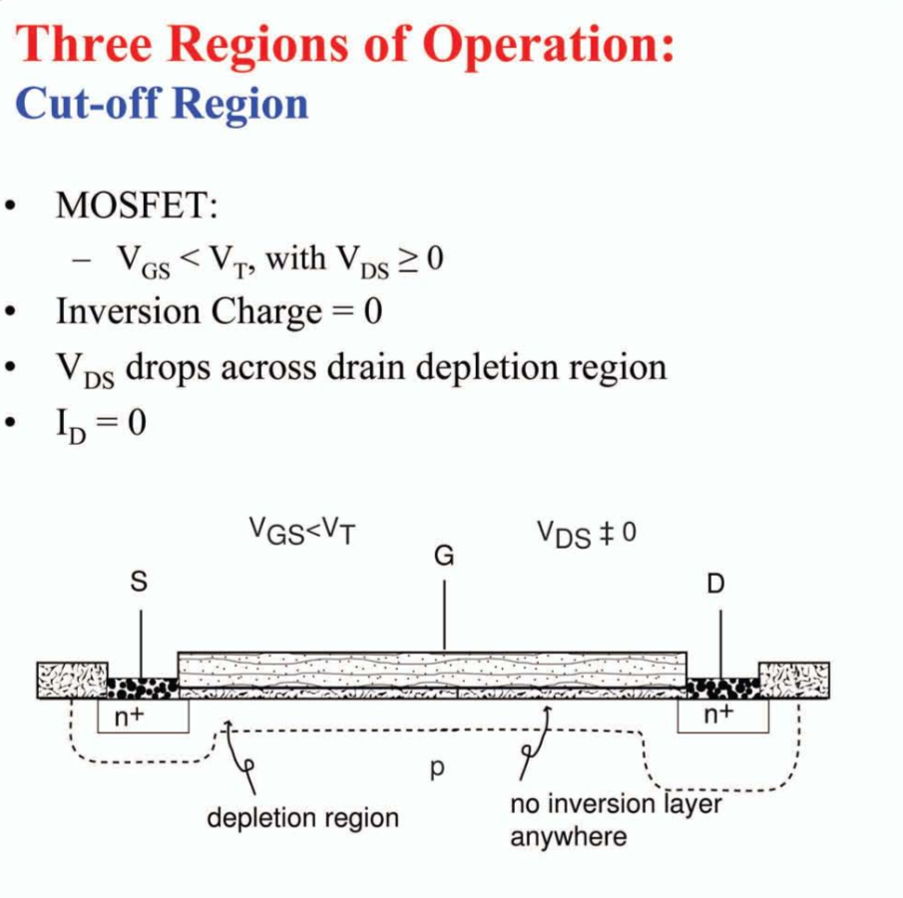
Important Operating Regions
MOSFET behavior depends on Gate and Drain voltages:
Cutoff: no strong channel → almost no current
Linear (Triode): channel exists along the whole length → acts like a controllable resistor
Saturation: channel is pinched near the drain → current mainly controlled by the Gate

Slide 22
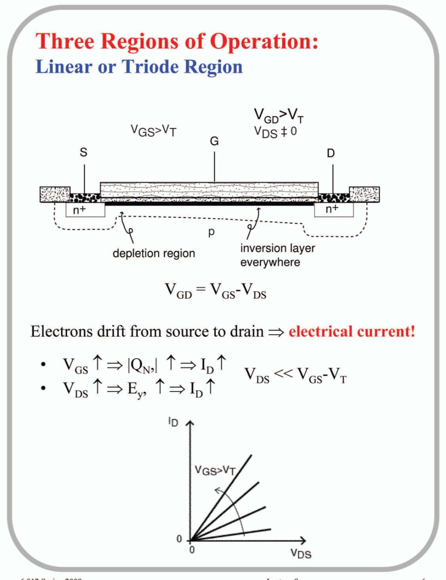
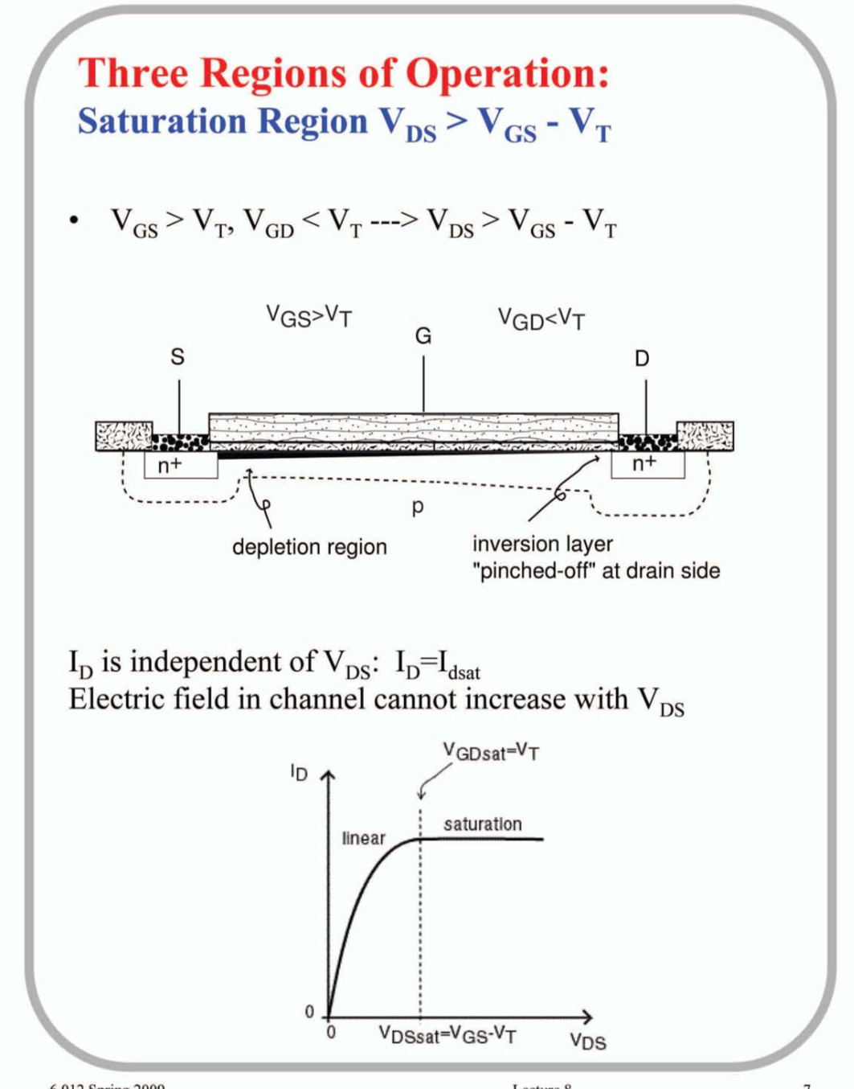

Slide 23
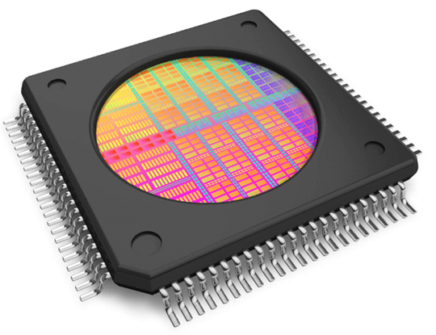
General Applications
CMOS (complementary Metal-Oxide Semicoductor): PMOS + NMOS
Fast switching speed (0,1)
logic gates, CPUs, memory
converters, chargers, motor drivers
amplifiers, analog switches
CMOS

Slide 24
scaling
The process of reducing the physical dimensions of transistors in ICs
performance improvement , less energy consumption , more components on a chip (integration density) , higher speed , lower costs$
Moore’s Law
1965-Gordon Moore
The number of transistors on a chip doubles approximately every 2 years

Slide 25
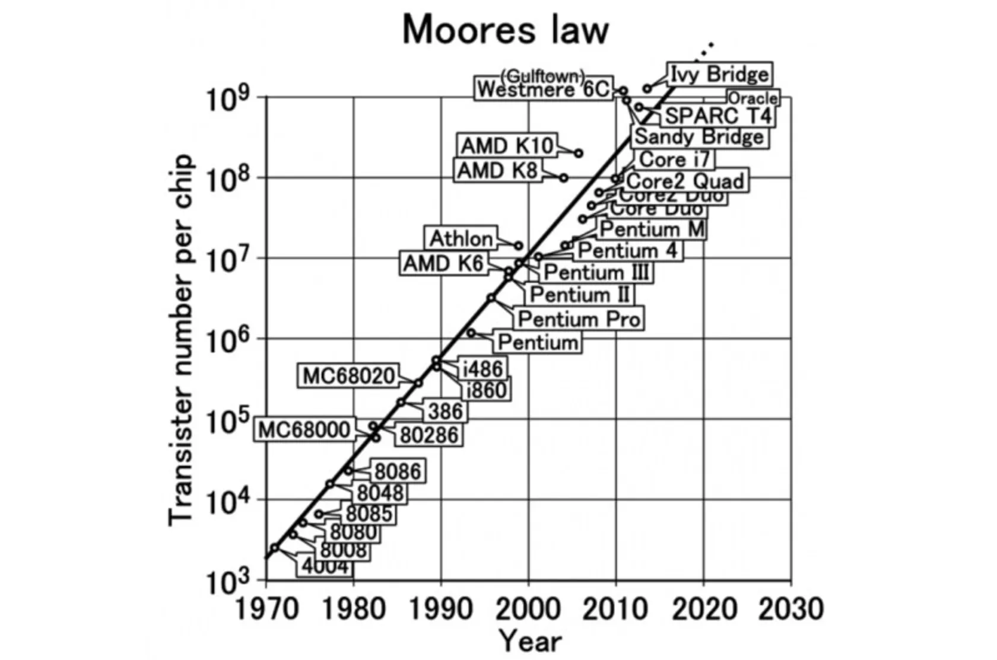
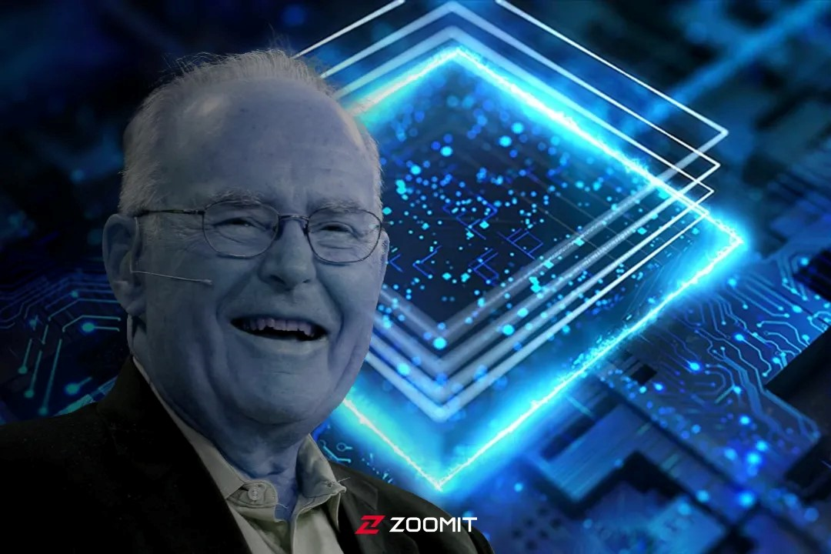

Slide 26
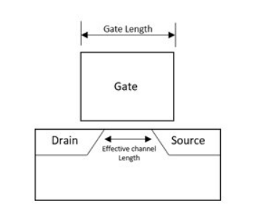
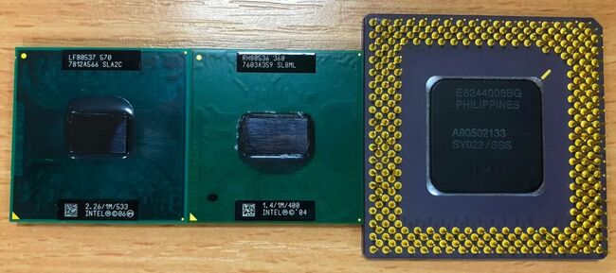
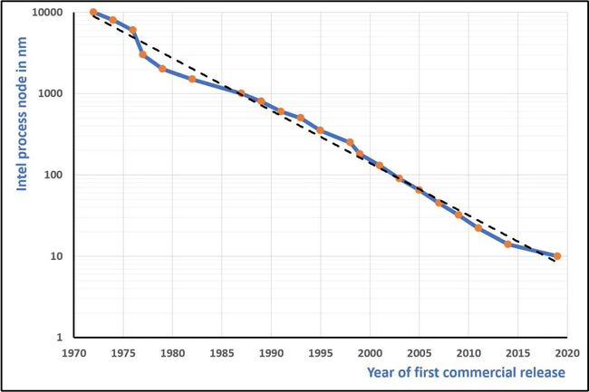
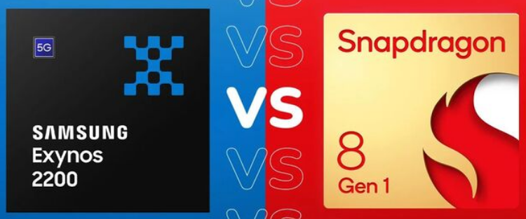
Process Node Gate Length smallest Gap between two Transistors No physical concept
Celeron | Pentium M | Pentium
2006 | 2004 | 1995
65nm | 90nm | 350nm
4nm

Slide 27
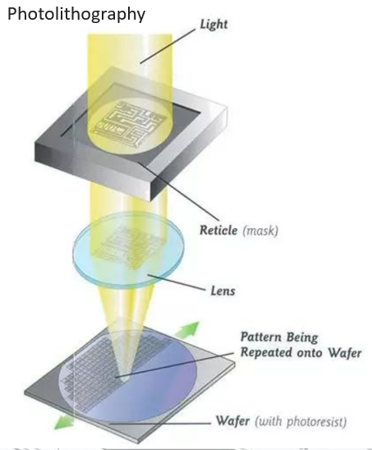
Lithography : carving on stone
Photolithography (Optical Lithography) : Using Light to make patterns on the wafer
Deep Ultra Violet (DUV, 193nm)
Extreme Ultra Violet (EUV, 13-14 nm)
TSMC 6nm component (about 10 silicon atoms)
silicon atom diameter 0.1nm
Distance between atoms 0.5nm
EUV Photolithography - smaller wave length – more energy – probable device damage

Slide 28
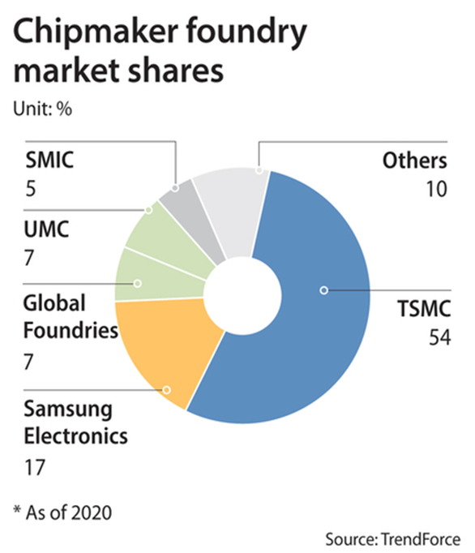
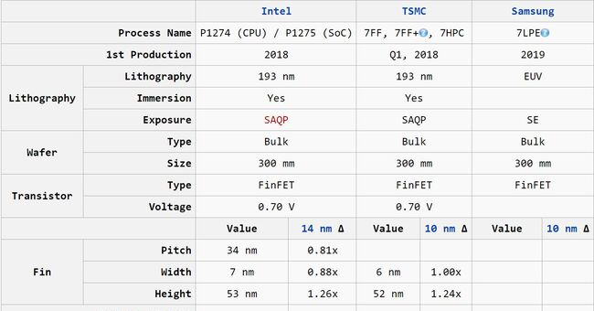

Slide 29
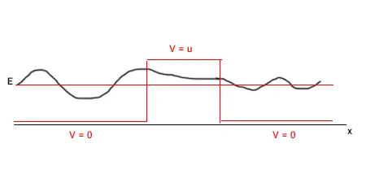
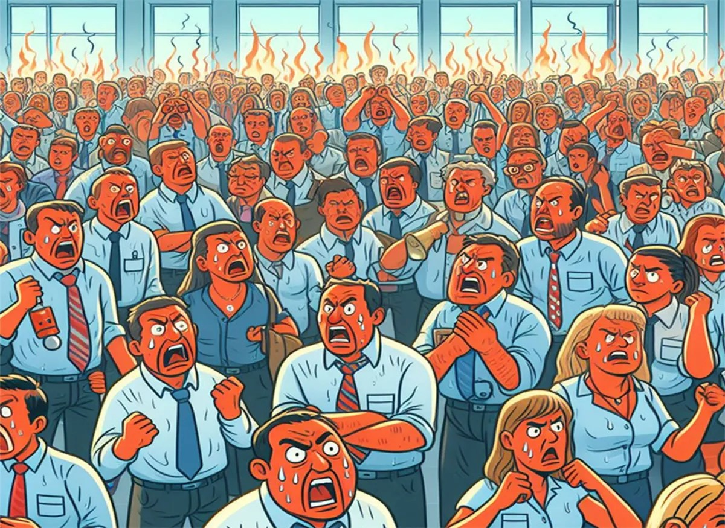
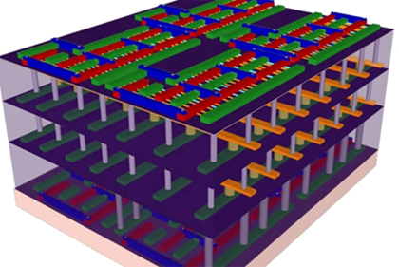
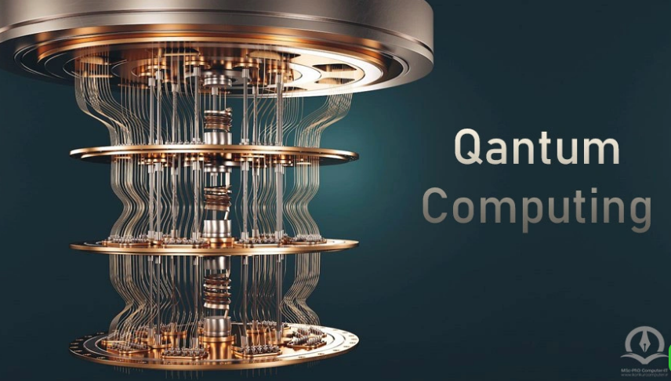
Challenges
Dopants distribution randomness
Cu diffusion in SiO2
Quantum effects (Tunneling) _ current leakage , more energy consumption
Total Heat increases
Poor electrostatic control
(Short-Channel Effects)_Threshold Voltage decreases
use High-k dielectrics, 3-D Transistors , Quantum Computers

Slide 30
Most Important Advantages of MOSFET:
Manufacturing Yield (well-behaved oxide layer) Speed Power Consumption

Slide 31
Thanks for your attention

