Slide 1

Impact of climate change on hospital visits for diarrhoea in urban Dhaka, Bangladesh: A time-series analysis
Dr Farhana Haque, MBBS, MPH, MSc
Assistant Scientist, icddr,b
Outbreak Investigation Officer, IEDCR
Notes:
Good morning/afternoon ladies and gentlemen. Today I will talk about the impact of climate change on hospital admissions for diarrhoea in urban Dhaka, the Capital City of Bangladesh. This study was conducted as part of a larger research commissioned by the World Health Organization Bangladesh to assess the health vulnerability and adaptation to climate change impacts in the country.

Slide 2
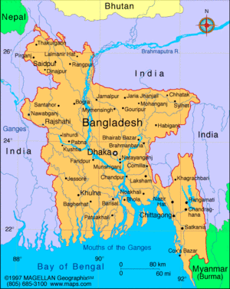
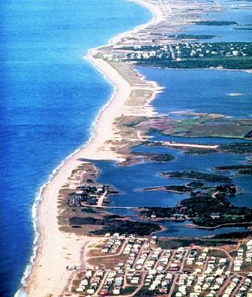
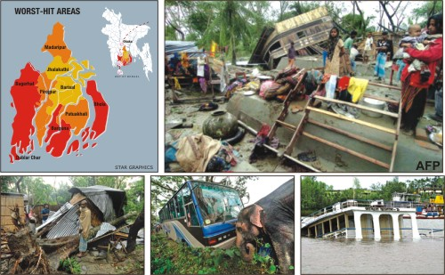
Notes:
Before I begin my presentation, let me introduce you to Bangladesh and why climate change is critical to Bangladesh though many of you have already heard about various environmental problems in the country including arsenicosis from keynote presentations. Bangladesh, a small low-lying country of 56,977 sq m , with 148 million people making it one of the most densely populated countries in the world. Given the large coastal population with the weak coastal protection system and the tropical cyclones in the Bay of Bengal, the shallow continental shelf, especially in the eastern part of Bangladesh, high tidal range, the sea‐level geography of the Bangladesh coastal land, the country is highly vulnerable to natural disasters (Appendix I) including inland and coastal inundation, storm surge, cyclones and tornados, drought, river erosion, drainage congestion/water logging, sea level rise and salinity intrusion

Slide 3
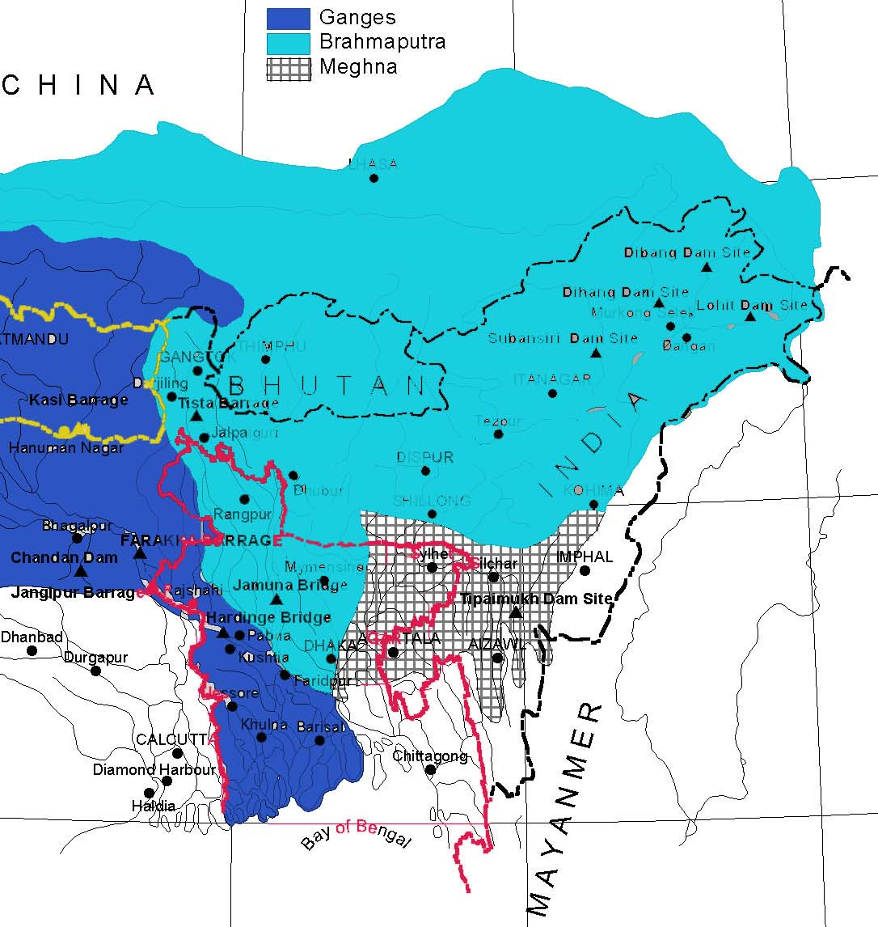
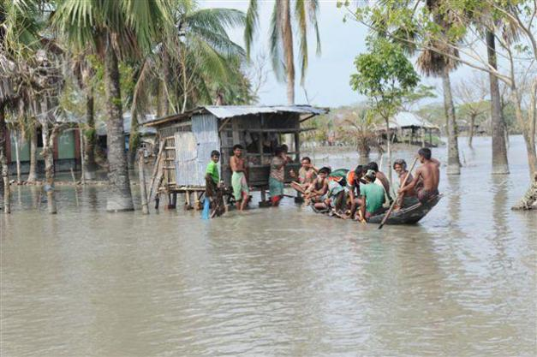
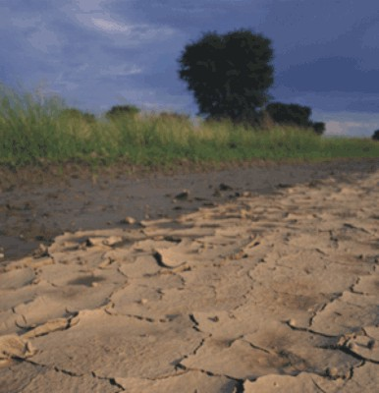
Notes:
Formed by a triangular delta plain at the confluence of the Ganges, Brahmaputra and Meghna (GBM) rivers, natural disasters occur commonly and floods occur most frequently. Floods are natural and recurrent phenomena that inundate about one-fifth of the country each year, while severe and devastating floods with a return period of 100 years inundate more than 60 percent of the country. The low-lying flat country with big inland water bodies, including some of the biggest rivers in the world, experiences 80% of annual rainfall in monsoon [17, 18]. Rainfall predicted to increase due to climate change in the Ganges, Brahmaputra and Meghna (GBM) basin might create huge water flow through the rivers of Bangladesh and cause severe damage to crops, property and health status of the affected population if adaptation measures are not taken. The northern part of the country are also hit by droughts during the dry season…leaving a large agricultural population without enough food.

Slide 4
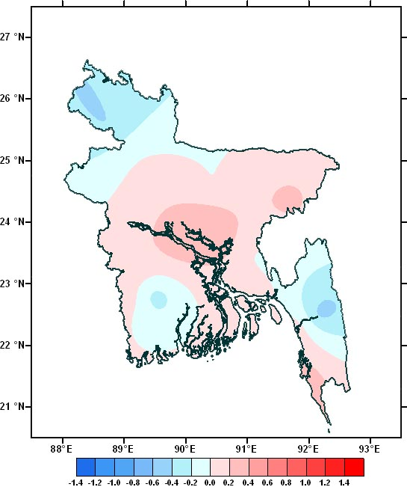
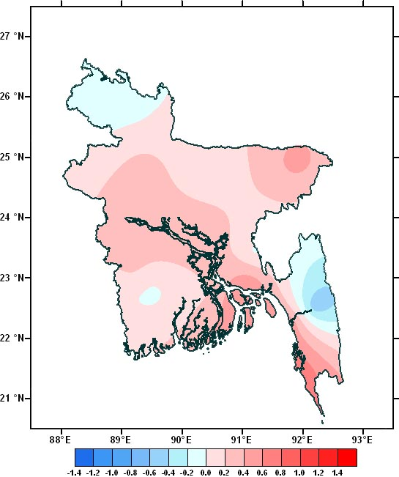
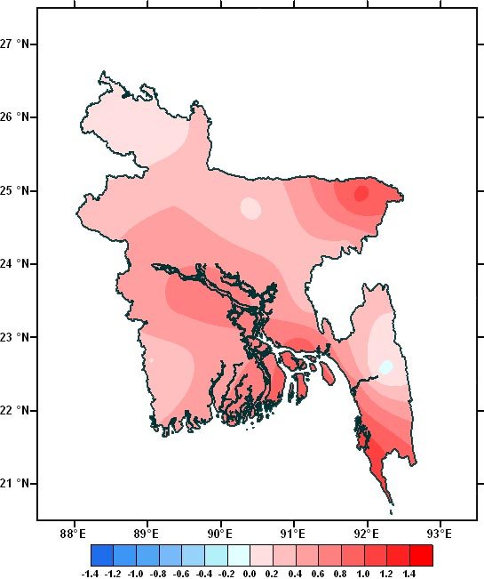
Observed deviation of yearly mean temperature per decade (1981-2010)
1981-1990
1991-2000
2001-2010
Notes:
Going back to today’s talk about the likely impact of climate change on diarrhoeal disease……it is vital to know what is climate change and if climate change is occurring in Bangladesh? Climate change or the statistically significant variation in the mean state of the climate for example mean temperature that usually lasts for decades or longer. The impacts of climate change are already visible in Bangladesh in the form of temperature extremes, erratic rainfall, increased number of intensified floods, cyclones, droughts, prevalence of extreme weather in the Bay of Bengal and salinity intrusion.
Compared with the mean temperature of 1981-1990 , you can see that there is a gradual increase of yearly mean temperature over decades based on local meteorological data

Slide 5
Regional Climate Model system RegCM 4 using the IPCC A1B emission scenario
2010 Year 2040
Notes:
How much temperature may be expected to rise? Various global climate model projections providing the best scenario (CISRO-3.0 and UKHAD CM-3) in validation analysis using different IPCC emission scenarios in the MAGICC/SCENGEN 5.3 software with the IPCC B2 SRES scenario, which assumes a world of moderate population growth and intermediate level of economic development and technological change suggested 1-2 degree rise in mean temp by the year 2030 in Dhaka Bangladesh.
To provide high temporal resolution, the latest version of the Regional Climate Model system RegCM 4, maintained in the Earth System Physics (ESP) section of the The Abdus Salam International Centre for Theoretical Physics (ICTP) was used. This flexible, easy to use model can be applied to any region of the World, with grid spacing of up to about 10 km (hydrostatic limit), and for a wide range of studies, from process studies to paleo-climate and future climate simulation. We considered the IPCC A1B emission scenario and conducted dynamic downscaling.
Thus both global and regional climate models suggest a likely increase in the mean temperature by 1 degrees by the year 2030.

Slide 6
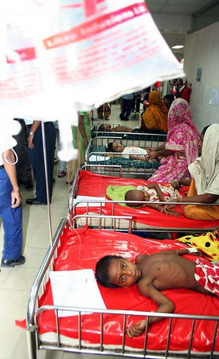
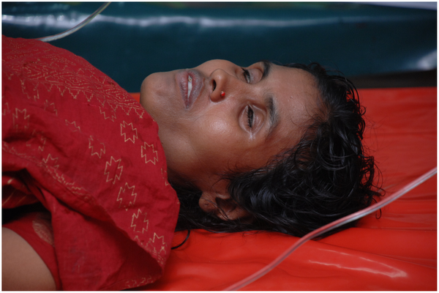
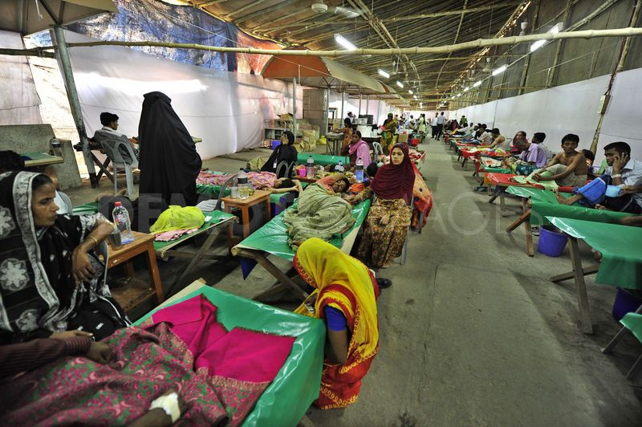
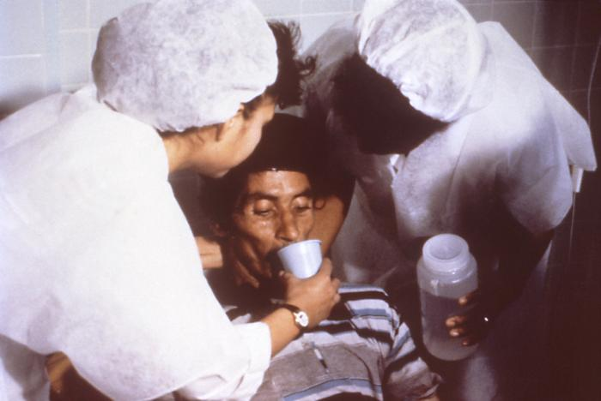
Diarrhoeal diseases
Leading cause of morbidity and mortality in developing countries
Estimated annual global childhood diarrhoea burden in 2010 from 139 countries – 1.7 billion
Affects all but disproportionately young children
In 2
In Bangladesh: 3 - 5 million people of all age groups hospitalized for diarrhoeal diseases (Health Bulletin, MIS)d(is
Notes:
Diarrhoeal disease is a condition of having 3/more loose or liquid bowel movements per day is a common cause of death in developing countries and the second most common cause of infant deaths worldwide. The loss of fluids through diarrhoeal disease can cause dehydration and electrolyte imbalances.
In 2009 diarrheal disease was estimated to have caused 1.1 million deaths in people aged 5 and over and 1.5 million deaths in children under the age of 5.
In 2010, .7 billion episodes of childhood diarrhoea were reported from 139 countries in 2010.
According to the HMIS data of the MOHFW, in 2009 in Bangladesh: > 5 million diarrhoeal patients of all age groups sought hospital care.

Slide 7
Can climate change lead to diarrhoeal disease?
Diarrhoeal diseases
Pathogens in climate change induced storm run-off
Floods overflow wastewater treatment plants/septic systems or combined sewer overflows
Raised temperature affect the survival of pathogens in the environment
Climate change increase droughts which increases contaminant concentration and multiple use of water body
Increased salinity increase aquatic invertebrates and increase cholera
Notes:
Climate change may increase diarrhoeal diseases in various ways. Raised temperature affect survival and replication of bacterial and protozoa pathogens and enteroviruses. CC may increase extreme events including floods which in turn may cause overflow of wastewater treatment plants/failure of septic systems or combined sewer overflows. CC may increase droughts which increases contaminant concentration and multiple use of water body increasing risk of exposure. CC may increase salinity and V. cholerae growth. All these factors could result in increased incidence of diarrhoeal disease.

Slide 8
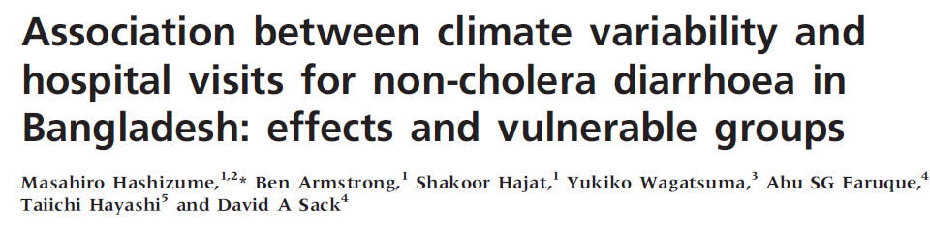
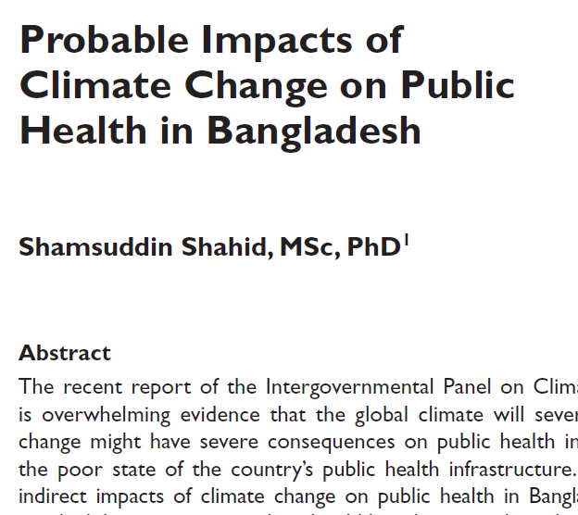
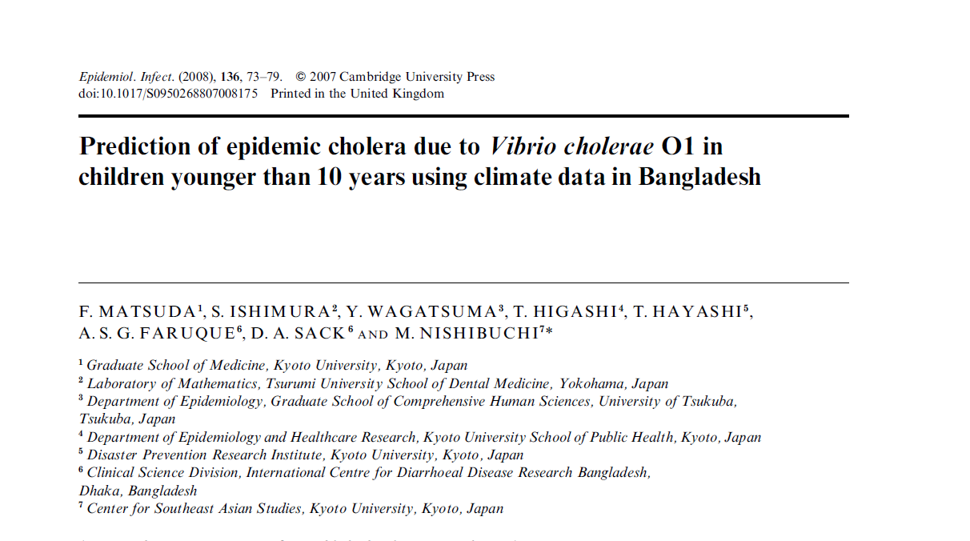
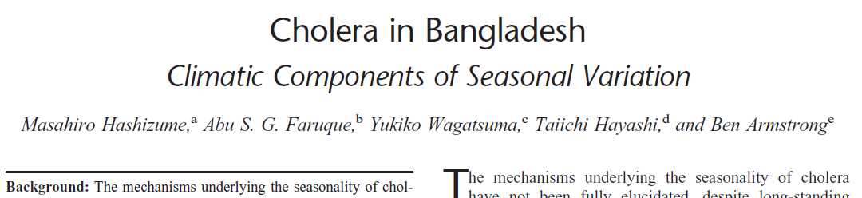
Climate variability and diarrhoeal diseases in Bangladesh
Notes:
There is already some evidence that climatic factors may influence diarrhoea occurrences. While several studies in Bangladesh have looked at variations of different diarhhoeal pathogens with short-term variations in climatic factors, measurements of potential impacts of gradual climate change occurring over decadal time-scales due to human actions (anthropogenic forcing) on diarrhoeal diseases are lacking. Moreover, the results in these studies have been expressed in terms of traditional effect-indicators such risk ratios and Odds ratios. Since climate is naturally variable and can vary considerably so, whereas climate change is gradual and occur on decadal time scales and because there is a need to translate the epidemiological findings of the climate change-diarrhoea relationships to the wider audience. To rationalize allocation of constrained resources and to prioritize policies to mitigate climate change impacts, decision makers require estimation of the disease burden attributable to climate change and its potential impact in the future.

Slide 9
Objectives
A collaborative, multidisciplinary study team from icddr,b and IEDCR conducted this study:
To estimate the relationship of long term variability in daily mean temperature (climate change) with the number of daily hospital admissions for diarrhoeal diseases
To predict the likely effect of change in daily mean temperature on diarrhoeal admissions in Dhaka Bangladesh in 2030
Predict the associated cost of reactive measures in order to inform policy making
Notes:
As a result a collaborative team from IEDCR and icddr,b conducted this study to measure the association between long term climate variability and change on hospital admissions for all-cause diarrhoea and then used this relationship to predict the potential impact of climate change on diarrhoea incidence in Dhaka Bangladesh in 2030

Slide 10
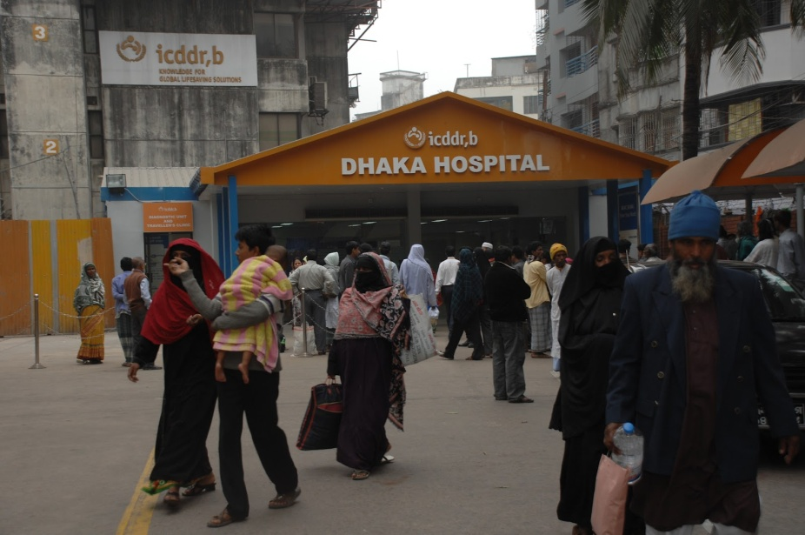
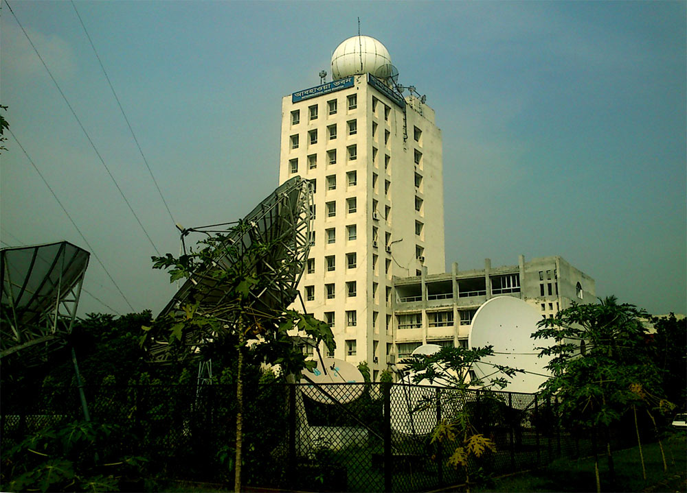
Data sources
Daily hospital admissions from Dhaka Hospital (1981-2010)
Served an urban population: ~ 13 million in 2010
Treats >110,000 patients annually
Daily ambient temperature: Bangladesh Meteorological Department
Notes:
In 1962 ICDDR,B set up a small hospital that quickly became a refuge for the neediest in Bangladesh, offering treatment that would otherwise be beyond their means. Today’s hospital has grown but continues the same high standard of care and dedication to the poor that made it famous in Bangladesh. The Dhaka Hospital serves ~13 million people living in urban Dhaka. The Dhaka Hospital treats more than 110,000 patients each year. We collected daily total admissions from icddr,b’s Dhaka Hospital for the 30 year period of 1981-2010.
The Diarrhoeal Disease Surveillance System was established at the Dhaka Hospital in 1979 to collect information on demographic, epidemiological and clinical characteristics of patients. A systematic 2% sample of patients attending the Dhaka from the Health and Demographic Surveillance System (HDSS) area are enrolled into the surveillance programme. Using structured questions, trained research assistants interview patients and/or their attendants to collect relevant information on socioeconomic and demographic characteristics, housing and environmental conditions, feeding practices, particularly of infants and young children, and use of drugs and fluid therapy at home. Information on clinical characteristics, anthropometric measurements, and treatments received at the facilities and outcomes of patients are also recorded.
We collected the daily ambient temperature from the Bangladesh meteorological department which has 35 stations across Bangladesh. Daily ambient temperature represents the average of 8 temperatures collected at a 3-hourly interval in a day.

Slide 11
Estimating relationship of unit change in daily ambient temperature and daily diarrhoeal admissions

Slide 12
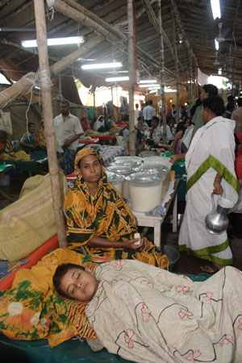
Data analysis technique
To estimate the relationship between unit change in daily ambient temperature and daily admissions
Time series analysis (Negative Binomial Model)
Population-level confounders: safe water supply, sanitation coverage, annual population growth, annual GDP growth rate, literacy level of the Dhaka’s inhabitants over the last 30 years.
We estimated the IRR for unit change in mean temperature
Courtesy: Dhaka Hospital, icddr,b
Notes:
We checked the data series for trend, seasonality, autocorrelation and possible outliers.
We pre-whitened the data series for checking cross-correlation between diarrhoea and mean temperature at different lags up to 4 weeks. We conducted detailed lag effects by fitting linear unconstrained distributed lag models.
We chose the preferred models according to the level of significance of regressors including the ACF and PACF values in each model and the results of a previous correlation analysis of all variables in our datasets.
To investigate the potential effects of daily climate mean temperature variability on daily hospital visits for diarrhoea, we used the log-linked negative binomial regression model in order to account for constant over-dispersion in our data using STATA.
To estimate the association between mean daily temperature and daily diarrhoea admissions, we conducted time series analysis after controlling for potential population level confounders as this study aimed to inform policy makers and adaptation, set at the level of populations.

Slide 13
Estimation of the total diarrhoea admissions in Dhaka in 2030 in the absence of 1º C increase in mean temperature (baseline scenario, C₀)

Slide 14
We estimated the annual incidence of diarrhoea admissions in the Dhaka Hospital during 1981-1990 - the period where no/negligible implications from climate change
We considered the baseline risk of diarrhoeal admissions in the absence of climate change in 2030 to be equal to the average annual risk during 1981-1990
Baseline incidence, C₀ X projected population in 2030 = number of diarrhoeal admissions in 2030 if there was no climate change

Slide 15
Estimation of the total diarrhoeal admissions in Dhaka in 2030 in the 1º C change in mean temperature

Slide 16
Baseline incidence, C₀ X upper/lower bounds of IRR (using 1981-2010 time series analysis)= incidence in the climate change scenario, C_{C}
Incidence in C_{C} scenario X projected population in the 2030 = Number of diarrhoea admissions in the climate change scenario in 2030
Notes:
We considered 2 scenarios:
Scenario C₀, year 2030, is the baseline scenario where no implications from climate change (incidence/risk using 1990 data)
Scenario C_{c}, year 2030 with implications of climate change, builds on the Scenario C₀ (IRR using 1981-2010 data)
According to the World Meteorological Organization and IPCC, the climate property was not strongly affected by anthropogenic forcing before 1990.
The climate change scenario C_{c} (the period assumed to be affected by human-induced factors owing to industrialization and greenhouse gas emission).
We generated the relationships between rates of daily hospital visits for diarrhoea and 1 degree Celsius increase in daily ambient temperature based on the results of time series regression using the 30 years data from 1981-2010
This is the IRR for the climate change scenario C_{C} (for 1ºC rise in daily ambient temperature)
We considered the potential confounders including the population growth in the catchment area of the Dhaka Hospital, annual GDP growth rate, safe water supply, sanitation coverage, and literacy rate into the model.
We did not include rainfall and humidity in our model as the impacts of climate change on rainfall and humidity are still not clear. Instead, we only included the daily ambient temperature showing clear variation with climate change.

Slide 17
Estimation of the additional diarrhoeal admissions in Dhaka Hospital in 2030 likely due to 1º C change in mean temperature

Slide 18
Additional diarrhoeal admissions in 2030 due to 1º C rise in mean temperature = Admissions in C_{C} scenario ── admissions in baseline scenario
N_{cc}= Cases C_{c} – Cases C₀

Slide 19
Additional cost of reactive measures
According to Dhaka Hospital in 2010:
~US $ 15 per hospital-based treatment per diarrhoeal case
We did not include the cost of mortality from diarrhoea nor the cost incurred by diarrhoea affected households.
Using the constant 2010 US $ and a 3% annual inflation rate
Notes:
This included the cost of treatment, bed, personnel and surveillance. We calculated of reactive adaptation measures as costs of treatment only.

Slide 20
Findings

Slide 21
Patient profile
 | 1981-2010
Total diarrhoeal admissions | 2,975,150
Daily median admissions (1981-1990) | 175
Daily median admissions (2000-2010) | 250
Daily median admissions (2000-2010) | 300
Male | 58%
0-4 years | 54%
5-14 years | 10%
15+ years | 36%
Notes:
During the 30 years, there were 3 million hospital admissions for diarrhoeal diseases. Among these, 58% were males. More than half belonged to 0-4 years.

Slide 22
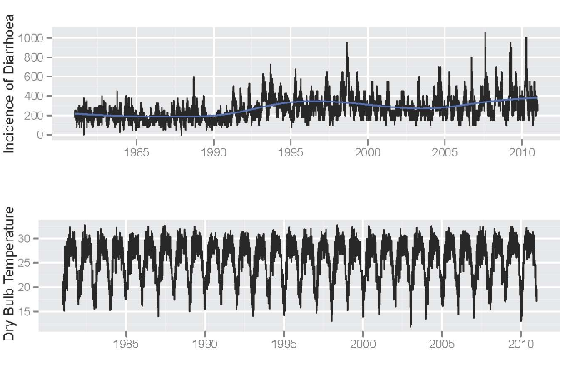
Seasonal variations in the number of diarrhoeal admissions per day and daily ambient temperature in Dhaka, Bangladesh, 1981-2010
Notes:
Diarrhoeal admissions had a bimodal seasonality of which the timing of 1st peak was before the monsoon and second peak was at the end of monsoon.

Slide 23
Percentage change in diarrhoea admissions per 1º C rise in mean temperature
The number of daily diarrhoeal admissions increased by 5% (95% CI: 4-7) per degree rise in mean temperature
The model assumes a log linear increase in risk

Slide 24
Risk in baseline and climate change scenarios for 1ºC change in daily ambient temperature in 2030
Scenario | Annual Risk | 95% CI | P-value
Scenario C₀ (Baseline scenario using estimates from 1990) | 0.0085
Scenario C_{C} (Climate change 1ºC mean temperature rise) | 0.0091 | 0.0089-0.0099 | 0.000

Slide 25
Baseline Scenario C_{B} (2030) Using incidence of 1990 |  | Scenario C_{CC} (1 ºC rise in ambient temperature 2030)
 |  | Lower | Upper
Diarrhoea cases | 221,780 | 231,400 | 257,400
Additional cases |  | 9,620 | 35,620
Percentage increase in cases % |  | 5 | 16
Cost of hospital treatment ($15/diarrhoea episode/in 2010) | US $ 4,025,307 | US $ 4,199,910 | US $ 4,671,810
Additional cost of treatment |  | US $ 174,603 | US $ 646,503

Slide 26

Limitations
Underestimate
Only based on hospital admissions
The impact of natural disasters not included – floods
Pathogen-specific estimates could provide more robust estimates

Slide 27
Conclusions
Global climate change is likely to raise mean temperature by ~1º C
Global climate models
Regional climate models
Observed data
Rise in mean temperature is likely to cause additional hospital admissions for diarrhoeal diseases in Dhaka by 2030
There is substantial associated cost for reactive measures

Slide 28
Recommendations
Conduct research to provide better estimates
Improve efforts to increase hospital capacity as well as allocate financial resources
Continued investment for improving water quality and sanitation infrastructure in order to mitigate the impact of climate change in Bangladesh

Slide 29
Acknowledgements
Co-investigators:
Md Kamal Hossain, icddr,b
Selina Khatun, WHO/IEDCR
Mujaddeed Ahmed, WHO/IEDCR
M. Mushtuq Husain, IEDCR
A.S.M. Alamgir, WHO/IEDCR
Nuzhat Nasreen Banu, IEDCR
Mahmudur Rahman, IEDCR
Emily S. Gurley, icddr,b
Special thanks to collaborators and funders:
IEDCR, Government of Bangladesh
WHO Bangladesh
We are grateful to:
Abbas Bhuiyan
Peter Kim Streatfield, icddr,b
Diarrhoea surveillance team, icddr,b
Thanks to reviewers:
Carrie Read
Notes:
Finally I would like to end my presentation by specially thanking IEDCR of the MoHFW for giving me the opportunity to conduct this study, the BMD for climate data and their suggestions about analyses and Dhaka Hospital of icddr,b along with the funders and collaborators. Thank you and
I would be happy to take a few questions.

