Slide 1
Determining the Effects of Political and Economic Freedom on the Success of a Nation
Chace Paulson

Slide 2
Research Question
Which has a stronger correlation with the overall success of a nation – political freedom or economic freedom?

Slide 3
Political and Economic Freedom
Freedom House’s Freedom Rating
Measures the degree of civil liberties and political rights in the world’s nations
Heritage’s Index of Economic Freedom
Measures the degree of economic freedom in the world’s nations
Criticism of the data set
The Index assumes that economic openness inherently leads to better growth

Slide 4
Defining Success
Break down success into five categories:
Economic Prosperity
a. GDP
b. Unemployment
Education
a. School Enrollment
b. Literacy
Safety
a. Crime Index
b. Homicide Rate
Health
a. Life Expectancy
b. Infant Mortality
Lifestyle
a. Median Income
b. Happiness

Slide 5
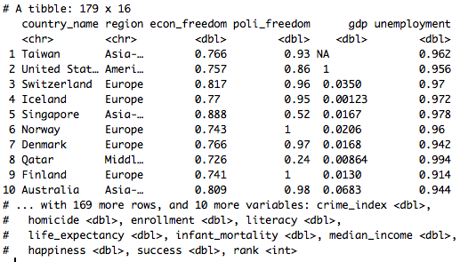
Calculating Success
Considering the 196 nation’s recognized by the U.S. Department of State has sovereign
Merge the 12 data sets into one combined tibble – success_data
Calculated the proportions for each of the ten variables and found the mean of said proportions
Remove any nation that had missing data for both variables in any of the five categories was removed
Reorder and rank countries by success
Mean(success_data) = 0.6117207

Slide 6
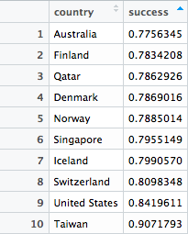
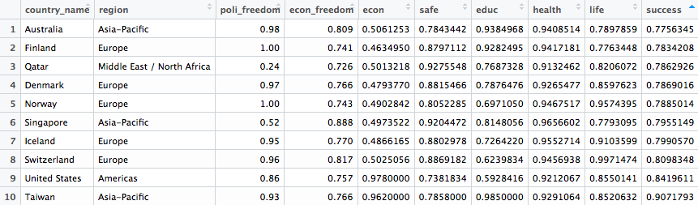
Most Successful Nations
Four different regions represented
High levels of economic freedom, mixed political freedom levels

Slide 7
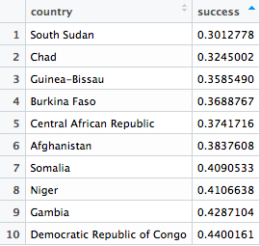
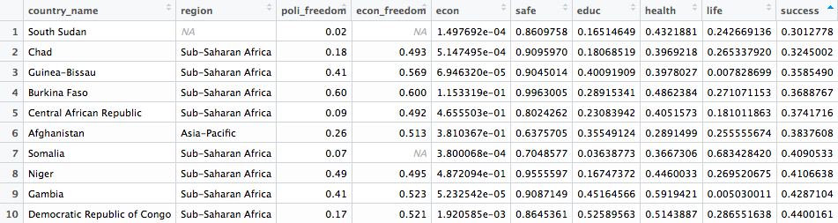
Least Successful Nations
Only two different regions represented
Similar levels of economic freedom; mixed levels of political freedom
Least fluctuation in safety

Slide 8
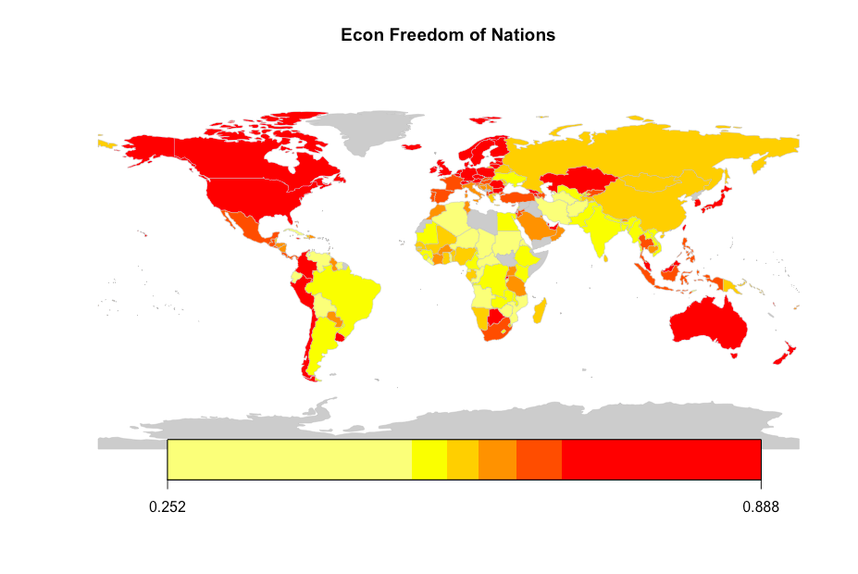
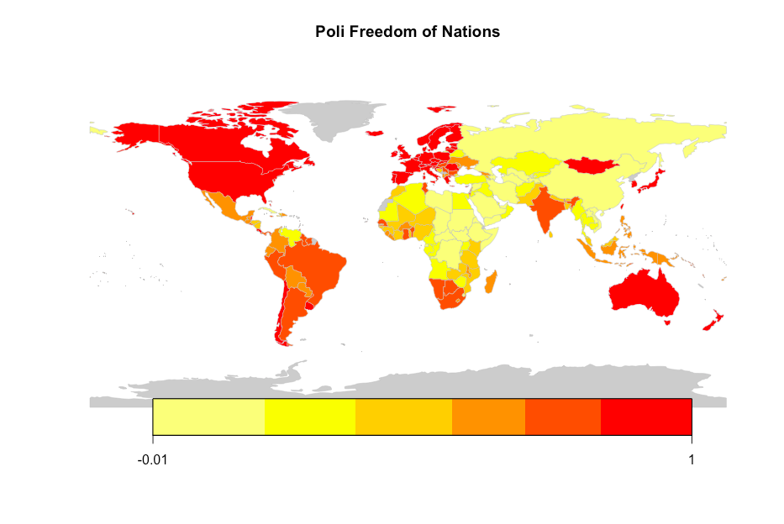
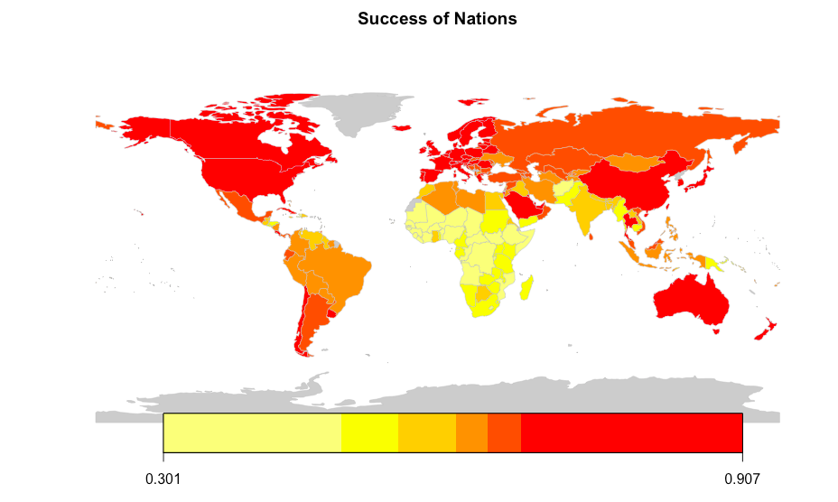
Mapping

Slide 9
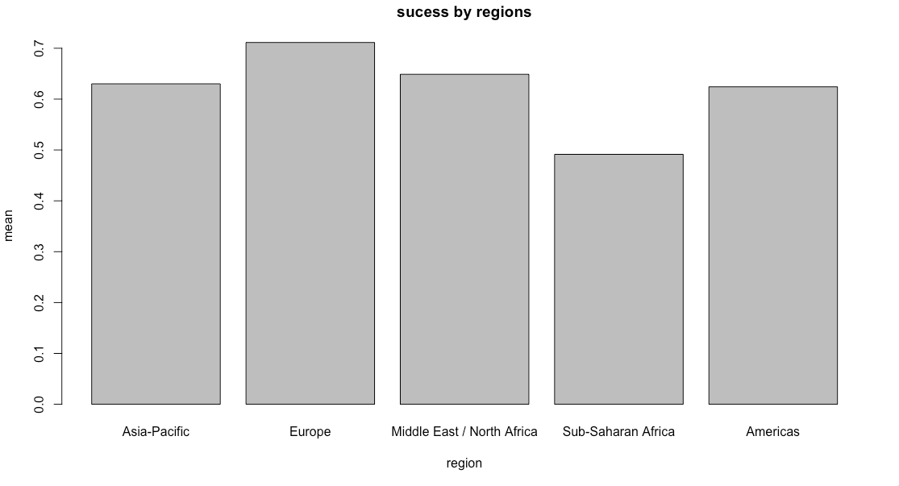
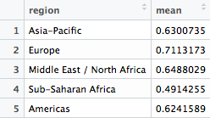
Success of Regions
Most successful region: Europe
Least successful region: Sub-Saharan Africa

Slide 10
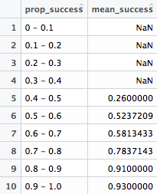
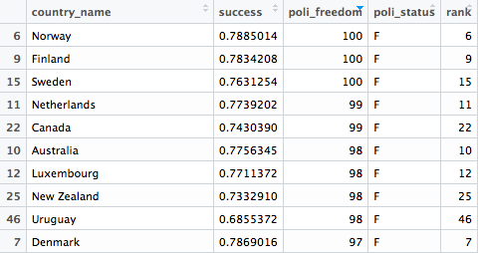
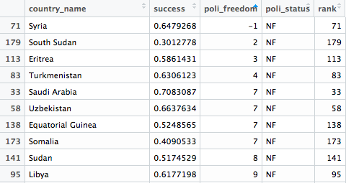
Political Freedom and Success
The proportion of political freedom follows standard, positive pattern
Each proportion holds a higher mean rate of success than the last
Weaker positive correlation between poli freedom and success
Notable outliers – Uruguay, Saudi Arabia, Syria

Slide 11
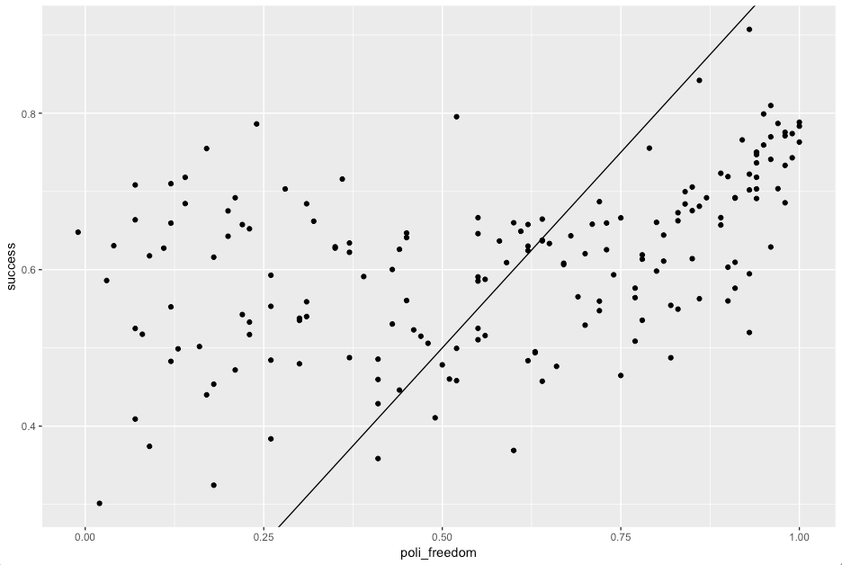
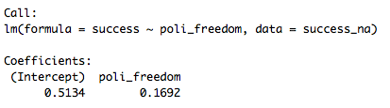
Political Freedom and Success
As political freedom increases by a factor of one, success rate will increase by 0.1692
Since work was calculated in proportions:
When the political freedom of a country is rated at 100, success rate be 16.92 percent higher than a country with a 0 rating
For a total success rate of 0.6826
P value = 8.07e-11

Slide 12
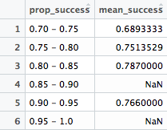
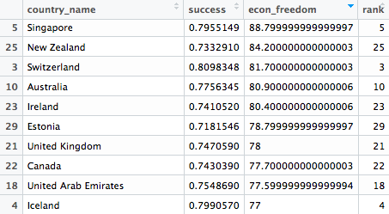
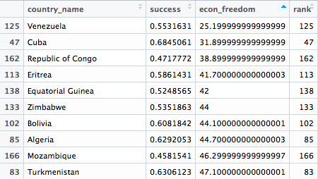
Economic Freedom and Success
Proportions do not follow standard pattern
Largest prop is 0.80-0.85
Likely because Taiwan is only country with rate of 90
Stronger positive correlation between econ freedom and success
Notable outliers – Cuba

Slide 13
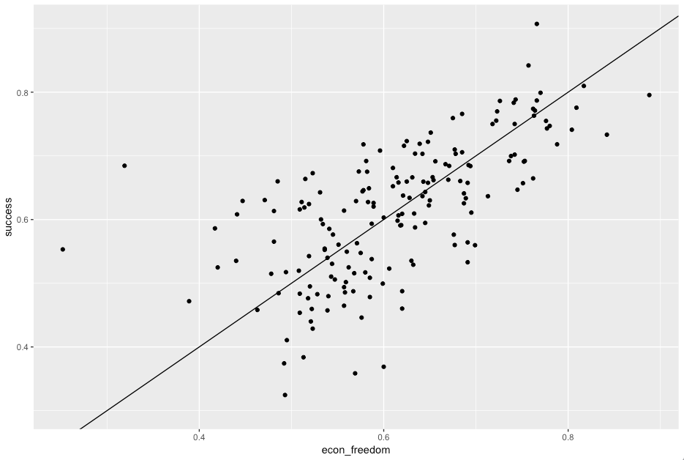
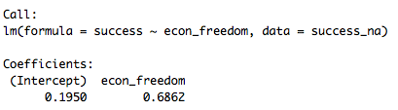
Economic Freedom and Success
As economic freedom increases by a factor of one, success rate will increase by 0.6862
Since work was calculated in proportions:
When the economic freedom of a country is rated at 100, success rate be 68.62 percent higher than a country with a 0 rating
For a total success rate of 0.8776
P Value = 2e-16

Slide 14
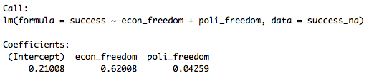
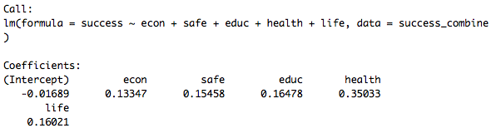
Multiple Linear Regression
Economic freedom has a much stronger correlation to success than political freedom
0.57749 higher
P value for econ: 4.42e-15
P value for poli: 0.0969
Within the five categories:
Health factors has the strongest impact on a nation’s success
Economic factors have the least impact on a nation’s success
All five have a p value of 2e-16
Individual P values:
Econ 7.42e-09
Safe 8.77e-13
Educ 2e-16
Health 6.12e-10
Life 5.43e-05

Slide 15
Conclusion
The U.S. tends to consider political freedom to be crucial to success
Gone to war to prevent communist takedowns, McCarthyism
In truth, economic freedom factors much more into the success of a nation than political freedom
Note: Possible Biases
In choosing both the categories and the variables to define success with, could be choosing factors that favor democracies

Slide 16
Sources
Data for the economic systems and types of government:
Economic Freedom (Heritage, link)
Political Freedom (Freedom House, link )
Data for the ten variable:
GDP (The World Bank, link)
Unemployment Rate (Central Intelligence Agency, link)
Total Crime Index (Numbeo, link)
Homicide Rate (World Bank, link)
High School Enrollment Rate (World Bank, link )
Literacy Rate (Central Intelligence Agency, link )
Life Expectancy (Central Intelligence Agency, link )
Infant Mortality Rate (Central Intelligence Agency, link )
Median Income (World Bank, link )
World Happiness Rating (World Happiness Report, link )

