Slide 1
Chapter two
Text Operations

Slide 2
Document representation
IR system/Search engine does not scan each document to see if it satisfies the query
It uses an index to quickly locate the relevant documents
Index: a list of concepts with pointers to documents that discuss them
  What goes in the index is important
Document representation: deciding what concepts should go in the index

Slide 3
Document representation
Two options:
Controlled vocabulary – a set of manually constructed concepts that describe the major topics covered in the collection
Free-text indexing – the set of individual terms that occur in the collection

Slide 4
Document representation
Controlled Vocabulary: a set of well-defines concepts
  Assigned to documents by humans (or automatically)
    E.g. Subject headings, key words, etc.
  May include parent-child relations b/n concepts
    E.g. computers: software: Information Retrieval

Slide 5
Free Text Indexing
Represent documents using terms within the document
Which terms? Only the most descriptive terms? Only the unambiguous ones? All of them?
  Usually, all of them (full-text indexing)
The user will use term-combinations to express higher level concepts
Query terms will hopefully disambiguate each other (e.g., “volkswagen golf”)
The search engine will determine which terms are important
Our goal is to describe content using content
Are all words equally descriptive?
What are the most descriptive words?
How might a computer identify these?

Slide 6
Controlled Vs Free Text Indexing
Both are effective and used often
We will focus on free-text indexing in this course
  cheap and easy
  most search engines use it
 | Cost of Assigning index terms | Ambiguity of index terms | Detail of representation
Controlled Vocabulary | High | Not ambiguous | Can’t represent arbitrary detail
Free text indexing | low | Can be ambiguous | Any level of detail

Slide 7
Free Text Indexing: Steps
Mark-up removal
Normalization – e.g downcasing
  Information and information
  Retrieval and RETRIEVAL
  US and us – can change the meaning of words
Tokenization - splitting text into words (based on sequences of non-alpha-numeric characters)
  Problematic cases: ph.d. = pd d, isn’t = isn t
Stopword removal
Do steps 1-4 to every document in the collection and create an index using the union of all remaining terms

Slide 8
Text Operations
Not all words in a document are equally significant to represent the contents/meanings of a document
  Some word carry more meaning than others
  Noun words are the most representative of a document content
Therefore, need to preprocess the text of a document in a collection to be used as index terms
Using the set of all words in a collection to index documents creates too much noise for the retrieval task
  Reduce noise means reduce words which can be used to refer to the document
Preprocessing is the process of controlling the size of the vocabulary or the number of distinct words used as index terms
  Preprocessing will lead to an improvement in the information retrieval performance
However, some search engines on the Web omit preprocessing
  Every word in the document is an index term

Slide 9
Text Operations
Text operations is the process of text transformations in to logical representations
4 main operations for selecting index terms, i.e. to choose words/stems (or groups of words) to be used as indexing terms:
  Tokenization of the text: generate a set of words from text collection
  Elimination of stop words - filter out words which are not useful in the retrieval process
  Normalization – bringing to one form – e.g. downcasing
  Stemming words:remove affixes(prefixes and suffixes) and group together word variants with similar meaning

Slide 10
Tokenization
Tokenization is one of the step used to convert text of the documents into a sequence of words, w₁, w₂, … w_{n} to be adopted as index terms
  It is the process of demarcating and possibly classifying sections of a string of input characters into words
  For example,
    The quick brown fox jumps over the lazy do
Objective - identify words in the text
  What is a word means?
    Is that a sequence of characters, numbers and alpha-numeric once?
Tokenization Issues
  numbers, hyphens, punctuations marks, apostrophes …

Slide 11
Issues in Tokenization
One word or multiple: How to handle special cases involving hyphens, apostrophes, punctuation marks etc? C++, C#, URL’s, e-mail, …
Two words may be connected by hyphens.
  Can two words connected by hyphens taken as one word or two words? Break up hyphenated sequence as two tokens?
    In most cases hyphen – break up the words (e.g. state-of-the-art → state of the art), but some words, e.g. MS-DOS, B-49 - unique words which require hyphens
Two words may be connected by punctuation marks .
  Punctuation marks: remove totally unless significant, e.g. program code: x.exe and xexe. What about Kebede’s, www.command.com?

Slide 12
Issues in Tokenization
Two words (phrase) may be separated by space.
  E.g. Addis Ababa, San Francisco, Los Angeles
Two words may be written in different ways
  lowercase, lower-case, lower case? data base, database, data-base?
  Numbers: are numbers/digits words and used as index terms?
    dates (3/12/91 vs. Mar. 12, 1991);
    phone numbers (+251923415005)
    IP addresses (100.2.86.144)
    Numbers are not good index terms (like 1910, 1999); but 510 B.C. is unique.
    Generally, don’t index numbers as text, though very useful.

Slide 13
Issues in Tokenization
What about case of letters (e.g. Data or data or DATA):
  cases are not important and there is a need to convert all to upper or lower. Which one is mostly followed by human beings?
Simplest approach is to ignore all numbers and punctuation marks (period, colon, comma, brackets, semi-colon, apostrophe, …) & use only case-insensitive unbroken strings of alphabetic characters as words.
  Will often index “meta-data”, including creation date, format, etc. separately
Issues of tokenization are language specific
  Requires the language to be known

Slide 14
Tokenization
Analyze text into a sequence of discrete tokens (words)
Input: “Friends, Romans and Countrymen”
Output: Tokens (an instance of a sequence of characters that are grouped together as a useful semantic unit for processing)
  Friends
  Romans
  and
  Countrymen

Slide 15
Exercise: Tokenization
The cat slept peacefully in the living room. It’s a very old cat.
The instructor (Dr. O’Neill) thinks that the boys’ stories about Chile’s capital aren’t amusing.

Slide 16
Stopword Removal
A stopword is a term that is discarded from the document representation
  Stopwords: words that we ignore because we expect them not to be useful in distinguishing between relevant/non-relevant documents for any query
  Stopwords are extremely common words across document collections that have no discriminatory power
  Assumption: stopwords are unimportant because they are frequent in every document
    They may occur in 80% of the documents in a collection.
    They would appear to be of little value in helping select documents matching a user need and needs to be filtered out as potential index terms

Slide 17
Stopword Removal
Stopwords are typically function words:
  Examples of stopwords are articles, prepositions, conjunctions, etc.:
    articles (a, an, the); pronouns: (I, he, she, it, their, his)
    Some prepositions (on, of, in, about, besides, against); conjunctions/ connectors (and, but, for, nor, or, so, yet), verbs (is, are, was, were),
    adverbs (here, there, out, because, soon, after) and
    adjectives (all, any, each, every, few, many, some) can also be treated as stopwords
Stopwords are language dependent

Slide 18
Why Stopword Removal?
Intuition:
  Stopwords have little semantic content; It is typical to remove such high-frequency words
  Stopwords take up 50% of the text. Hence, document size reduces by 30-50%
Smaller indices for information retrieval
  Good compression techniques for indices: The 30 most common words account for 30% of the tokens in written text
With the removal of stopwords, we can measure better approximation of importance for text classification, text categorization, text summarization, etc.

Slide 19
How to detect a stopword?
One method: Sort terms (in decreasing order) by document frequency (DF) and take the most frequent ones based on the cutoff point
  In a collection about insurance practices, “insurance” would be a stop word
Another method: Build a stop word list that contains a set of articles, pronouns, etc.
  Why do we need stop lists: With a stop list, we can compare and exclude from index terms entirely the commonest words.
  Can you identify common words in Amharic and build stop list?

Slide 20
Trends in Stopwords
Stopword elimination used to be standard in older IR systems. But the trend is away from doing this nowadays.
Most web search engines index stopwords:
  Good query optimization techniques mean you pay little at query time for including stop words.
  You need stopwords for:
    Phrase queries: “King of Denmark”
    Various song titles, etc.: “Let it be”, “To be or not to be”
    “Relational” queries: “flights to London”
  Elimination of stopwords might reduce recall (e.g. “To be or not to be” – all eliminated except “be” – no or irrelevant retrieval)

Slide 21
Normalization
  It is Canonicalizing tokens so that matches occur despite superficial differences in the character sequences of the tokens
  Need to “normalize” terms in indexed text as well as query terms into the same form
  Example: We want to match U.S.A. and USA, by deleting periods in a term
Case Folding: Often best to lower case everything, since users will use lowercase regardless of ‘correct’ capitalization…
  Republican vs. republican
  Fasil vs. fasil vs. FASIL
  Anti-discriminatory vs. anti discriminatory
  Car vs. Automobile?

Slide 22
Normalization issues
Good for
  Allow instances of Automobile at the beginning of a sentence to match with a query of automobile
  Helps a search engine when most users type ferrari while they are interested in a Ferrari car
Bad for
  Proper names vs. common nouns
    E.g. General Motors, Associated Press, Kebede…
Solution:
  lowercase only words at the beginning of the sentence
In IR, lowercasing is most practical because of the way users issue their queries

Slide 23
Stemming/Morphological analysis
Stemming reduces tokens to their “root” form of words to recognize morphological variation .
  The process involves removal of affixes (i.e. prefixes and suffixes) with the aim of reducing variants to the same stem
  Often removes inflectional and derivational morphology of a word
    Inflectional morphology: vary the form of words in order to express grammatical features, such as singular/plural or past/present tense. E.g. Boy → boys, cut → cutting.
    Derivational morphology: makes new words from old ones. E.g. creation is formed from create , but they are two separate words. And also, destruction → destroy
    Compounding – combining words to form new ones e.g beefsteak

Slide 24
Stemming
The final output from a conflation algorithm is a set of classes, one for each stem detected.
  A Stem: the portion of a word which is left after the removal of its affixes (i.e., prefixes and/or suffixes).
  Example: ‘connect’ is the stem for {connected, connecting connection, connections}
  Thus, [automate, automatic, automation]→ all reduce to → automat

Slide 25
Ways to implement stemming
There are basically two ways to implement stemming.
  The first approach is to create a big dictionary that maps words to their stems
  The second approach is to use a set of rules that extract stems from words
    Techniques widely used include: rule-based, statistical, machine learning or hybrid
  But, since stemming is imperfectly defined, anyway, occasional mistakes are tolerable, & the rule-based approach is the one that is generally chosen

Slide 26
Porter Stemmer
Stemming is the operation of stripping the suffices from a word, leaving its stem
  Google, for instance, uses stemming to search for web pages containing the words connected, connecting, connection and connections when users ask for a web page that contains the word connect.
In 1979, Martin Porter developed a stemming algorithm that uses a set of rules to extract stems from words, and though it makes some mistakes, most common words seem to work out right
  Porter describes his algorithm and provides a reference implementation in C at http://tartarus.org/~martin/PorterStemmer/index.html

Slide 27
Porter stemmer
Most common algorithm for stemming English words to their common grammatical root
It is simple procedure for removing known affixes in English without using a dictionary. To gets rid of plurals the following rules are used:
  SSES → SS caresses → caress
  IES → i ponies → poni
  SS → SS caress → caress
  S → Φ cats → cat
  EMENT → Φ (Delete final ement if what remains is longer than 1 character )
    replacement → replac
    cement → cement

Slide 28
Porter stemmer
Porter stemmer works in steps.
  While step 1a gets rid of plurals –s and -es, step 1b removes -ed or -ing.
  e.g.
  ;; agreed -> agree ;; disabled -> disable
;; matting -> mat ;; mating -> mate
;; meeting -> meet ;; milling -> mill
;; messing -> mess ;; meetings -> meet
;; feed -> feed

Slide 29
Stemming: challenges
May produce unusual stems that are not English words:
  Removing ‘UAL’ from FACTUAL and EQUAL
May conflate (reduce to the same token) words that are actually distinct.
    “computer”, “computational”, “computation” all reduced to same token “comput”
Not recognize all morphological derivations.

Slide 30
Statistical Properties of words in a Text
How is the frequency of different words distributed?
How fast does vocabulary size grow with the size of a corpus?
There are three well-known researchers who define statistical properties of words in a text:
  Zipf’s Law: models word distribution in text corpus
  Luhn’s idea: measures word significance
  Heap’s Law: shows how vocabulary size grows with the growth corpus size

Slide 31
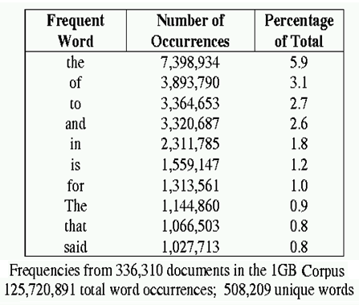
Word Distribution/Frequency
A few words are very common.
    2 most frequent words (e.g. “the”, “of”) can account for about 10% of word occurrences.
Most words are very rare.
    Half the words in a corpus appear only once, called “read only once” or Hapax Legomena (in Greek)

Slide 32
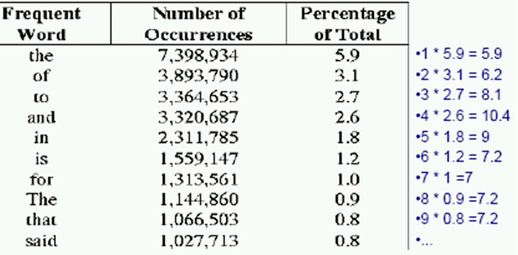
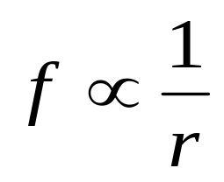
Word distribution: Zipf's Law
Zipf's Law states that when the distinct words in a text are arranged in decreasing order of their frequency of occuerence (most frequent words first), the occurence characterstics of the vocabulary can be characterized by the constant rank-frequency law of Zipf.
If the words, w, in a collection are ranked, r, by their frequency, f, they roughly fit the relation:
r * f = c
  Different collections have different constants c.
The table shows the most frequently occurring words from 336,310 document corpus containing 125, 720, 891 total words; out of which 508, 209 are unique words

Slide 33
Explanations for Zipf’s Law
The law has been explained by “principle of least effort” which makes it easier for a speaker or writer of a language to repeat certain words instead of coining new and different words.
  Zipf’s explanation was his “principle of least effort” which balance between speaker’s desire for a small vocabulary and hearer’s desire for a large one.

Slide 34
Methods that Build on Zipf's Law
Stop lists: Ignore the most frequent words (upper cut-off). Used by almost all systems.
Significant words: Take words in between the most frequent (upper cut-off) and least frequent words (lower cut-off)
Term weighting: Give differing weights to terms based on their frequency, with most frequent words weighed less. Used by almost all ranking methods.

Slide 35
Word significance: Luhn’s Ideas
Luhn Idea (1958): the frequency of word occurrence in a text furnishes a useful measurement of word significance
Luhn suggested that both extremely common and extremely uncommon words were not very useful for indexing
For this, Luhn specifies two cutoff points: an upper and a lower cutoffs based on which non-significant words are excluded
  The words exceeding the upper cutoff were considered to be common
  The words below the lower cutoff were considered to be rare
  Hence they are not contributing significantly to the content of the text
  The ability of words to discriminate content, reached a peak at a rank order position half way between the two-cutoffs

Slide 36
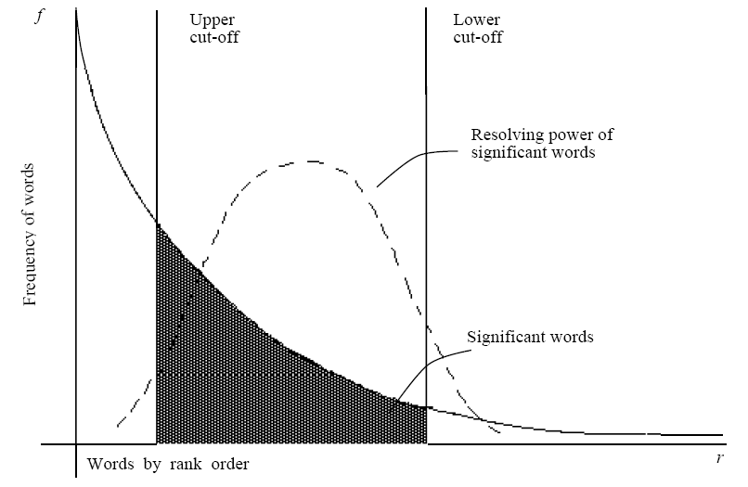
Luhn’s Ideas
Luhn (1958) suggested that both extremely common and extremely uncommon words were not very useful for document representation & indexing

Slide 37
Heaps’ Law
As the corpus grows, the number of new terms will increase dramatically at first, but then will increase at a slower rate
Nevertheless, as the corpus grows, new terms will always be found (even if the corpus becomes huge)
  there is no end to vocabulary growth
  invented words, proper nouns (people, products), misspellings, email addresses, etc.

Slide 38
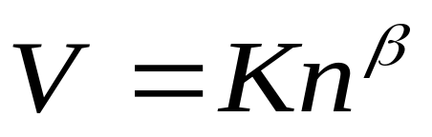
Vocabulary Growth: Heaps’ Law
How does the size of the overall vocabulary (number of unique words) grow with the size of the corpus?
  This determines how the size of the inverted index will scale with the size of the corpus.
Heap’s law: estimates the number of vocabularies in a given corpus
  The vocabulary size grows by O(n^{β}), where β is a constant between 0 – 1.
  If V is the size of the vocabulary and n is the length of the corpus in words, Heap’s provides the following equation:
Where constants:
  K ≈ 10−100
  β ≈ 0.4−0.6 (approx. square-root)

Slide 39
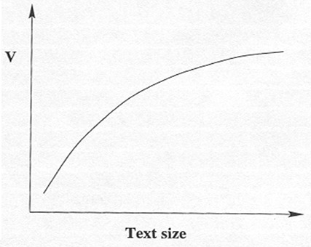
Heap’s distributions
Distribution of size of the vocabulary vs. total number of terms extracted from text corpus

