Slide 1
VSCode/UV install for Windows

Slide 2

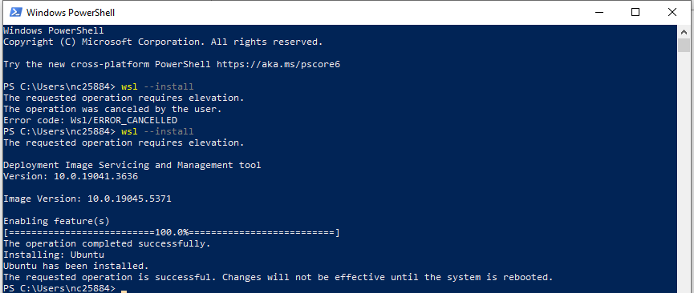
1. Install WSL and VSCode Install WSL and VSCode by following these instructions. https://code.visualstudio.com/docs/remote/wsl
Install the Windows Subsystem for Linux along with your preferred Linux distribution.
1.a Go to windows powershell and enter the wsl --install command.

Slide 3
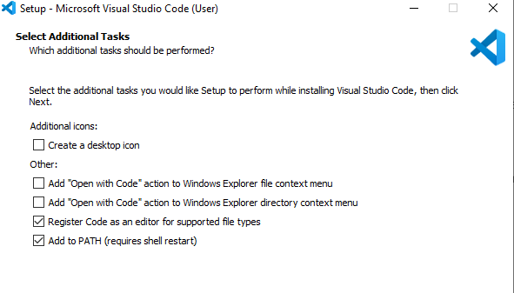

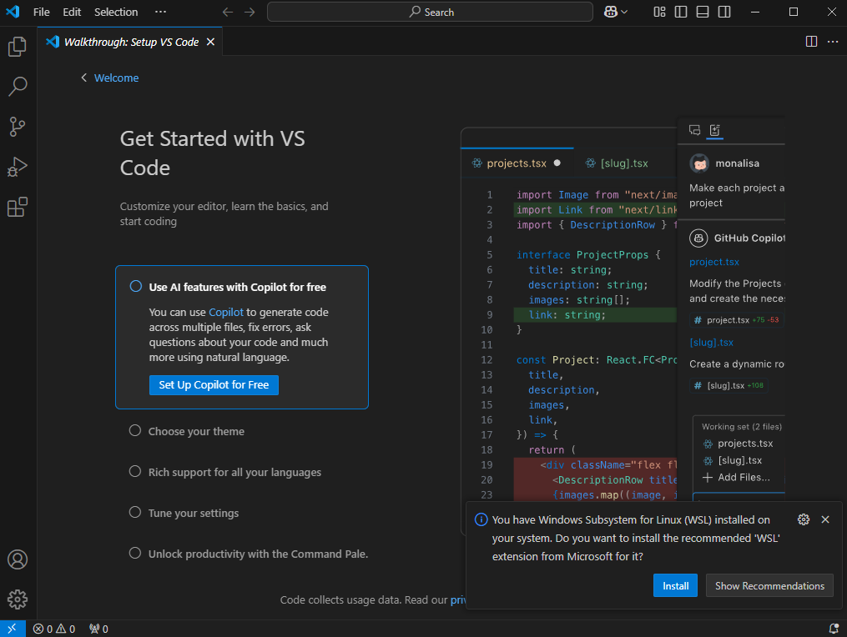
1. Install WSL and VSCode Install WSL and VSCode by following these instructions. https://code.visualstudio.com/docs/remote/wsl
Install the Windows Subsystem for Linux along with your preferred Linux distribution.
2. Install Visual Studio Code on the Windows side (not in WSL).
2
1
3
Note: When prompted to Select Additional Tasks during installation, be sure to check the Add to PATH option so you can easily open a folder in WSL using the code command

Slide 4
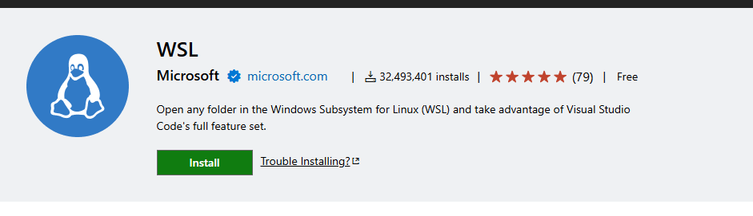
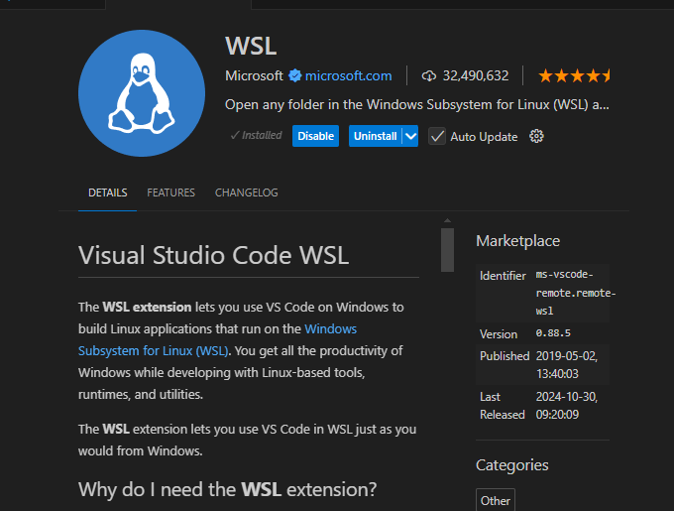
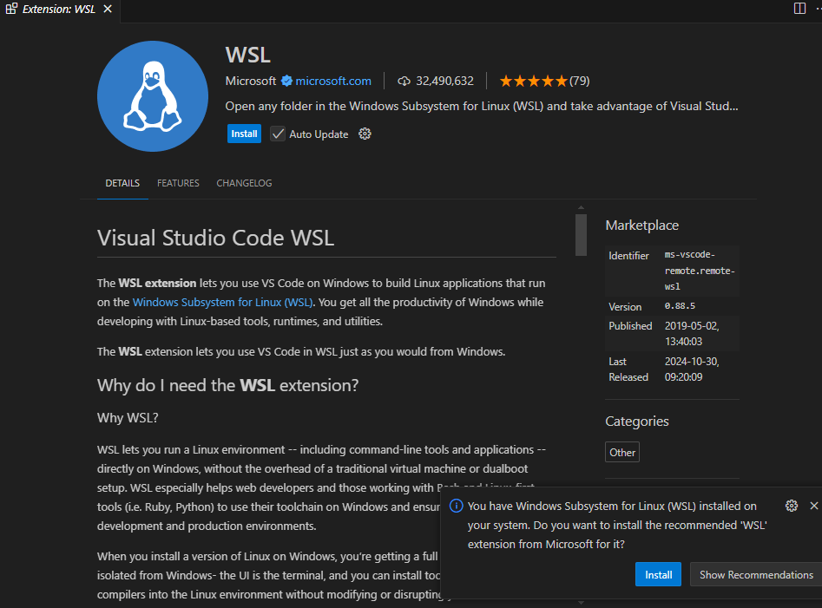
1. Install WSL and VSCode Install WSL and VSCode by following these instructions. https://code.visualstudio.com/docs/remote/wsl
Install the Windows Subsystem for Linux along with your preferred Linux distribution.
2. Install the WSL extension.
1
2

Slide 5
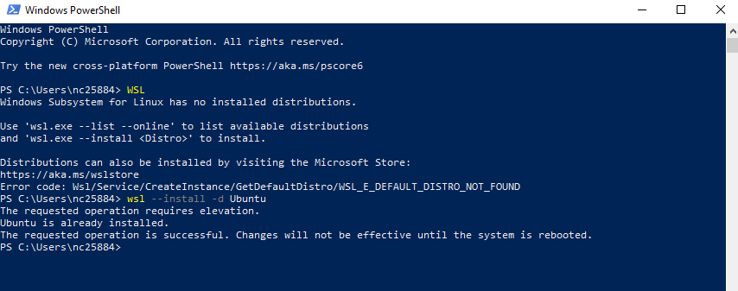
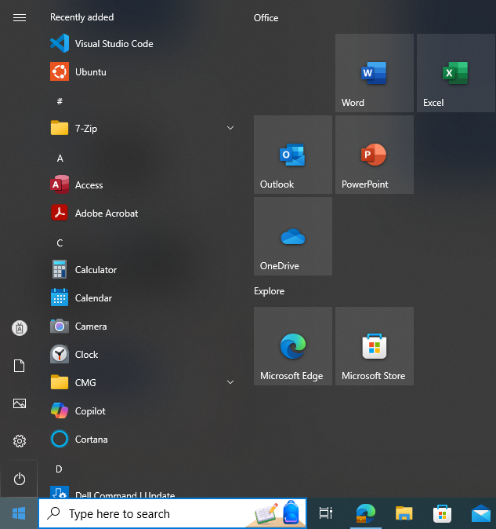
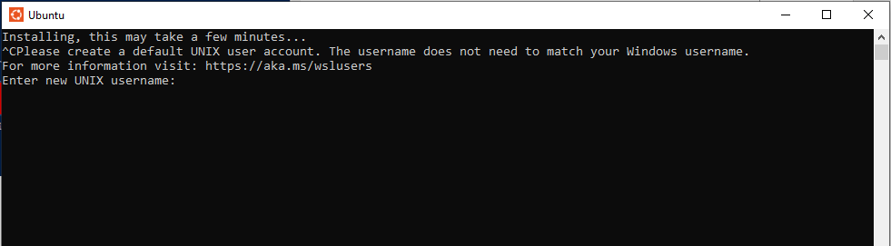
1. Install Ubuntu.
Go to windows powershell and enter the wsl --install –d Ubuntu
2. Restart computer
Open Ubuntu
If Ubuntu is not responding (showing message “this may take a few minutes”)
enter ctrl c
When it works it will show you: enter new Unix username

Slide 6
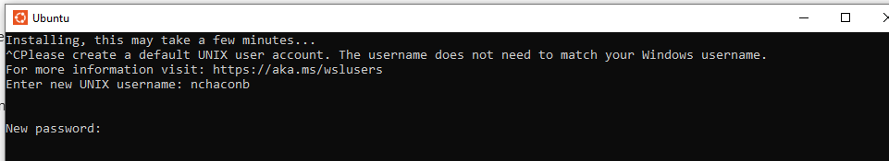
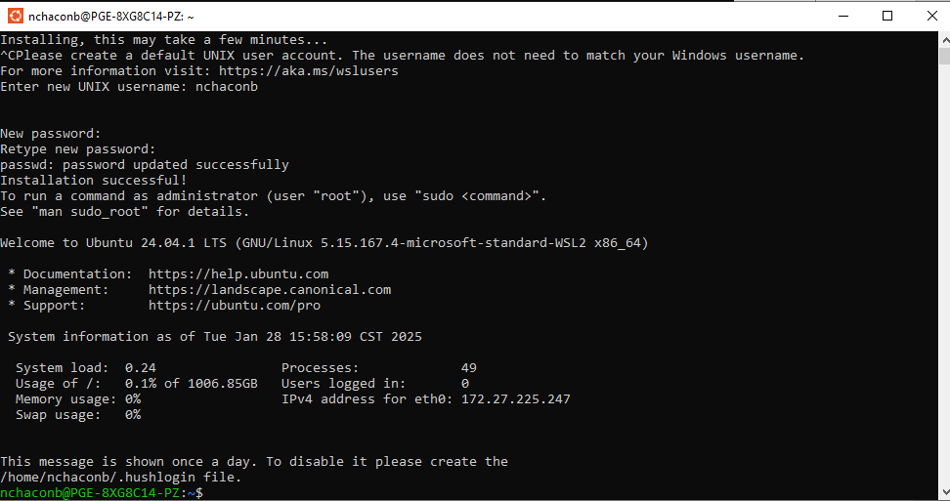
4. Enter UNIX username and password.
1
2

Slide 7
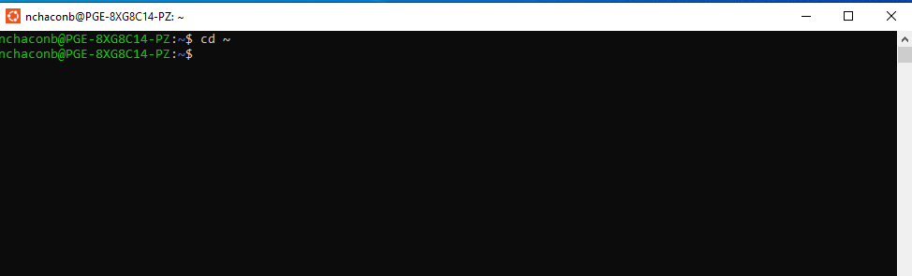
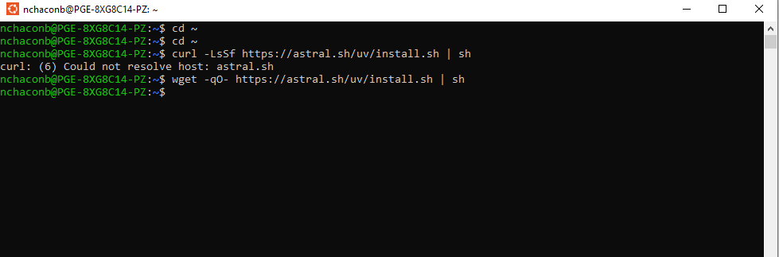
5. Go to HOME directory. This is done entering the cd~ command in the Ubuntu terminal.
6. Install UV using the following command:
If it doesn’t work use:
wget -qO- https://astral.sh/uv/install.sh | sh
cd ~
curl -LsSf https://astral.sh/uv/install.sh | sh

Slide 8
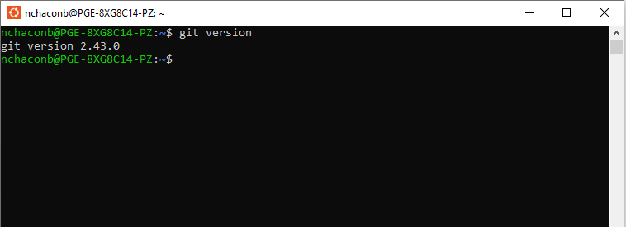
Git Version
5. In the Ubuntu terminal check Git Version
git --version

