Slide 1


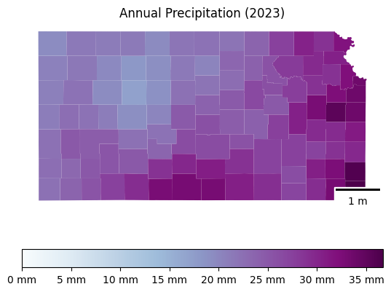
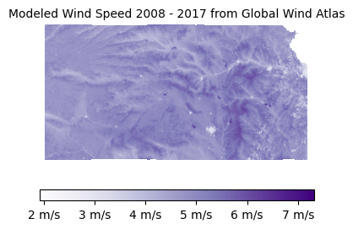
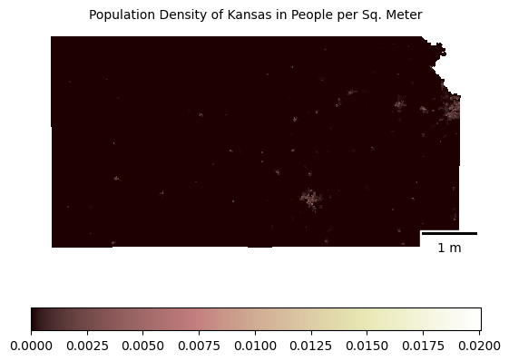
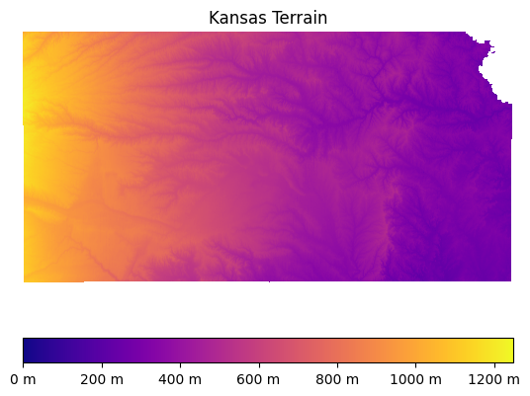
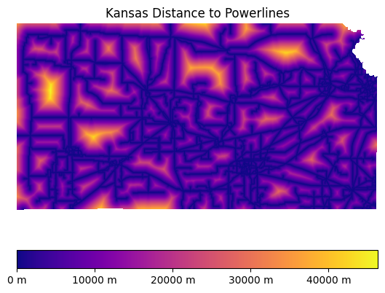
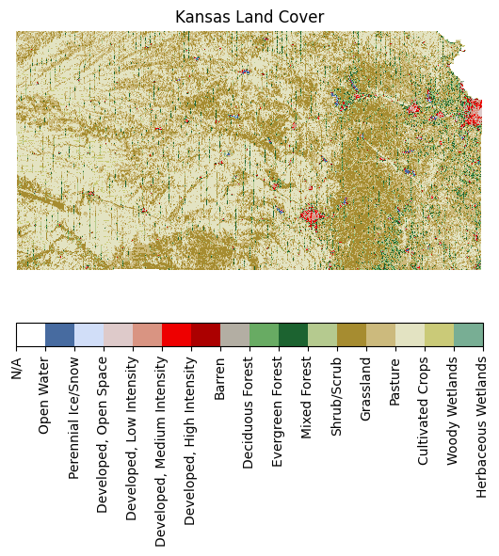
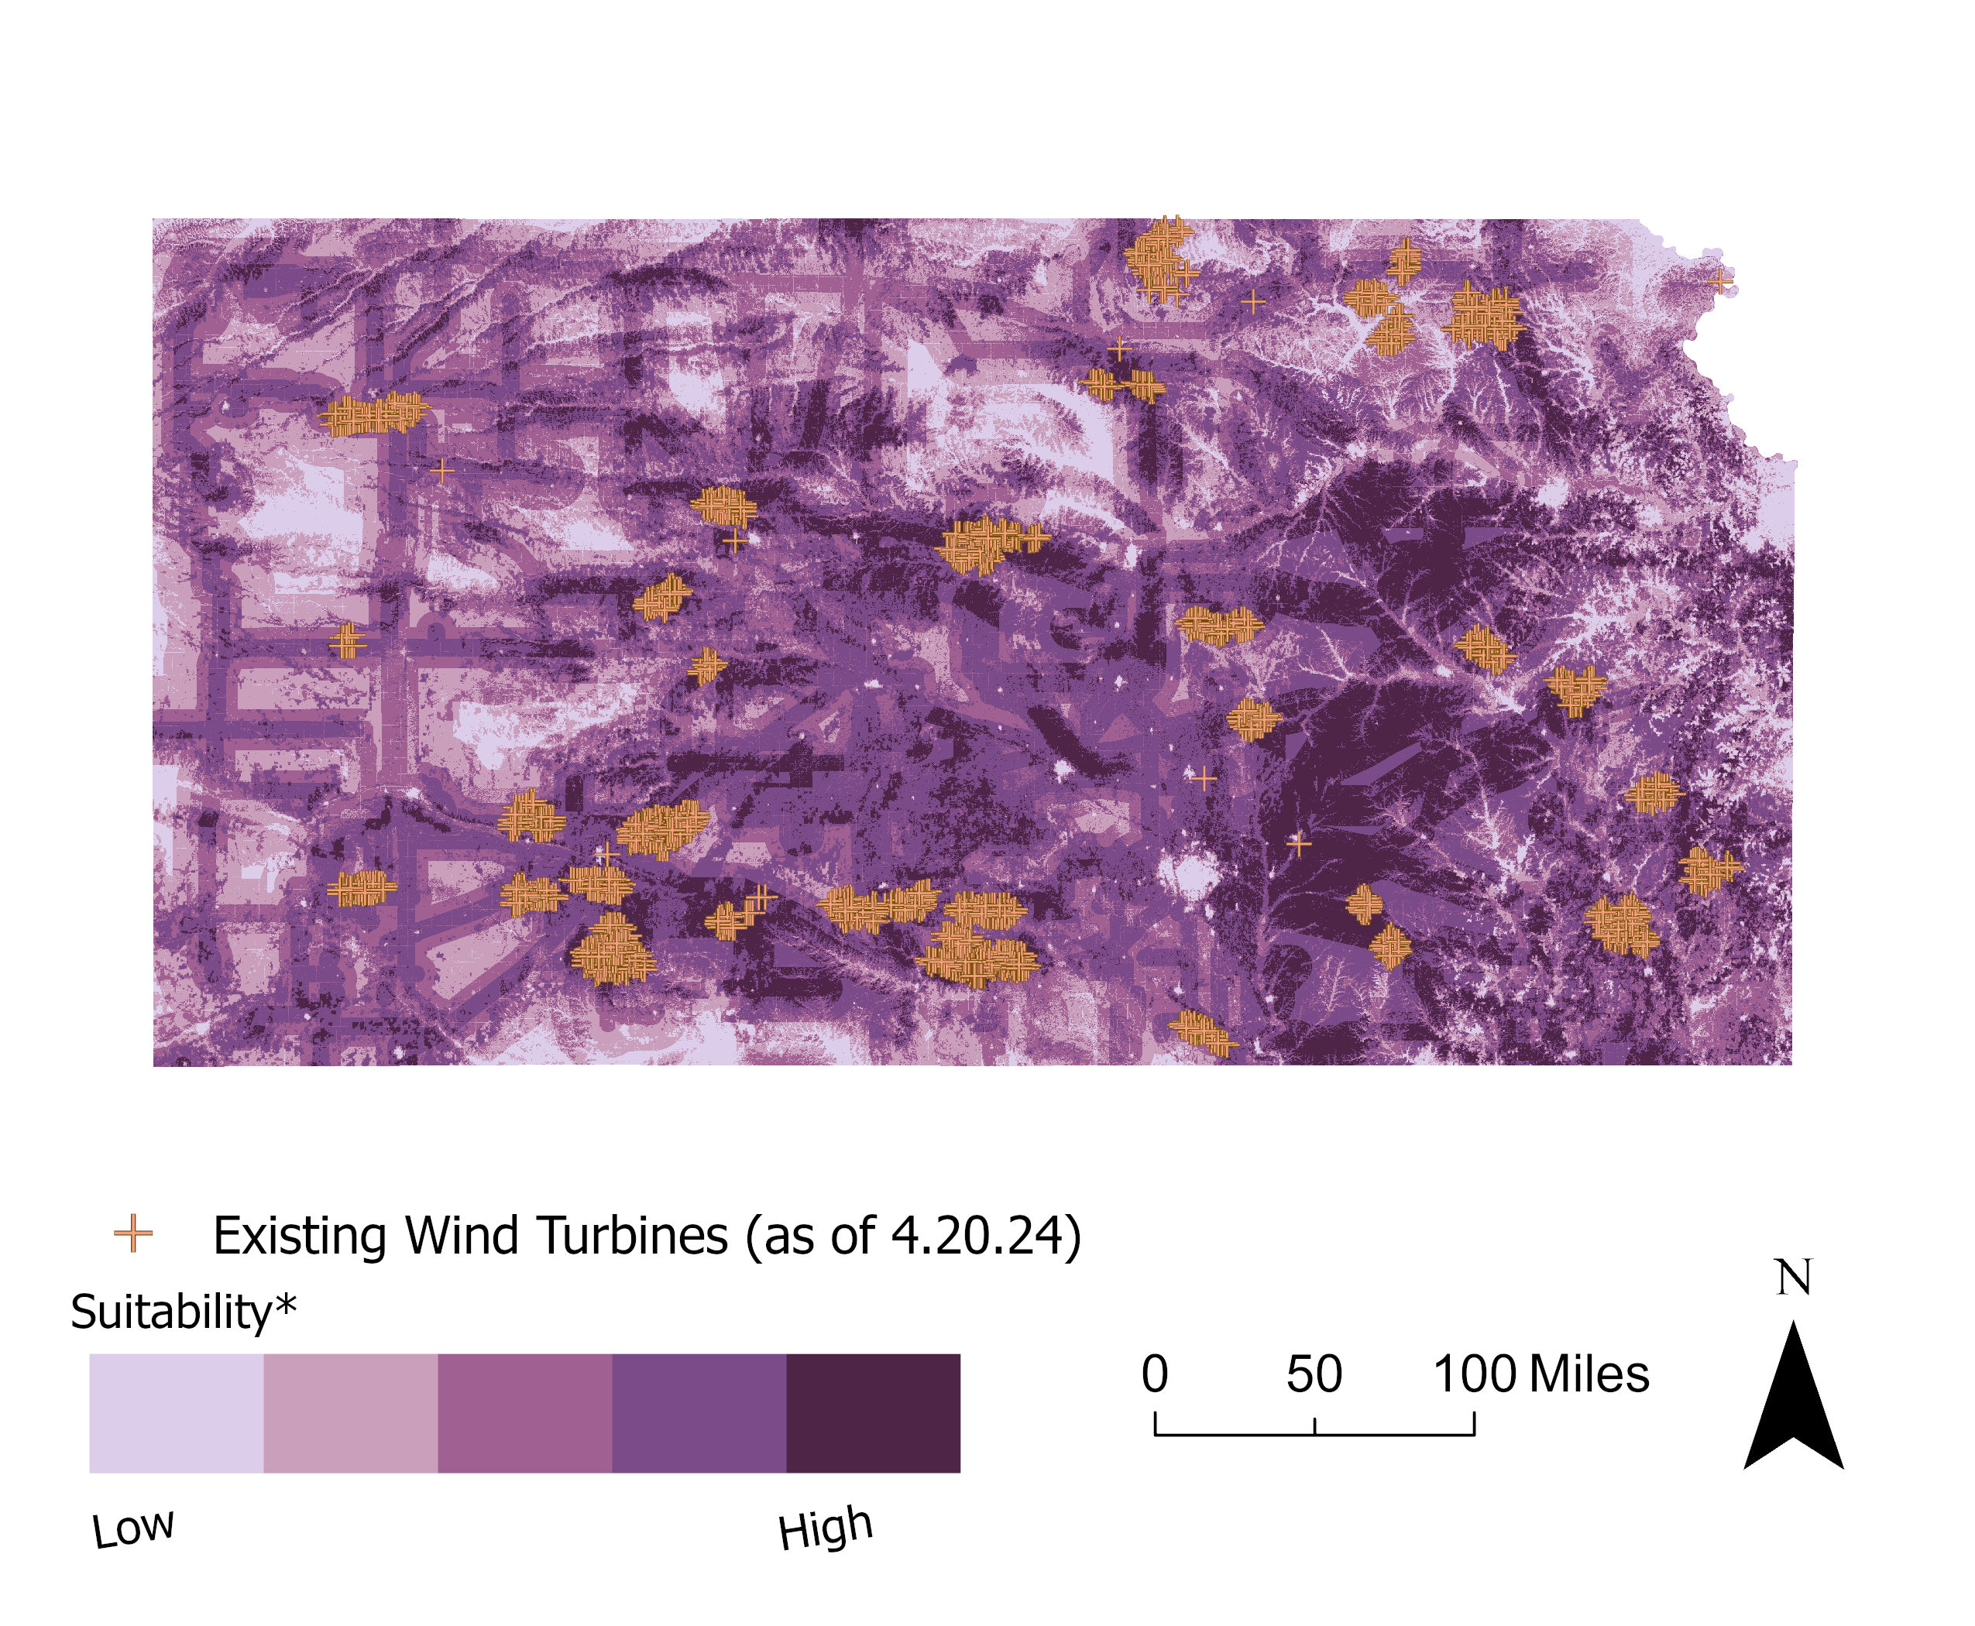
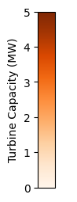
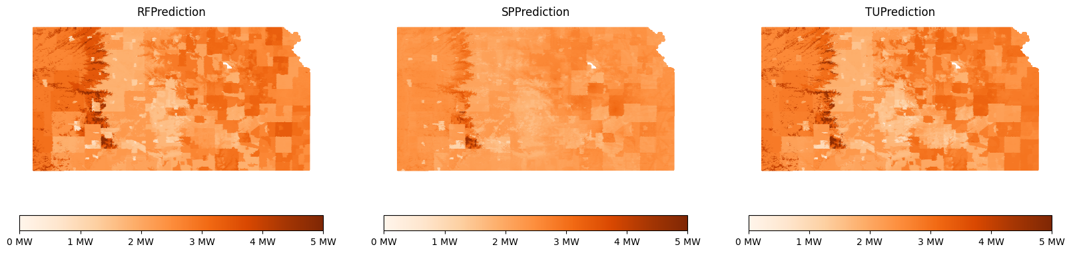
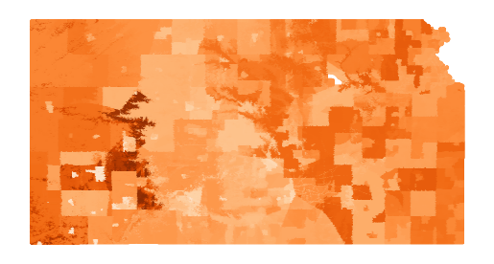
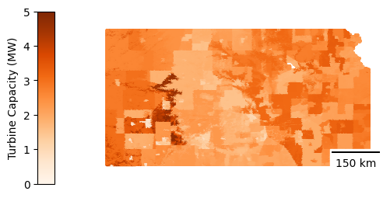
Comparing Classic Suitability Analysis and Machine Learning Techniques for Predicting Wind Turbine Output in Kansas
Introduction
Factors Considered
Classic Suitability Analysis
Factor | Weight
Wind Speed | 40%
Distance to Power Lines | 30%
Land Cover | 10%
Population | 10%
Rainfall | 5%
Elevation | 5%
Random Forest Regressors
Basic RF
Spatial RF
Geographic RF
Conclusions
Chad Fisher | EM 212: Applied Data Science | 5.8.24

