Slide 1
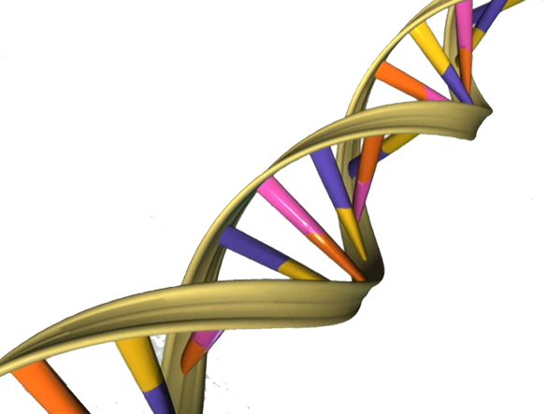
CS6800 Advanced Theory of Computation
Hybrid Genetic Algorithm in Solving TSP
By Ting-Yu Mu

Slide 2
Outline
Introduction of pure Genetic Algorithm
Introduction of Traveling Salesman Problem
Example of pure GA solving TSP
The Hybrid Genetic Algorithm
The design and the implementation of the Hybrid GA
Conclusion

Slide 3

The Pure Genetic Algorithm
A search heuristic that mimics the process of natural evolution
Utilized for generating useful solutions to optimization/search problems
Techniques inspired by natural evolution:
Inheritance
Mutation
Selection
Crossover

Slide 4
The Methodology of GA
A typical GA needs:
A genetic representation of the solution domain
A fitness function to evaluate the domain
Initialization
Many individual solutions are randomly generated to form an initial population (chromosomes)
The population size depends on the problem
Selection
A proportional of the existing population is selected to breed a new generation through a fitness-based process (fitness function)

Slide 5
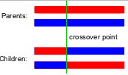
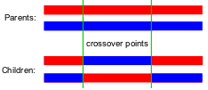
The Methodology of GA
Genetic Operations
A pair of parent solutions is selected for breeding the child using:
Crossover (recombination): Varies chromosomes
One-point crossover
Two-point crossover
Mutation:
Used to maintain genetic diversity from parent and child
1010010 → 1010110

Slide 6
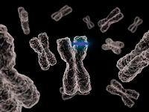
The Methodology of GA
Termination:
The process is repeated until a termination condition has been satisfied, the conditions include:
A solution is found that satisfies the need
Fixed number of generations reached
Computation time reached
The best solution’s fitness value is reached
Combinations of all above

Slide 7
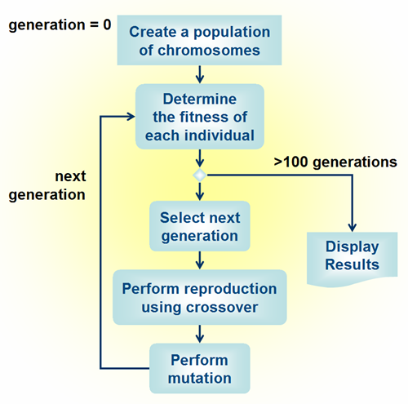
The Methodology of GA

Slide 8
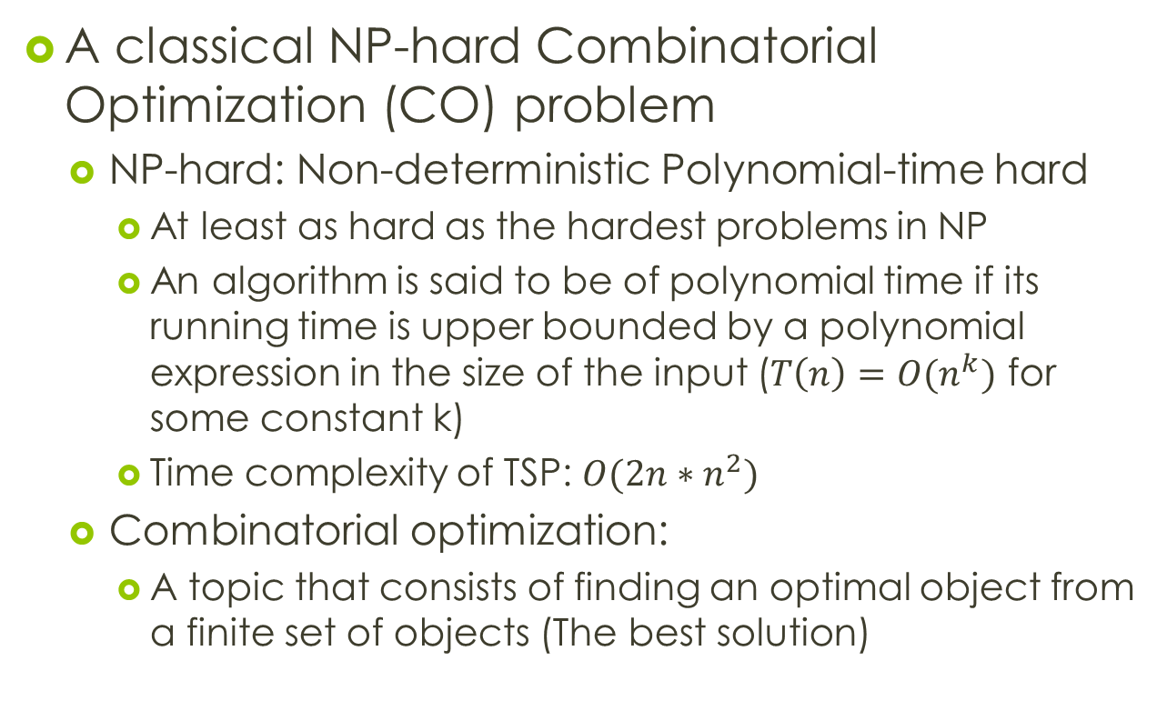
Traveling Salesman Problem
A classical NP-hard Combinatorial Optimization (CO) problem
NP-hard: Non-deterministic Polynomial-time hard
At least as hard as the hardest problems in NP
An algorithm is said to be of polynomial time if its running time is upper bounded by a polynomial expression in the size of the input ($T\left(n\right)=O(n^{k})$ for some constant k)
Time complexity of TSP: $O({2n∗n}^{2})$
Combinatorial optimization:
A topic that consists of finding an optimal object from a finite set of objects (The best solution)

Slide 9
Traveling Salesman Problem
Given n number of cities and the distances between each of the cities:
Objective: Find the cheapest round-trip route that a salesman has to take by visiting all the cities exactly once and returning to the starting city
Possible solutions:
Complete algorithm
Bad idea due to computational complexity
Approximate algorithm (better):
Nearest Neighbor (NN) algorithm
Genetic Algorithm

Slide 10
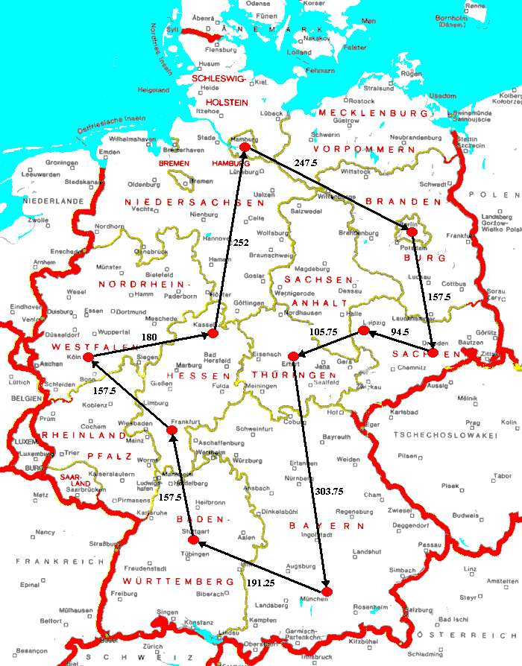
Pure GA for Solving TSP
Involves various stages for solving TSP:
Encoding
Evaluation
Crossover
Mutation
Elitism
Decoding

Slide 11
Pure GA for Solving TSP
Encoding of TSP:
Decides the format of the chromosome
Decimal chromosome is used instead of binary due to the complexity of the problem
All the genetic operations are done by manipulating genes (integers), and each gene corresponds to a city
Each chromosome corresponds to a route
Two conditions need to be met:
The length of the chromosome should be exactly = n
No integer in the range {1, 2, …, n} should occur more than once

Slide 12
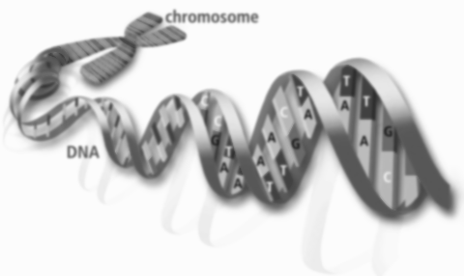
Pure GA for Solving TSP
Evaluation of Chromosomes:
The main goal of TSP is to minimize the tour distance: same for the evaluation criterion
The lesser the distance traveled, the better the route is
The termination criterion is the number of generation evolved
GA stops after certain number of iterations
The solution:
The best chromosome in the last generation

Slide 13
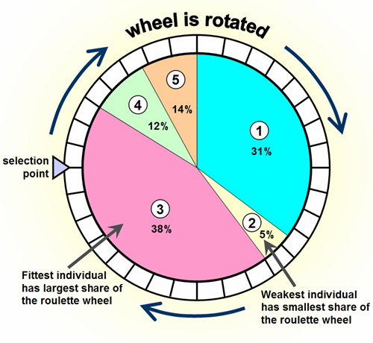
Pure GA for Solving TSP
Crossover Operation:
Two chromosomes are randomly selected using roulette wheel selection
The chromosomes with higher fitness stand a better chance for getting selected
The operation continues until
the specified crossover rate
is met
Higher fitness chromosomes
will produce a better next
generation with higher fitness
values

Slide 14
Pure GA for Solving TSP
Crossover Operation:
Example: Crossover operation for TSP of 8 cities
The parents selected are P1 and P2
P1: 4 6 1 8 5 3 2 7, P2: 3 2 8 6 4 7 1 5
Two indices are chosen at random (Ex. 2 and 5), creating a window of cities in each chromosome
tmp1: 6 1 8 5, tmp2: 2 8 6 4
Exchanges these two windows from each other
The initial child IC1 and IC2 are generated by scanning P1 and P2 gene by gene, left to right, until all the genes are scanned:
IC1: 1 2 8 6 4 5 3 7, IC2: 3 6 1 8 5 2 4 7

Slide 15
Pure GA for Solving TSP
Mutation Operation:
Works on a single chromosome at a time and alters the genes randomly
Reversing the order of genes between the randomly chosen indices
The chosen chromosome C1 = 3 6 1 8 5 2 4 7
Choose two random indices: 3 and 7
Creates a window: 1 8 5 2 4
Reverse the window: 4 2 5 8 1
New chromosome: 3 6 4 2 5 8 1 7
Critical step due to the optimization of sub-route
Changing the starting and ending points

Slide 16
Pure GA for Solving TSP
Elitism:
Helps to keep the better solutions intact and pass over into the next generation without alteration
The elitism rate directly depends on the size of the population
The rate should be decreased when the population size is increased
For example:
The TSP with population of 100 cities, the elitism rate is set to 50%
Due to the mutation will also randomly worsens the best solutions found so far

Slide 17
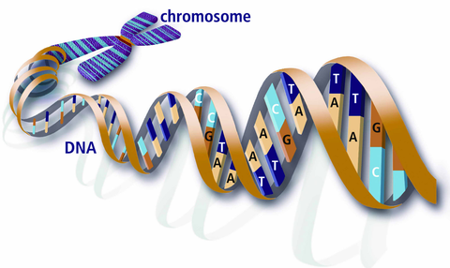
Pure GA for Solving TSP
Decoding of Chromosomes:
It decodes the best chromosome in the final generation
After the max number of generations are reached, the GA will terminate, the best chromosome so far found is chosen as the solution
The route that the salesman has to travel in order

Slide 18
Hybrid GA for Solving TSP
Hybrid genetic algorithms are used to improve the convergence rate and find more optimal solution over the pure GA
The Hybrid GA uses the Nearest Neighbor (NN) TSP heuristics for initialization of population
Nearest Neighbor is chosen to hybrid with GA to see the performance enhancement in solving TSP

Slide 19
Hybrid GA for Solving TSP
Nearest Neighbor Algorithm:
The algorithm generates the NN routes for each city considering them as the starting city for that particular route
The algorithm:
Step1: Move all the cities to a list
Step2: Select the starting city as present city and remove it from the list
Step3: Find the nearest city to the present city in the list and make it present city and remove it from the list
Step4: Repeat step3 until the list is empty
Step5: Return to the starting city and show NN route

Slide 20

Hybrid GA for Solving TSP
Nearest Neighbor Hybrid of GA
All the NN routes are found for each city as starting city
The NN routes are stored and analyzed for their fitness values
The better routes from this NN algorithm are considered along with the solutions generated by the genetic algorithms

Slide 21
The Comparison
The performance comparison between pure GA and Hybrid GA in convergence rate:
The Hybrid GA is way better than pure GA though it involves an extra complexity in getting NN route
NN depends on starting city, Hybrid GA does not

Slide 22

Conclusion
Importing of solutions from NN algorithm into the initial population of the pure GA gives better convergence
The hybrid approach also consumes lesser memory and lesser computational time
To achieve better performance of GA:
Parallel programming
Genetic operations refinement
Crossover refinement
Mutation refinement

Slide 23
References
[1] Performance Enhancement in solving TSP using Hybrid Genetic Algorithm.
http://ieeexplore.ieee.org
[2] Genetic Algorithm. http://en.wikipedia.org/wiki/Genetic_algorithm
[3] NP-hard. http://en.wikipedia.org/wiki/NP-hard
[4] Combinatorial Optimization. http://en.wikipedia.org/wiki/Combinatorial_optimization

