Slide 1


Joy
Practicing Joy
Chad Fowler

Slide 2
Joy
Practicing Joy
Chad Fowler

Slide 3
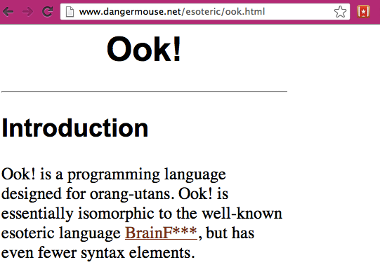

Slide 4
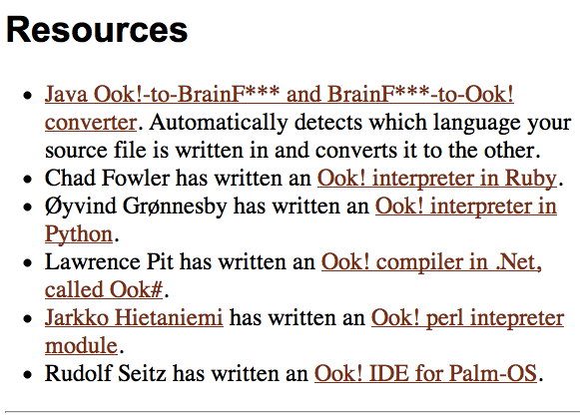

Slide 5


Slide 6
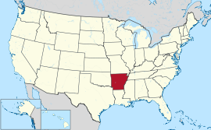

Slide 7
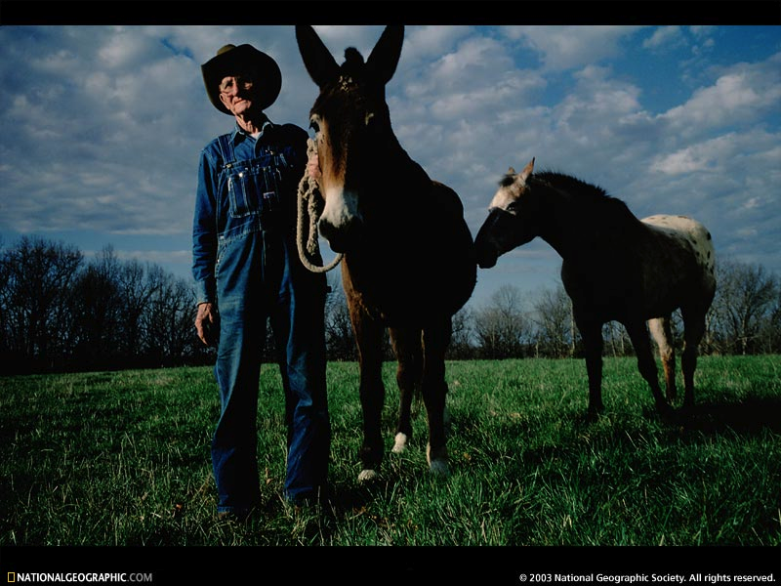

Slide 8
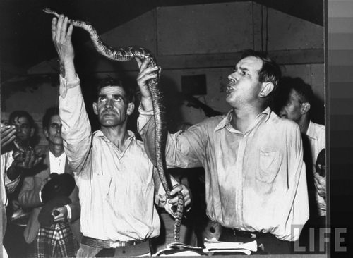

Slide 9
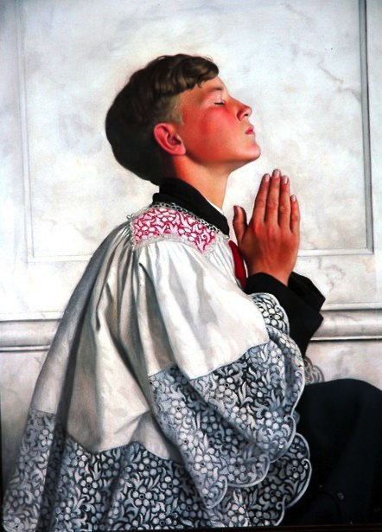

Slide 11


Slide 12
guilt

Slide 13
Reclusive nerd

Slide 14
“Special”

Slide 15


Slide 16


Slide 17
misanthrope

Slide 18
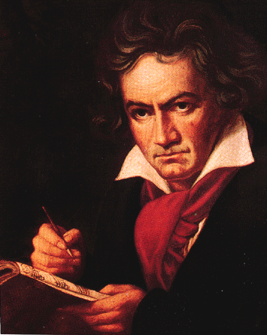
genius

Slide 19


Slide 20
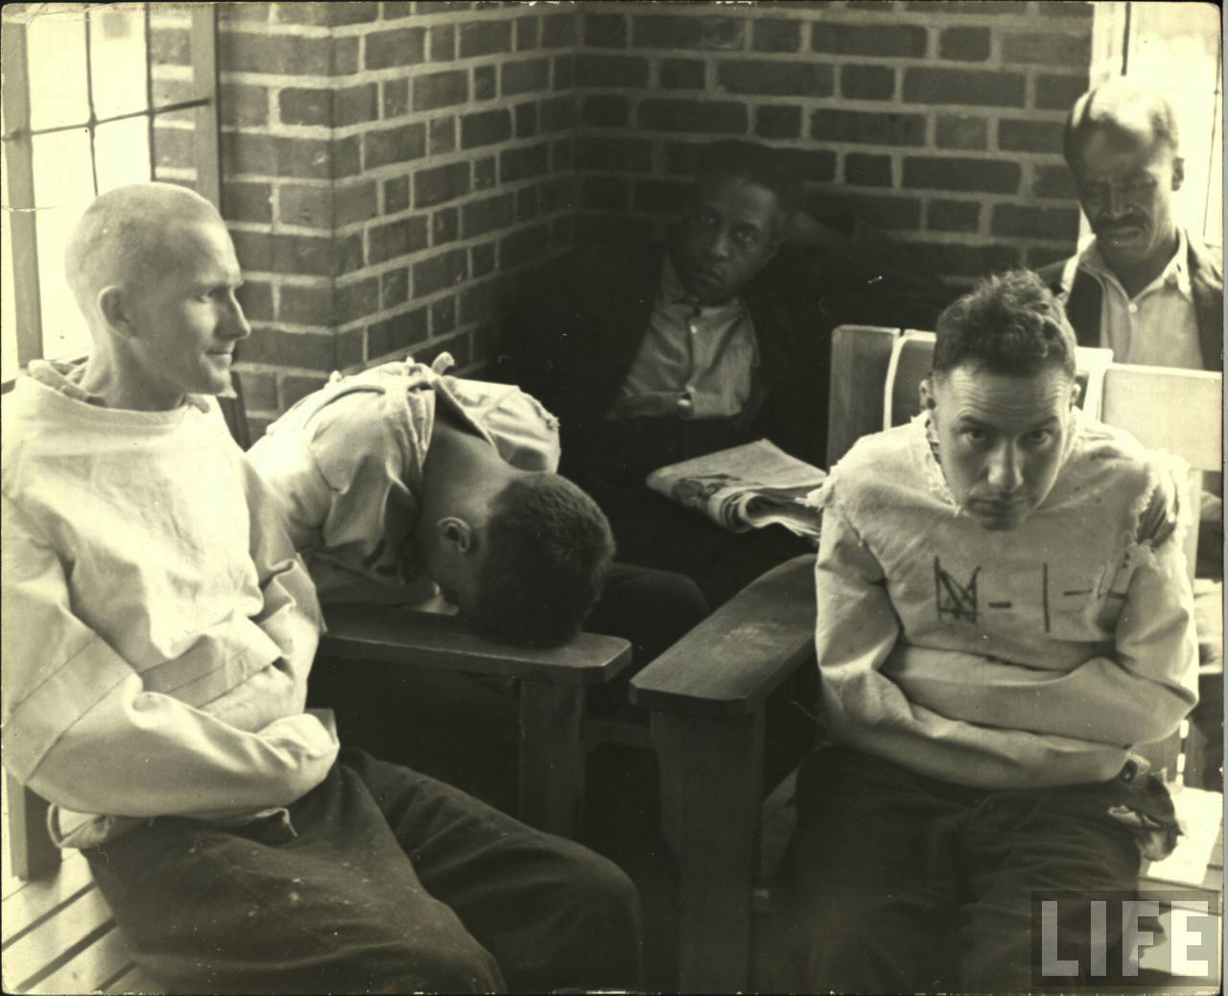

Slide 21


Slide 22


Slide 23

Bi-polar “mixed”

Slide 24

Medical rollercoaster

Slide 25
lost memory

Slide 26
lost car

Slide 27
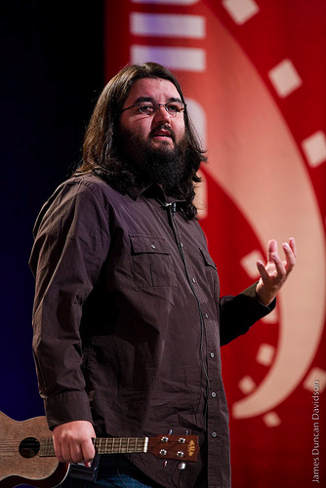
gained weight

Slide 28
Lost friends

Slide 29

“Happiness”?

Slide 30
“Joy”?

Slide 31
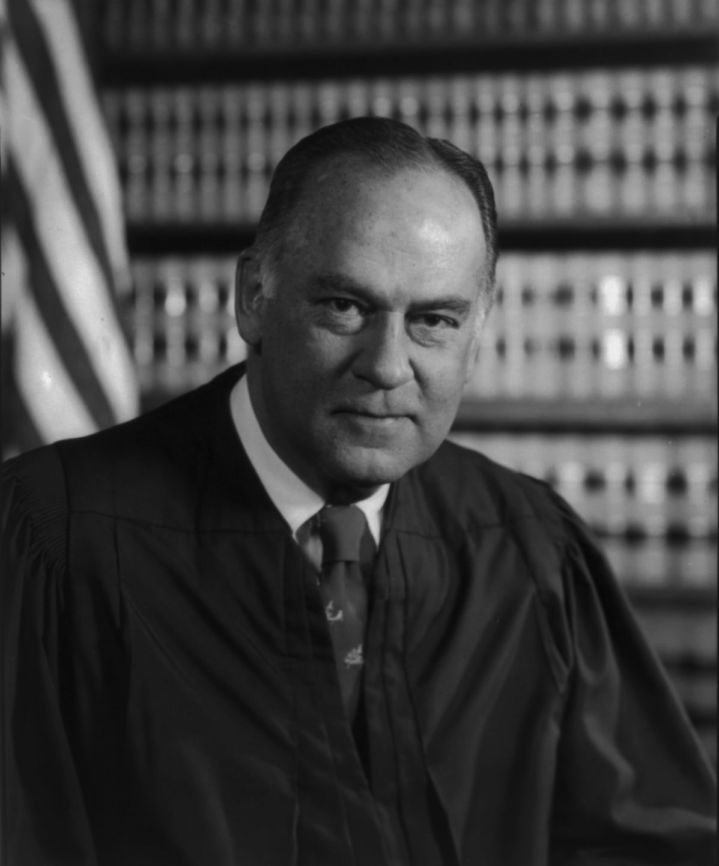

Slide 32
Joy is The Goal

Slide 33
selfish?

Slide 34
What we think it is
Stuff
Recognition
Acceptance
Physical attraction

Slide 35
Detractors
Boredom
Mean people
Failure at work
Lack of money

Slide 36
All of that stuff is extrinsic

Slide 37
“Our life is the creation of our mind”

Slide 38
“Our life is the creation of our mind”

Slide 39

“Happy”

Slide 40

“Joy of Coding!”

Slide 41

Joy?

Slide 42

Happiness...developers generally aren't good at it

Slide 43
But we're disciplined, analytical, and we care....

Slide 44
...but maybe not about the right stuff.

Slide 45
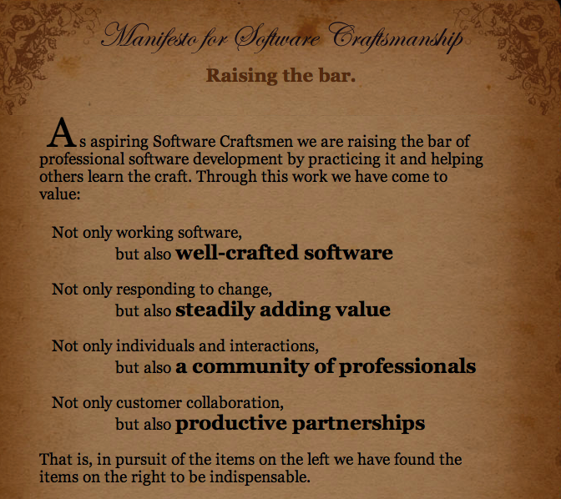

Slide 46
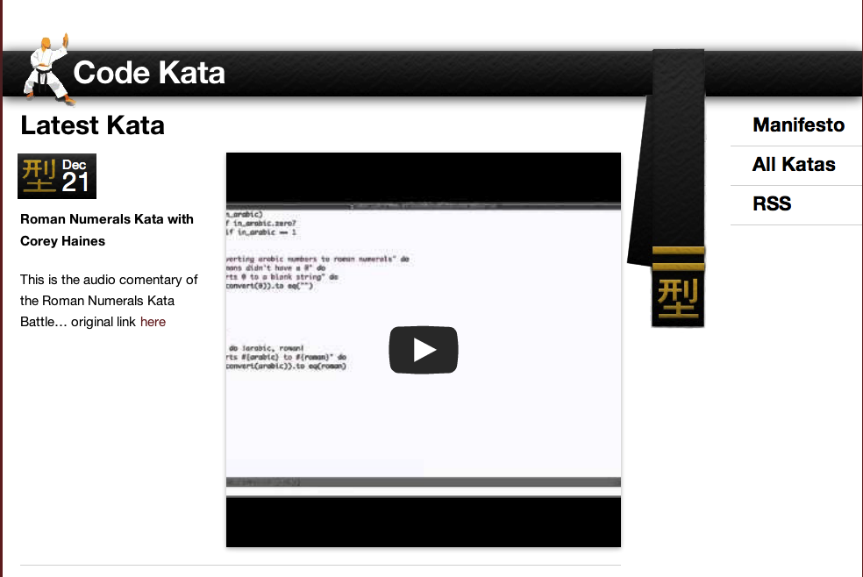

Slide 47
TDD/BDD

Slide 48
SOLID, SRP, LSV, IoC, etc. etc.

Slide 49

Patterns

Slide 50
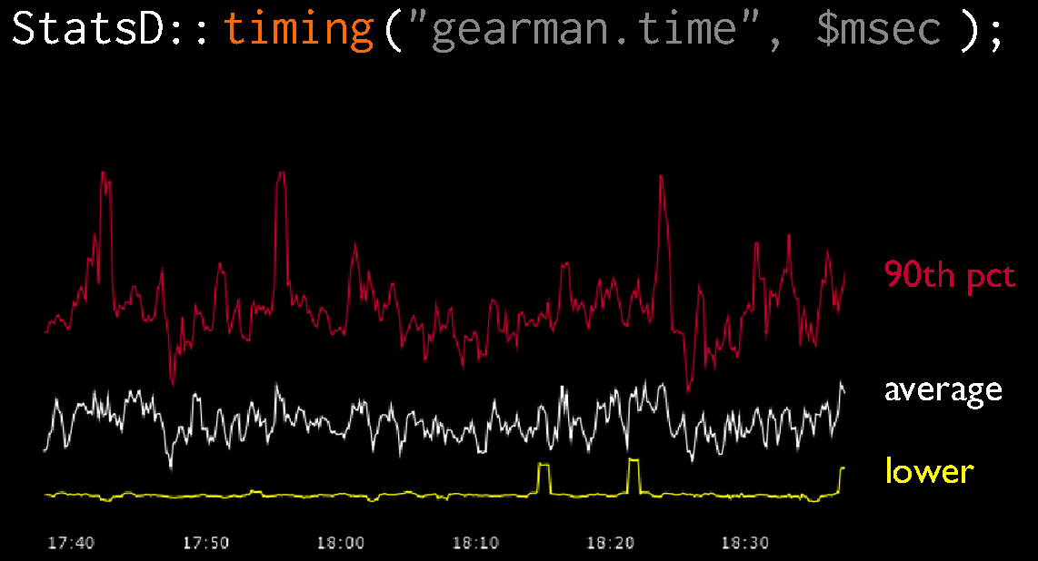
Measurement

Slide 51
Minutiae

Slide 52


Slide 53
Joy?

Slide 54


Slide 55


Slide 56
Can't we solve this problem?

Slide 57
Chad's Rules for SURVIVAL Happiness

Slide 58
Rule #1: Bad things are going to happen

Slide 59
MTBF vs MTTR

Slide 60
Rule #2: You get to decide how you feel

Slide 61
“Our life is the creation of our mind”

Slide 62


Slide 63
Rule #3: It's possible to choose to be happy

Slide 64
Rule #4: Important things require training and thought

Slide 65
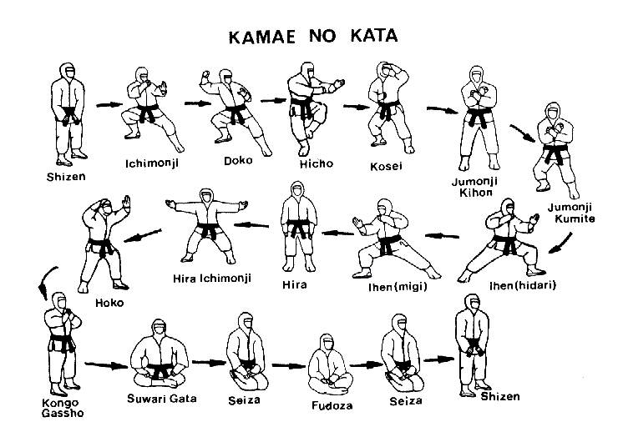
Training

Slide 66

Legacy system/tech debt

Slide 67
View

Slide 68
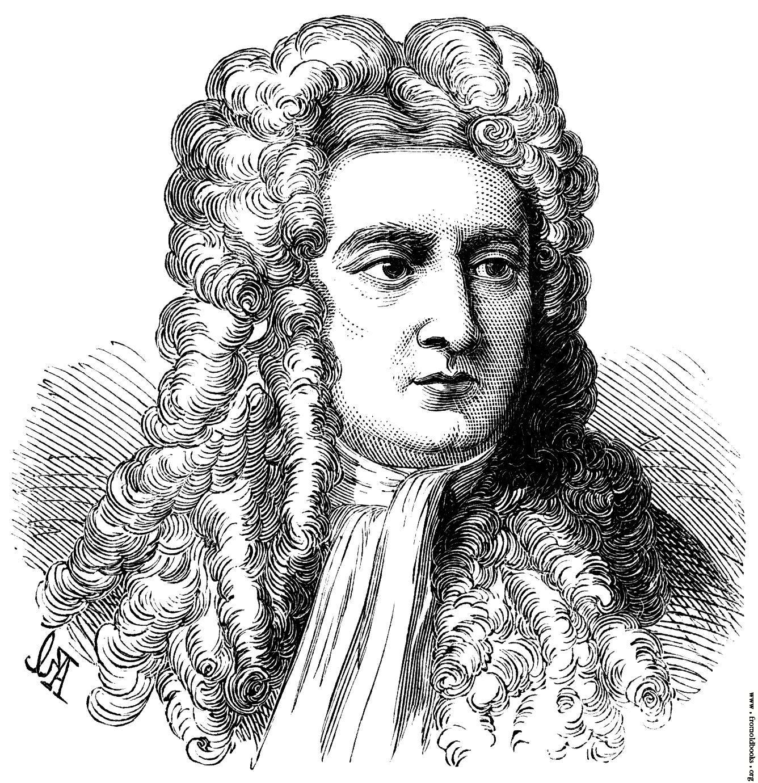
Actions have an effect

Slide 69

Impermanence

Slide 70
Intention

Slide 71

Intention

Slide 72

Intention

Slide 73
Speech

Slide 74
Complaining is lazy

Slide 75
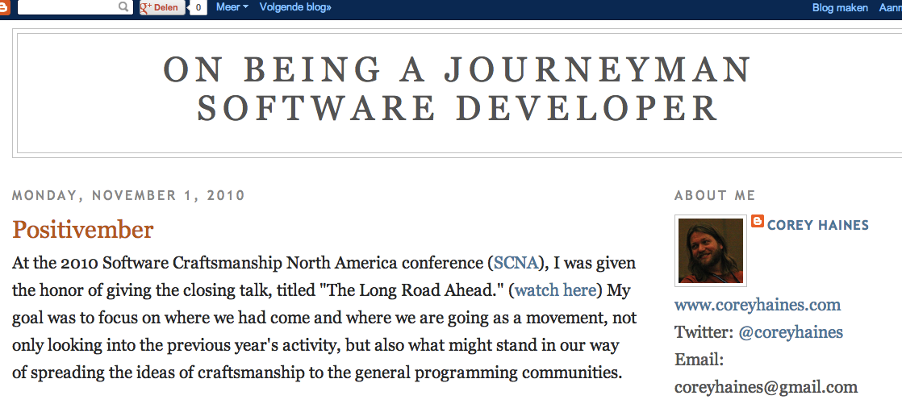
Complaining is lazy

Slide 76

Complaining is lazy

Slide 77
Actions (stealing, hurting yourself and others, etc.)
Duh

Slide 78
Work
(ethical, professional, etc.)

Slide 79


Slide 80
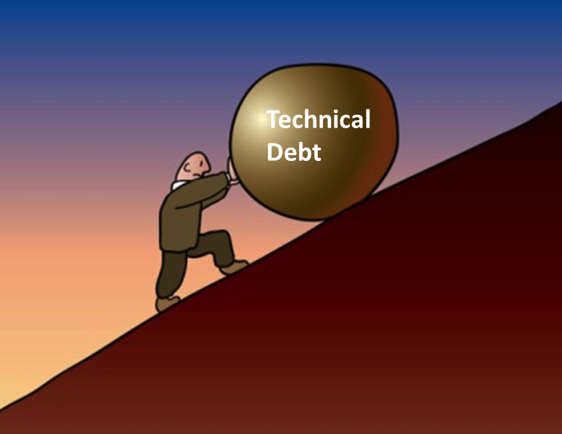

Slide 81
Mindfulness

Slide 83
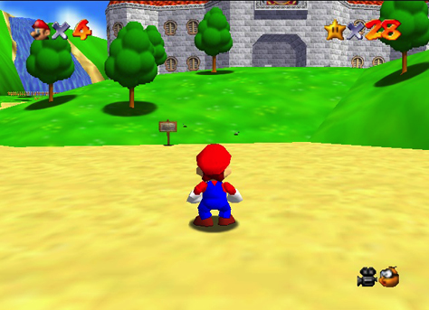

Slide 84
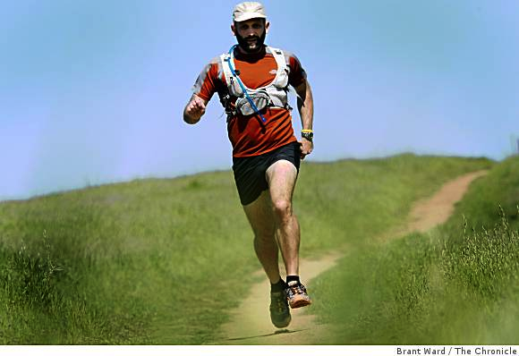

Slide 85
practice empathy

Slide 86
Concentration

Slide 87


Slide 88


Slide 89


Slide 90


Slide 91
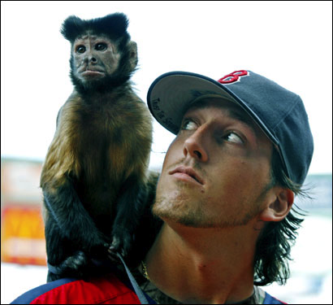

Slide 92


Slide 93


Slide 94
Wrapping up....

Slide 95
Joy is intrinsic

Slide 96

Thanks!

Slide 97
Happiness is a discipline

Slide 98

Happiness is a discipline

