Slide 1
Project One: FinTech Financial Programming and Quantitative Analysis
Starbucks Coffee Shop
Team:
Chad Burford
Erik McFarlane
Diego Torres

Slide 2
Project One: Starbucks Locations Analysis
Project Goals:
Find US data for all Starbucks locations
Find US census information (total population, population density, income) by city
Find Min/Max/Avg/StD. for Starbucks locations versus census information
Based on #3 determine top underserved and overserved locations on a per capita/income basis
Questions for Analysis:
Is there a correlation between the total number of stores within a city and the city's annual average income?
Is there a correlation between the total number of stores within a city and the city's population?
Are there underserved or overserved cities based on standard deviation from a mean?

Slide 3
Code Approach: Import Libraries and Datasets
Starbucks dataset ('Data_Files/starbucks_locations.csv.txt’)
Convert dataset into a Dataframe
Sanitize dataset (drop unnecessary columns)
Filter unnecessary values
Make relevant groupings in order to: get number of stores for each city and get the cities' Latitude/Longitude
Merge grouby results into Dataframe that will be merged with other datasets
U.S. income information by city ('Data_Files/kaggle_income.csv’)
Convert dataset into a Dataframe
Sanitize dataset (drop unnecessary columns)
Filter unnecessary values
Homogenize column names to merge with Starbucks dataframeMerge with Starbucks dataframe
U.S. income population by city ('Data_Files/us population with cordinates.csv.txt’)
Convert dataset into a Dataframe
Sanitize dataset (drop unnecessary columns)
Filter unnecessary values
Homogenize column names to merge with combined Income/Starbucks dataframe
Merge grouby results into final combined Dataframe

Slide 4
Code Approach: Analysis
Analysis:
Create scatter plots
Create map "heat" plots
Create standard deviation plot
Combine plots into an interactive dashboard
Number of Starbucks per city per population
Avg income per starbucks per city
U.S. income information by city
Chart/Scatter plot of locations vs. #3 (will determine which cities have too many or too few Starbucks

Slide 5
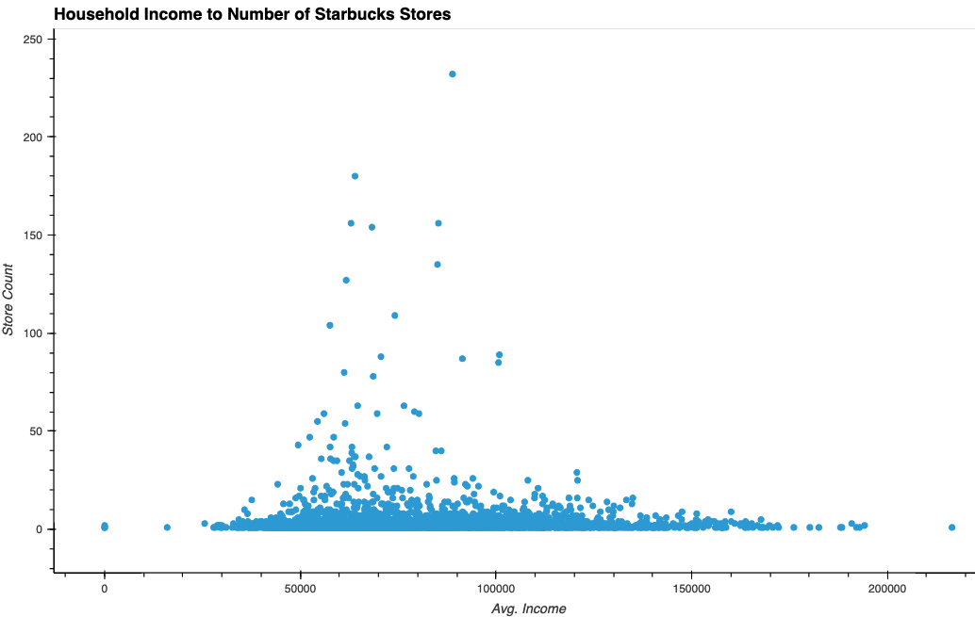
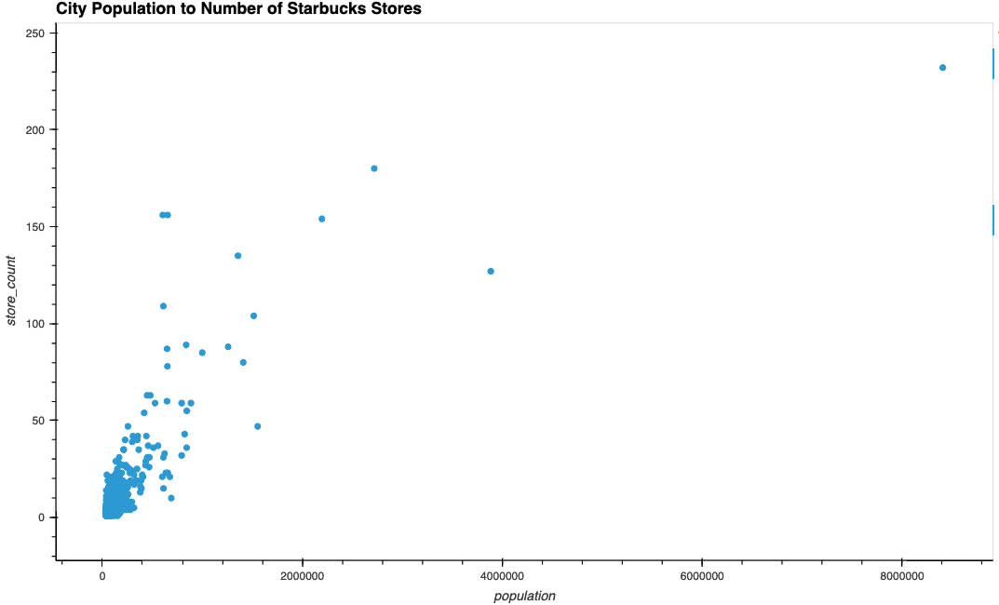
Correlation between Population / Average Income and Store Counts

Slide 6
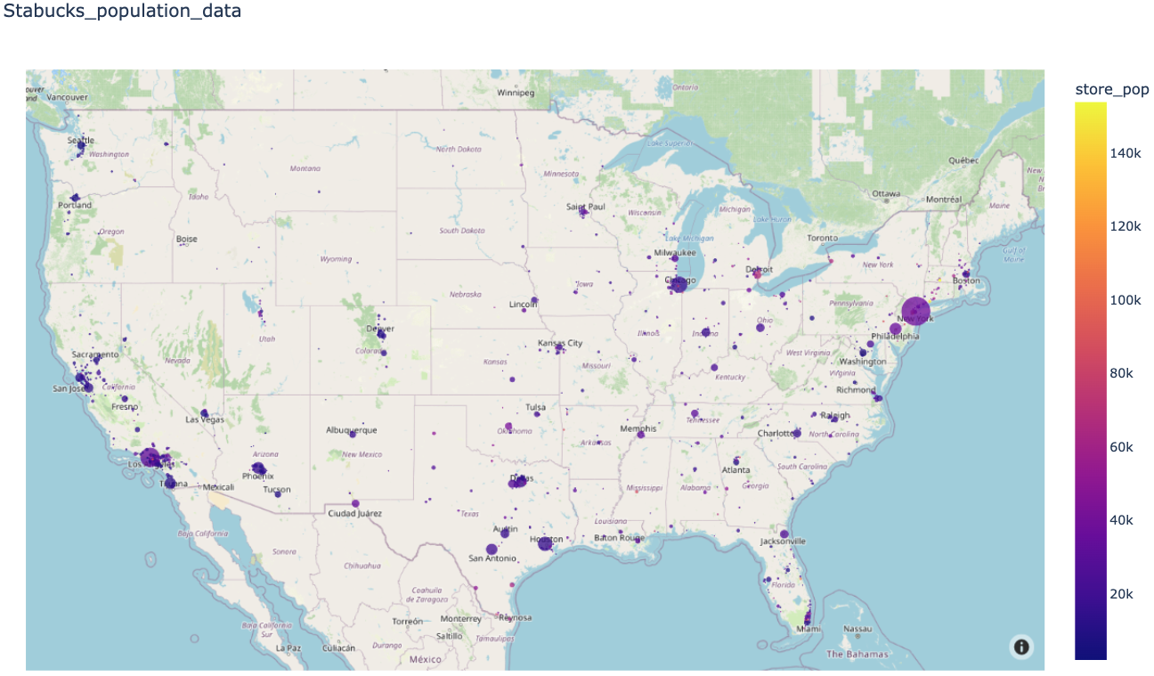
Map of City Population and Store Counts

Slide 7
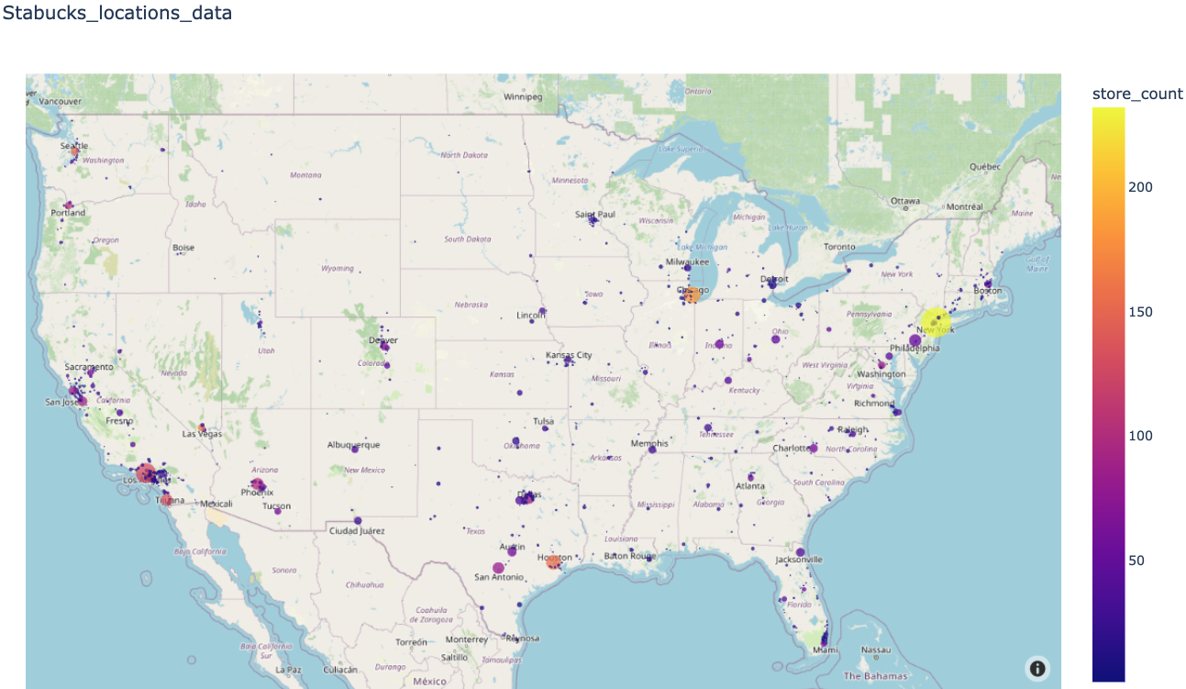
Map of City with Store Counts

Slide 8
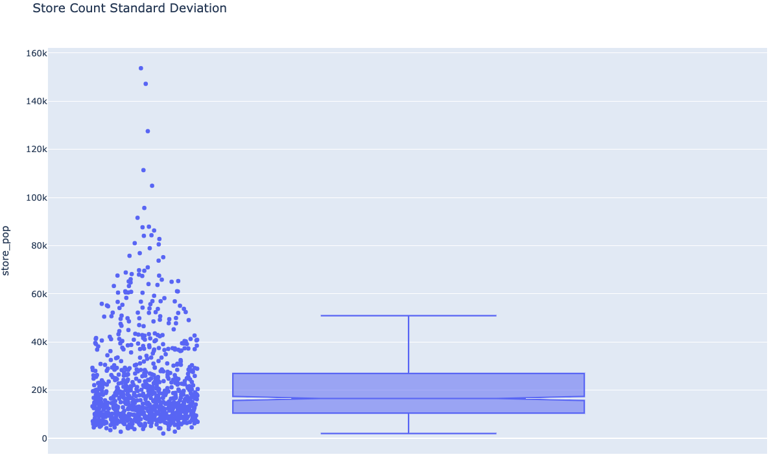
Standard Deviation between Population and Store Counts

Slide 9
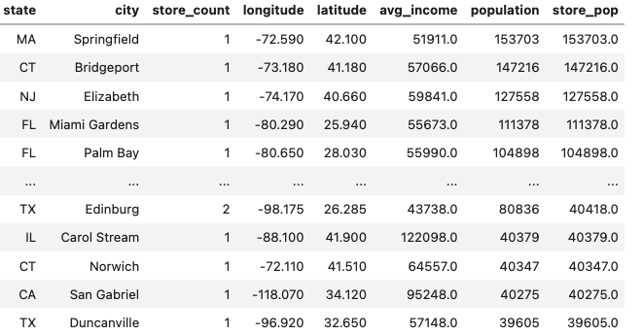
Average Store Count per City Population
The Max number of stores per population = 153,703.0
The Min number of stores per population = 2,012.0
The Avg number of stores per population = 22,240.0
The Standard deviation number of stores per population = 18,130.0
Top 125 US Expansion City Candidates – DataFrame Format

Slide 10
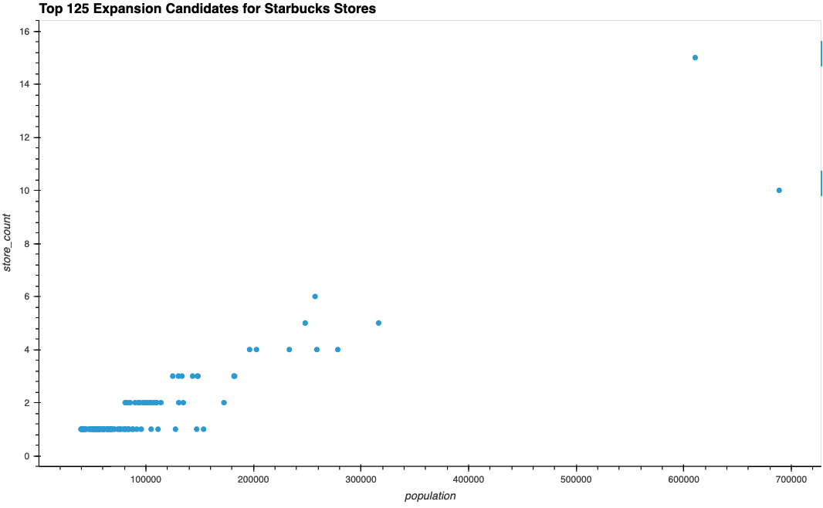
Top 125 US Expansion City Candidates – Scatter Plot

Slide 11
Project One: Conclusions
Is there a correlation between the total number of stores within a city and the city's annual average income?
We did not see much, if any, coorelation between the number of coffee stores in a given city and the average annual income of that city. The scatter plot shows a similar view at income averages at $45,000/annually as to a city with an average income of $100,000/annually or higher.
Is there a correlation between the total number of stores within a city and the city's population?
We can see coorelation in the number of stores witin a given city and the population of that city. The scatter plot shows a linear upward trend as population increases, the number of stores increases. This can also be seen from the analysis around the average population count for one store. It is very consistant for most areas.
Are there underserved or overserved cities based on standard deviation from a mean?
We can derive a list of good candidate cities to look at for expansion based on those cities that had population averages, per a single coffee shop, well above one standard deviation. We found about 125 cities to investigate and determine if additional stores could be opened.

