Slide 1

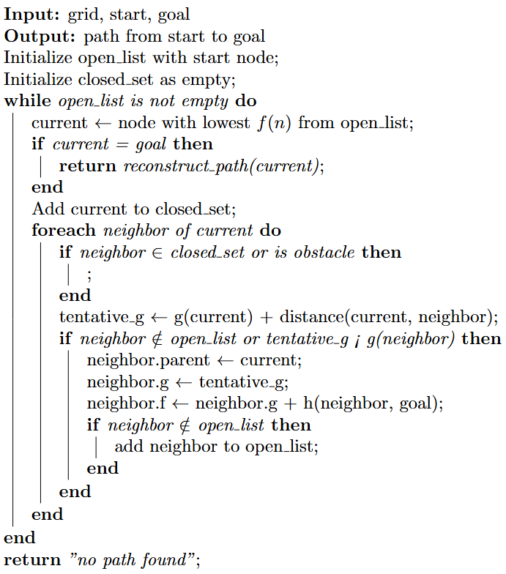
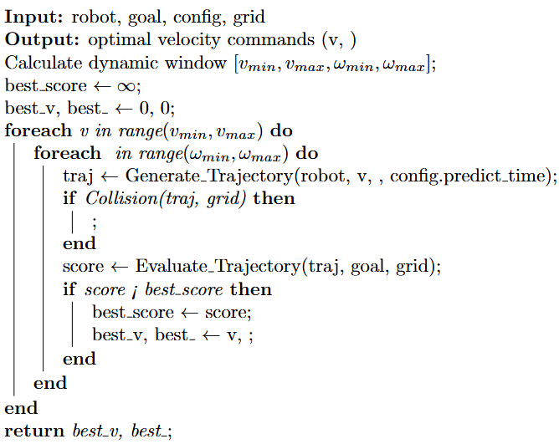
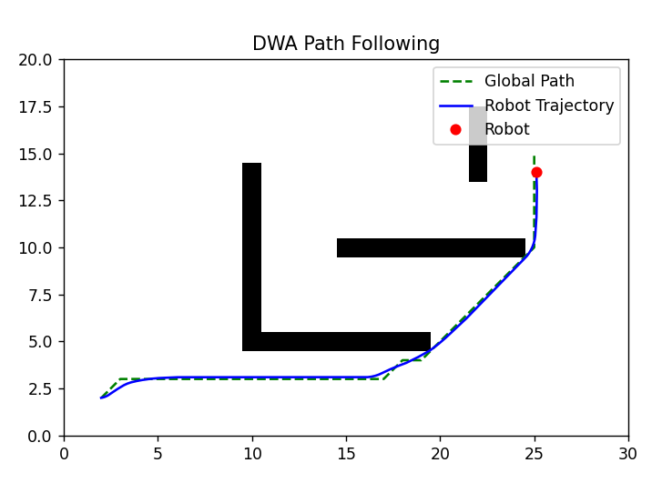
Robot Path Planning and Navigation using A* Algorithm and Dynamic Window Approach
Muskan Dewangan || Arya Mahesh Bhiwapurkar || Chandan Singh Chauhan
International Institute of Information Technology , Naya Raipur
INTRODUCTION
METHODOLOGY
CONCLUSIONS
Path planning is the task of finding a path from a starting point to a goal point in a given environment. In the context of mobile robots, the path must also take into account the presence of obstacles.
A* Algorithm (Global Path Planning)
- A* is a best-first search algorithm that uses a heuristic function to guide the search process
- Combines actual cost from start (g) and estimated cost to goal (h) to form f(n) = g(n) + h(n)
- Explores nodes with the lowest f-cost first, ensuring optimality
- Uses a priority queue (open list) and visited set (closed list) to manage the search
- Efficiently finds the shortest path in static environments
Dynamic Window Approach (Local Navigation)
- DWA is a velocity-based local navigation method that accounts for robot dynamics
- Samples possible velocity commands within the robot's dynamic constraints
- Predicts trajectories for each velocity pair and evaluates them
- Selects the optimal velocity command based on multiple objectives (goal direction, clearance, velocity)
- Enables real-time obstacle avoidance while following the global path
A* Algorithm (Global Path Planning)
The A* algorithm creates an optimal path from start to goal by evaluating nodes based on:
g(n): Cost from start to current node
h(n): Heuristic estimate (Euclidean distance) to goal
f(n) = g(n) + h(n): Total estimated cost.
Dynamic Window Approach (Local Navigation)
DWA enables real-time obstacle avoidance while following the global path by:
Computing dynamic window of possible velocities (v, ω)
Generating trajectories for velocity samples
Evaluating trajectories based on: Distance to obstacles, Progress toward goal and Alignment with global path
Advantages :
Efficient Navigation: The integration of A* algorithm with DWA provides a computationally efficient solution for autonomous navigation that successfully finds optimal paths while avoiding obstacles.
Real-time Adaptability: The DWA controller demonstrates excellent capability to adapt to local conditions in real-time while maintaining adherence to the global path objective.
Implementation Simplicity: The approach uses straightforward algorithms that are easy to implement and tune, making it accessible for various robotic applications without requiring specialized hardware.
Disadvantages:
Parameter Sensitivity: DWA performance depends heavily on proper tuning of parameters like prediction time and sampling resolution, which may require adjustment for different environments
Static Environment Assumption: The current implementation works well for static obstacles but would require additional modifications to handle dynamic or moving obstacles..
Computational Scaling: As environment complexity increases, both A* and DWA face increased computational demands, potentially limiting real-time performance in very large or complex spaces.
OBJECTIVE
1. To implement the A* algorithm for finding an optimal global path from start to goal position in an environment with static obstacles.
2. To develop a Dynamic Window Approach controller that enables a robot to follow the generated path while avoiding obstacles.
3. To demonstrate successful path following behavior through simulation in a 2D environment.
4. To analyze the effectiveness of the combined approach by comparing the planned path with the actual robot trajectory.
REFERENCE
Y. Li et al., "A Mobile Robot Path Planning Algorithm Based on Improved A* Algorithm and Dynamic Window Approach," in IEEE Access, vol. 10, pp. 57736-57747, 2022, doi: 10.1109/ACCESS.2022.3179397.
keywords: {Heuristic algorithms;Mobile robots;Path planning;Interference;Search problems;Path planning;hybrid algorithms;improved A* algorithm;improved DWA}
RESULTS
INTEGRATION APPROACH
The figure shows:
Successful navigation from start (1.9,2) to goal (25,14.5)
Effective obstacle avoidance around multiple barriers
Close adherence between planned path (green dashed line) and actual trajectory (blue line)
Adaptive behavior in complex regions, especially in the narrow passage near coordinates (20,5)
A* algorithm computes the global path once at the beginning
DWA controller:
Takes current robot state and global path as input
Samples velocities within robot's dynamic constraints
Selects optimal velocity commands to follow the path while avoiding obstacles
Updates at each time step (dt = 0.1s)
The robot follows waypoints in sequence until reaching the goal position
ACKNOWLEDGEMENTS
Guided by- Dr. Shailesh Khapre

