Slide 1

A revision tool by:
Adam, Mahbub, Pedrum and Tom

Slide 2
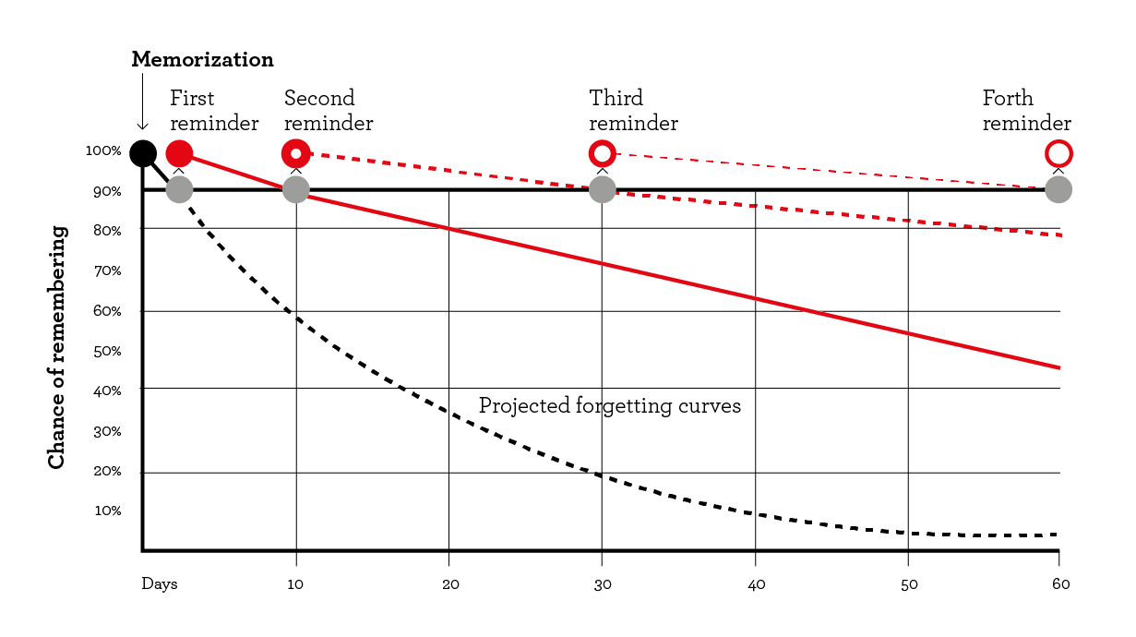
Context
Notes:
Mention the backend functionality

Slide 3
Key challenges
Adding cards
Deleting cards
Searching by subject
Notes:
Connecting end points

Slide 4
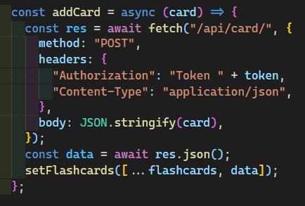
Adding cards
Backend
Token
New card
Updated card list
Frontend

Slide 5
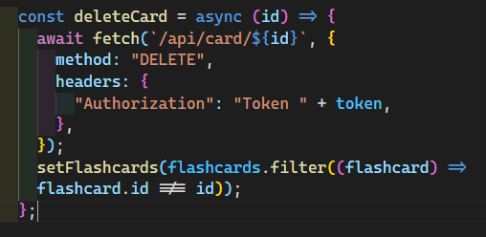
Deleting cards
Backend
Token
Del card
Updated card list
Frontend

Slide 6
Design opportunities
pagination
difficulty
Advanced search
Notes:
Connecting end points

Slide 7
Live Demo!

