Slide 1
1.3 DSRIP Quality Related Outcomes: Round4
Justin

Slide 2
Outstanding Questions/Todos
Fix p value in notes p<=
goals for each year and measure
what is the incentive

Slide 3
Data Sources
Category C Data File
File: Category C Summary Worksheet
Currently have DY7 (2018), DY8 (2019), DY9 (2020), DY10 (2021)

Slide 4
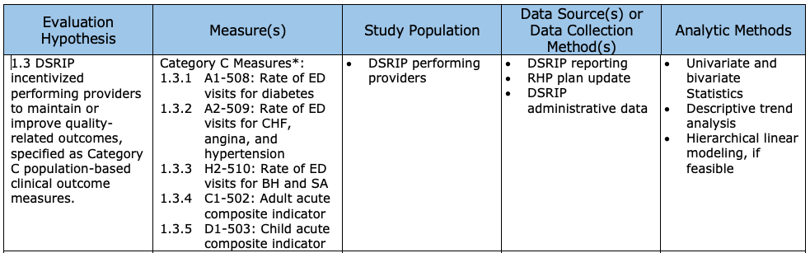
Evaluation Design Plan - Overall

Slide 5
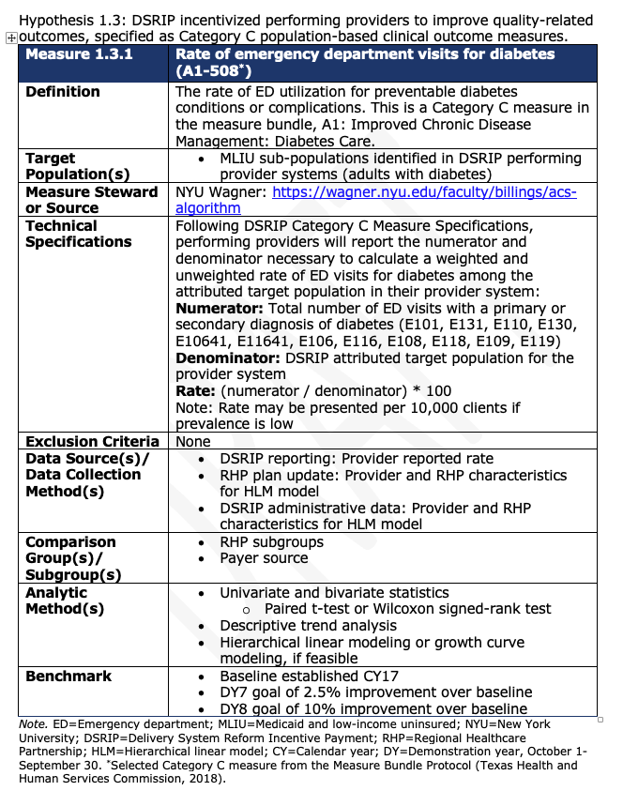
Measure 1.3.1 Design Plan

Slide 6
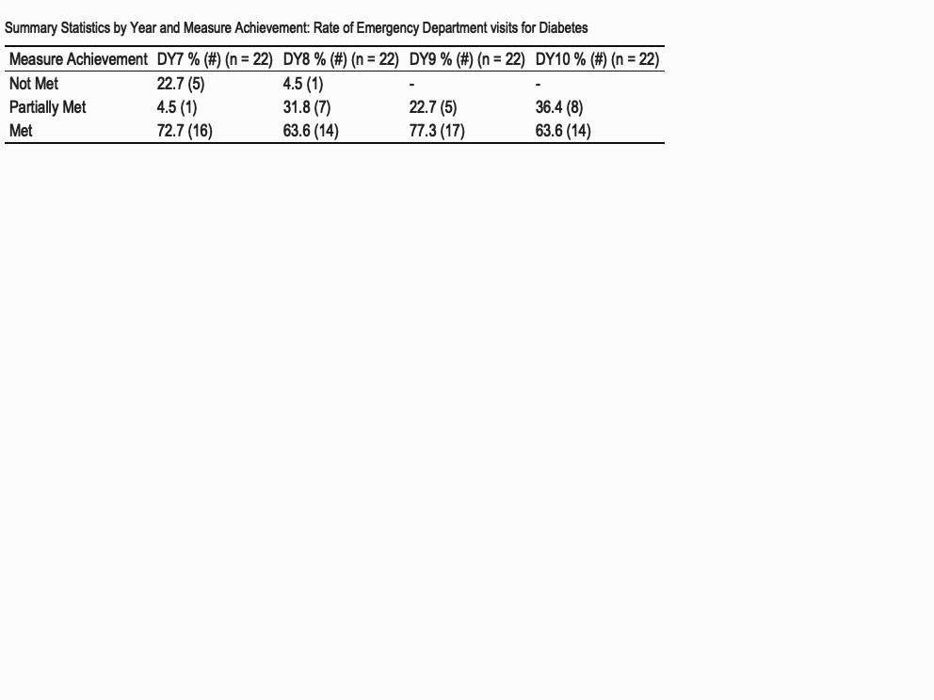
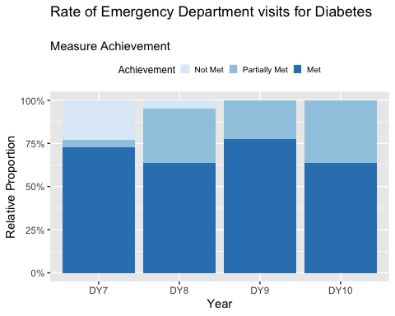
Measure 1.3.1 - Overall Measure

Slide 7
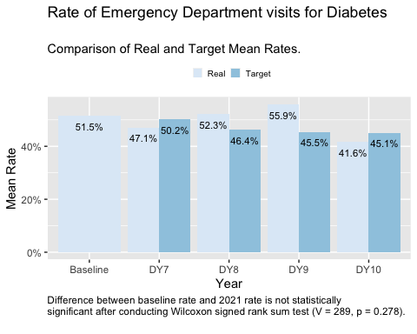
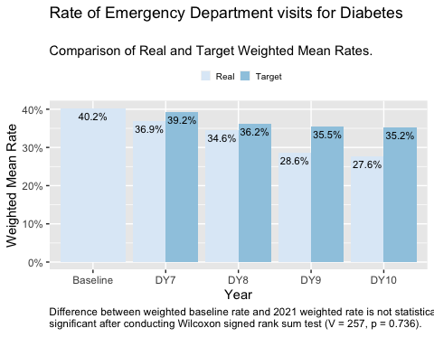
Measure 1.3.1 - Analysis of Achievement Rates

Slide 8
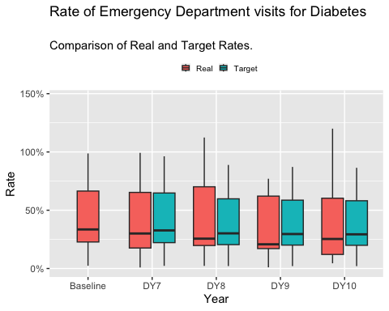
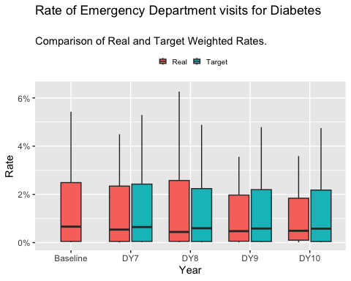
Measure 1.3.1 - Analysis of Achievement Rates (Box Plots)

Slide 9
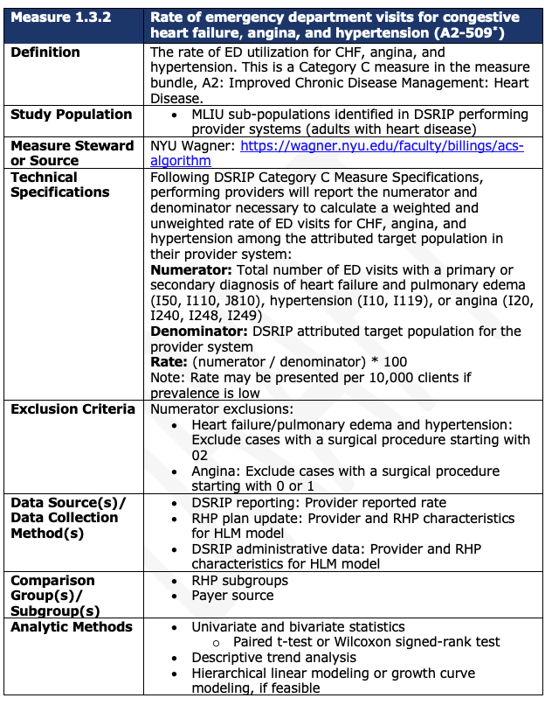
Measure 1.3.2 - Design Plan

Slide 10
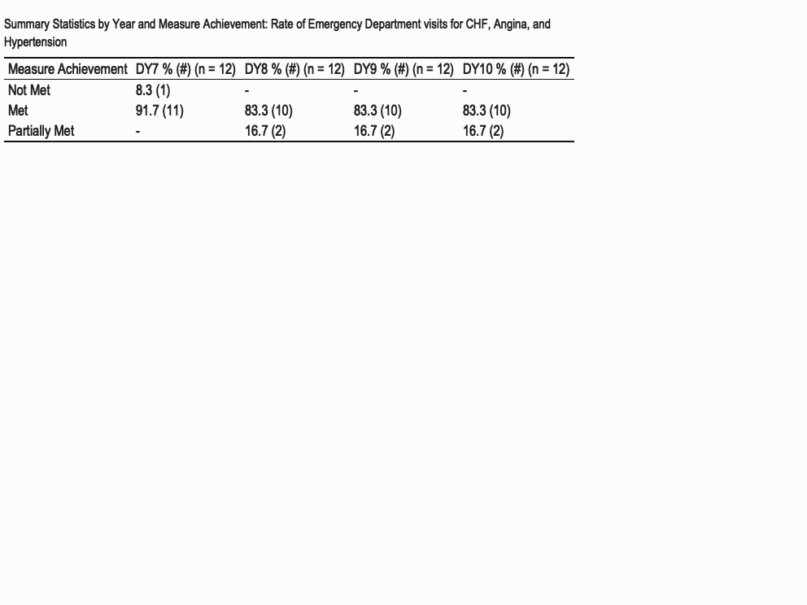
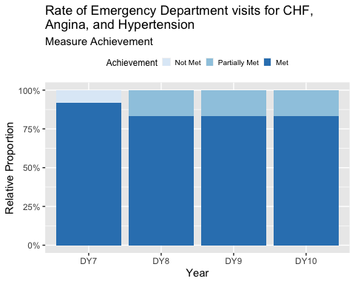
Measure 1.3.2 - Overall Measure

Slide 11
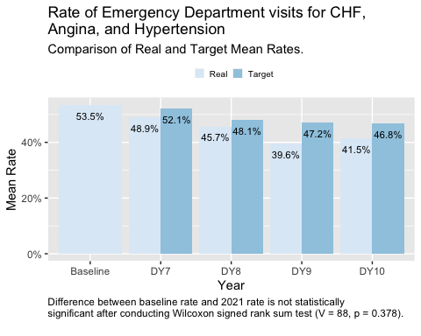
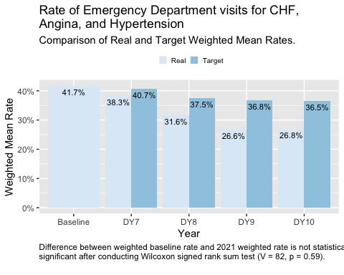
Measure 1.3.2 - Analysis of Achievement Rates

Slide 12
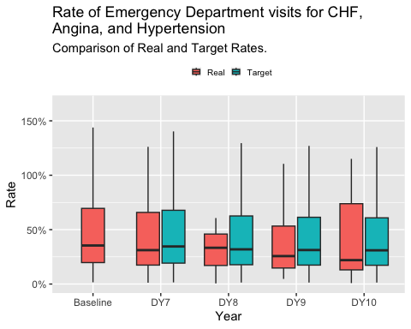
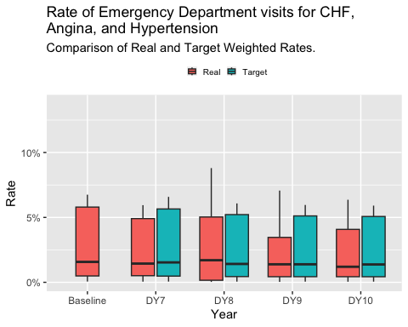
Measure 1.3.2 - Analysis of Achievement Rates (Box Plots)

Slide 13
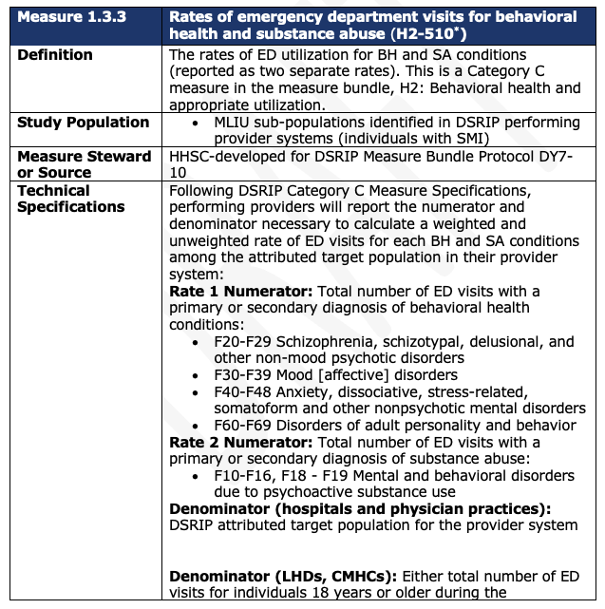
Measure 1.3.3 - Design Plan

Slide 14
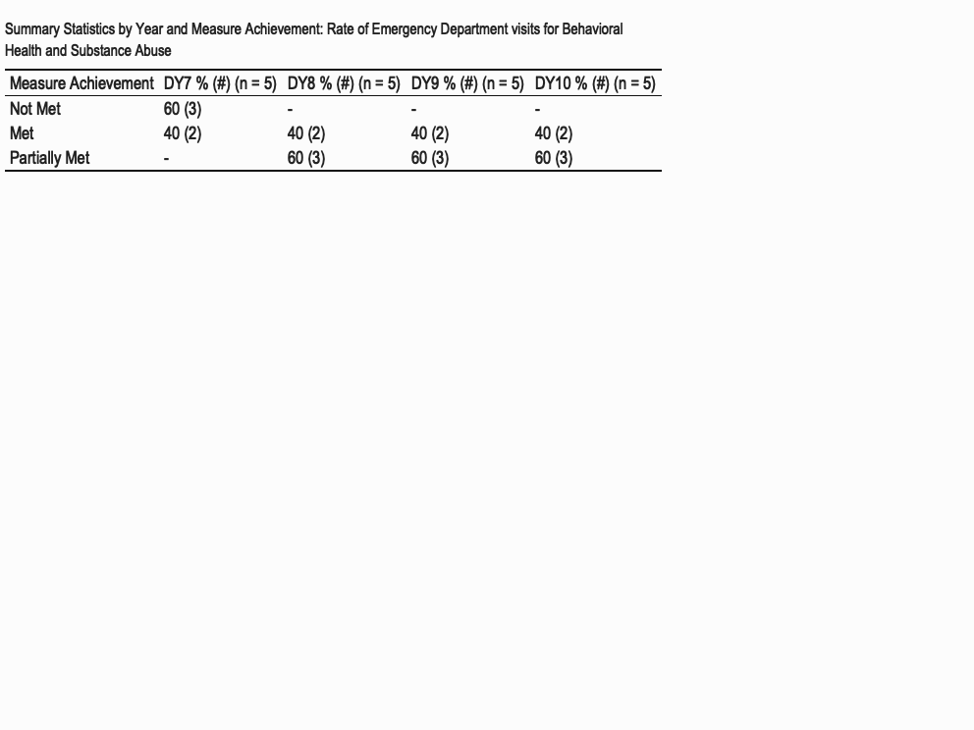
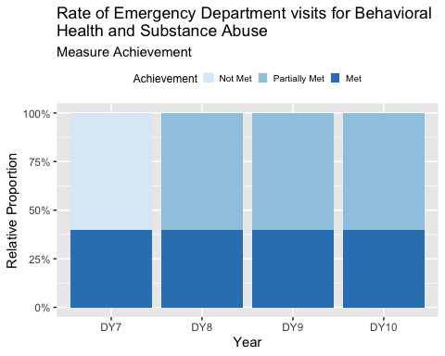
Measure 1.3.3 - Overall Measure

Slide 15
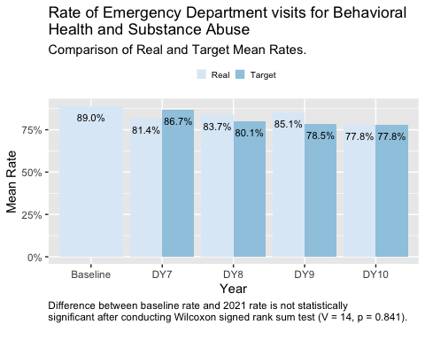
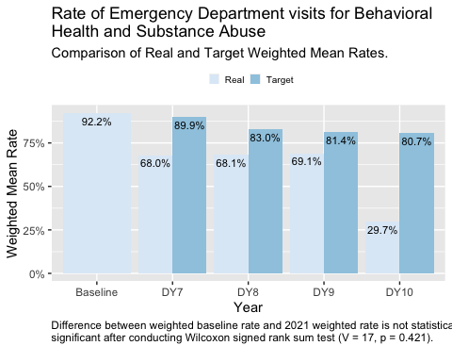
Measure 1.3.3 - Analysis of Achievement Rates

Slide 16
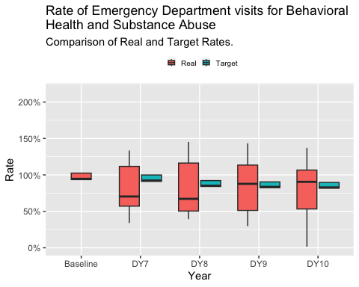
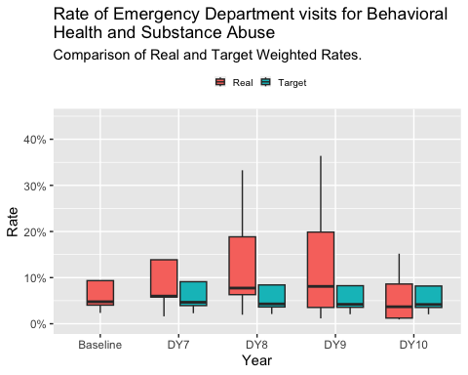
Measure 1.3.3 - Analysis of Achievement Rates (Box Plots)

Slide 17
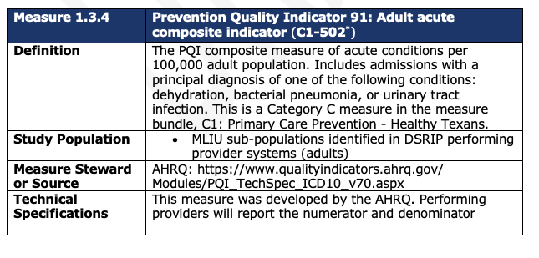
Measure 1.3.4 - Design Plan

Slide 18
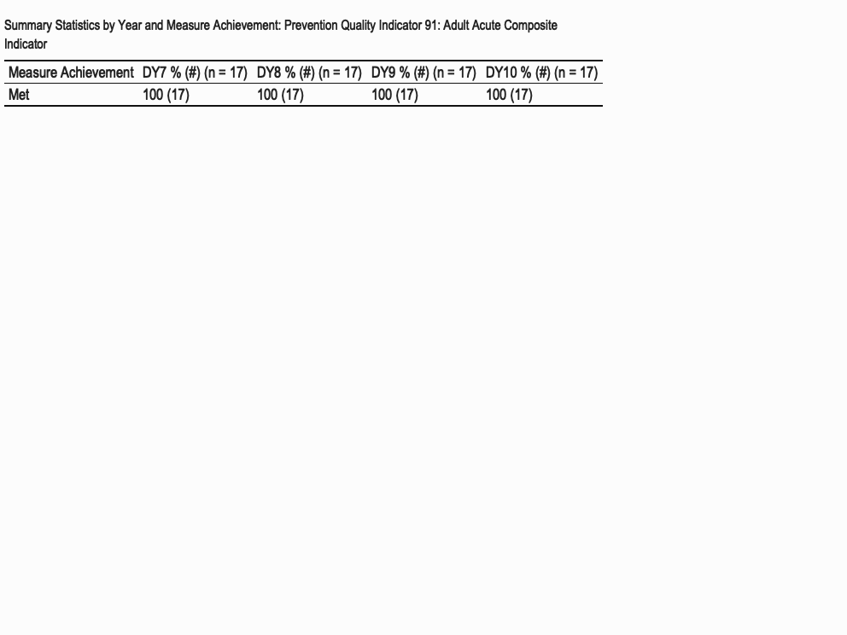
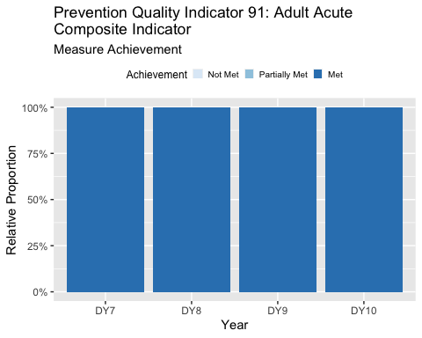
Measure 1.3.4 - Overall Measure

Slide 19
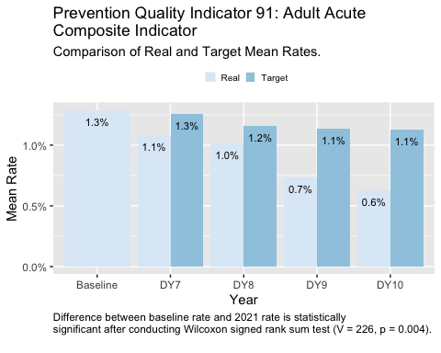
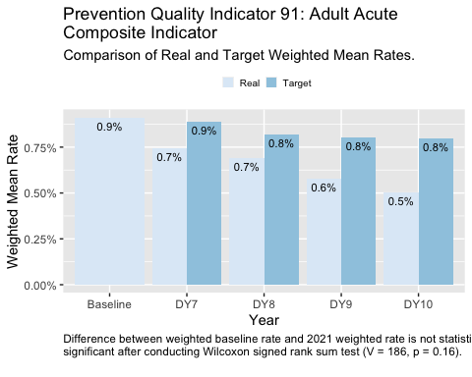
Measure 1.3.4 - Analysis of Achievement Rates

Slide 20
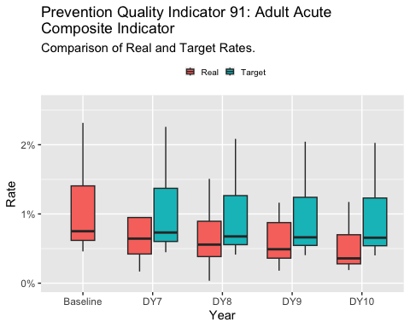
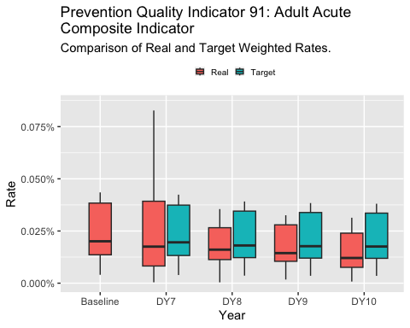
Measure 1.3.4 - Analysis of Achievement Rates (Box Plots)

Slide 21
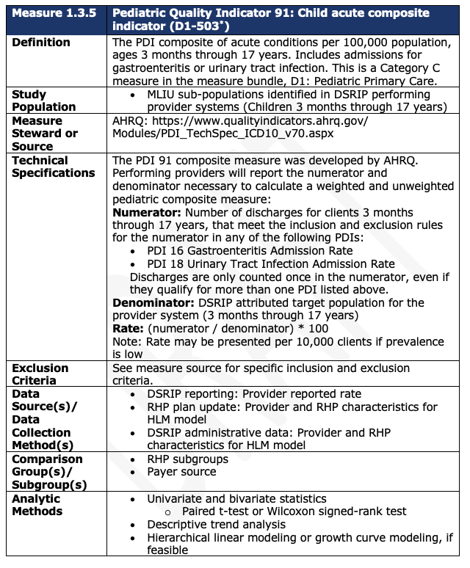
Measure 1.3.5 - Design Plan

Slide 22
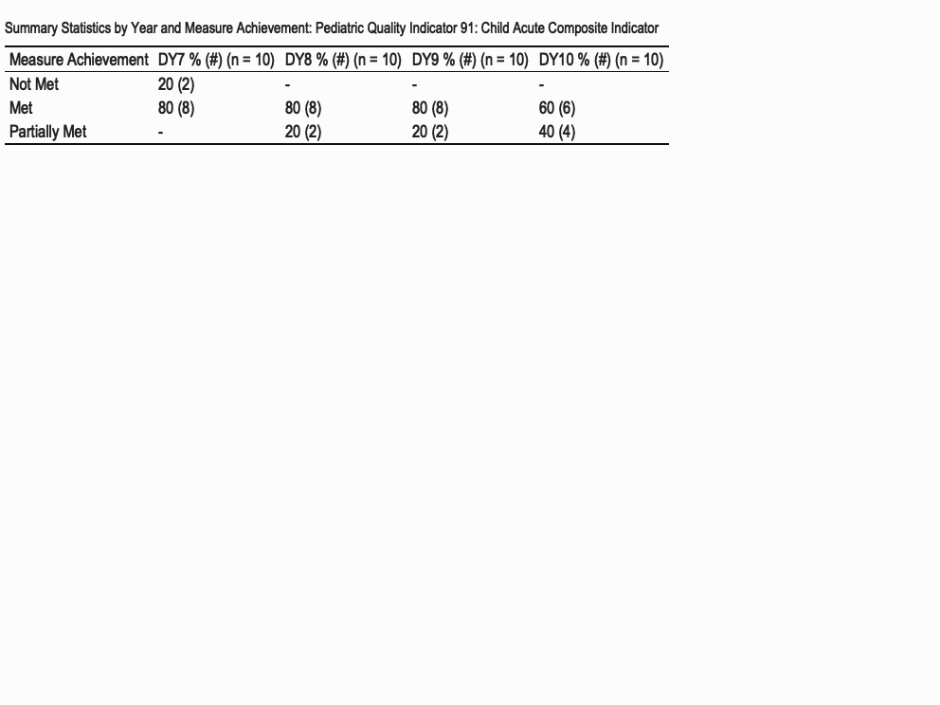
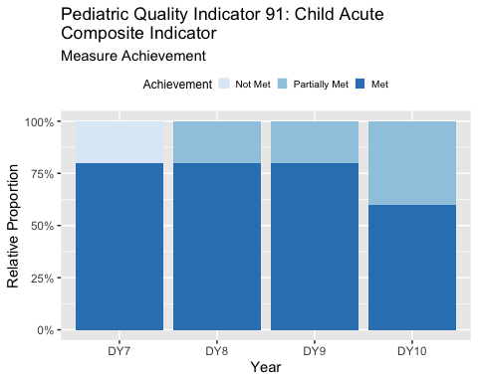
Measure 1.3.5 - Overall Measure

Slide 23
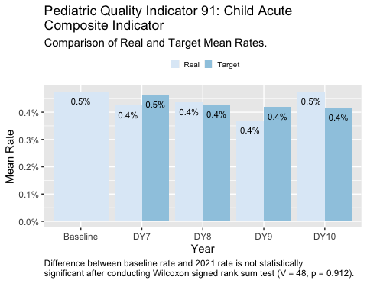
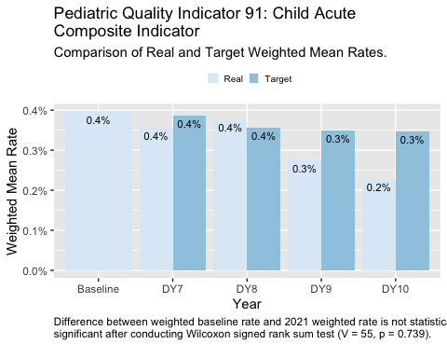
Measure 1.3.5 - Analysis of Achievement Rates

Slide 24
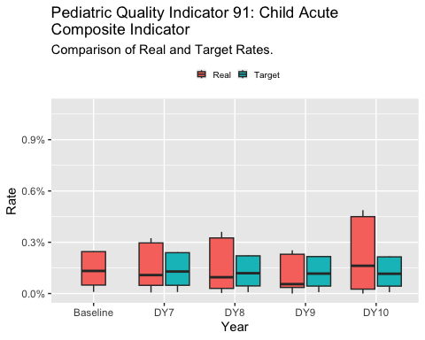
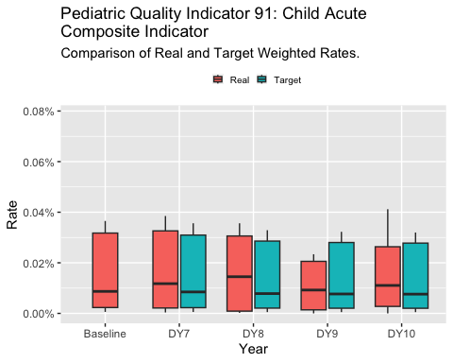
Measure 1.3.5 - Analysis of Achievement Rates (Box Plots)

Slide 25
Next steps…
Establish outline of report

Slide 26
Questions

Slide 27
Backup

Slide 28
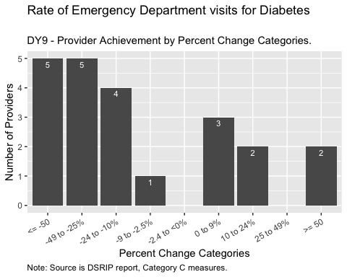
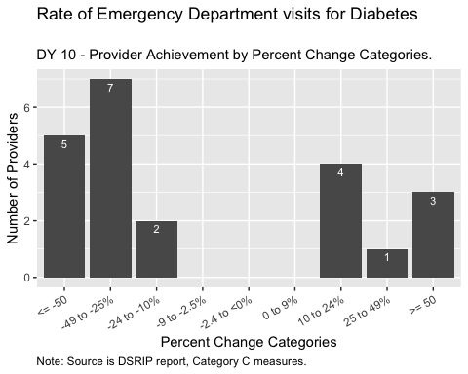
Measure 1.3.1 - Percent Change

Slide 29
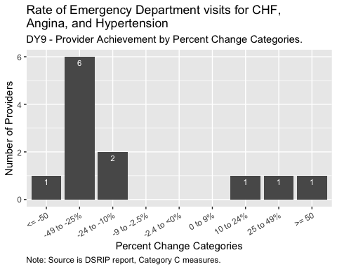
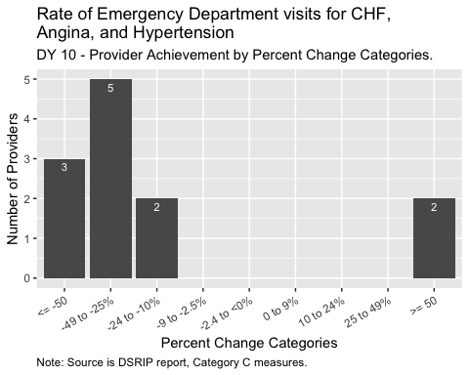
Measure 1.3.2 - Percent Change

Slide 30
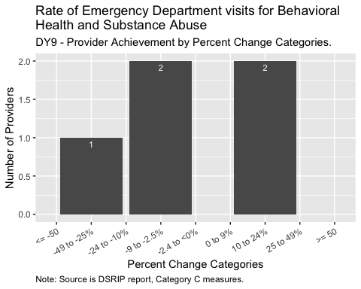
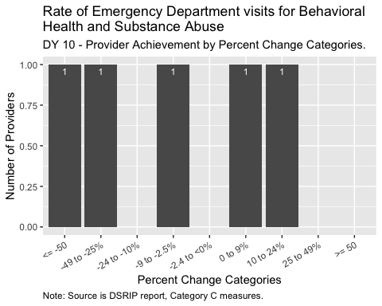
Measure 1.3.3 - Percent Change

Slide 31
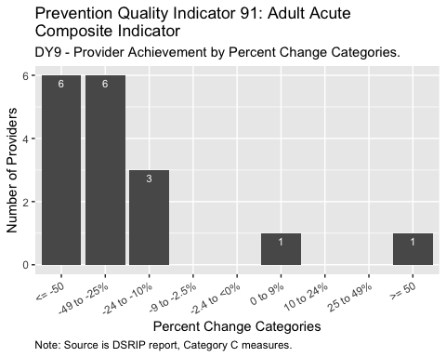
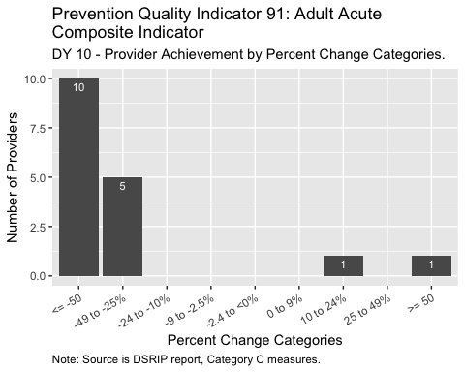
Measure 1.3.4 - Percent Change

Slide 32
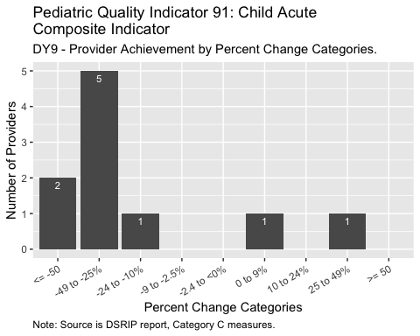
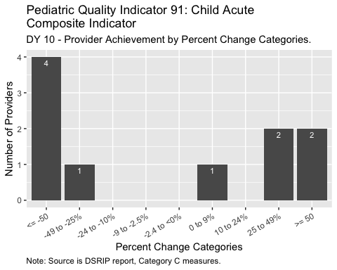
Measure 1.3.5 - Percent Change

