Slide 1
1.2 DSRIP Claims
Summative Report Preliminary Results
17 November 2022

Slide 2
DSRIP Claims Status Update for Summative Report
Analytic sample finalized
  5,650 clients
  1:1 Propensity Score Matching
  2,825 DSRIP clients / 2,825 Non-DSRIP clients
All updated data received
6 Measures for Hypothesis 1.2
  1.2.1 Usual Provider of Care
  1.2.2 Interval Between Provider Visits
  1.2.3 Testing HbA1c Levels
  1.2.4 Diabetes Medication Adherence
  1.2.5 Emergency Department Visits for Diabetes
  1.2.6 Cost of Care

Slide 3
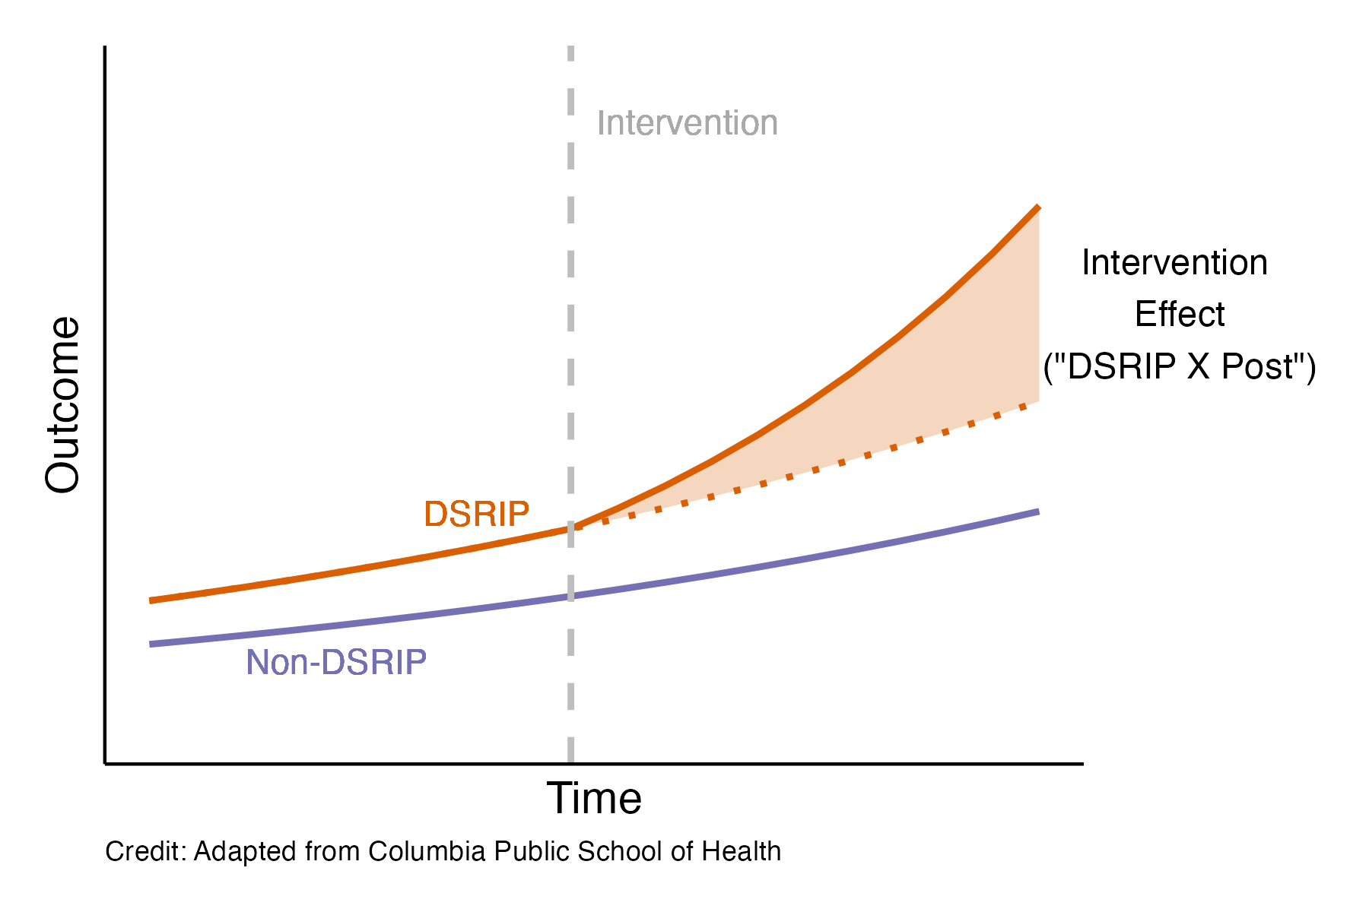
Methodological Approach
Graphical Representation of Difference-in-Difference Modeling
Difference-in-difference (DID) modeling
Various forms of regression modeling utilized given the context and underlying structure of the data
  Ordinary Least Squares
  Truncated
  Gamma
  Negative Binomial
  Logistic

Slide 4
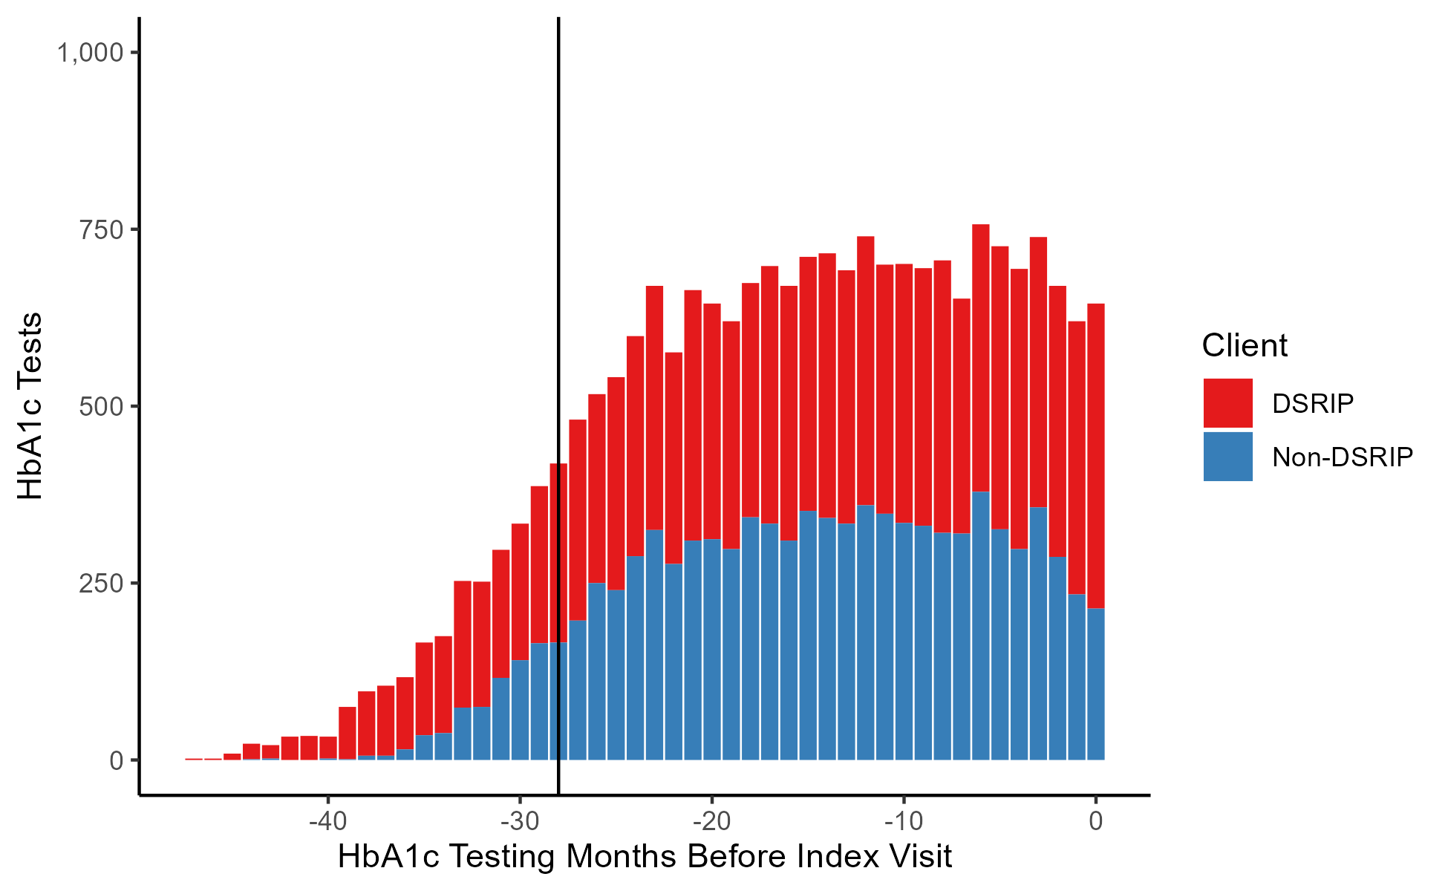
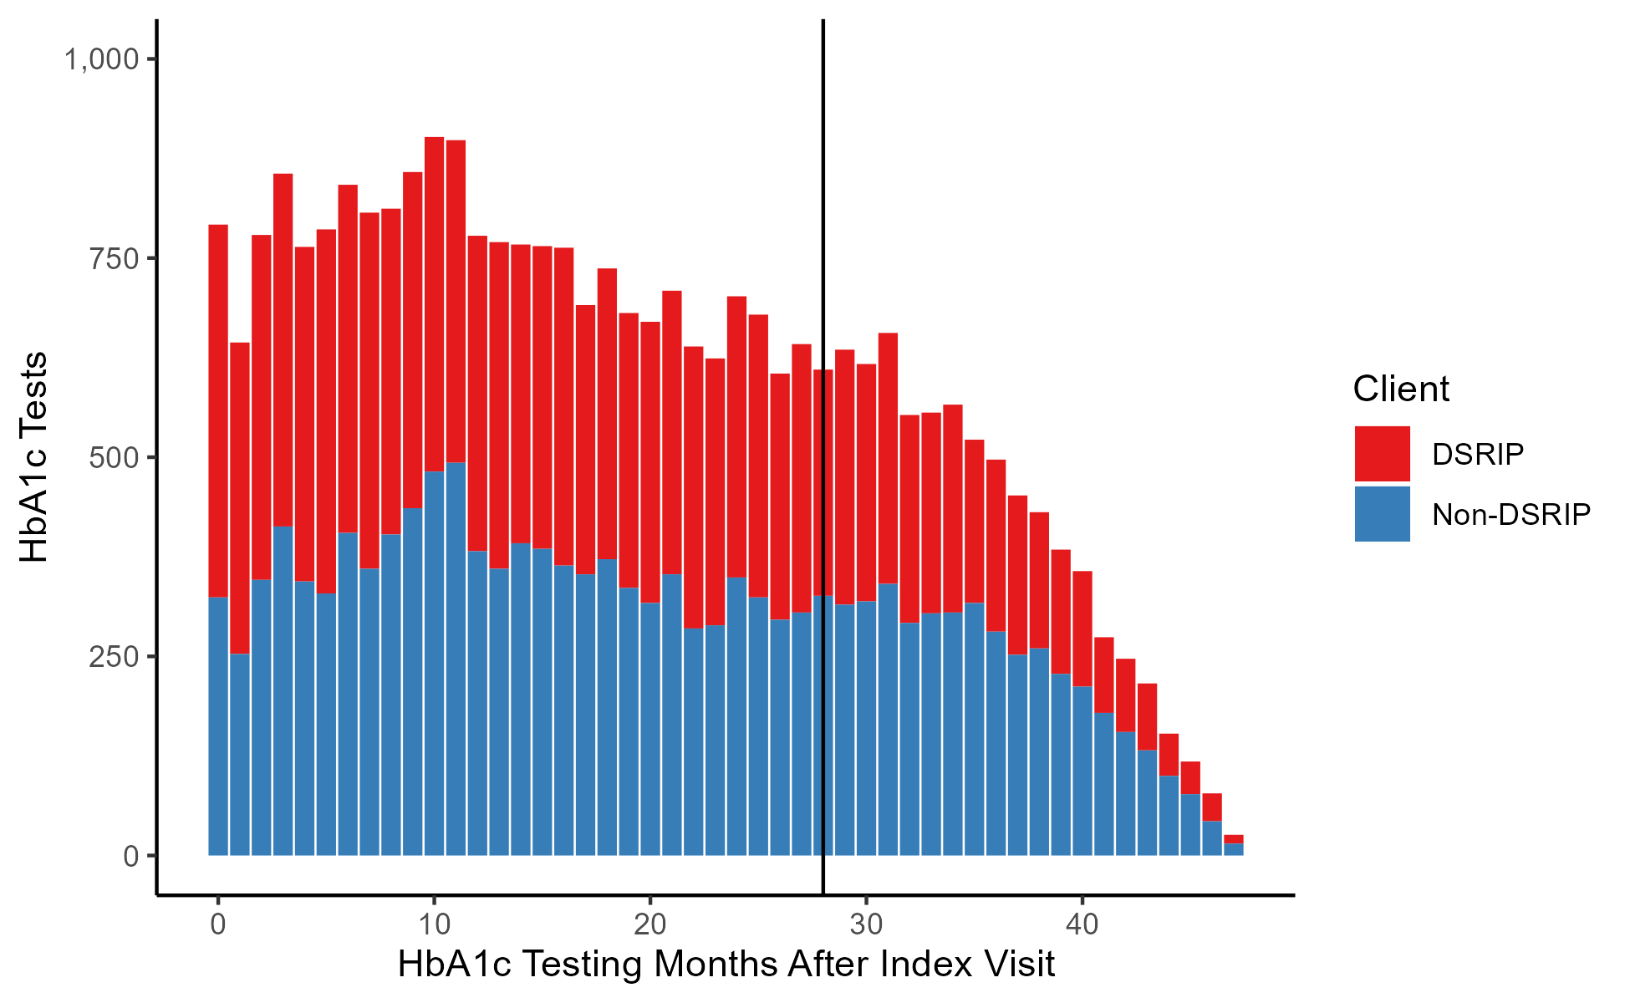
1.2.3 Testing HbA1c Levels
Distribution of HbA1c Testing Before Index Visit
Distribution of HbA1c Testing After Index Visit

Slide 5
1.2.3 Testing HbA1c Levels
Mean HbA1c Testing Frequencies
Logistic Regression Results for DSRIP HbA1c Testing Frequency Effect
Client | Measurement Period | Mean Frequency | Sample Size
DSRIP | 1 | 0.318 | 2,825
DSRIP | 2 | 0.368 | 2,825
DSRIP | 3 | 0.467 | 2,825
DSRIP | 4 | 0.352 | 2,825
Non-DSRIP | 1 | 0.291 | 2,825
Non-DSRIP | 2 | 0.312 | 2,825
Non-DSRIP | 3 | 0.445 | 2,825
Non-DSRIP | 4 | 0.353 | 2,825
Coefficient | Odds Ratio | Std. Error | z-value
DSRIP X Post | 0.862** | 0.06 | -2.66
DSRIP | 1.204*** | 0.04 | 4.602
Post | 2.069*** | 0.069 | 10.61
Trend | 0.863*** | 0.028 | -5.319
Q2 Index | 1.003 | 0.037 | 0.089
Q3 Index | 1.124** | 0.038 | 3.058
Q4 Index | 1.038 | 0.04 | 0.923
(Intercept) | 0.521*** | 0.054 | -12.027
Note: Measurement period #1 = 14-month time span that is 28 months preceding the date of the index visit and up to 14 months before date of the index visit; measurement period # 2 = 14-month time span that is 14 months preceding and up to the day before the date of the index visit; measurement period # 3 = 14-month time span that is the day of the index visit to 14 months after the date of the index visit; measurement period # 4 = 14-month time span that is 14 months after the date of the index visit to 28 months after the date of the index visit. Interval measurement begins with client’s first HbA1c test during measurement period. DSRIP = Delivery System Reform Incentive Payment.
Note: *** = p-value < 0.001; ** = p-value < 0.01; * = p-value < 0.05. Standard errors presented in log-form. n = 4,872. DSRIP = Delivery System Reform Incentive Payment.

Slide 6
1.2.5 Emergency Department Visits for Diabetes
Mean All-Cause ED Visits
Mean Diabetes-Related ED Visits
Client | Measurement Period | Visits | Sample Size
DSRIP | 1 | 2.74 | 2,825
DSRIP | 2 | 3.45 | 2,825
DSRIP | 3 | 3.54 | 2,825
DSRIP | 4 | 2.73 | 2,825
Non-DSRIP | 1 | 2.02 | 2,825
Non-DSRIP | 2 | 2.22 | 2,825
Non-DSRIP | 3 | 2.63 | 2,825
Non-DSRIP | 4 | 2.12 | 2,825
Client | Measurement Period | Visits | Sample Size
DSRIP | 1 | 0.46 | 2,825
DSRIP | 2 | 0.56 | 2,825
DSRIP | 3 | 0.57 | 2,825
DSRIP | 4 | 0.43 | 2,825
Non-DSRIP | 1 | 0.38 | 2,825
Non-DSRIP | 2 | 0.40 | 2,825
Non-DSRIP | 3 | 0.43 | 2,825
Non-DSRIP | 4 | 0.38 | 2,825
Note: Measurement period #1 = 12-month time span that is 24 months preceding the date of the index visit and up to 12 months before date of the index visit; measurement period # 2 = 12-month time span that is 12 months preceding and up to the day before the date of the index visit; measurement period # 3 = 12-month time span that is the day of the index visit to 12 months after the date of the index visit; measurement period # 4 = 12-month time span that is 12 months after the date of the index visit to 24 months after the date of the index visit.

Slide 7
1.2.5 Emergency Department Visits for Diabetes
Negative Binomial Regression Estimate Effect of DSRIP on Frequency of All-Cause ED Visits
Negative Binomial Regression Estimate Effect of DSRIP on Frequency of Diabetes-Related ED Visits
Coefficient | IRR | Std. Error | z-value
DSRIP X Post | 0.902** | 0.04 | -2.605
DSRIP | 1.474*** | 0.028 | 13.752
Post | 1.205*** | 0.049 | 3.816
Trend | 0.963 | 0.02 | -1.915
Q2 Index | 0.844*** | 0.026 | -6.492
Q3 Index | 8.95*** | 0.027 | -4.058
Q4 Index | 0.909** | 0.029 | -3.327
(Intercept) | 2.441*** | 0.039 | 23.158
Coefficient | IRR | Std. Error | z-value
DSRIP X Post | 0.954 | 0.062 | -0.753
DSRIP | 1.314*** | 0.044 | 6.172
Post | 1.115 | 0.077 | 1.418
Trend | 0.961 | 0.031 | -1.292
Q2 Index | 0.841*** | 0.041 | -4.208
Q3 Index | 0.921 | 0.043 | -1.912
Q4 Index | 0.894* | 0.045 | -2.484
(Intercept) | 0.449*** | 0.06 | -13.229
Note: *** = p-value < 0.001; ** = p-value < 0.01; * = p-value < 0.05. n = 5,650. Standard errors presented in log-form. DSRIP = Delivery System Reform Incentive Payment. IRR = incident rate ratio.

Slide 8
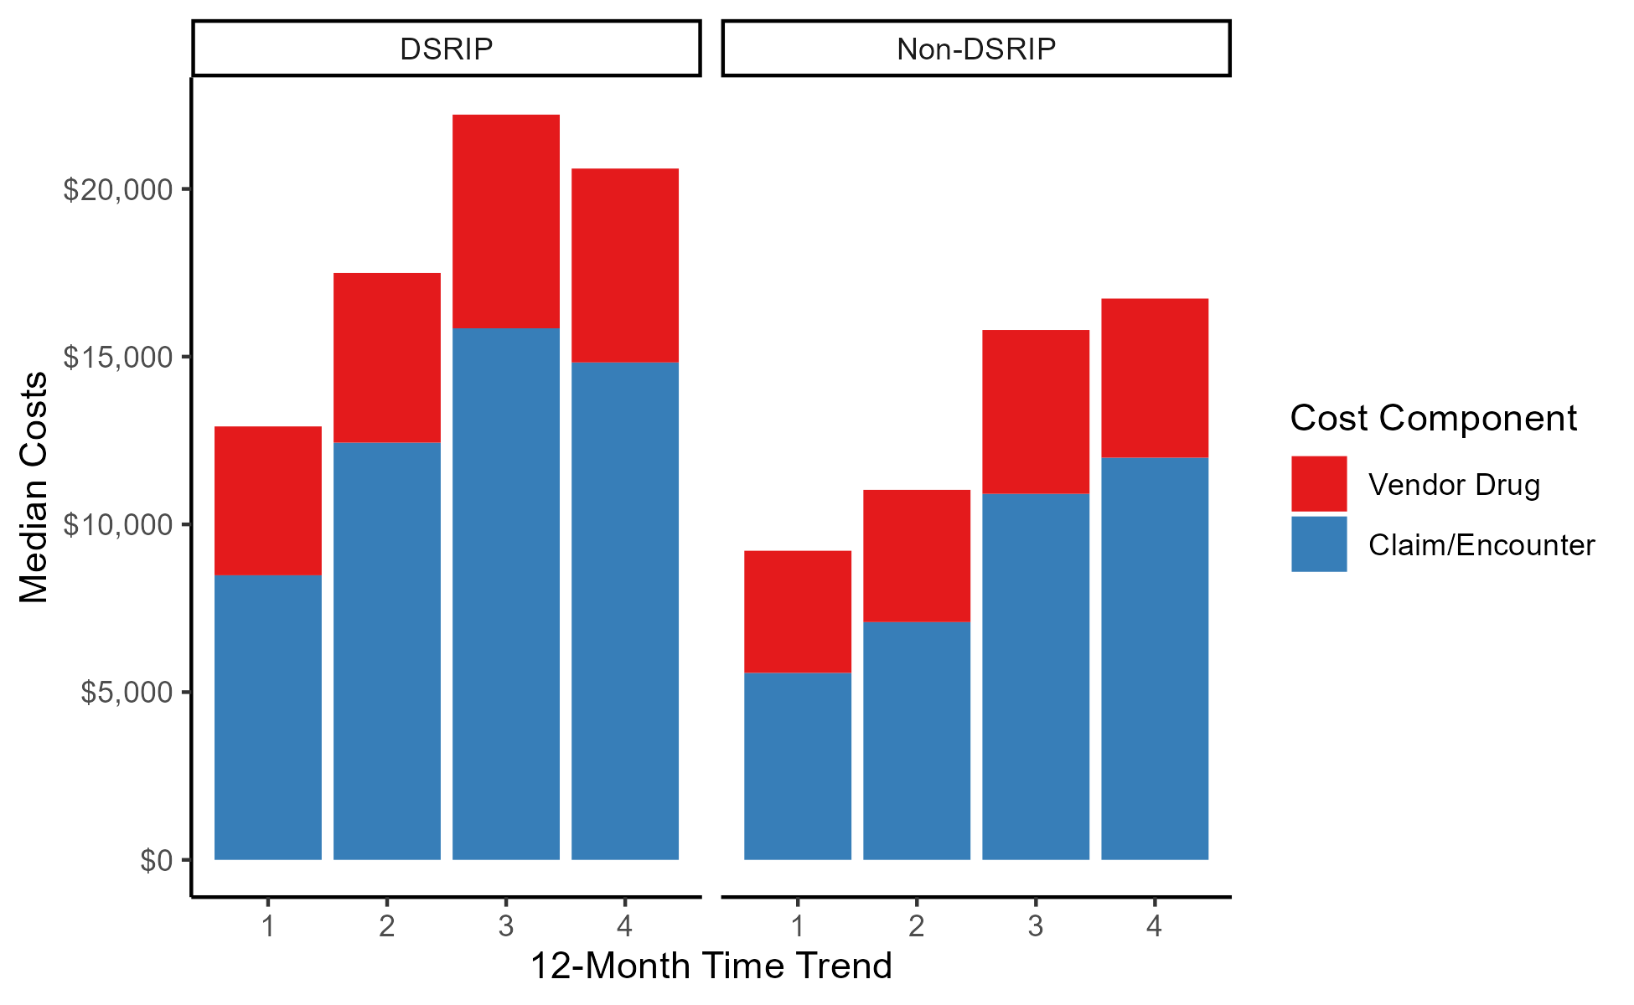
1.2.6 Cost of Care
Median Total Medicaid Costs
Median Total Medicaid Costs by Cost Component
Client | Measurement Period | Median Total Costs | Sample Size
DSRIP | 1 | $12,920 | 2,825
DSRIP | 2 | $17,494 | 2,825
DSRIP | 3 | $22,214 | 2,825
DSRIP | 4 | $20,606 | 2,825
Non-DSRIP | 1 | $9,214 | 2,825
Non-DSRIP | 2 | $11,029 | 2,825
Non-DSRIP | 3 | $15,794 | 2,825
Non-DSRIP | 4 | $16,731 | 2,825
Note: Measurement period #1 = 12-month time span that is 24 months preceding the date of the index visit and up to 12 months before date of the index visit; measurement period # 2 = 12-month time span that is 12 months preceding and up to the day before the date of the index visit; measurement period # 3 = 12-month time span that is the day of the index visit to 12 months after the date of the index visit; measurement period # 4 = 12-month time span that is 12 months after the date of the index visit to 24 months after the date of the index visit.
Note: Time trend #1 = 12-month time span that is 24 months preceding the date of the index visit and up to 12 months before date of the index visit; time trend # 2 = 12-month time span that is 12 months preceding and up to the day before the date of the index visit; time trend # 3 = 12-month time span that is the day of the index visit to 12 months after the date of the index visit; time trend # 4 = 12-month time span that is 12 months after the date of the index visit to 24 months after the date of the index visit. DSRIP = Delivery System Reform Incentive Payment.

Slide 9
1.2.6 Cost of Care
Estimate Effect of DSRIP on Log of Total Medicaid Costs
Log Link Gamma Regression Estimate Effect of DSRIP on Total Medicaid Costs
Coefficient | Estimate | Std. Error | t value
DSRIP X Post | -0.016 | 0.035 | -0.467
DSRIP | 0.3*** | 0.025 | 12.119
Post | 0.303*** | 0.043 | 7.103
Trend | 0.053** | 0.017 | 3.02
Q2 Index | -0.007 | 0.023 | -0.284
Q3 Index | -0.005 | 0.024 | -0.194
Q4 Index | -0.073** | 0.025 | -0.2885
(Intercept) | 9.229*** | 0.034 | 272.989
Coefficient | Estimate | Std. Error | t value
DSRIP X Post | -0.036 | 0.033 | -1.117
DSRIP | 0.264*** | 0.023 | 11.382
Post | 0.199*** | 0.04 | 4.995
Trend | 0.078*** | 0.016 | 4.774
Q2 Index | -0.015 | 0.022 | -0.707
Q3 Index | -0.01 | 0.023 | -0.423
Q4 Index | -0.049* | 0.024 | -2.055
(Intercept) | 9.874*** | 0.032 | 311.887
Note: *** = p-value < 0.001; ** = p-value < 0.01; * = p-value < 0.05. n = 5,650. DSRIP = Delivery System Reform Incentive Payment.

