Slide 6
Research
Source of data
Type of data
Type of analysis
Quantitative
Questionnaire
Attribute
Variable analysis
Interview
Qualitative
Relational
Network analysis
Observation
Mixed-method
Ideational
Typological analysis
Text

Slide 7
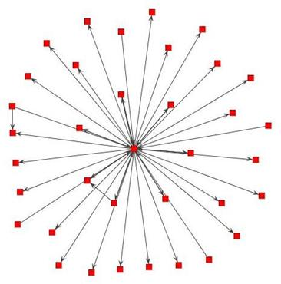
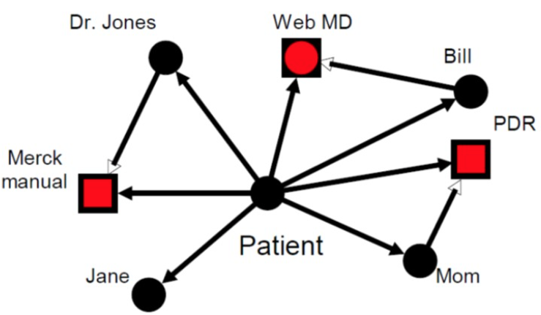
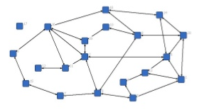
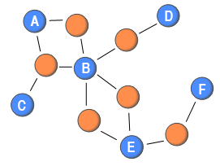
One-mode ego network
Two-mode ego network
One-mode whole network
Two-mode whole network

Slide 8
Topology
Directional
A Un-directional Network
B Directional Network
Perspective
C Whole Network
D Ego-centric Network
Strength
E Binary
F Weight
Association
G 1 mode
H 2 mode
Time
I cross-sectional
J Aggregated
K longitudinal
ACEG: Un-directional Whole Binary One-mode Network
ACEH: Un-directional Whole Binary Two-mode Network
ACFG: Un-directional Whole Weighted One-mode Network
ACFH: Un-directional Whole Weighted One-mode Network
ADEG: Un-directional Ego-centric Binary One-mode Network
ADEH: Un-directional Ego-centric Binary Two-mode Network
ADFG: Un-directional Ego-centric Weighted One-mode Network
ADFH: Un-directional Ego-centric Weighted One-mode Network
BCEG: Directed Whole Binary One-mode Network
BCEH: Directed Whole Binary Two-mode Network
BCFG: Directed Whole Weighted One-mode Network
BCFH: Directed Whole Weighted One-mode Network
BDEG: Directed Ego-centric Binary One-mode Network
BDEH: Directed Ego-centric Binary Two-mode Network
BDFG: Directed Ego-centric Weighted One-mode Network
BDFH: Directed Ego-centric Weighted One-mode Network
-
-
-
Notes:
각각 연구들이 어떤 토폴로지에 속하는지, 각 토폴로지마다 가능한 분석과 가능하지 않은 분석은?

