Slide 1
Two published flight dynamics models rewritten in rust and structured as an ecs
19 FEBRUARY 2021
2d Lt Chad Willis
Committee: Dr. Douglas Hodson Maj Richard dill dr. Scott nykl

Slide 2
Overview
Motivation
Background
Build
Experiment Design
Experiment Results
Impact
Future Work

Slide 3
Motivation
Problems with Object-Oriented Programming (OOP)
Code dependencies
Maintainability
Parallelization
Cache efficiency
More data than necessary is brought into cache memory
Data-Oriented Design (DOD) and Entity-Component-System (ECS) architecture
Composition over inheritance
Extend Lt Joey Vagedes’ research
100% overhead improvement in normal use cases, 600% in large data object cases
Video games ≈ simulations

Slide 4
Motivation
Rust programming language
Provides some powerful benefits
Memory-safety
Performance
Strict compiler
Improving simulation software
Rust + ECS
Built two flight simulators with these two technologies

Slide 5
BACKGROUND

Slide 6
PHYSICS OF FLIGHT MODELING
Published textbooks describing the Flight Dynamics Models
Physics for Game Programmers by Grant Palmer
Physics for Game Developers by David Bourg
Flight Dynamics Models (FDM)
Calculate external forces and equations of motion
1. Calculate the body’s mass properties (mass, center of mass, and moment of inertia).
2. Identify and quantify all forces and moments acting on the body.
3. Take the vector sum of all forces and moments.
4. Solve the equations of motion for linear and angular accelerations. (rate of change)
5. Integrate with respect to time to find linear and angular velocity. (how much)
6. Integrate again with respect to time to find linear and angular displacement. (amt. traveled)
Update Position and Orientation frame by frame
Notes:
Linear Acceleration is the rate of change of linear velocity and Angular Acceleration is the rate of change of angular velocity. Linear Velocity is how much an object travels in a straight line, and Angular Velocity is how much an object rotates

Slide 7
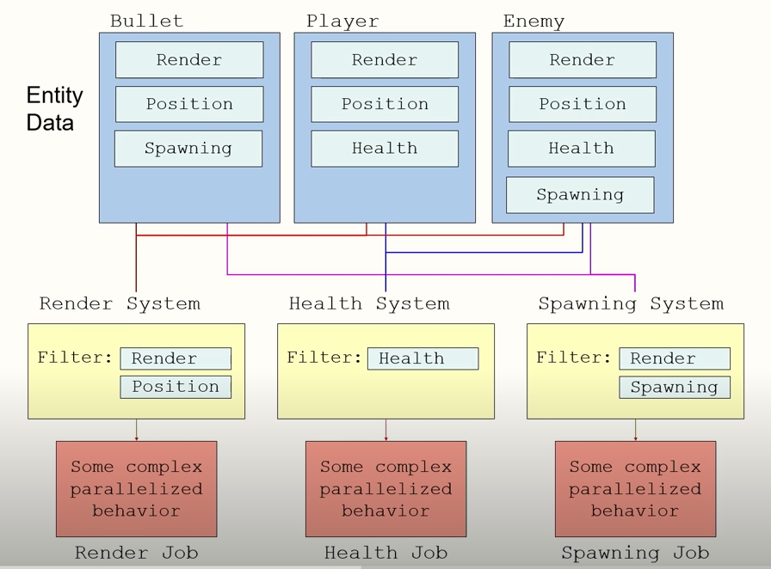
Dod and ecs
Structure data to optimize cache
Composition over inheritance
E: Entity – An identifier, index into dataset
C: Component – Data that composes the Entity
S: System – Methods on operating on data
Decoupling code

Slide 8
Flightgear flight simulator
Used for visualization
Free and configurable
Configure it to use an external FDM
Send position and orientation data to FlightGear
Interface via User Datagram Protocol (UDP) packet
Packet format defined by FlightGear
FlightGear gives us an example of how to send UDP packets
Uses latitude, longitude, and altitude for position

Slide 9
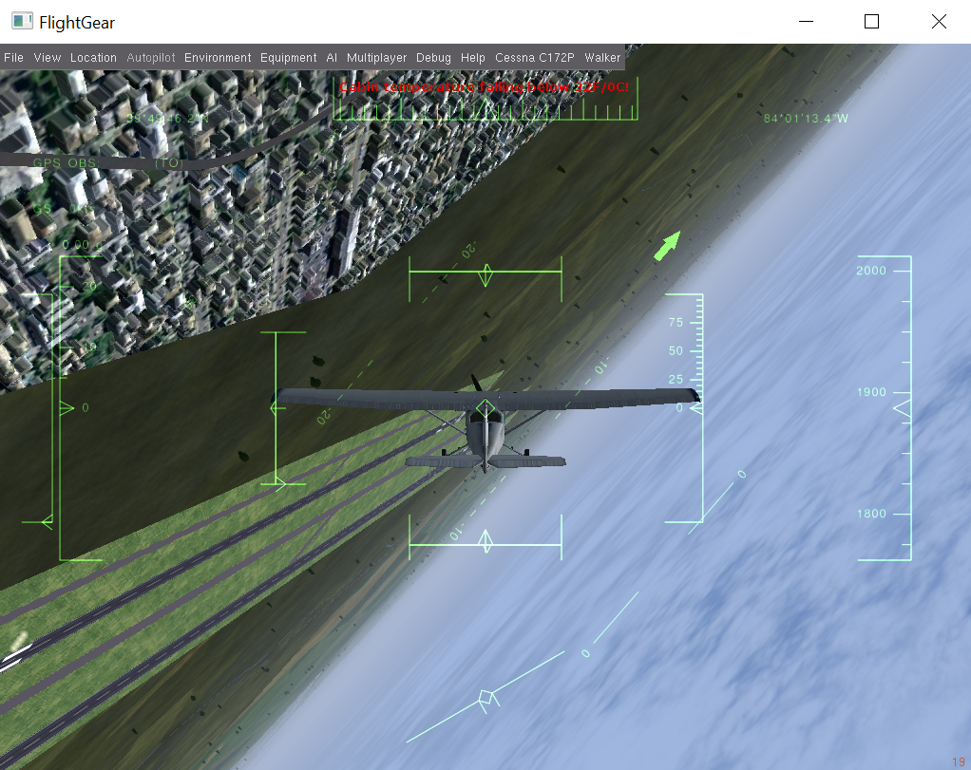
Flightgear flight simulator

Slide 10
Build
Crates
Specs Parallel ECS (SPECS)
ECS framework
Device Query
Keyboard input
Bincode & Serde
Convert struct into bytes
Coord Transform
Meters displaced -> East-North-Up -> Lat/Lon/Alt
Float Cmp
Compare floating-point numbers for FDM testing

Slide 11
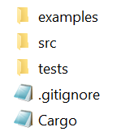
Build
Rust organization
cargo.exe run --example bourg
cargo.exe run –example palmer
cargo test --test bourg_integration
cargo test –test palmer_integration

Slide 12
build
Re-implementation process
Translate FDM code from native language to Rust
Bourg – C++, Palmer – C
Structure into ECS
Add flight simulator aspects
Keyboard input
UDP Packet make/send
Debugging
Refactoring

Slide 13
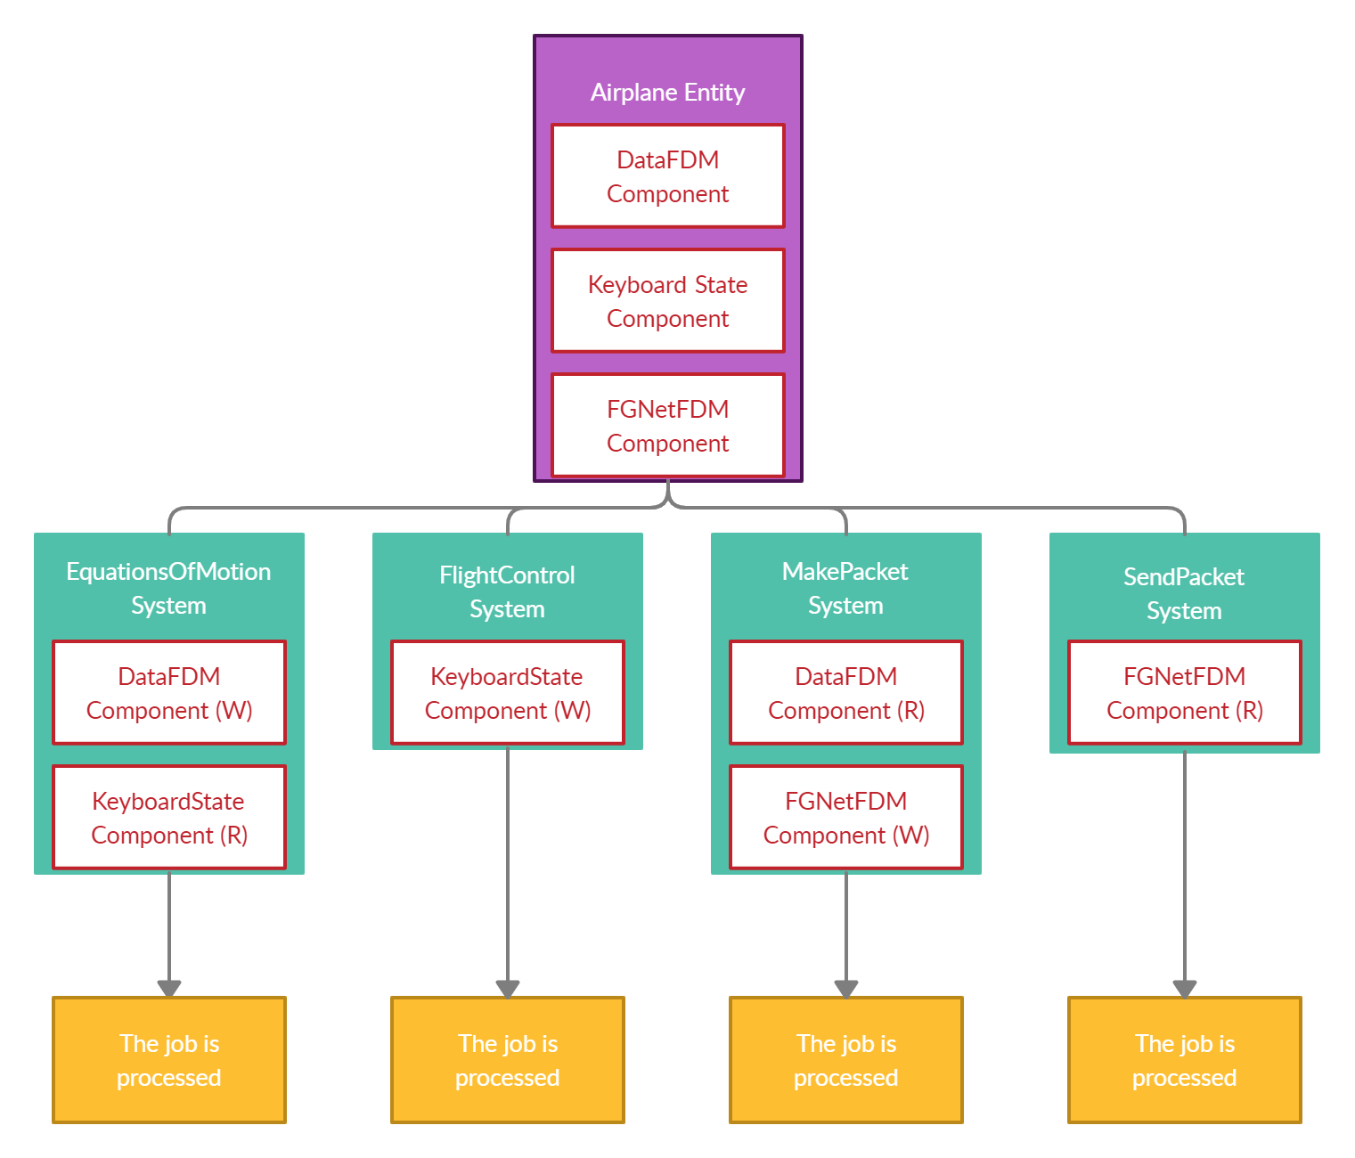
build
Components
DataFDM – All the airplane state data
KeyboardState – Stores state of keyboard
FGNetFDM – FlightGear defined packet

Slide 14
build
Systems
EquationsOfMotion – the FDM
FlightControl – Handles key presses
MakePacket – Updates the packet
SendPacket – Sends the packet to FlightGear
Read/Write Conflicts
Execution order
FlightControl
EquationsOfMotion
MakePacket
SendPacket

Slide 15
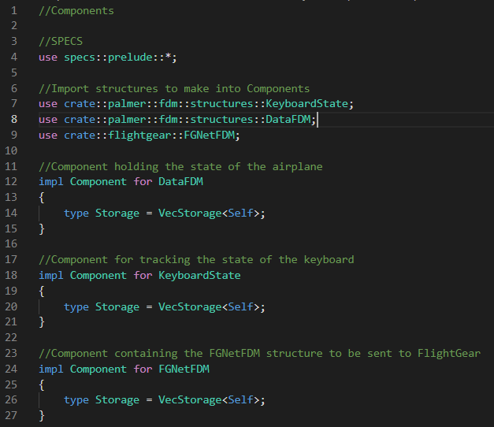
Build

Slide 16
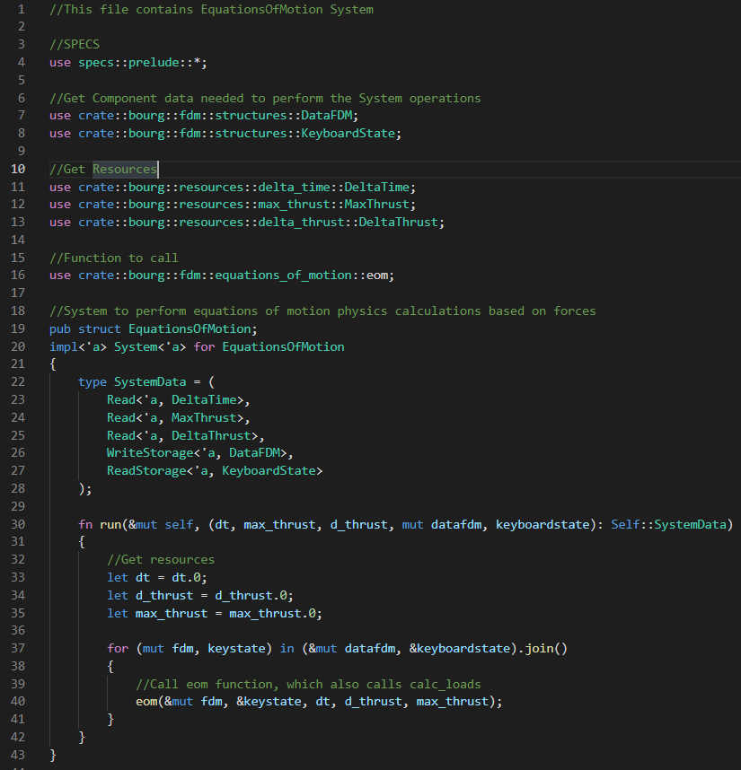
Build

Slide 17
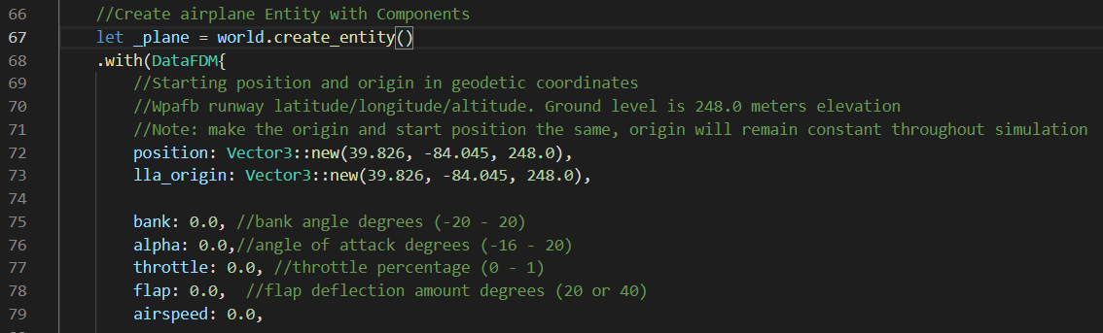
build

Slide 18
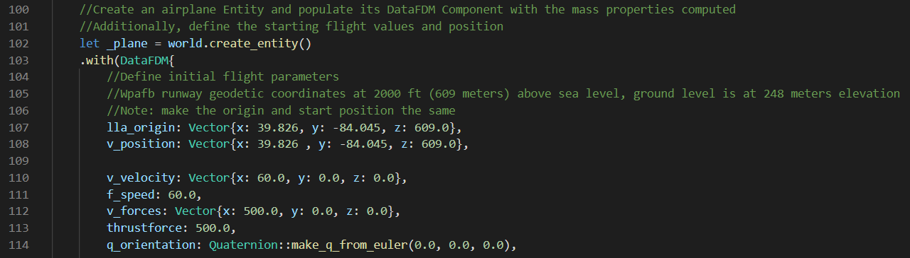
build
Bourg rotations vs Palmer rotations
Bourg uses a quaternion to track airplane orientation (roll, pitch. yaw)
Palmer directly modifies state variables that are passed to FlightGear
Bourg activates the airplane’s components which subsequently modify state variables that are sent to FlightGear

Slide 19
Experimental design
Built two flight dynamics models
Do they work as expected compared to the original code?
Integration tests for both flight dynamics model
Set up a test scenario with the original FDM’s code that simulates the airplane through a fixed flight path with predetermined flight controls and output flight data
Set up the same test scenario but as an integration test using my code
Ran the integration test and compared the original output to my output
Results are compared to a floating-point tolerance

Slide 20
Experimental design
Palmer-based Flight Dynamics Model
Angle of Attack
Bank
Flaps
Everything
Position coordinates and airspeed
60 seconds

Slide 21
Experimental design
Bourg-based Flight Dynamics Model
Nothing
Roll
Pitch
Yaw
Flaps
Everything
Position coordinates, Euler angles, and airspeed
30 seconds

Slide 22
Experiment Results
Palmer – All pass with tolerance of 0.000001
Bourg – All pass with tolerance of 0.01
Palmer uses 64-bit and Bourg uses 32-bit

Slide 23
Impact
ECS proven to be a candidate for real-time flight simulation software
Takes Lt Vagdes’ thesis into fruition
Optimized systems with little extra work by the programmer
Flexible FDM library

Slide 24
Future Work
Improvement upon ECS design
EquationsOfMotion System is bigger than what I would like
Smaller Systems that run in parallel = faster
Get rid of Bourg’s vector, quaternion, matrix
Use Rust crates instead
Integrate Lt Garland’s ECS radar system with my code

Slide 25
Questions?

Slide 26
Experiment design Supplemental
Palmer-based Flight Dynamics Model
Angle of Attack
Flight Control Instructions
Throttle (%): 100
Angle of Attack (deg): 4.0
Bank Angle (deg): 0.0
Flaps Angle (deg): 0.0

Slide 27
Experiment design Supplemental
Palmer-based Flight Dynamics Model
Bank
Flight Control Instructions
Throttle (%): 100
Angle of Attack (deg): 10.0
Bank Angle (deg): 5.0
Flaps Angle (deg): 0.0

Slide 28
Experiment design Supplemental
Palmer-based Flight Dynamics Model
Flaps
Flight Control Instructions
Throttle (%): 100
Angle of Attack (deg): 4.0
Bank Angle (deg): 0.0
Flaps Angle (deg): 20.0

Slide 29
Experiment design Supplemental
Palmer-based Flight Dynamics Model
Everything
Flight Control Instructions
Throttle (%): 100
Angle of Attack (deg): 4.0
Bank Angle (deg): 5.0
Flaps Angle (deg): 20.0

Slide 30
Experiment design Supplemental
Bourg-based Flight Dynamics Model
Nothing
Frame by Frame Flight Control Instructions
None

Slide 31
Experiment design Supplemental
Bourg-based Flight Dynamics Model
Roll
Frame by Frame Flight Control Instructions
1 – 5: Increase Thrust
6 – 246: Pitch Up
247 – 307: Roll Right
308 – 900: None

Slide 32
Experiment design Supplemental
Bourg-based Flight Dynamics Model
Pitch
Frame by Frame Flight Control Instructions
1 – 5: Increase Thrust
6 – 900: Pitch Up

Slide 33
Experiment design Supplemental
Bourg-based Flight Dynamics Model
Yaw
Frame by Frame Flight Control Instructions
1 – 5: Increase Thrust
6 – 246: Pitch Up
247 – 307: Yaw Right
308 – 900: None

Slide 34
Experiment design Supplemental
Bourg-based Flight Dynamics Model
Flaps
Frame by Frame Flight Control Instructions
1 – 900: Flaps Down

Slide 35
Experiment design Supplemental
Bourg-based Flight Dynamics Model
Everything
Frame by Frame Flight Control Instructions
1 – 5: Increase Thrust
6 – 246: Pitch Up
247 – 307: Yaw Left
308 – 368: Yaw Right
369 – 429: Roll Right
430 – 490: Roll Left
491 – 505: Pitch Down
506 – 511: Thrust Down
512 – 900: Flaps Deflected

Slide 36
Experiment design Supplemental
Bourg-based Flight Dynamics Model
Custom Type Modules
Vector
Magnitude
Normalization
Reversal
Addition
Subtraction
Cross product
Dot product
Multiplication by scalar
Division by scalar
Matrix
Inverse
Multiplication by vector
Quaternion
Magnitude
Addition
Multiplication by scalar
Division by scalar
Conjugate
Multiplication
Multiplication by vector
Rotation by vector
Construction by Euler angles
Euler angle extraction

Slide 37
Experiment design Supplemental
Bourg-based Flight Dynamics Model
Initial flight parameters for each test
Variables | Initial Values
Position Coordinates (x, y, z) | -5000.0, 0.0, 2000.0
Velocity Vector (x, y, z) | 60.0, 0.0, 0.0
Force Vector (x, y, z) | 500.0, 0.0, 0.0
Thrust Force (pounds) | 500.0
Airspeed (knots) | 60.0
Notes:
-Initial data when beginning a Bourg test. These values are the same as Bourg’s default code -Palmer tests begin stationary at (0,0,0) position, so we won’t include a table showing that

