Slide 1
An ECS-BASED FLIGHT DYNAMICS MODEL WRITTEN IN RUST
19 FEBRUARY 2021
2d Lt Chad Willis
Committee: Dr. Douglas Hodson Maj Richard dill dr. Scott nykl

Slide 2
Overview
Motivation
Background
Build
Experiment Design
Experiment Results
Impact
Future Work

Slide 3
Motivation
Data-Oriented Design and Entity-Component-System architecture
Rust programming language
Improving simulation software
Notes:
-Extend research upon Joey Vagedes’ thesis which explores the benefits and applicability of ECS in simulation software
-Explain that this research explores actually re-implementing flight dynamics models into ECS-based, Rust-based software

Slide 4
BACKGROUND
Notes:
-We’ll go into some background info…

Slide 5
PHYSICS OF FLIGHT MODELING
Published textbooks
Physics for Game Programmers by Grant Palmer
Physics for Game Developers by David Bourg
Flight Dynamics Models
Calculate external forces and equations of motion
Notes:
-Use two published textbooks containing the flight models -Explain the FDMs: both seek to update position and orientation by considering forces and integrating the equations of motion

Slide 6
Dod and ecs
Structure data to optimize cache
Composition over inheritance
E: Entity – An identifier, index into dataset
C: Component – State that composes the Entity
S: System – Methods on operating on state
Notes:
-Explain briefly DOD and ECS
-Ease of programming and performance benefits

Slide 7
Rust
Performance and memory-safety
Crates
Specs Parallel ECS (SPECS)
Device Query
Bincode & Serde
Coord Transform
Float Cmp
Notes:
-Explain what Rust is and the benefits of Rust
-Explain crates and briefly explain the crates used

Slide 8
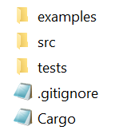
Rust
Organization
cargo.exe run --example bourg
cargo test --test bourg_integration
cargo test --lib vector
cargo test
Notes:
-Explain the way Rust organizes a package and how this is an improvement upon how the FDM’s were originally designed
-Explain Rust integration and unit testing

Slide 9
Flightgear flight simulator
Used as a visualization system
User Datagram Packet to interface
Notes:
-Explain what FlightGear is an how it was used

Slide 10
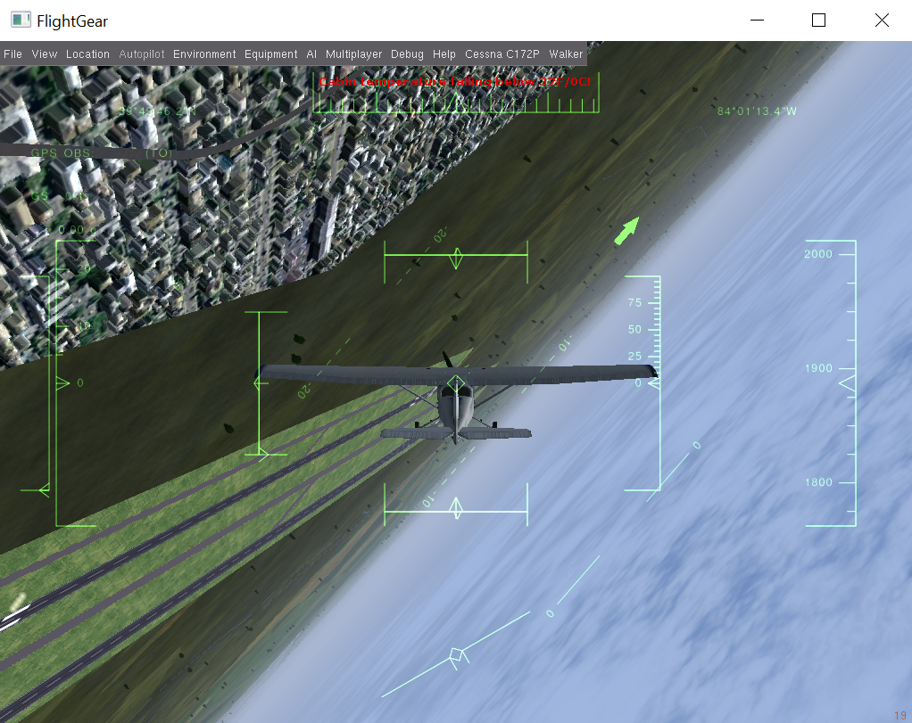
Flightgear flight simulator
Notes:
-Just a snapshot during simulation with FlightGear (doing a barrel roll)

Slide 11
build
Re-implementation process
Translate FDM code from native language to Rust
Structure into ECS
Debug
Refactor
Notes:
-General process of re-implementing the FDMs
-Discuss the debugging problems I had
-Discuss the refactoring/organizing to make the application flexible for many people to use it in many ways (Rust like)

Slide 12
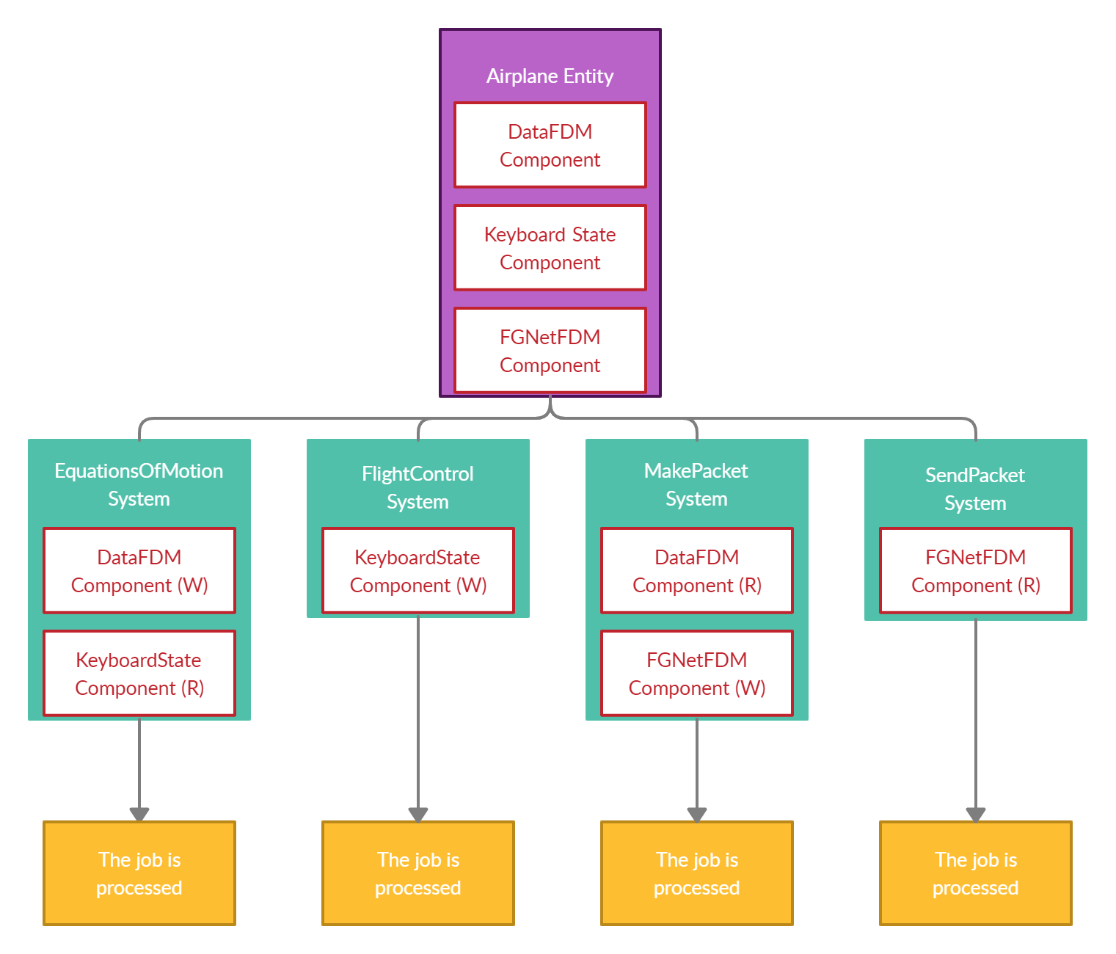
build
Notes:
-The Entity, Components, and Systems used in the flight simulators

Slide 13
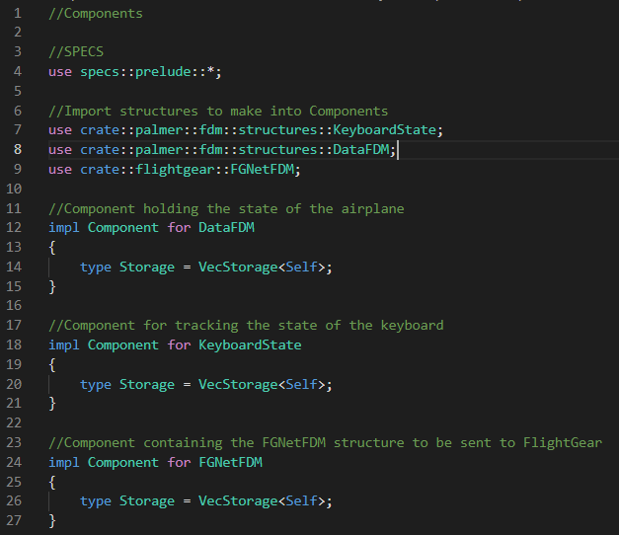
Build
Notes:
-How Components are created

Slide 14
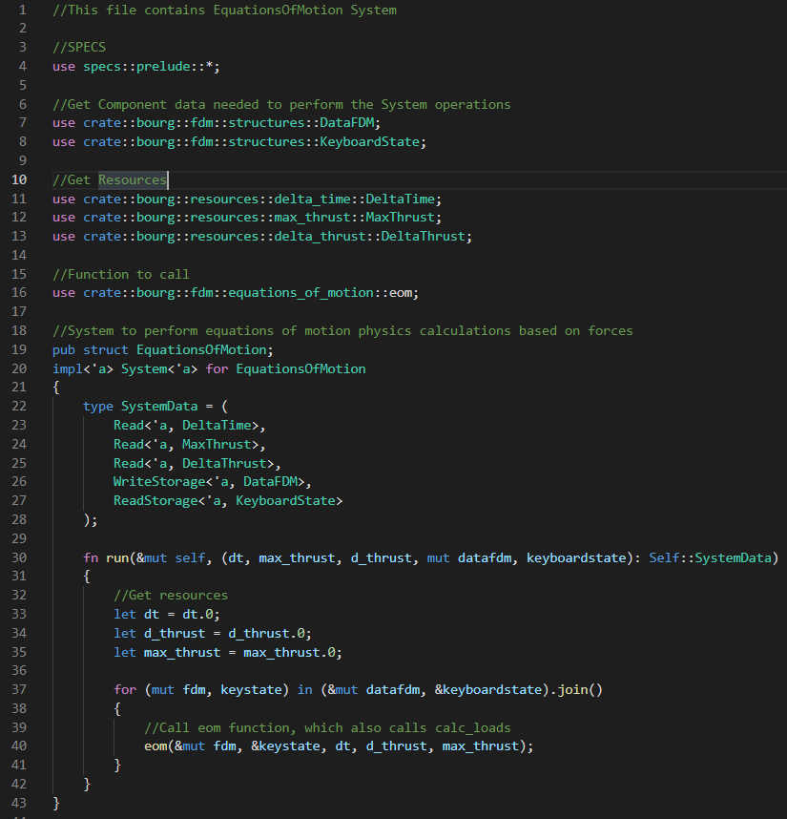
Build
Notes:
-How a System is created

Slide 15
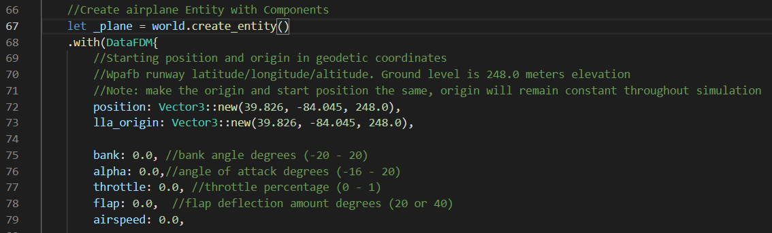
build
Notes:
-How the Palmer-based example initializes the airplane Entity

Slide 16
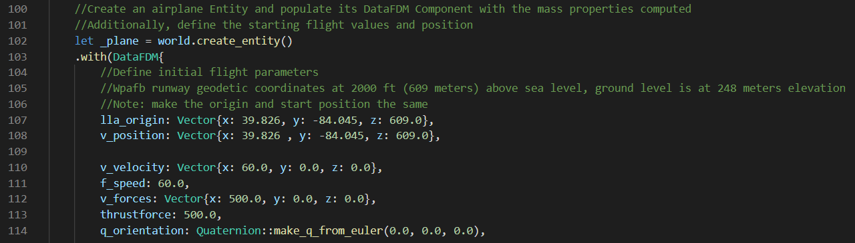
build
Notes:
-How the Bourg-based example initializes the airplane Entity

Slide 17
Experimental design
Palmer-based Flight Dynamics Model
Angle of Attack
Bank
Flaps
Everything
Position coordinates and airspeed
60 seconds
Notes:
-The design of the Palmer FDM tests (using Rust integration tests)

Slide 18
Experimental design
Bourg-based Flight Dynamics Model
Nothing
Roll
Pitch
Yaw
Flaps
Everything
Position coordinates, Euler angles, and airspeed
30 seconds
Notes:
-The design of the Bourg FDM tests (using Rust integration tests)

Slide 19
Experiment Results
Palmer – All pass with epsilon of 0.000001
Bourg – All pass with epsilon of 0.01
Notes:
-The results were accurate to these tolerances in every test for that model
-Possible that Bourg is less accurate due to use of 32-bit floating point numbers instead of 64-bit in Palmer’s model

Slide 20
Impact
ECS proven to be a candidate for real-time flight simulation software
Optimized systems with little extra work by the programmer
Flexible Flight Dynamics Model library
Notes:
-As Joey Vagedes’ thesis found, ECS is viable for simulation
-Restate that ECS provides optimized performance and can make editing coding a more seamless process
-The resulting software package is a flight dynamics model library that is structured in a way that makes it flexible for different uses

Slide 21
Future Work
Improvement upon ECS design
Do away with Bourg’s vector, quaternion, matrix
Notes:
-Find dependencies in FDM to split into more Systems that can run in parallel, also put DataFDM Component into smaller chunks
-Get rid of Bourg’s custom classes because crates exist that could replace the modules

Slide 22
Questions?

Slide 23
Experiment design Supplemental
Palmer-based Flight Dynamics Model
Angle of Attack
Flight Control Instructions
Throttle (%): 100
Angle of Attack (deg): 4.0
Bank Angle (deg): 0.0
Flaps Angle (deg): 0.0
Notes:
-These slides show the experiment details

Slide 24
Experiment design Supplemental
Palmer-based Flight Dynamics Model
Bank
Flight Control Instructions
Throttle (%): 100
Angle of Attack (deg): 10.0
Bank Angle (deg): 5.0
Flaps Angle (deg): 0.0

Slide 25
Experiment design Supplemental
Palmer-based Flight Dynamics Model
Flaps
Flight Control Instructions
Throttle (%): 100
Angle of Attack (deg): 4.0
Bank Angle (deg): 0.0
Flaps Angle (deg): 20.0

Slide 26
Experiment design Supplemental
Palmer-based Flight Dynamics Model
Everything
Flight Control Instructions
Throttle (%): 100
Angle of Attack (deg): 4.0
Bank Angle (deg): 5.0
Flaps Angle (deg): 20.0

Slide 27
Experiment design Supplemental
Bourg-based Flight Dynamics Model
Nothing
Frame by Frame Flight Control Instructions
None

Slide 28
Experiment design Supplemental
Bourg-based Flight Dynamics Model
Roll
Frame by Frame Flight Control Instructions
1 – 5: Increase Thrust
6 – 246: Pitch Up
247 – 307: Roll Right
308 – 900: None

Slide 29
Experiment design Supplemental
Bourg-based Flight Dynamics Model
Pitch
Frame by Frame Flight Control Instructions
1 – 5: Increase Thrust
6 – 900: Pitch Up

Slide 30
Experiment design Supplemental
Bourg-based Flight Dynamics Model
Yaw
Frame by Frame Flight Control Instructions
1 – 5: Increase Thrust
6 – 246: Pitch Up
247 – 307: Yaw Right
308 – 900: None

Slide 31
Experiment design Supplemental
Bourg-based Flight Dynamics Model
Flaps
Frame by Frame Flight Control Instructions
1 – 900: Flaps Down

Slide 32
Experiment design Supplemental
Bourg-based Flight Dynamics Model
Everything
Frame by Frame Flight Control Instructions
1 – 5: Increase Thrust
6 – 246: Pitch Up
247 – 307: Yaw Left
308 – 368: Yaw Right
369 – 429: Roll Right
430 – 490: Roll Left
491 – 505: Pitch Down
506 – 511: Thrust Down
512 – 900: Flaps Deflected

Slide 33
Experiment design Supplemental
Bourg-based Flight Dynamics Model
Custom Type Modules
Vector
Magnitude
Normalization
Reversal
Addition
Subtraction
Cross product
Dot product
Multiplication by scalar
Division by scalar
Matrix
Inverse
Multiplication by vector
Quaternion
Magnitude
Addition
Multiplication by scalar
Division by scalar
Conjugate
Multiplication
Multiplication by vector
Rotation by vector
Construction by Euler angles
Euler angle extraction

Slide 34
Experiment design Supplemental
Bourg-based Flight Dynamics Model
Initial flight parameters for each test
Variables | Initial Values
Position Coordinates (x, y, z) | -5000.0, 0.0, 2000.0
Velocity Vector (x, y, z) | 60.0, 0.0, 0.0
Force Vector (x, y, z) | 500.0, 0.0, 0.0
Thrust Force (pounds) | 500.0
Airspeed (knots) | 60.0
Notes:
-Initial data when beginning a Bourg test. These values are the same as Bourg’s default code -Palmer tests begin stationary at (0,0,0) position, so we won’t include a table showing that

