Slide 1
An ECS-BASED FLIGHT DYNAMICS MODEL WRITTEN IN RUST
19 FEBRUARY 2021
2d Lt Chad Willis
Committee: Dr. Douglas Hodson Maj Richard dill dr. Scott nykl

Slide 2
Overview
Motivation
Background
Build
Experiment Design
Experiment Results
Impact
Future Work

Slide 3
Motivation
Data-Oriented Design and Entity-Component-System architecture
Rust programming language
Improving simulation software
Notes:
-Extend research upon Joey Vagedes’ thesis which explores the benefits and applicability of ECS in simulation software
-Explain that this research explores actually re-implementing flight dynamics models into ECS-based, Rust-based software

Slide 4
BACKGROUND
Notes:
-We’ll go into some background info…

Slide 5
PHYSICS OF FLIGHT MODELING
Published textbooks
Physics for Game Programmers by Palmer
Physics for Game Developers by Bourg
Flight Dynamics Models
6 Degrees of Freedom
Calculate external forces and equations of motion
Notes:
-Use two public textbooks containing the flight models -Explain the FDMs: both 6-DoF and seek to update position and orientation by considering forces and integrating the equations of motion

Slide 6
Dod and ecs
Structure data to optimize cache
Composition over inheritance
E: Entity – An identifier, index into dataset
C: Component – State that composes the Entity
S: System – Methods on operating on state
Notes:
-Explain briefly DOD and ECS

Slide 7
Rust
Performance and memory-safety
Crates
Specs Parallel ECS (SPECS)
Device Query
Bincode & Serde
Coord Transform
Float Cmp
Notes:
-Explain what Rust is and the benefits of Rust
-Explain crates and briefly explain the crates used

Slide 8
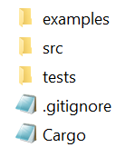
Rust
Organization
cargo.exe run --example bourg
cargo test --test bourg_integration
cargo test --lib vector
cargo test
Notes:
-Explain the way Rust organizes a package and how this is an improvement upon how the FDM’s were originally designed
-Explain Rust integration and unit testing

Slide 9
Flightgear flight simulator
Used as a visualization system
User Datagram Packet to interface
Notes:
-Explain what FlightGear is an how it was used

Slide 10
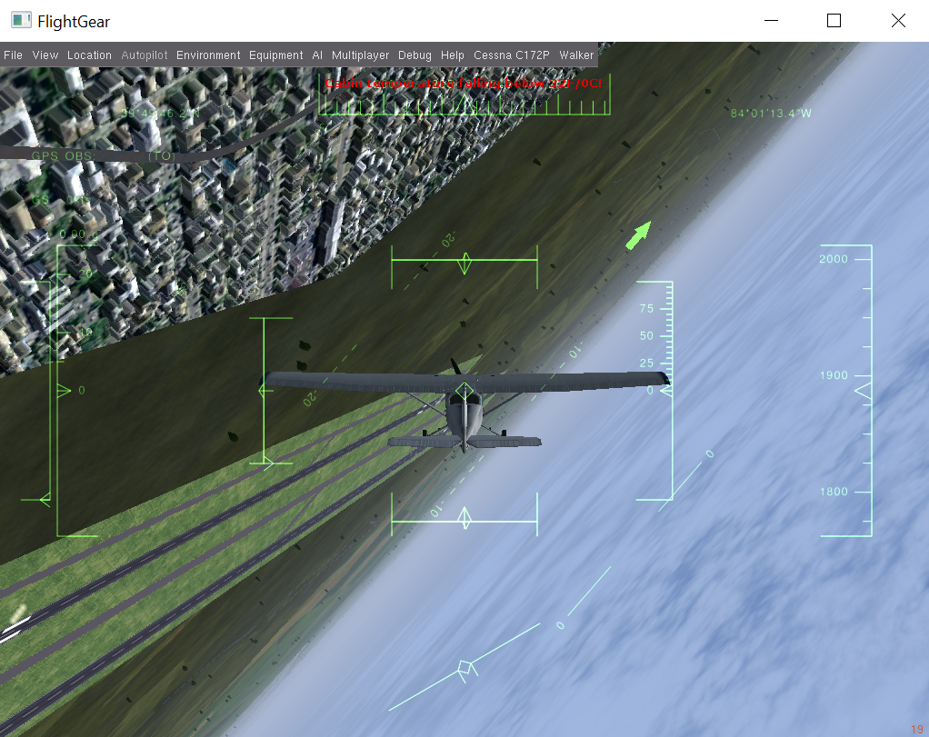
Flightgear flight simulator
Notes:
-Just a snapshot during simulation with FlightGear (doing a barrel roll)

Slide 11
build
Re-implementation process
Translate FDM code from native language to Rust
Structure into ECS
Debug
Refactor
Notes:
-General process of re-implementing the FDMs
-Discuss the debugging problems I had
-Discuss the refactoring/organizing to make the application able for many people to use it in many ways (Rust like)

Slide 12
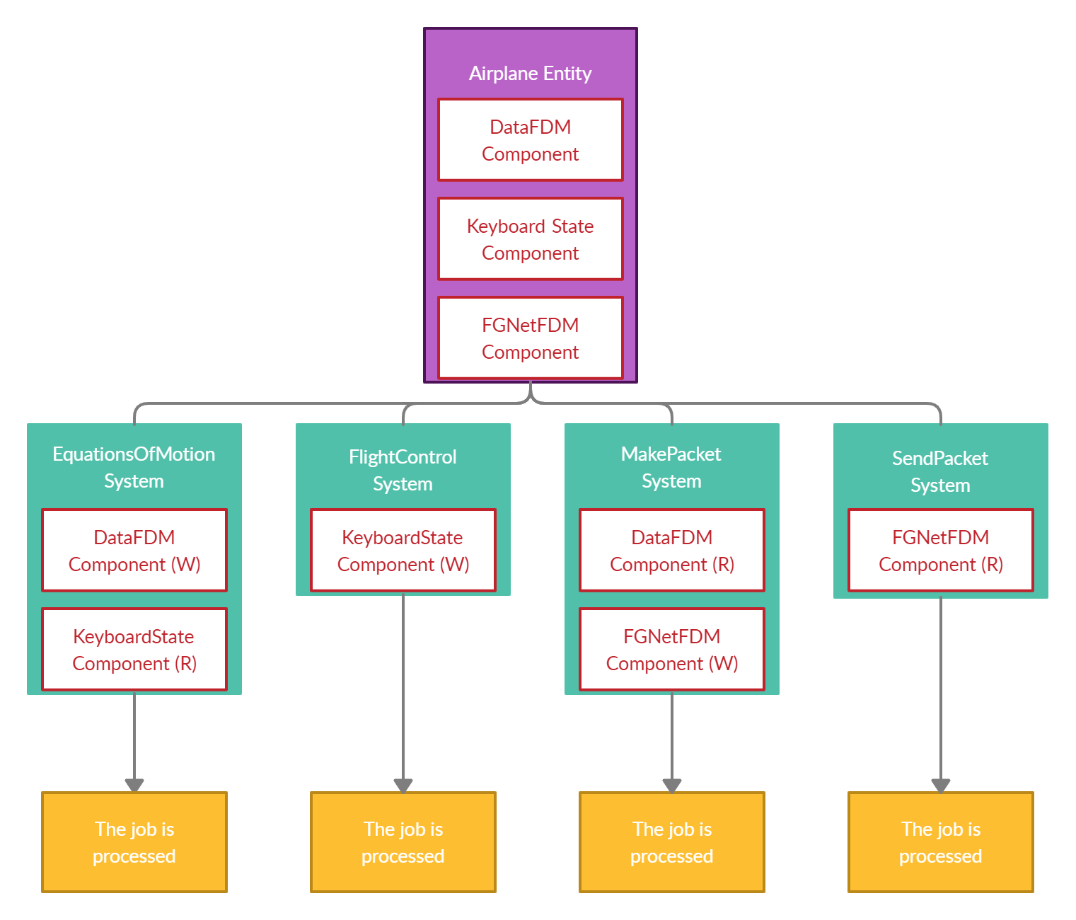
build
Notes:
-The Components and Systems used in the flight simulators, along with their dependencies

Slide 13
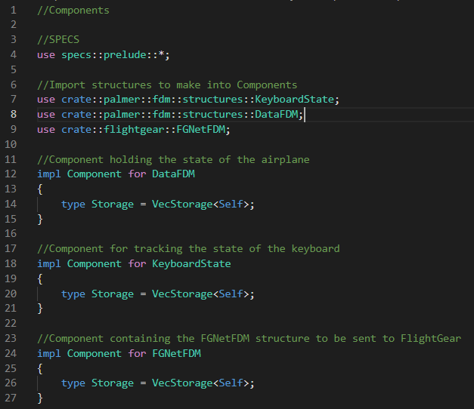
Build
Notes:
-How Components are created

Slide 14
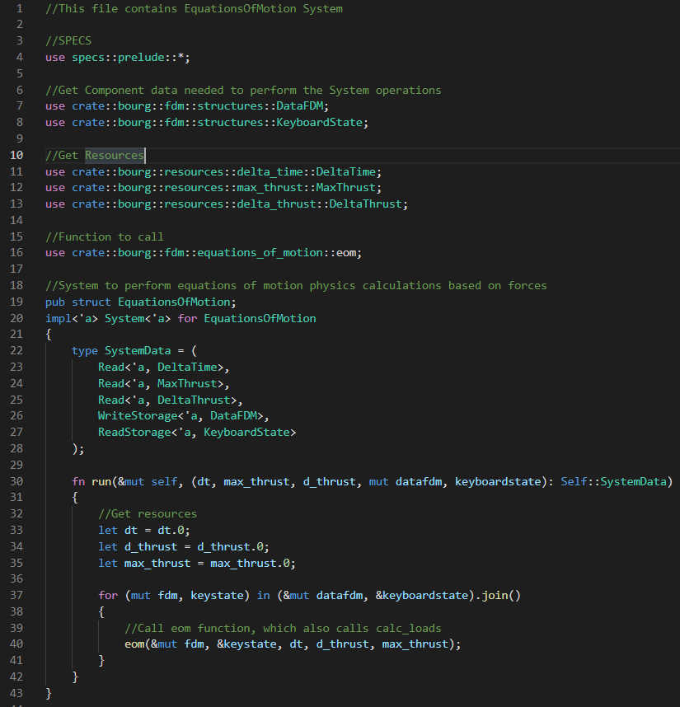
Build
Notes:
-How a System is created

Slide 15
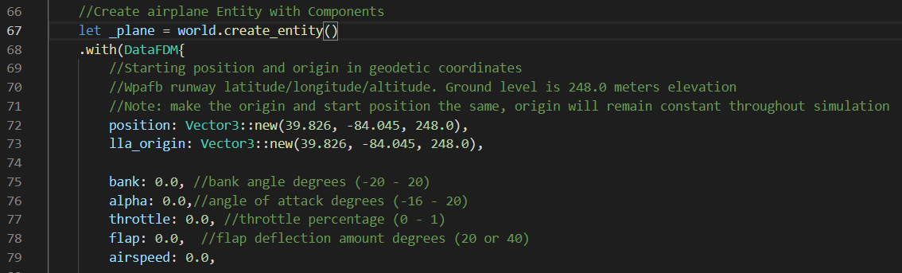
build
Notes:
-How the Palmer-based example initializes the airplane Entity

Slide 16
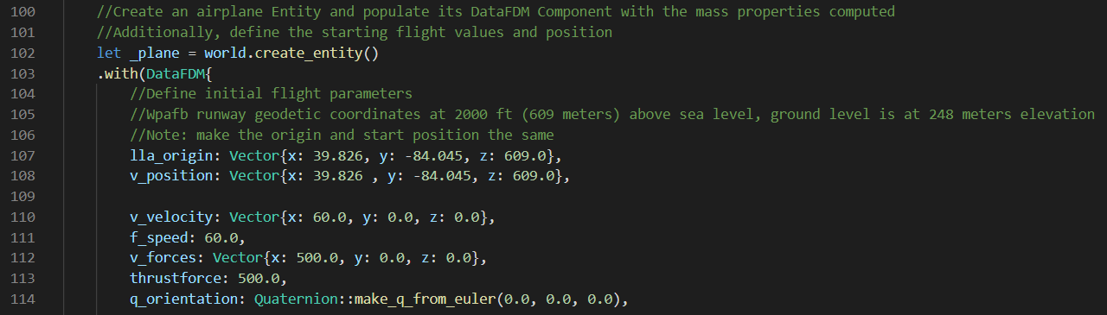
build
Notes:
-How the Bourg-based example initializes the airplane Entity

Slide 17
Experimental design
Palmer-based Flight Dynamics Model
Angle of Attack
Bank
Flaps
Everything
Position coordinates and airspeed
60 seconds
Notes:
-The design of the Palmer FDM tests (using Rust integration tests)

Slide 18
Experimental design
Bourg-based Flight Dynamics Model
Nothing
Roll
Pitch
Yaw
Flaps
Everything
Position coordinates, Euler angles, and airspeed
30 seconds
Notes:
-The design of the Bourg FDM tests (using Rust integration tests)

Slide 19
Experiment Results
Palmer – All pass with epsilon of 0.000001
Bourg – All pass with epsilon of 0.01
Notes:
-The results were accurate to these tolerances in every test for that model
-Possible that Bourg is less accurate due to use of 32-bit floating point numbers instead of 64-bit in Palmer’s model

Slide 20
Impact
ECS proven to be a candidate for real-time flight simulation software
Optimized systems with little extra work by the programmer
Notes:
-As Joey Vagedes’ thesis found, ECS is viable for simulation,

Slide 21
Future Work
Improvement upon ECS design
Do away with Bourg’s vector, quaternion, matrix
Notes:
-Find dependencies in FDM to split into more Systems that can run in parallel, also put DataFDM Component into smaller chunks
-Get rid of Bourg’s custom classes because crates exist that could replace the modules

Slide 22
Questions?

Slide 23
Experiment design
More design details

