Slide 1
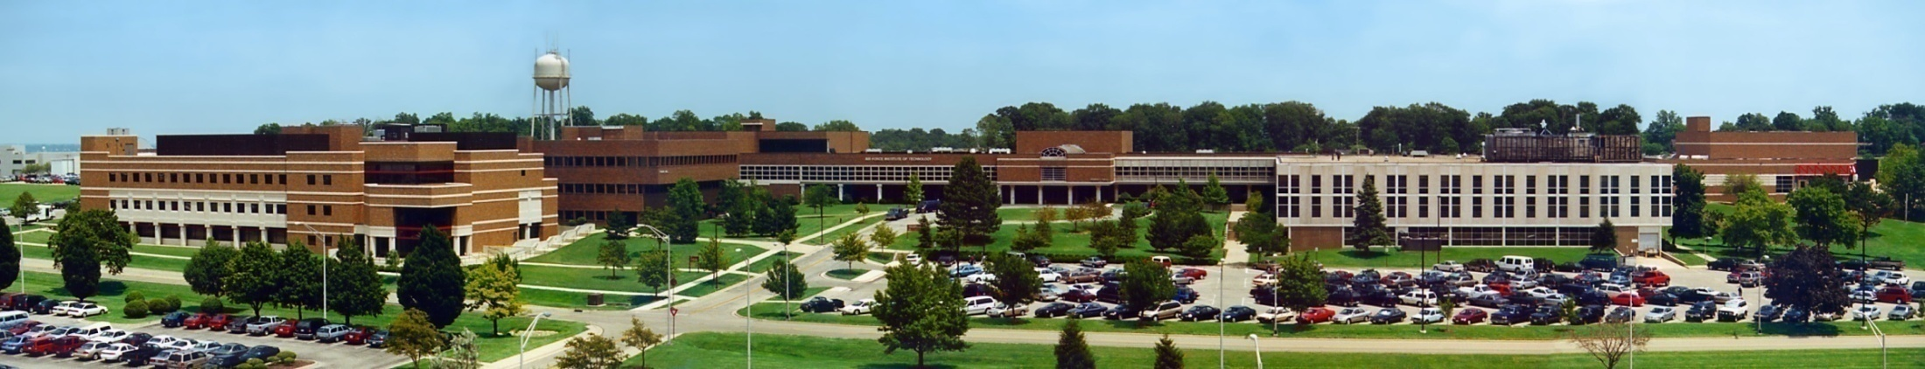
CSCE 693 – Software Evolution Game Patterns
Air Force Institute of Technology
Douglas D. Hodson, PhD
Bldg 640, Room 311C
255-3636 x4719

Slide 2
Patterns of Interest
Game object-based
Entity-Component-based
Blended (unpure) design
Entity-Component-System

Slide 3
Game Object-based Pattern (The Entity is the Game Object)

Slide 4
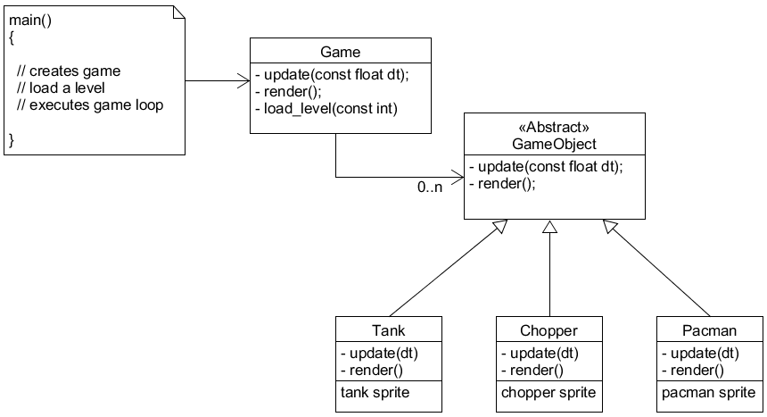
Existing Design

Slide 5
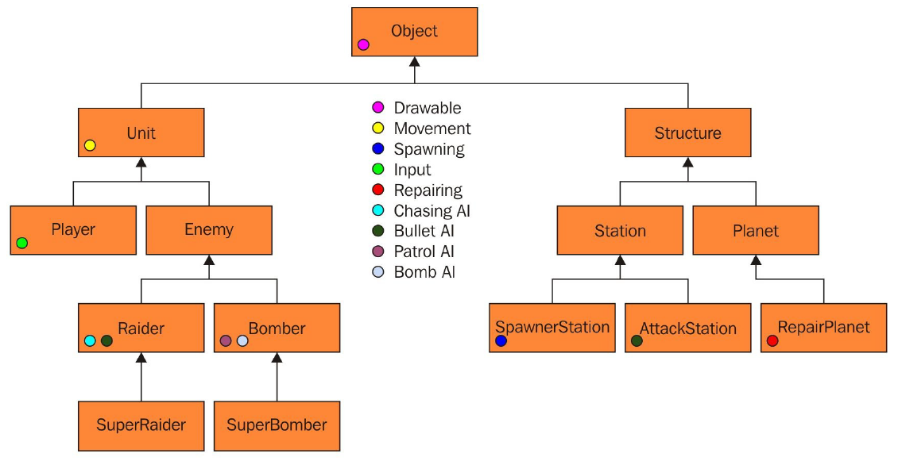
Typical Hierarchy
Reference: Game Development Patterns and Best Practices
Manageable and sensible initially

Slide 6
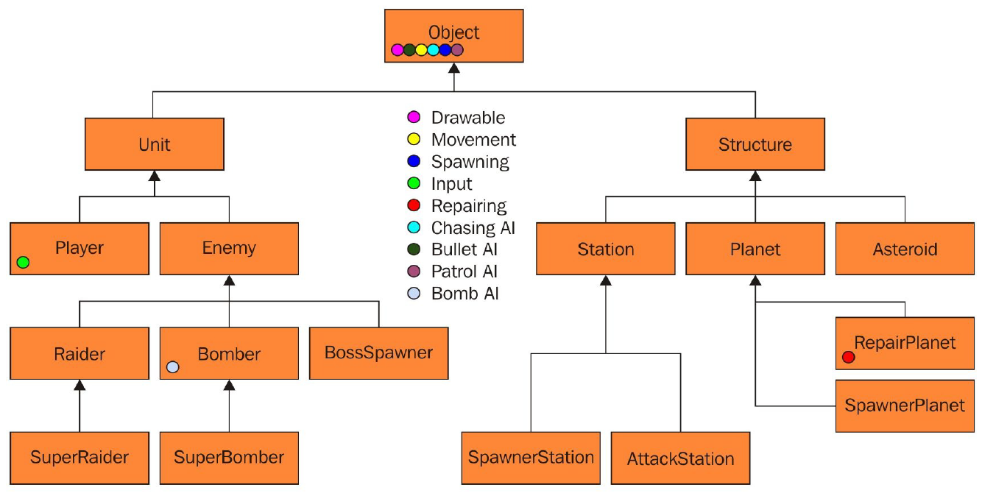
Refactored Hierarchy
Reference: Game Development Patterns and Best Practices
Functionality tends to migrate up to base
Example: MIXR’s base entity class SLOC (header:1100, implementation: 4000)

Slide 7
Entity-Component Pattern (The Entity is Defined by it’s Components)

Slide 8
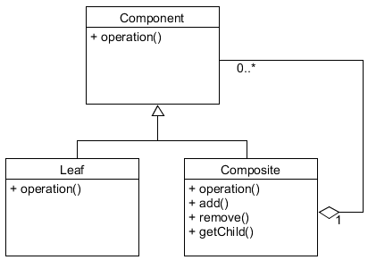
Composite Pattern
child
parent

Slide 9
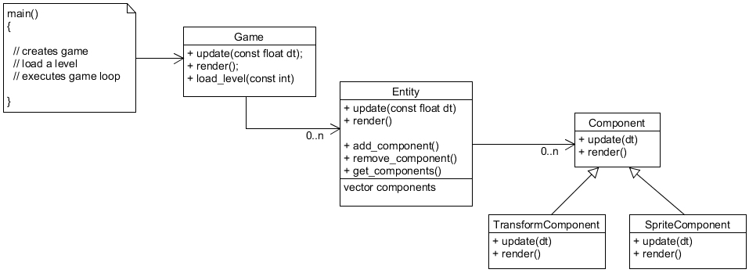
Component-based Design
update all entities
update all components
Challenges...
Movement needs position data and so does Sprite
Dependencies
Order of execution

Slide 10
Blended Design (The Entity is Defined by it’s Type, while Certain Behaviors/Aspects are Defined by Components)

Slide 11
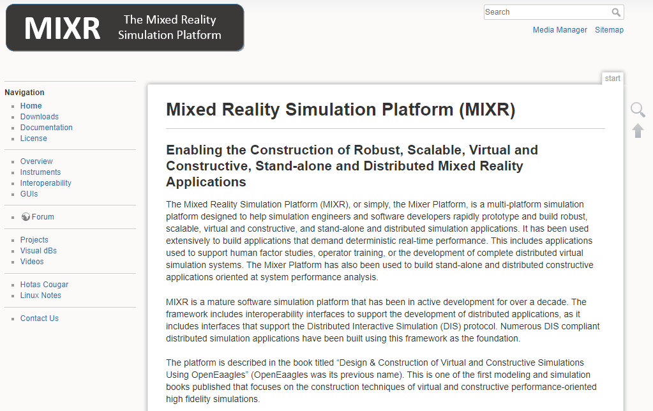
MIXR

Slide 12

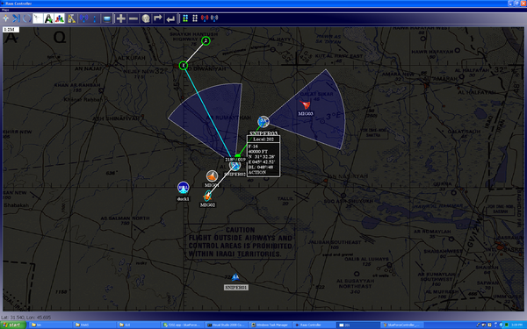
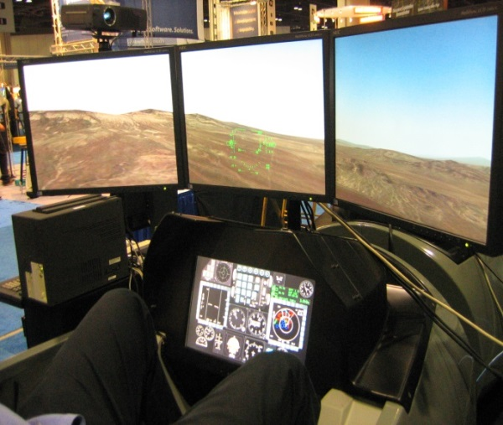
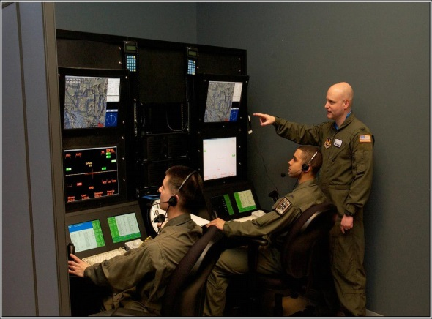
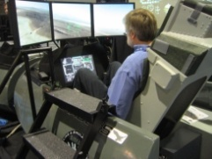
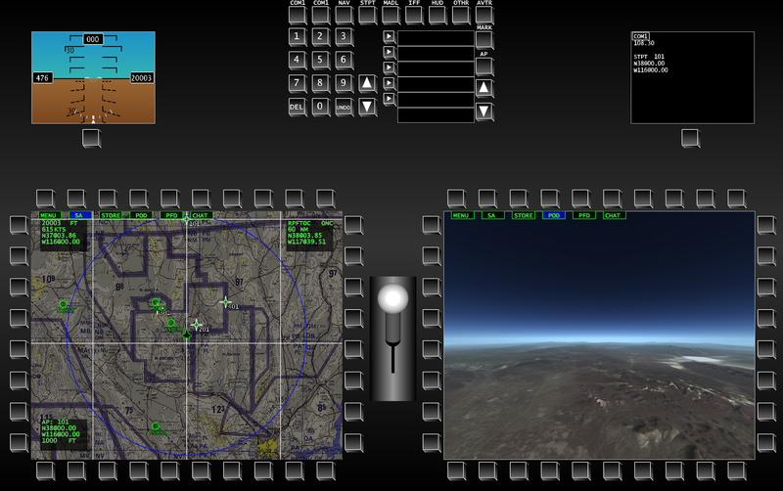
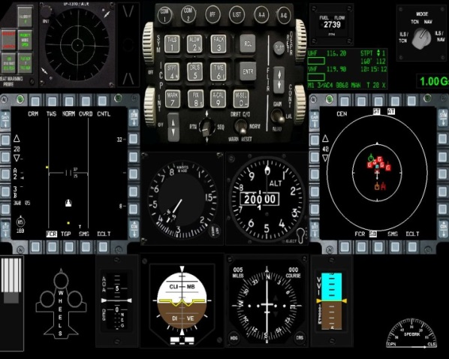
MIXR
Mixed Reality Environments / Virtual / Serious Gaming!

Slide 13
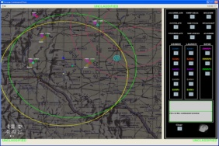
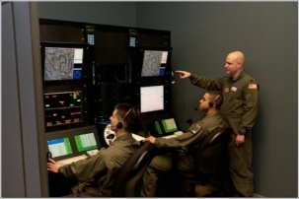
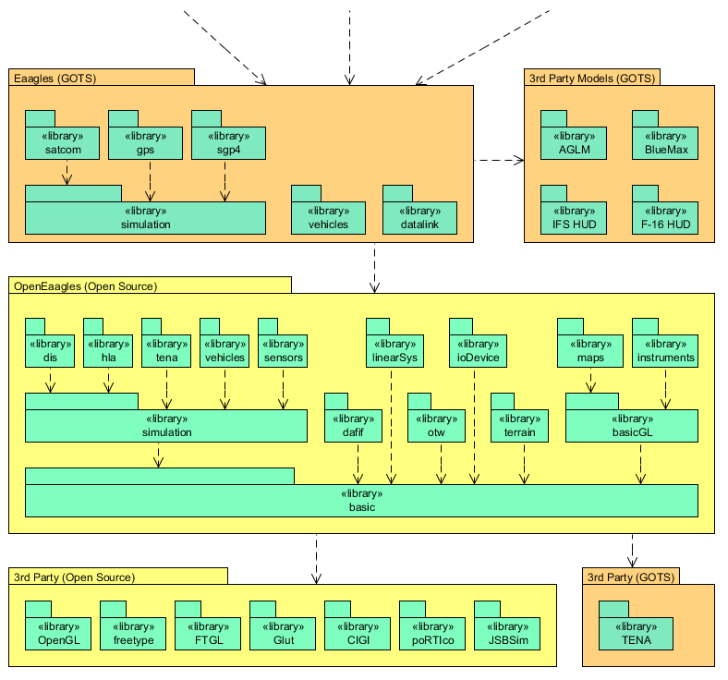
Simulation / Framework Relationship
Products
Simulators & Simulations Based on Framework Structure
Framework
Defines Simulation Architecture, PVI Graphics and Instruments Library, Input Language and Abstract Modeling Environments for RF, IR, datalinks, GPS, Satcom, Weapons, etc
External Packages to Support Graphics & Interoperability

Slide 14
Abbreviated Class Hierarchy
RwrTrack
Track
RdrTrack
DigiPlayer
Object
Emission
EcmEmission
SAM
BlueMaxPlayer
RacPlayer
Component
Player
AirVehicle
FI6APlayer
Missile
RacMissile
Weapon
Bomb
“Type”
Decoy
Mode
Sensor
Radar
Antenna
….
RWR
Simulation
Jammer
NetworkIO
OtwCIGI
….
Station
OtwHUD
Otw
“Component”
….

Slide 15
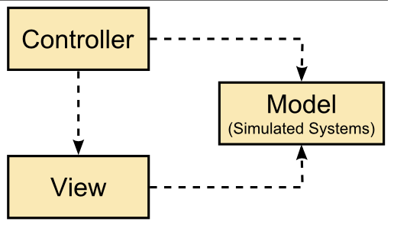
Model-View-Controller Pattern
Model is the application’s domain logic
It’s the simulation!
View is the application’s graphical displays
Controller associates model to view(s)

Slide 16
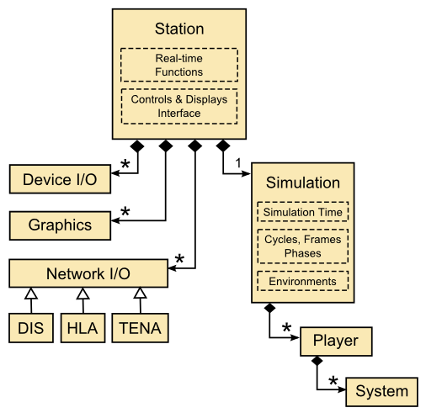
Simulation Design Pattern
Controller
View(s)
Model

Slide 17
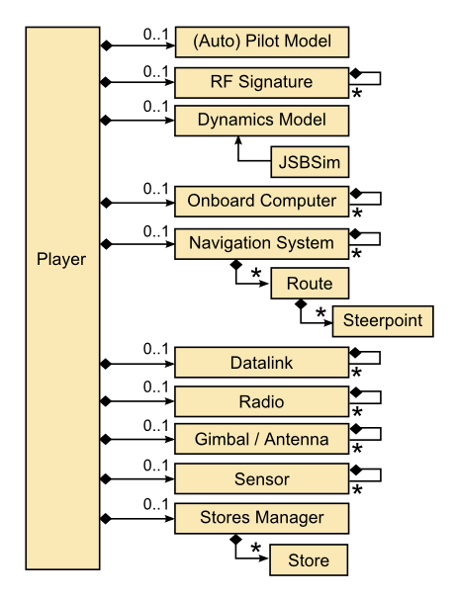
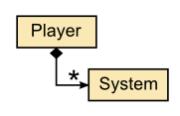
Player Pattern
Hierarchical System Model

Slide 18
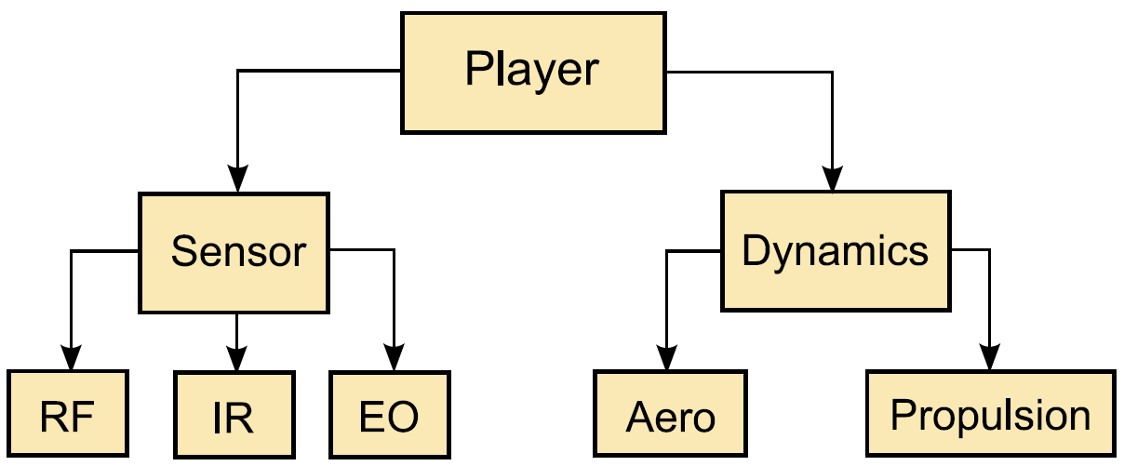
Example: Hierarchical System Model

Slide 19
RF Modeling Pattern

Slide 20
RF Modeling
Radar Pulse
Beam Center
ECM Xmit

Slide 21
RF Modeling – Emission Path
Player 1
Player 2
Sensor Manager
Radar
RWR
Transmitter
Antenna
Antenna
Receiver
Track Mgr
Track Mgr
Receiver
Jammer
Antenna
Transmitter
Player 1
Radar with a transmitter, receiver and a track manager
Antenna assigned to the Radar
Player 2
RWR and Jammer controlled by a Sensor Manager
Antenna assigned to each sensor

Slide 22
RF Modeling – Emission Path (cont)
Player 1
Player 2
(2)
Sensor Manager
Radar
(1)
RWR
Transmitter
Antenna
Antenna
Receiver
Track Mgr
Track Mgr
Receiver
Jammer
Antenna
Transmitter
(1) Radar transmitter creates an RF emission packet and sends it to its antenna
(2) The antenna, after computing geometry and gains, sends emission packets to other players

Slide 23
RF Modeling – Emission Path (cont)
Player 1
Player 2
(2)
Sensor Manager
Radar
(4)
(1)
RWR
Transmitter
(3)
Antenna
Antenna
Receiver
Track Mgr
Track Mgr
Receiver
Jammer
Antenna
Transmitter
(3) Players apply their radar cross section from their Signatures (not shown) and send the modified packets back to the antennas
(4) Players send the packet to any onboard antennas

Slide 24
RF Modeling – Emission Path (cont)
Player 1
Player 2
Sensor Manager
Radar
(4)
RWR
(7)
Transmitter
(3)
(6)
(6)
(5)
Antenna
Antenna
(5)
Receiver
Track Mgr
Track Mgr
Receiver
Jammer
Antenna
Transmitter
(5) Antennas that are assigned to receivers will apply gains and pass the emission packets to the receivers
(6) The receivers apply any final effects (e.g., noise, ECM). Emissions that exceed a given threshold are sent as reports to the track managers
(7) Track managers will provide track lists

Slide 25
RF Modeling – Emission Path (cont)
Player 1
Player 2
(9)
Sensor Manager
Radar
(10)
RWR
(7)
Transmitter
(6)
(5)
Antenna
Antenna
(5)
Receiver
Track Mgr
(6)
(11)
Track Mgr
Receiver
Jammer
(8)
Antenna
Transmitter
(8) Jammer transmitter creates a ECM emission packet and sends it to its assigned antenna
(9) The antenna after computing geometry and gains, sends ECM packets to other players
(10) Players send the ECM packets to any onboard antennas
(11) Antennas, which are assigned to receivers, will apply gains and pass the ECM packets to the receivers for processing

Slide 26
Pros/Cons
Hierarchy is somewhat confusing
What should a unique type define?
Tends to be real world “systems”
What constitutes a component?
Tends to be real world “subsystems”
This is not a game, the real world helps define those distinctions
The Component class does a lot of stuff.... so does Player
Hard to argue with results, this pattern has proven flexible to design a wide range of applications

Slide 27
Entity-Component-System (ECS) Pattern (The Entity is Defined by it’s Collection of Components, but the Component Only Hold Data which is Updated by the Systems) (This pattern can be viewed as an cache-friendly optimization – a Data Oriented Design)

Slide 28
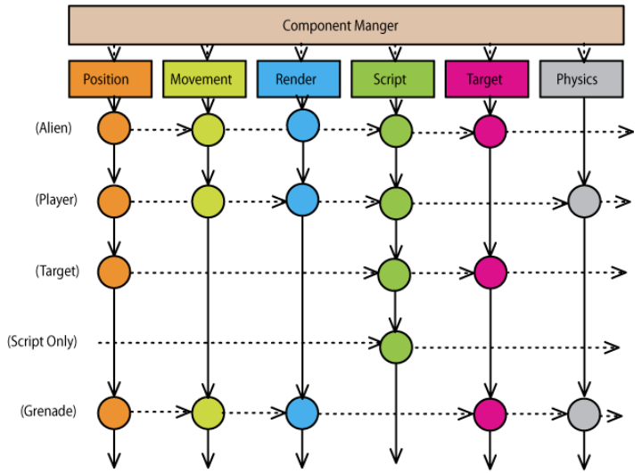
Component-based Design
Aspect (available functional and behavioral features for a particular entity)
Entity
(organized as aggregate)
Reference: Evolve Your Hierarchy
Memory (organized as an array localized to avoid cache misses and efficiently updated by an aspect)

Slide 29
A Different Perspective (An Analogy)

Slide 30
The Role of System in ECS
Entity
Unique entity ID
Position
Velocity
Sprite
Health
Entity are like keys – you can tell them apart by their ID (even if they have the same teeth)
Keys fit into locks – locks are our systems (aspects)

Slide 31
The Role of System in ECS
Position
Velocity
Delta Time
Calculations
System (Movement)
This system (aspect) only processes entities that have a position and a velocity
Systems (aspects) can access time, graphics, sound, etc...
They are independent - they can have their own threads

Slide 32
Our Graphics System
Position
Sprite
Calculations
Draw to screen
System (Drawing)

Slide 33
Static Item (e.g., Rock)
Entity
Unique entity ID
Position
Sprite

Slide 34
Qt3D ECS... (“Aspect” vs “System”)

Slide 35
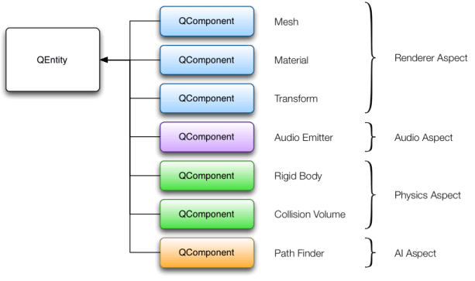
Prefer “Aspect” Over “System”
Reference: Qt 3D Overview Documentation
The word aspect more clearly conveys the separation of things an entity can do
But is a bit overloaded, as there is “Aspect Oriented Programming”

Slide 36
References
GDC 2002 Presentation: A Data-Driven Game Object System
https://www.gamedevs.org/uploads/data-driven-game-object-system.pdf
Entity Systems are the future of MMOG development
http://t-machine.org/index.php/2007/09/03/entity-systems-are-the-future-of-mmog-development-part-1/
The Entity-Component-System C++ Game Design Pattern
https://www.gamedev.net/articles/programming/general-and-gameplay-programming/the-entity-component-system-c-game-design-pattern-part-1-r4803/
Template-based ECS Implementation
Cowboy Programming: Evolve Your Hierarchy
http://cowboyprogramming.com/2007/01/05/evolve-your-heirachy/
Ash Entity Framework
https://www.richardlord.net/ash/
An Entity-Component-System in C++ and Qt
http://cppedinburgh.uk/slides/201611-qt3d-ecs.pdf

Slide 37
EOF

Slide 38
Common Station Overview
Simulation
Network Interface
Network protocol Unique
Simulation Time
Cycles,
Frames,
Phases
Player List
Environments
Player
Station
Signatures
Antennas
Real-time
functions
Player
Unique
Behavior
Sensors/Mgr
OTW interfaces
Stores/Wpns
Ownship
C/D
Interface
Navigation
Displays
Controls
&
Displays
Pilot Logic
Dynamics
Cockpit
I/O
…
Player
Player
BasicGL Foundation Classes
Basic Foundation Classes

