Slide 1

CSCE 693 – Software Evolution Entity-Component Implementation
Air Force Institute of Technology
Douglas D. Hodson, PhD
Bldg 640, Room 311C
255-3636 x4719

Slide 2
Entity-Component Pattern (The Entity is Defined by it’s Components)

Slide 3
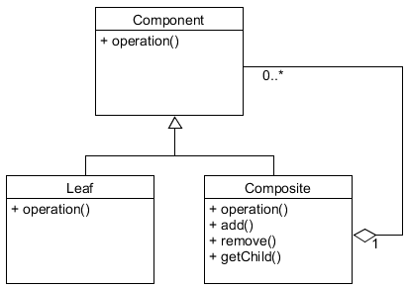
Composite Pattern
child
parent

Slide 4
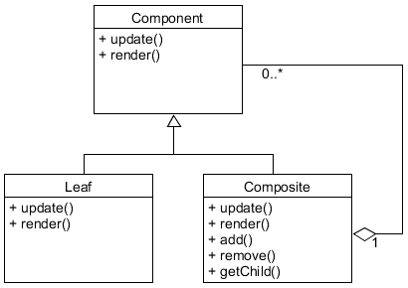
Composite Pattern (More Specific)
child
parent
update() handles movement, render() draws the sprite

Slide 5
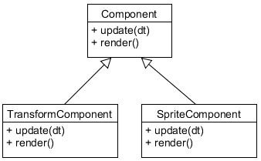
Composite Pattern (Altered)
Composite class is gone (everything is a leaf)
add() and remove() methods are gone
In some ways it's not a "component" (per definition) at all
It's just a piece or aspect of something larger

Slide 6
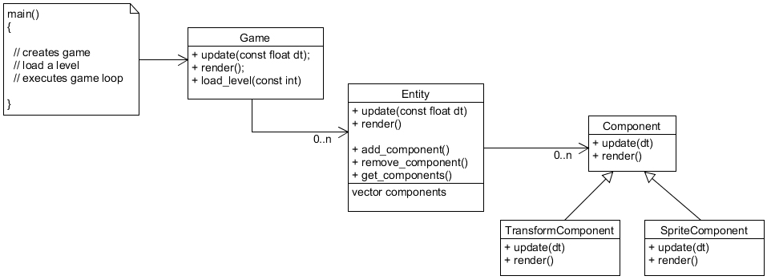
Component-based Design
updates all entities
updates all components
Challenges...
Movement needs position data and so does Sprite
Dependencies
Order of execution

Slide 7
An Example Entity-Component Implementation

Slide 8
Component-based Design
updates all entities
updates all components
Challenges...
Movement needs position data and so does Sprite
Dependencies
Order of execution

Slide 9
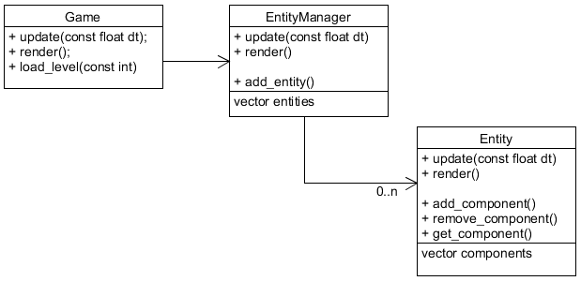
Class: EntityManager

Slide 10
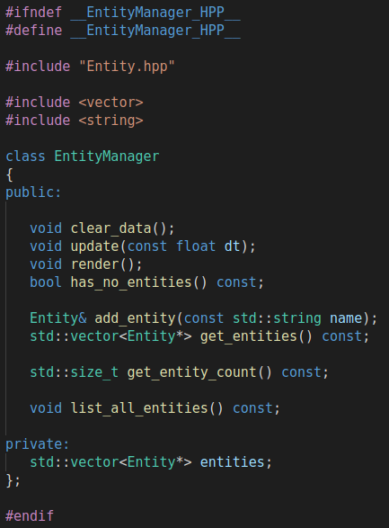
Class: EntityManager

Slide 11
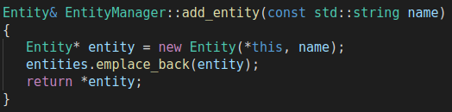
Class: EntityManager
Adding a new entity is very straightforward
No "variation" (subtypes) of entities, they are all the same
What about memory here? How does "entity" get deleted?

Slide 12
Class: Entity
Adding a component is not so straightforward

Slide 13
A Variety of Components
It’s a class hierarchy
Each component has a type that must be considered
Each component has its own constructor parameters

Slide 14
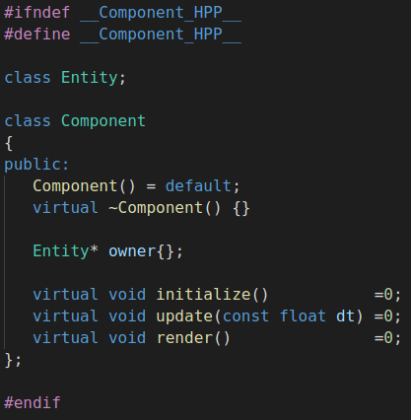
Base Component Class
What is the purpose of initialize()?
How is it different than a constructor?

Slide 15
Two Component Types
TransformComponent
Conceptually simple, it maintains a position and velocity
It is constructed by an “initial” position and velocity
It updates position using velocity and delta time
Nothing to render
SpriteComponent
Conceptually simple as well, holds a texture, and renders it at the correct position
But it need to know position – meaning it needs to know how to get it from the TransformComponent
It’s constructor receives a texture filename (not actually... later) and points at the texture data
It’s initialize method gets a pointer to the TransformComponent, so it has access to data

Slide 16

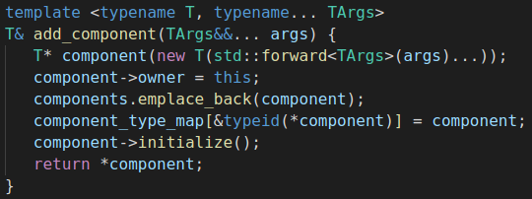
Adding a Component
Within Game::load_level(), create entity, add components
This code requires explanation
Ignore for now
Method in Entity Class
The vector of components in Entity class

Slide 17
C++ Member Templates

Slide 18
Problem
You have a single member function that needs to take a parameter that can be of any type
You can't or don't want to be constrained to a particular type or category of types (by using a base class pointer parameter)

Slide 19
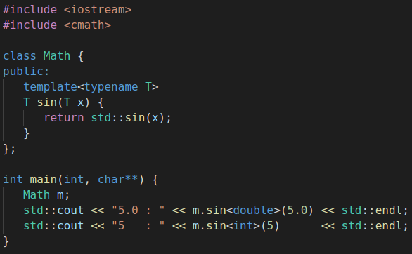

Example

Slide 20
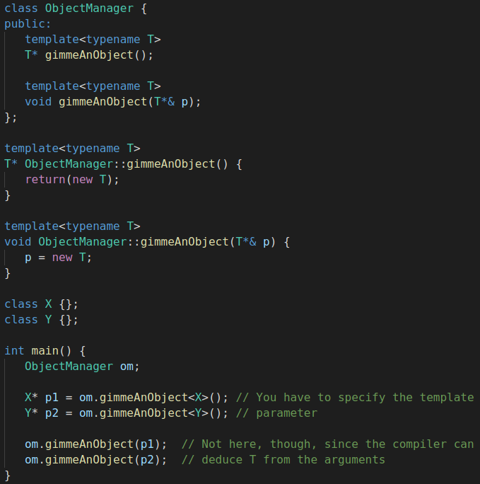
Example

Slide 21
C++ Variadic Templates

Slide 22
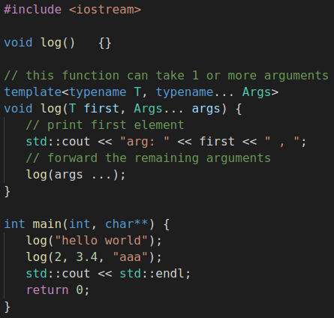
Variadic Template Example
Introduced in C++11
Allows a function to take a variable number of arguments of any type
Key thing to remember, there is a recursion going on here...
Code is being generated

Slide 23
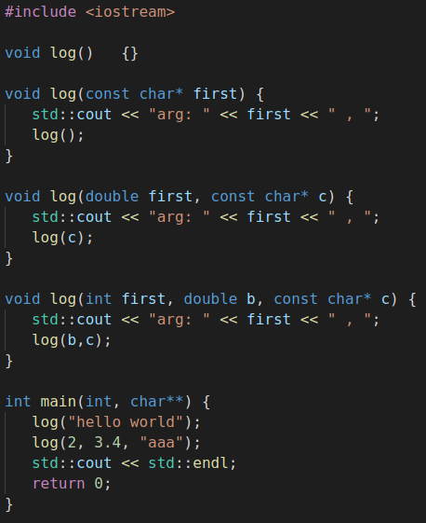

Unraveling Template Generation
Most of the functions generated came from the template
Function overloading!
This example inspired by
https://thispointer.com/c11-variadic-template-function-tutorial-examples/

Slide 24
C++ std::forward<T>

Slide 25
std::forward
std::move takes an object and allows you to treat it as a temporary (an rvalue)
When you see std::move, it indicates that the value of the object should not be used afterwards, but you can still assign a new value and continue using it
std::forward has a single use case: to cast a template function parameter (inside the function) to the value category (lvalue or rvalue) the caller used to pass it
rvalues are passed as rvalues
lvalues are passed as lvalues
I.e., “perfect” forwarding

Slide 26
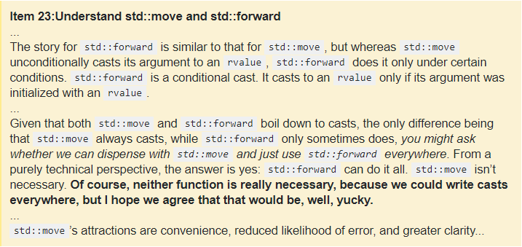
Scott Meyers Comment

Slide 27
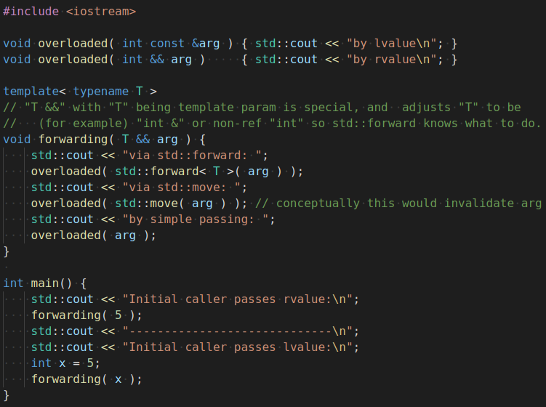
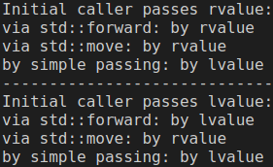
std::forward Illustrated

Slide 28
Back to Adding a Component

Slide 29
Adding a Component
Within Game::load_level(), create entity, add components
Now, pay attention
Method in Entity Class
The vector of components in Entity class

Slide 30
Type Information

Slide 31
typeid Operator
The typeid keyword is a unary operator that yields run-time type information about its operand if the operand's type is a polymorphic class
It returns an lvalue of type const std::type_info
The class std::type_info holds implementation-specific information about a type
Including its name
Means to compare two types for equality...

Slide 32
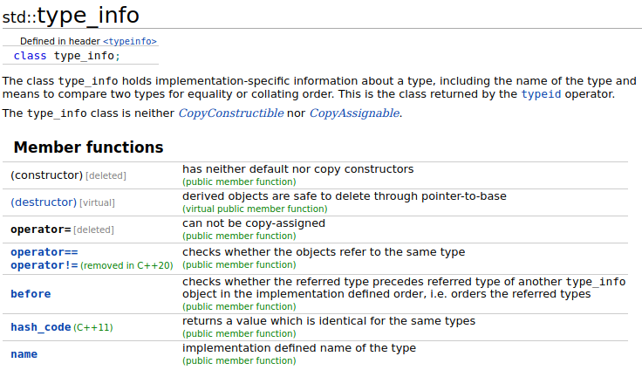
std::type_info

Slide 33
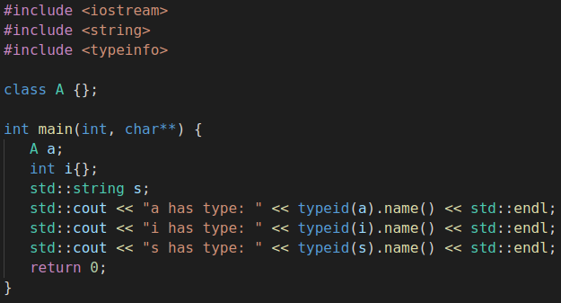

Example
Output from name() is implementation specific!!

Slide 34
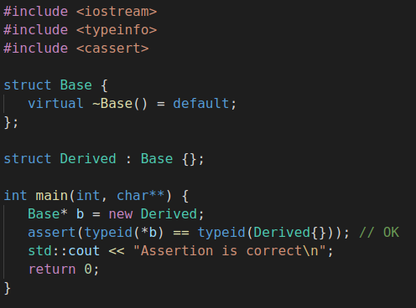
Example
From a type perspective, class Derived is the same type as Base, because it's derived

Slide 35
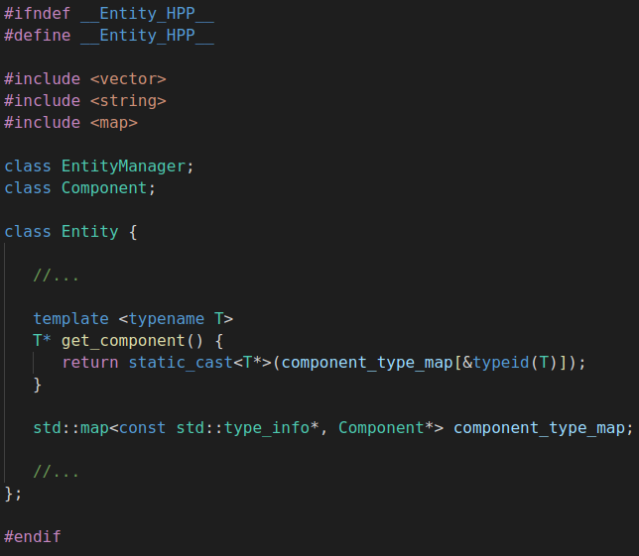
Component Type Map
The type of each component associated with the Entity is stored in a map
That way it can be found later
Actually, the address for the type_info is being stored as a map key
Can be retrieved...

Slide 36
Adding a Component
Within Game::load_level(), create entity, add components
Adds type information to map
Method in Entity Class
The vector of components in Entity class

Slide 37
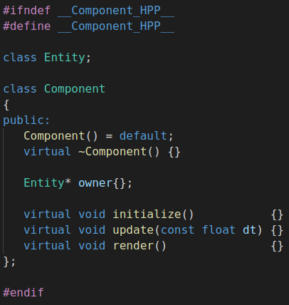
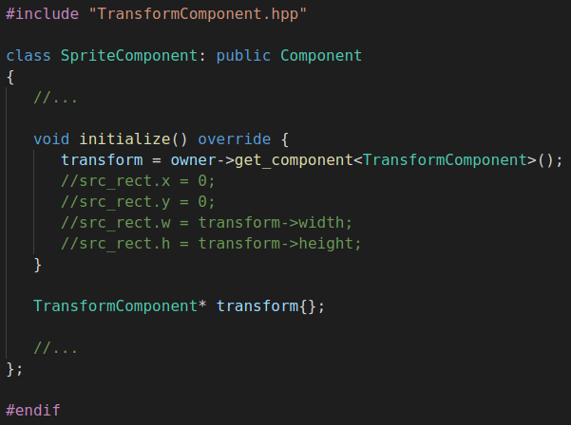
Usage in SpriteComponent
The Sprite component uses this method to set an internal pointer to the Transform component (via "owner" pointer)
Remember "owner" is a pointer to parent container

Slide 38
Adding a Component
Within Game::load_level(), create entity, add components
This needs to be fixed -- part of homework #6
Method in Entity Class
The vector of components in Entity class

Slide 39
Asset Manager (Associating a "id" (i.e., std::string) to a Texture)

Slide 40
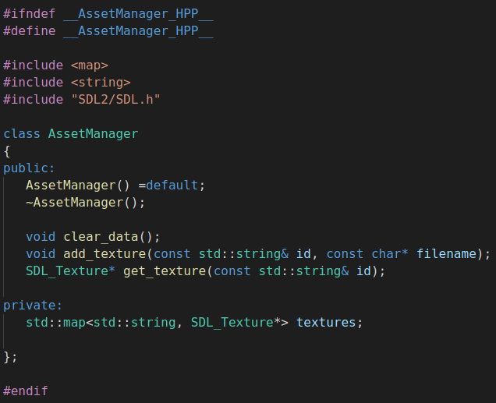
Asset Manager

Slide 41
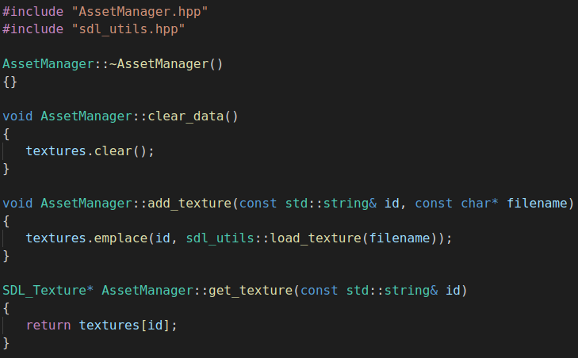
Asset Manager
What about memory associated with a texture?
If fixed, should pointer be "unique" or "shared"?

Slide 42
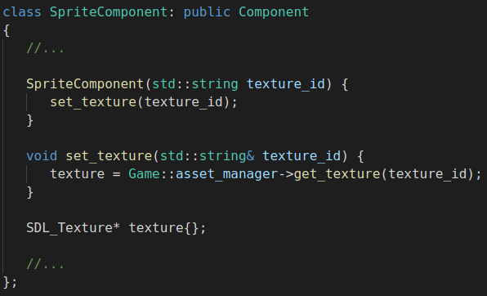
Sprite Component
The sprite component is also maintaining a copy of a pointer to texture!
It's being shared!

Slide 43
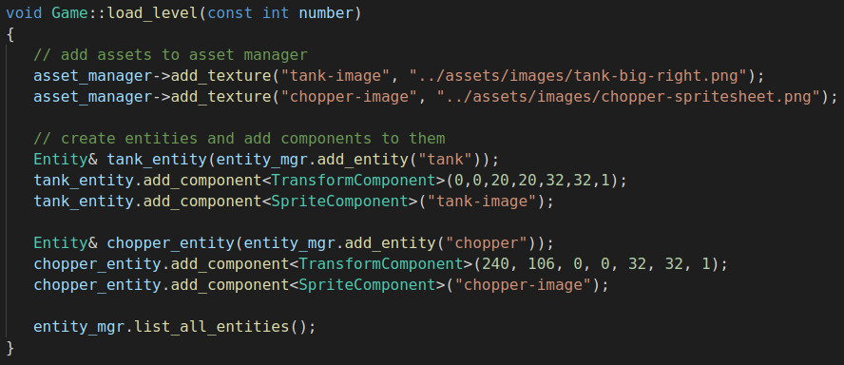
Loading/Defining a Level
Notice that the asset manager is being "preloaded" with images that are converted to textures -- they can be referenced by an "id"

Slide 44
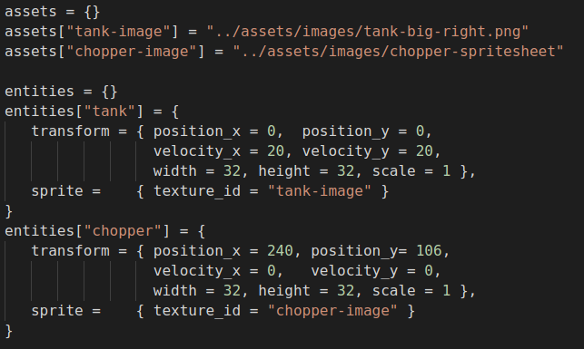
Defining a Level (Lua)
Equivalent configuration information to define a game level

Slide 45
Rendering a Background (Non-Moving Entities) (take a break, a little distraction)

Slide 46
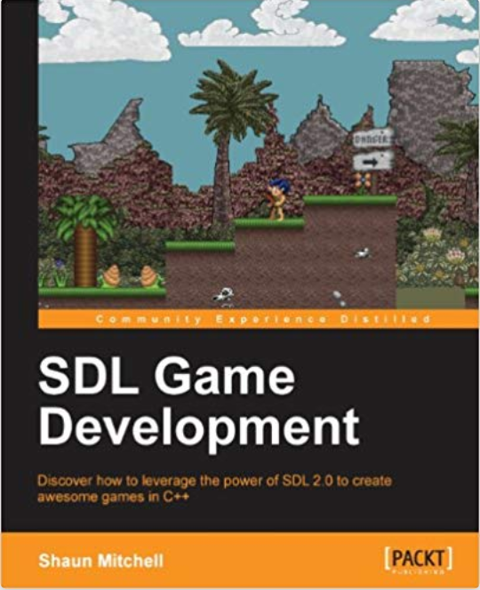
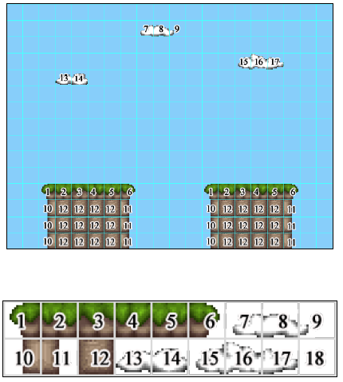
Mapping Tiles to a Tile Map

Slide 47

Load Assets (e.g., dirt.png)
The loaded images will be the “tiles” that used to draw background
Tiles are of a particular size (e.g., 32x32 pixels)
Draw to screen as a matrix of tiles

Slide 48
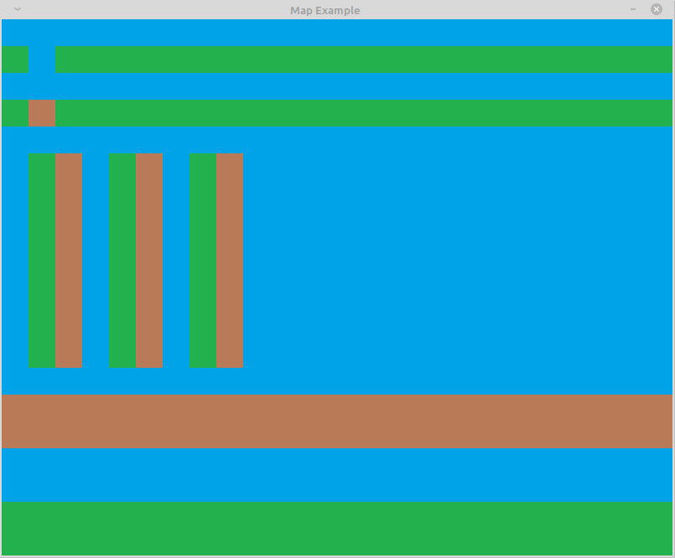



Background Defined As A Matrix
water
grass
dirt

Slide 49
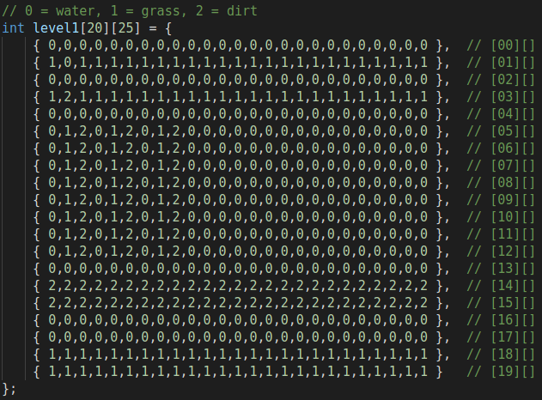
Mapping
Background map defined by a matrix

Slide 50
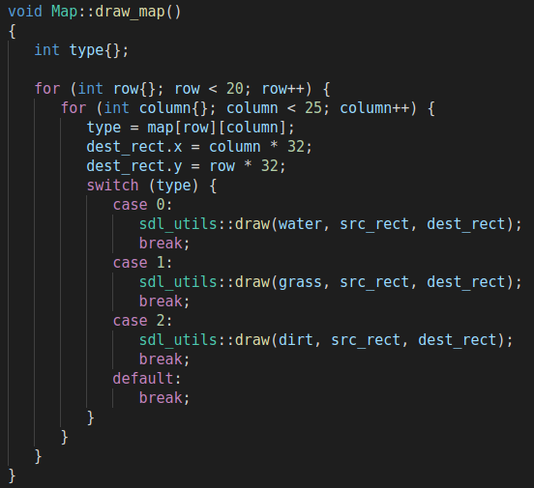
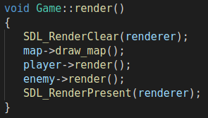
Decoding Map For Drawing

Slide 51
References
"Writing a Member Function Template"
https://www.oreilly.com/library/view/c-cookbook/0596007612/ch08s13.html
"Variadic templates in C++"
https://eli.thegreenplace.net/2014/variadic-templates-in-c/
"C++11 - Variadic Template Function | Tutorial & Examples
https://thispointer.com/c11-variadic-template-function-tutorial-examples/

Slide 52
EOF

