Slide 1

CSCE 693 – Software Evolution C++ Select Topics, Part 2
Air Force Institute of Technology
Douglas D. Hodson, PhD
Bldg 640, Room 311C
255-3636 x4719

Slide 2
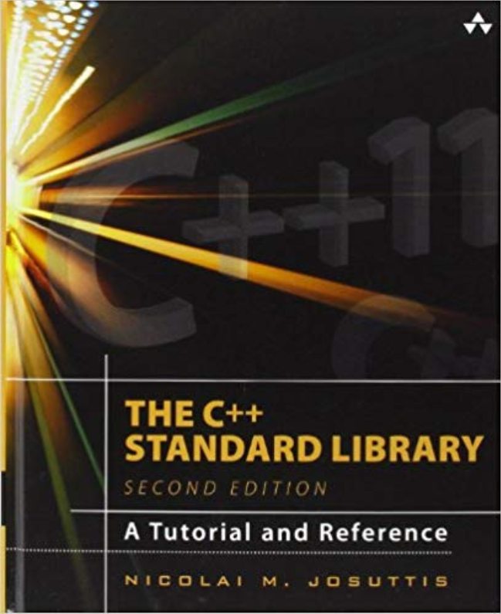

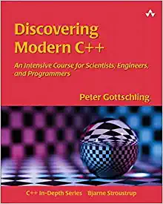
References
C++ moves for people who don’t know or care what rvalues are
https://medium.com/@winwardo/c-moves-for-people-who-dont-know-or-care-what-rvalues-are-%EF%B8%8F-56ee122dda7
Quick Q: What’s the difference between std::move and std::forward?
https://isocpp.org/blog/2018/02/quick-q-whats-the-difference-between-stdmove-and-stdforward

Slide 3

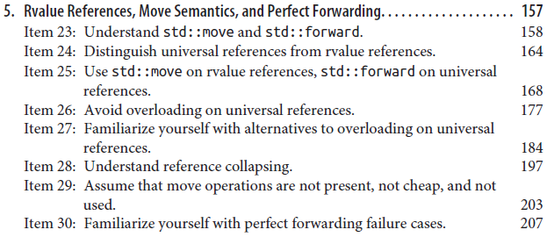
References
Understanding the meaning of lvalues and rvalues in C++
https://www.internalpointers.com/post/understanding-meaning-lvalues-and-rvalues-c
A brief introduction to Rvalue references
https://www.artima.com/cppsource/rvalue.html
C++ Rvalue references explained
http://thbecker.net/articles/rvalue_references/section_01.html

Slide 4
Understanding the Meaning of Lvalues and Rvalues (Traditional Understanding and Use)

Slide 5
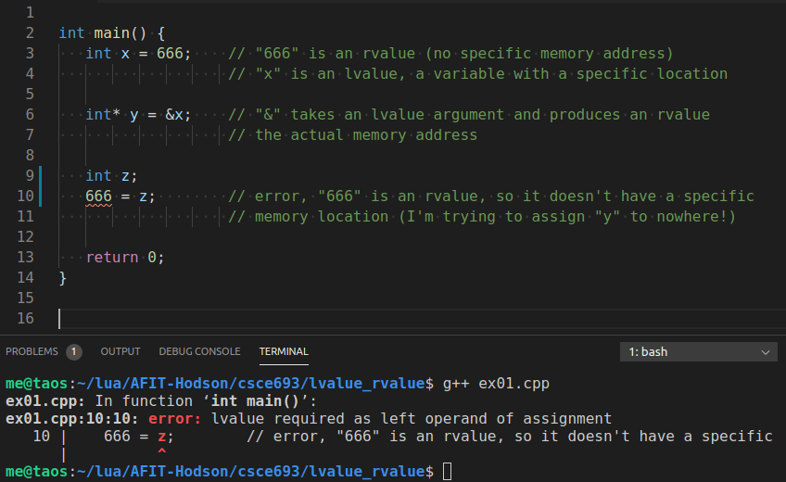
lvalue / rvalue
lvalue is something that points to a specific memory location
rvalue is something that doesn’t point anywhere
In general rvalues are temporary and short lived while lvalues live a longer life since they exist as variables
Can think of lvalues as containers and rvalue as things contained in the containers

Slide 6
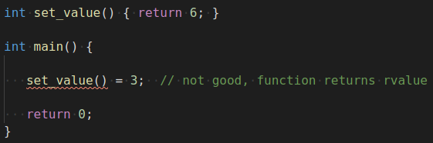
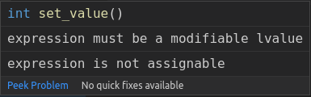
Functions Returning lvalues & rvalues
set_value() returns an rvalue, which cannot be a left operand of assignment

Slide 7
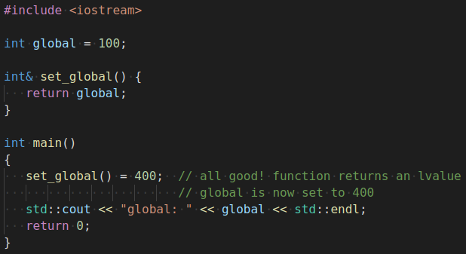
Functions Returning lvalues & rvalues
set_global() returns an lvalue reference, which is perfectly acceptable
Pay attention to “&” – this is NOT an address, it’s specifies a reference

Slide 8
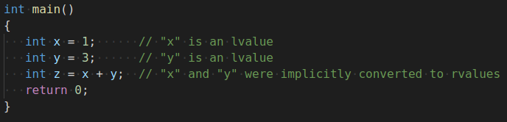
lvalue to rvalue Conversion
“x” and “y” have undergone implicit lvalue to rvalue conversions
Many other operators perform such conversions
Subtraction, addition, division....

Slide 9
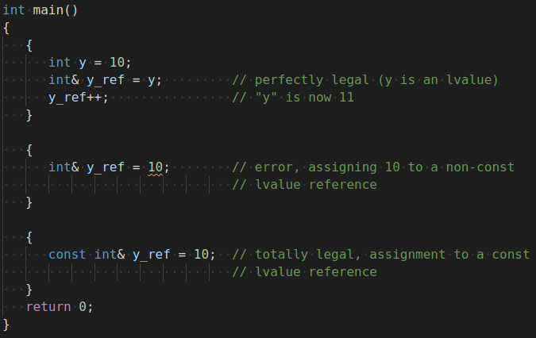
lvalue References
Can an rvalue be converted to an lvalue?
No!
Not a technical limitation
Modern C++ allows it (to come....)

Slide 10
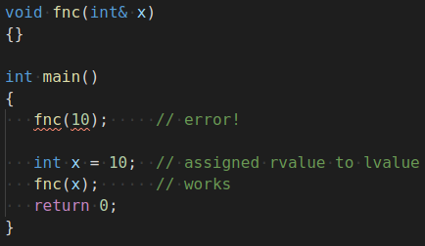
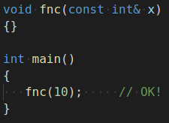
Constant lvalue References
Assigning rvalues to constant lvalue references is ok

Slide 11
What We Know So Far
lvalues have an address
rvalues don’t
rvalues can be converted to lvalues (+,-,*,/, etc.)
rvalues can be assigned to constant lvalue
Under the hood, they are stored in a real variable
Cannot assign an rvalue to reference!
This is not a technical limitation

Slide 12
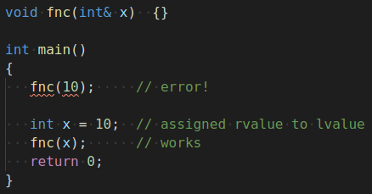
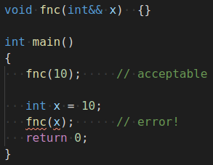
New Syntax (&&), New Type!
lvalue reference
rvalue reference
Modern C++ allows a reference to an rvalue
New syntax introduced

Slide 13
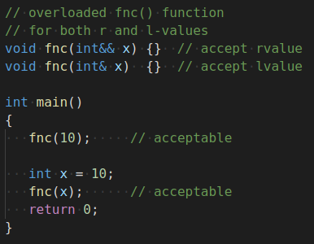
How About We Overload fnc()?
We have used the fact that the value being passed is typed differently to trigger a different overloaded version of the function
This at its’ core is what rvalue references are all about
They define a new type to trigger overloaded operators to support “move” operations
The value actually being passed is an lvalue

Slide 14
C++ std::move

Slide 15
Many Consider std::move() to be Misnamed, it Could have been rvalue_cast (It generates no code and serves as a casting operation)

Slide 16
rvalue References Enable What?
Implement Move Semantics
rvalue References
Enables Perfect Forwarding (Not Discussed)
rvalue reference type is a tool to enable overloads to occur (different functions to be selected) that help solve some problems

Slide 17
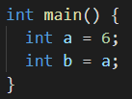
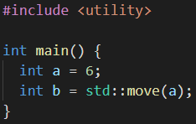
Move Semantics Illustrated
Moving a value doesn’t “move” anything
Unless the type has special operations for moving object, a move is just a copy

Slide 18
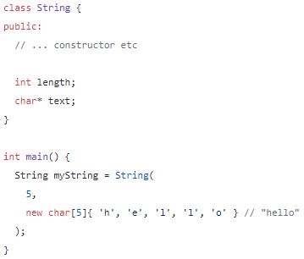
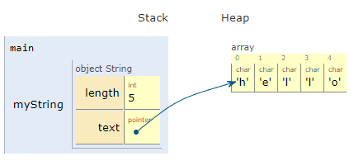
Move Semantics Illustrated
Consider a simple String class

Slide 19
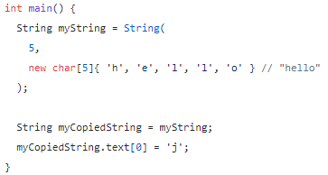
Move Semantics Illustrated
Copy the string

Slide 20
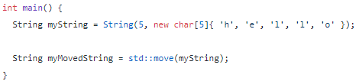
Move Semantics Illustrated
Move the string

Slide 21
Where are Move Semantics Used?
Mostly where-ever ownership of an object needs to be transferred
Unique pointers are a good example
A Thread object
A Printer object
A temporary (e.g., a return value)!
For the String class, std::move(myString) is loosely equivalent to static_cast<String&&>(myString)

Slide 22
Why Do We Care About All This?

Slide 23
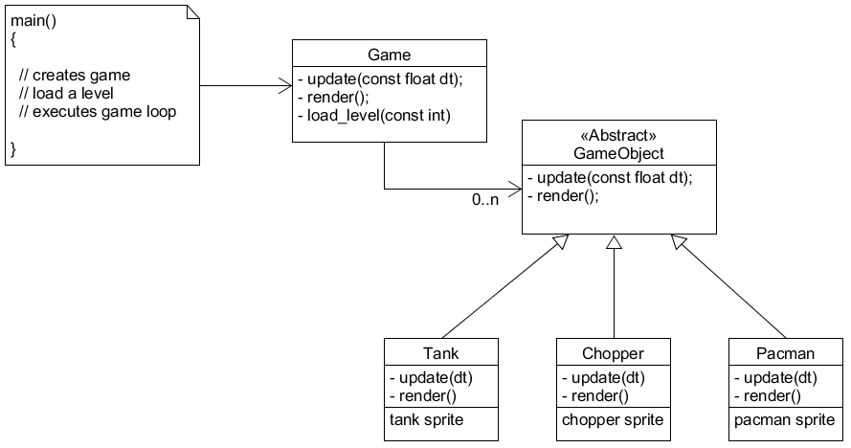
Better Design
We want a vector of GameObjects that can be “referenced” so that update() and render() can be called -AND- automatically deleted when program ends

Slide 24
Basic Idea
A vector of GameObjects
std::vector
The vector contains all the GameObjects within the game
A smart pointer to them, so when the smart pointer gets deleted, so does object
std::unique_ptr<>()

Slide 25
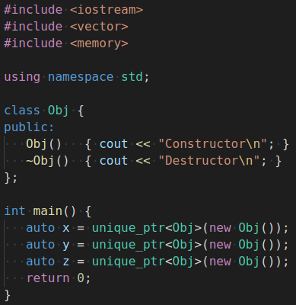
Step #1: Several Objects on Heap
Creates 3 objects that automatically destroyed when main exits

Slide 26
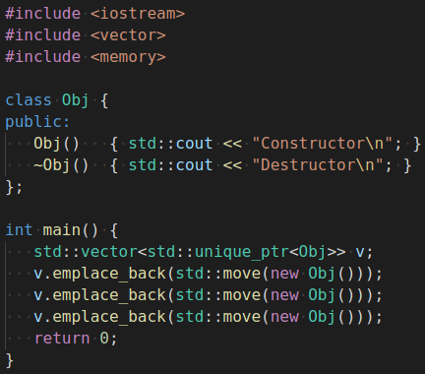
Step #2: Several Objects in Vector
Creates 3 objects and add them to vector
When vector is deleted, it automatically deletes all objects (which are unique_ptr’s); because of that, all the objects being pointed at are deleted

Slide 27
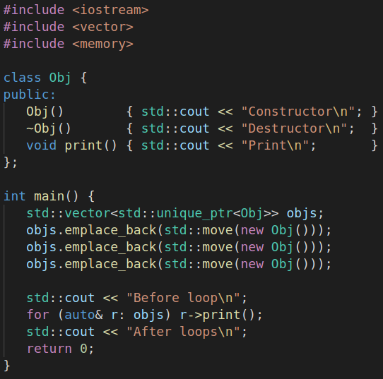
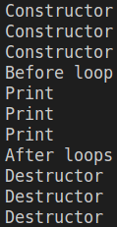
Step #3: Call Obj Methods

Slide 28
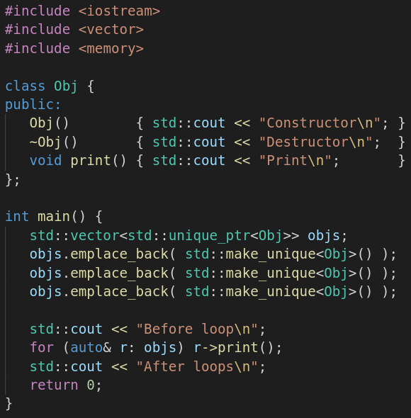
Step #4: Even Better
Q: Why can I remove std::move?
std::move() is redundant
Raw pointers can’t be moved
make_unique<>() is preferred over using “new”

Slide 29
EOF

Slide 30
C++ std::forward

Slide 31
std::forward
std::move takes an object and allows you to treat it as a temporary (an rvalue)
When you see std::move, it indicates that the value of the object should not be used afterwards, but you can still assign a new value and continue using it
std::forward has a single use case: to cast a template function parameter (inside the function) to the value category (lvalue or rvalue) the caller used to pass it
rvalues are passed as rvalues
lvalues are passed as lvalues
I.e., “perfect” forwarding

Slide 32
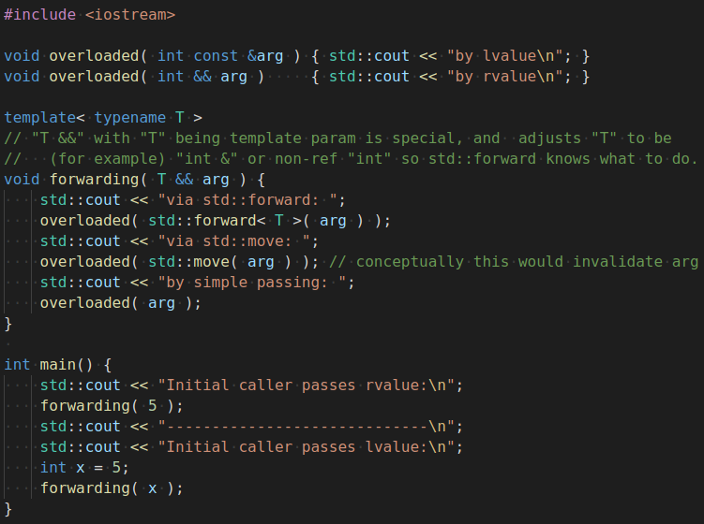
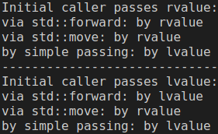
std::forward Illustrated

