Slide 1
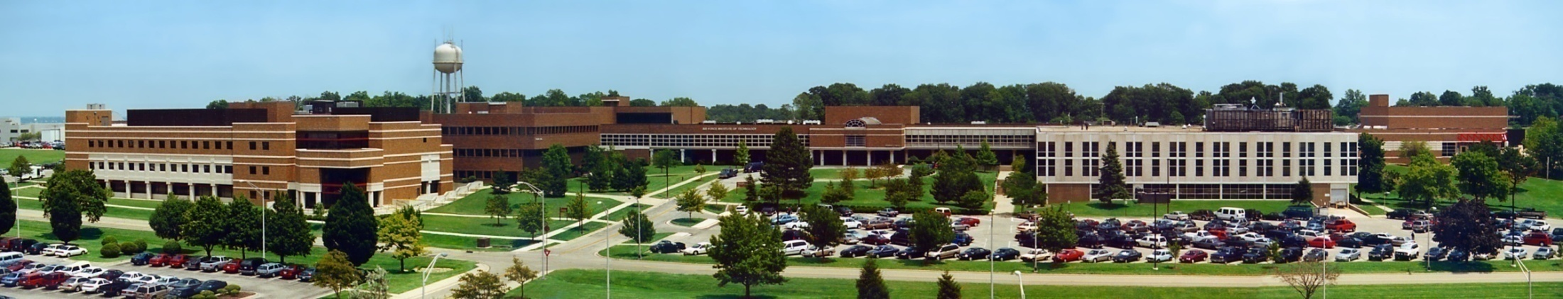
CSCE 693 – Software Evolution Course Introduction
Air Force Institute of Technology
Douglas D. Hodson, PhD
Bldg 640, Room 311C
255-3636 x4719

Slide 2
About You!
About you
Knowledge of programming, experience, interests, thesis topic, etc…
Experience with
C++
Windows and/or Linux
Visual Studio
GCC?
Computer available to install software, program, compile, etc.?

Slide 3
Catalog Course Description
This course is concerned with the evolution of software from design to implementation and covers various topics in the software development lifecycle.
Emphasis is on the enduring principles of good design, such as abstraction, modularity and specifications, and their application through the use of well-established patterns.
Course concepts are refined through hands-on exercises and a group project.

Slide 4
CSCE 693 History
A course on software design patterns using Java
A course on software design patterns using C++ and Qt
A course on pure modern C++
Now a course on understanding programming language features by building an interesting piece of software (a simple game engine)

Slide 5
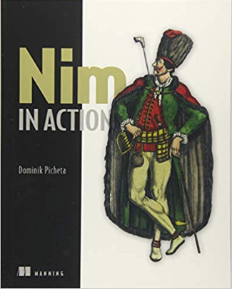
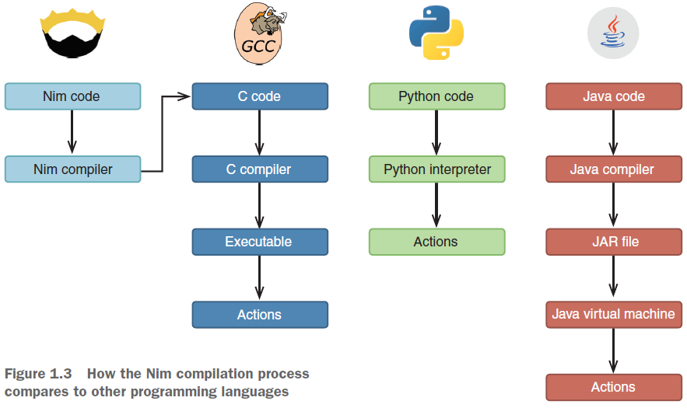
Overarching Goal (Understand This!)

Slide 6
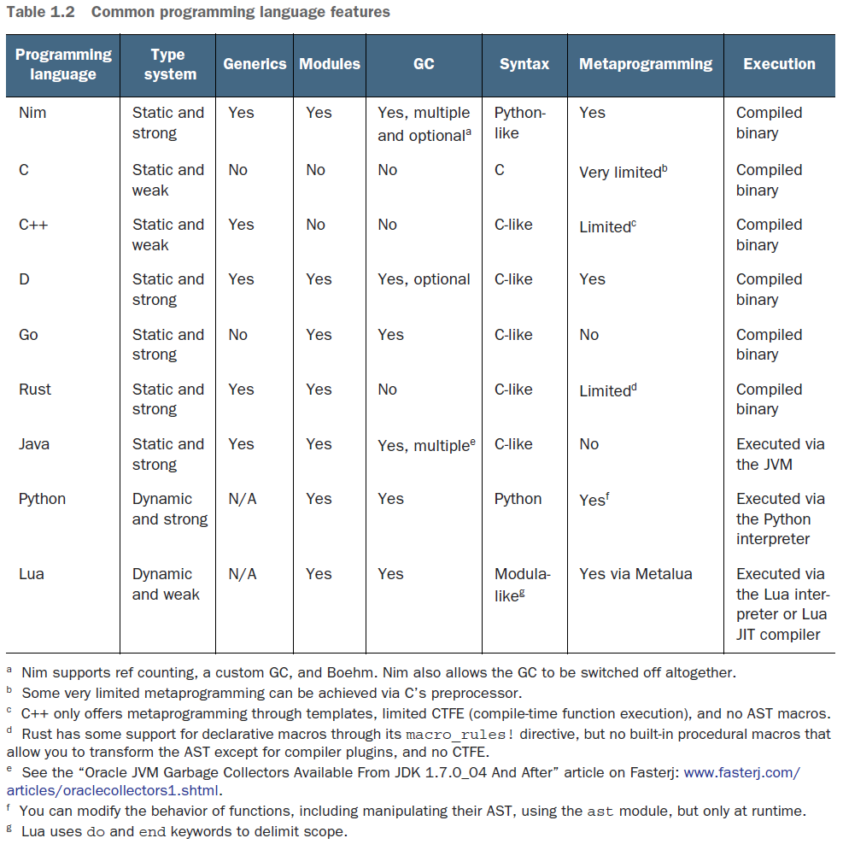
Overarching Goal (Understand This!)

Slide 7
Overarching Goal (Understand This!)

Slide 8


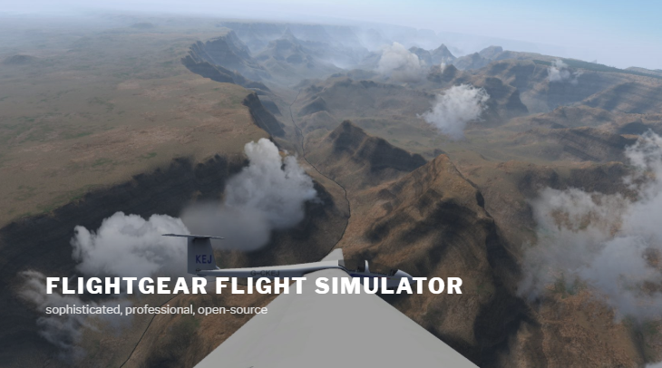
Struggles in Course Design
For sure, want to emphasize Modern C++ (C++11/14/17)
What version of Lua?
Natural tendency to use latest 5.3
But! LuaJIT complicates this – it’s fast and used by lots of projects (e.g., Lua Love)
API is oriented around 5.1 (kind or “old”)
But Lua Love is NOT easy to build for Windows
A complicated set of dependencies exist
Motivating project
A flight simulator? (using an existing game engine)
A simple game engine?
Maybe a simple game engine, then a flight simulator built on it...

Slide 9
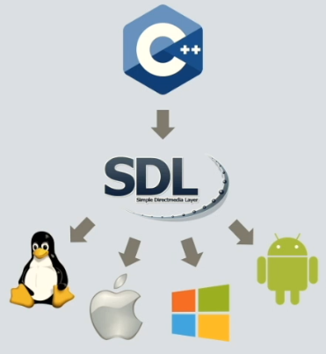
Struggles in Course Design
Udemy course helped force a decision
Course of interest: Fundamentals of 2D Game Engines with C++, SDL, and Lua

Slide 10
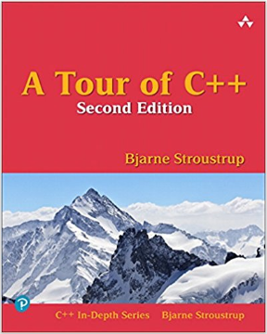
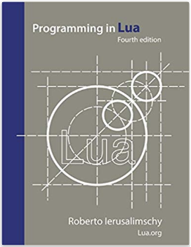
Solid References
Two languages of interest C/C++ and Lua
Lots of references available

Slide 11
Achieving Learning Goals
Learning Goal
Understand basic differences in computer programming languages (maybe have a better grasp of how to evaluate them for a particular purpose)
Think beyond language syntax
Get a sense of use cases for various languages
How to do this
Work with two very different languages (C++ & Lua)
High performance code written in C++
Application specific code in Lua (“configuration”)
Build something interesting (a game engine!)
See how each language is used to leverage respective strengths

Slide 12
Notional Agenda/Approach
Introduction to Lua, interpreter vs REPL
C/C++ review
Introduction to SDL2
Interfacing Lua with C/C++
Manually
Template library sol2/3
Game architecture C++ based
Extend architecture with Lua

Slide 13
Assumptions
You can write, compile and run C and C++ code in Linux
Use GCC and create a basic Makefile
Everything is just a bit easier if we stick with Linux

Slide 14
Class Schedule
Academic term
7 Jan – 19 Mar
CSCE 693 Lecture
Tues/Thurs 1400-1540 (Building 640, Room 326)
Office hours
Best way to schedule time is to send Outlook meeting request

Slide 15
Grading
CSCE 693
100% Homework / projects
Grade Scale
A (Excellent 4.0) (>=90%)
A- (3.7) (>=88%)
B+ (3.3) (>=84%)
B (Good - 3.0) (>=80%)
B- (2.7) (>=75%)
C+ (2.3) (>=70%)
C (Fair - 2.0)
C- (1.7)
Late homework policy
1 day, 20%
2 days, 30%
3 days, zero

Slide 16
Resources
L: Drive
Lots of resources in “resources” folder

Slide 17


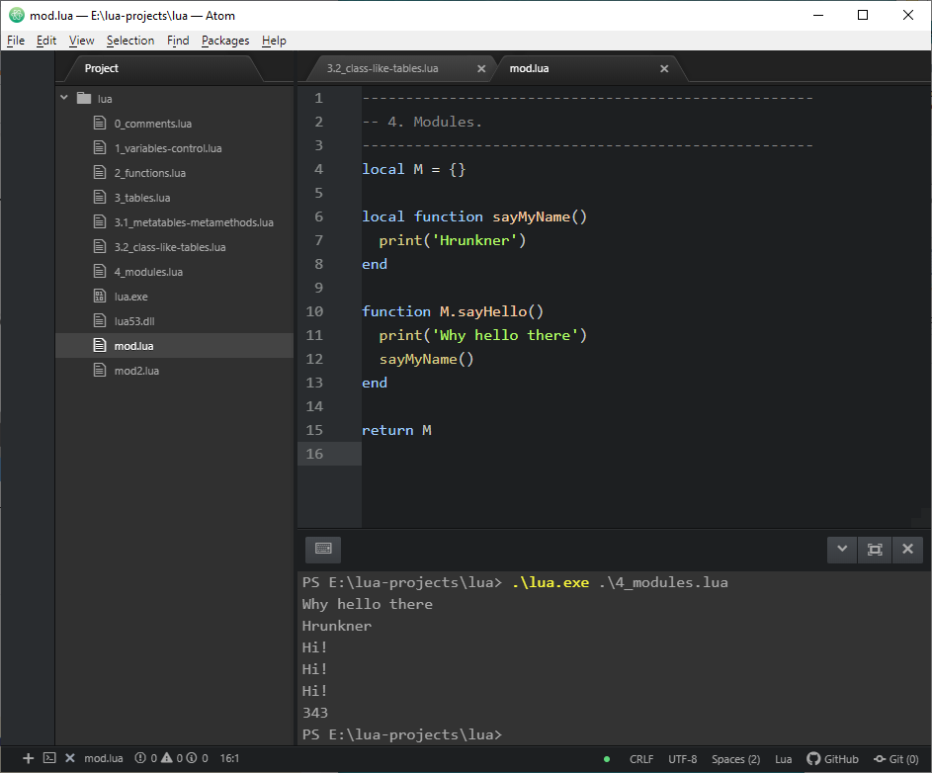
IDE / Super Editors / Etc.

Slide 18
Homework #1
Download Lua source code from website
Create a Linux project to compile code to build
The Lua library (static, liblua.a)
The Lua REPL interface (lua application)
The Lua compiler (luac)
Write a Lua-based program to print “hello world” 20 times

Slide 19
To Restate, Understand This

