Slide 1

CSCE 693 – Software Evolution Introduction to Lua
Air Force Institute of Technology
Douglas D. Hodson, PhD
Bldg 640, Room 311C
255-3636 x4719

Slide 2
Editing and Running Lua Programing using Highly Customizable Editing Apps (GitHub Atom and Visual Studio Code) (see InfoWorld article for more details)

Slide 3



About Atom and Code
Both are open source product built in top of Electron which allows you to build desktop apps using web technologies
Meaning desktop applications can be written in JavaScript, HTML, etc., and deployed using Node.js

Slide 4

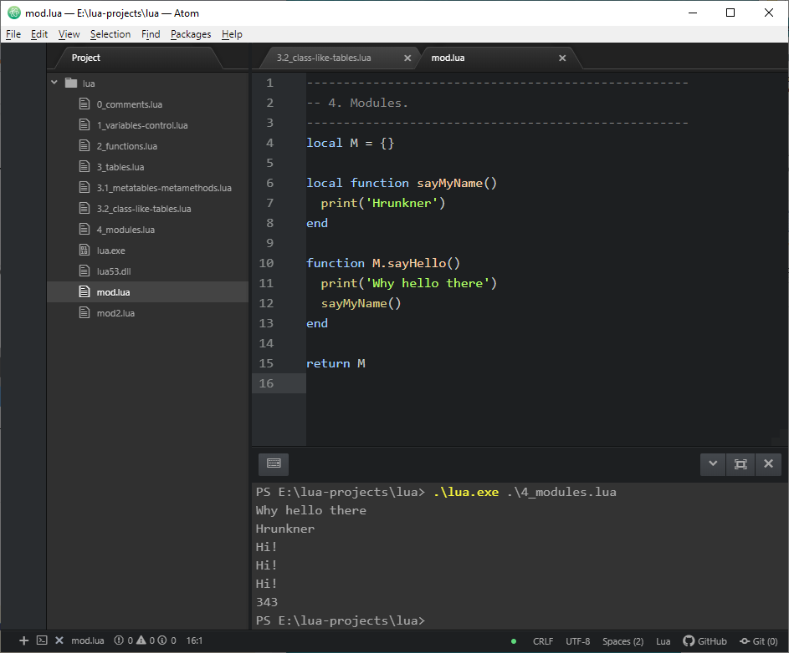
GitHub Atom

Slide 5

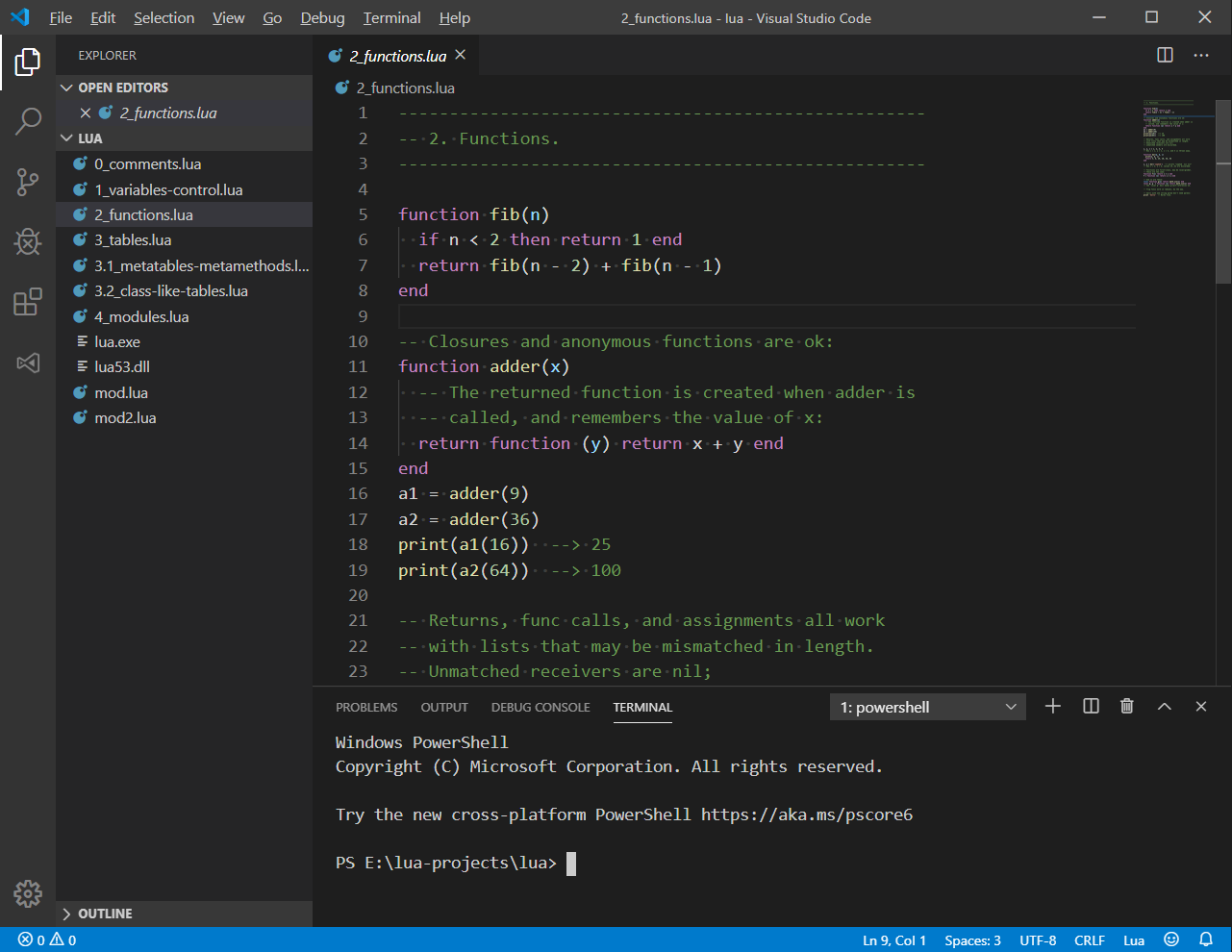
Visual Studio Code

Slide 6
Compiling Lua

Slide 7
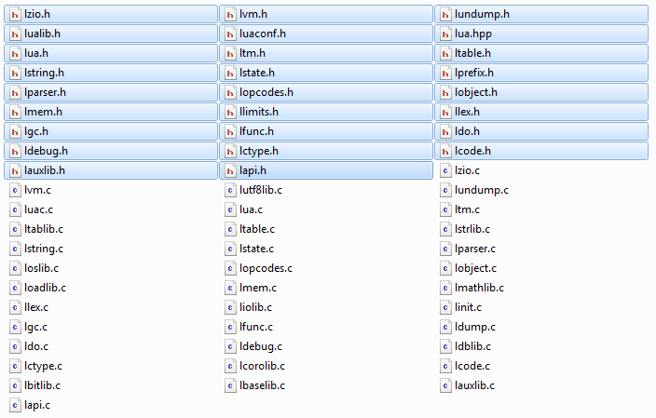
Lightweight C-based Source Code
Entire Source Tree

Slide 8
Compiling Source Code
Produces 3 artifacts
A command line driven executable interpreter (lua)
A compiler which translates lua code to bytecode (luac)
A library that can be linked against a C/C++ application
Can be static or shared/dynamic

Slide 9
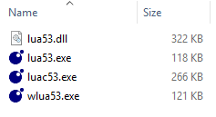
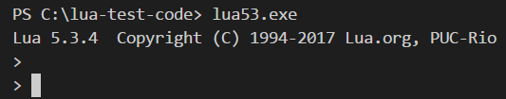
Files, Sizes, Etc.
REPL => Read, Evaluate, Print, Loop
Library
REPL UI
Compiler
The only difference between wlua.exe and lua.exe is that the former has subsystem:windows rather than subsystem:console specified at link time. As a result, Windows will not associate wlua with a console, and does not create a console window.

Slide 10
Short Interactive Demo

Slide 11
Programming in Lua

Slide 12
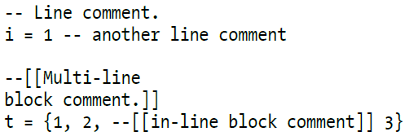
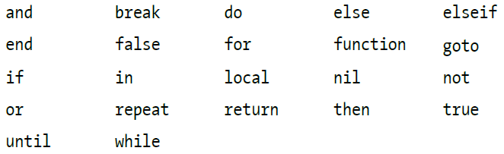
Comments / Reserved Words
Comments
Reserved words

Slide 13
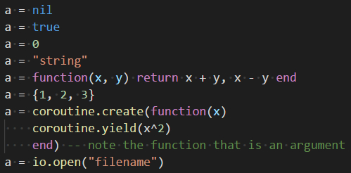
Types
Lua is dynamically typed – meaning, Lua variables have no defined type!

Slide 14
Types: Eight Basic Value Types
nil: single value (nil); corresponds to a null value in C
boolean: (true/false); equivalent to their C++ counterparts
number: (integers and floating point)
string: immutable, arbitrary sequences of bytes
function: consist of both Lua functions and C functions; first-class value; anonymous (they do not have names)
table: Lua’s primary data type; implemented as an associative array
thread: are separate, independent lines of execution; used to implement coroutines – collaborative threads (not asynchronous threads); they share the same global environment; Lua’s main thread is a coroutine
userdata: act in place of C data types that cannot be represented by any other Lua value; maps a Lua variable to data managed by the C code; Userdata values cannot be modified by Lua itself

Slide 15
Variables
Global and local variables
Globals do not need to be declared
Local’s declared using keyword local
Lexically scoped
Example: function bodies, control structure body parts, and Lua files

Slide 16
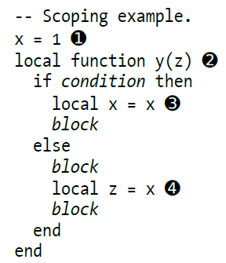
Variables
x is a global variable
y is a local function; z is an implicit local argument
x is a local variable being assigned to global x
z is a local variable being associated to global x

Slide 17
EOF

