Slide 1

CSCE 693 – Software Evolution The Lua Library (Interfacing & Interacting with the Interpreter)
Air Force Institute of Technology
Douglas D. Hodson, PhD
Bldg 640, Room 307A
255-3636 x4719

Slide 2
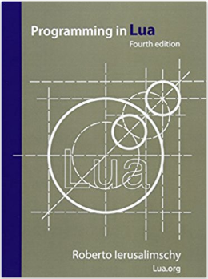
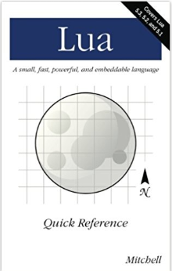
References
Official Reference
Quick; to the point (covers different versions of API)

Slide 3
The Lua Library Interprets and Executes Code Written in the Lua Language

Slide 4
Why Embed A Scripting Language?
Host Code (C++)
Guest Code (Lua)
Host Code (C++): A specific application
Defines entry point - initial ‘start up’ configuration
Leverage interpreter to enable execution of user-defined logic at selected points
Guest Code (Lua): A library of functions that can be called by the application as selected points
Because Lua is a library, we often call this embedding

Slide 5
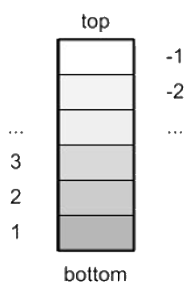
C++ Application (Host)
(static types & you manage memory)
Lua Script
(dynamic types and Garbage Collected)
int main()
{
lua_State* L = LuaL_newstate();
…
}
Lua Script
(dynamic types and Garbage Collected)
Lua Script
(dynamic types and Garbage Collected)
The C-based Lua Interpreter (Guest)

Slide 6
Lua is a C Library
C header files of interest
lua.h : provides Lua’s basic C API
function prefix “lua_”
lauxlib.h : higher level, API/convenience functions to interface C with Lua
function prefix “luaL_”
lualib.h : standard library module

Slide 7
Calling and Linking to the Lua Library via C++

Slide 8
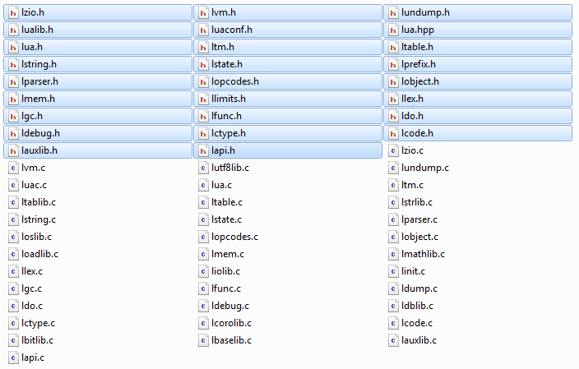
Lightweight C-based Source Code
For C++ Include lua.hpp

Slide 9
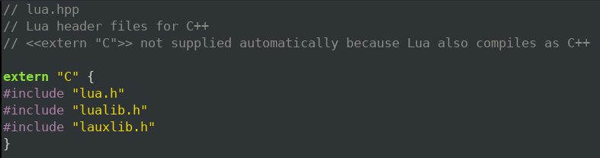
Include for C++ (lua.hpp)
The C++ header file “wraps” the C headers with extern
extern “C” : specifies that the function is defined elsewhere and uses the C-language calling convention

Slide 10
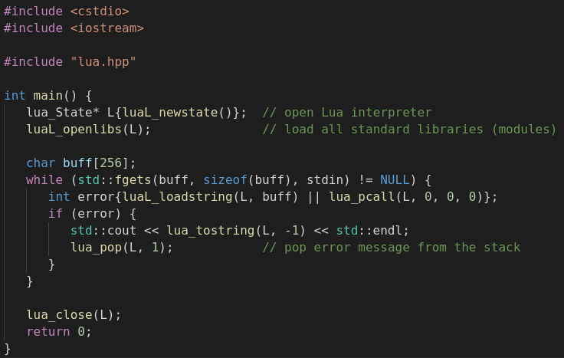
Simple C++-based Lua REPL

Slide 11
Pattern of Interaction
Create a Lua state
Register C functions
Example: luaL_openlibs registers several “modules” with associated C functions (these are the built-in standard library)
Load and/or run dynamic code as needed

Slide 12
Lua’s Standard Libraries (Useful functions that are implement directly through the C API)

Slide 13
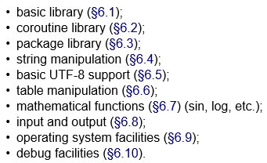
Provided Modules (i.e., Std Library)
Loads Lua Modules
Reference: Lua 5.3 Reference Manual
https://www.lua.org/manual/5.3/manual.html

Slide 14
Demo of Standard Libraries

Slide 15
Math
math.cos(20)

Slide 16
Operating System Facilities
os.clock()
os.date()

Slide 17
Input/Output
file = io.open(“test.lua”, “r”)
io.input(file)
print(io.read())
io.close(file)
file = io.open(“test.lua”, “a”)
io.output(file)
io.write(“last line”)
io.close(file)

Slide 18
Source Code for Standard Libraries
Convenience functions

Slide 19
Simple C++-based Lua REPL

Slide 20
Addressing the Impedance Mismatch Between C/C++ and Lua
C++ Code
Lua Code

Slide 21
Built-in Types (C++ vs Lua)
Type | Keyword
Boolean | bool
character | char
integer | int
float | float
double float | double
valueless | void
wide character | wchar_t
Type | Description
nil | Used to differentiate the value from having some data or no(nil) data
Boolean | Includes true and false as values. Generally used for condition checking
number | Represents real(double precision floating point) numbers
string | Represents array of characters
function | Represents a method that is written in C or Lua
userdata | Represents arbitrary C data
thread | Represents independent threads of execution and it is used to implement coroutines
table | Represent ordinary arrays, symbol tables, sets, records, graphs, trees, etc., and implements associative arrays. It can hold any value (except nil)
Note: lots of ways to define and create new types
Note: you cannot create new Lua types (but you can mimick their creation to a good extent using metatables and tables

Slide 22
Impedance Mismatch
Concept of a stack
When C/C++ wants to call a Lua function, the function as well as its parameters are pushed onto the stack and then executed by the virtual machine
Return values are placed back on stack for C/C++ to retrieve
Same process happens in reverse when Lua code wants to call C/C++ code

Slide 23
Stack
C/C++ Code
Lua Code

Slide 24
C++ Application (Host)
(static types & you manage memory)
Lua Script
(dynamic types and Garbage Collected)
int main()
{
lua_State* L = LuaL_newstate();
…
}
Lua Script
(dynamic types and Garbage Collected)
Lua Script
(dynamic types and Garbage Collected)
The C-based Lua Interpreter (Guest)

Slide 25
Stack
Keeps all Lua objects in use by a C function
Injection functions
Converts a C value into a Lua value
Push the result into the stack
Projection functions
Convert a Lua value into a C value
Get the Lua value from anywhere in the stack

Slide 26
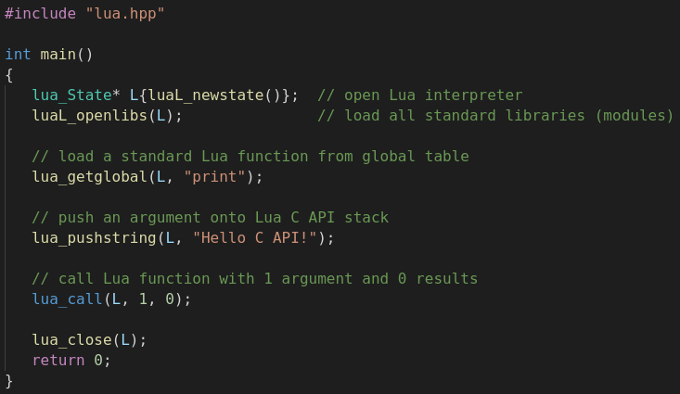
Calling Lua

Slide 27
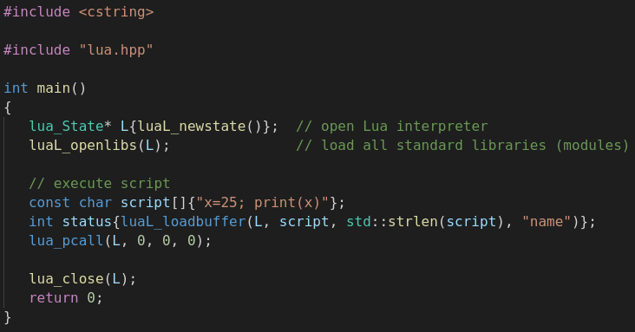
Run Inline Script

Slide 28
How the Lua Standard Libraries are Loaded

Slide 29
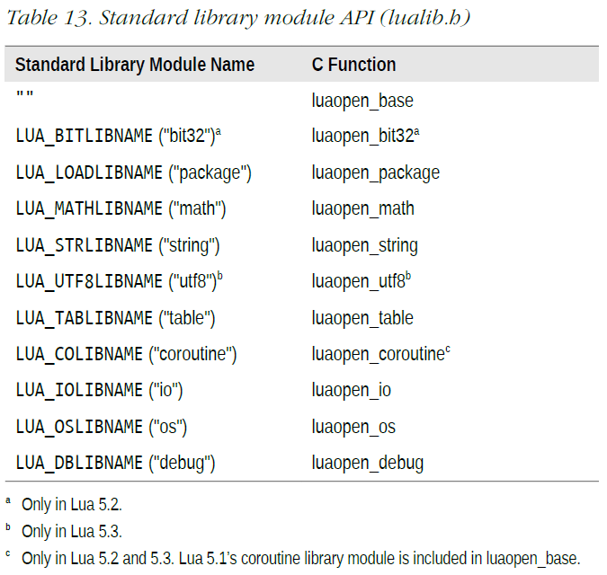
Provided Modules (i.e., Std Library)

Slide 30
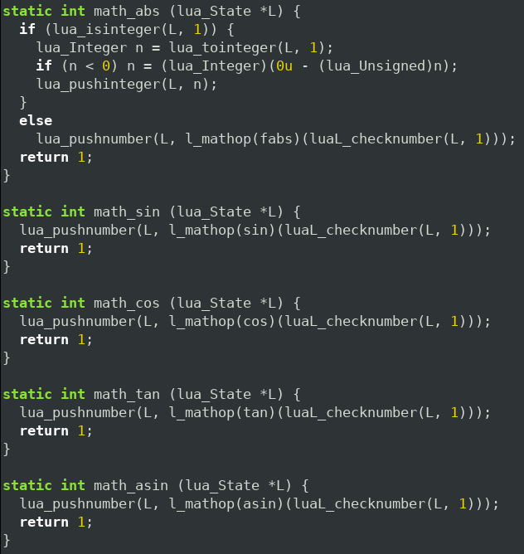
Lua’s Math Library Interface

Slide 31
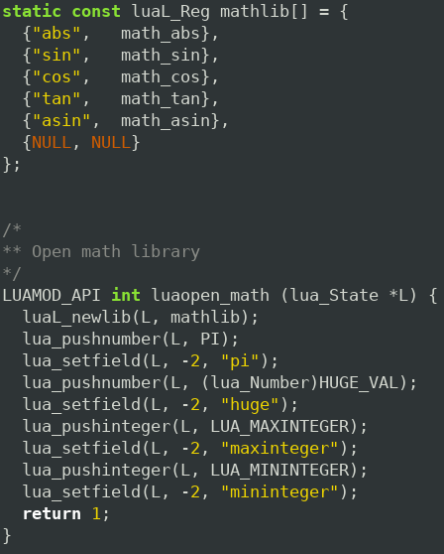
luaopen_math()

Slide 32
Templates to Generate “Binding” Code sol3 (sol2 v3.0.3)

Slide 33
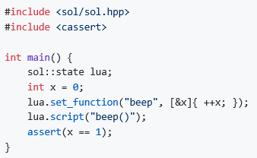
Sneak Peak

Slide 34
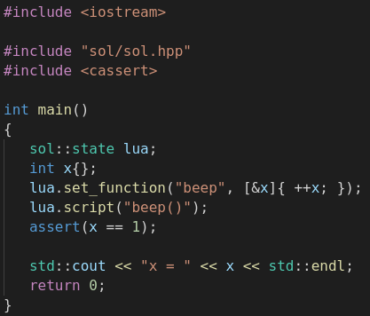
Must Compile with C++17 Flags

Slide 35
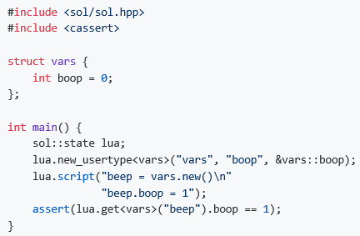
Sneak Peak

Slide 36
Performance
Performance of the interface
Overhead that libraries impose around the Lua C API
Benchmarks
https://sol2.readthedocs.io/en/latest/benchmarks.html

Slide 37
EOF

Slide 38
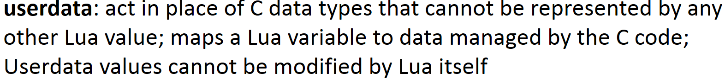
Issues to Consider
How do I create an object instance
From lua: call code to create instance – it should return userdata
Conceptually simple, but…..
Who controls memory? (C code or Lua garbage collector?)
Use cases
C/C++ creates a block of data (userdata) and ‘passes’ it back to Lua
C/C++ returns a pointer in a block of data (userdata) that it is still using
Lots of “boilerplate” code being used to marshal arguments back and forth – Can we simplify or automate?

