Slide 1

CSCE 693 – Software Evolution Game Engine Design: Game Loop
Air Force Institute of Technology
Douglas D. Hodson, PhD
Bldg 640, Room 311C
255-3636 x4719

Slide 2
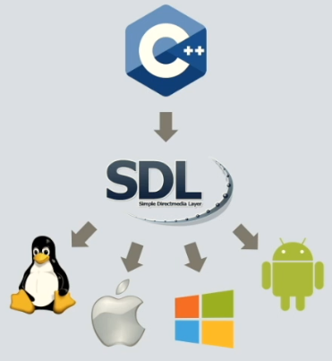
Simple DirectMedia Layer (SDL)
A C-based interface to low level platform functionalities such as audio, keyboard, mouse, joystick, and graphics hardware via OpenGL and DirectX
Abstracts functionality across several platforms
It’s sometimes considered to be the x-platform version of DirectX, as it defines a collection of application programming interfaces (APIs)

Slide 3
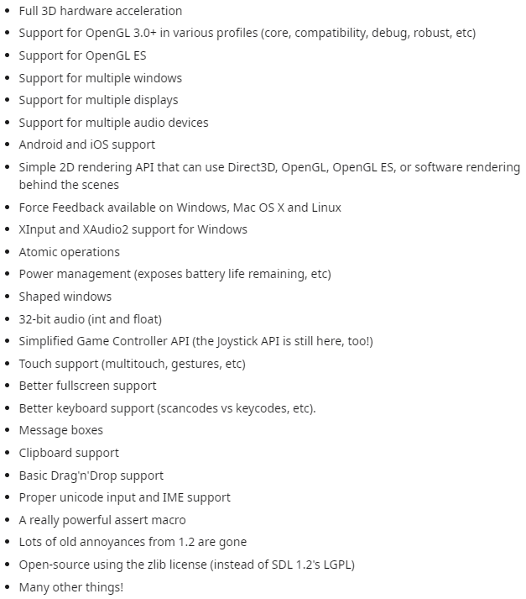
SDL Versions
SDL v1.2
Old, deprecated, don’t use
Supported many antiquated PC platforms
Amiga, Atari, etc.
SDL2
New, the version to use
Dropped support for antiquated PC platforms
Plus lots more

Slide 4
Reason Behind Selecting SDL2
Defines a 2D API
Without having to become an OpenGL expert!
Compiles with almost NO dependencies!
Alternatives:
GLFW (Graphics Library Framework) is meant for the OpenGL programmer
It provides a simple API for creating windows, contexts and surfaces, receiving input and events
Written in C
SFML (Simple and Fast Multimedia Library)
Written in C++
Last I checked, it has a complicated set of dependencies

Slide 5
Compiling and Linking to SDL2
configure --prefix=[install location] --enable-static
“prefix” defines the location at which “make install” will put include and library files
“enable-static” will cause a static version of the SDL2 library to be created (e.g., libSDL2.a)
LDFLAGS += -Bstatic –lSDL2 –lpthread –ldl
When statically compiled, libSDL2.a will need to be linked to the Linux pthread library and the dl library
“pthread” C library: used to implement POSIX (Portable Operating System Interface) threads
The “dl” C library: used to load dynamic libraries (i.e. “.so”)

Slide 6
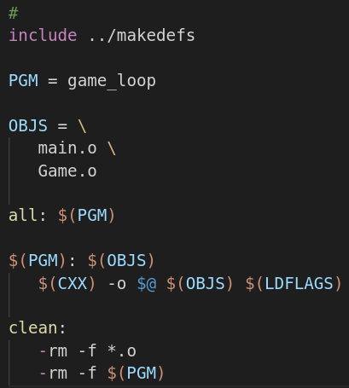
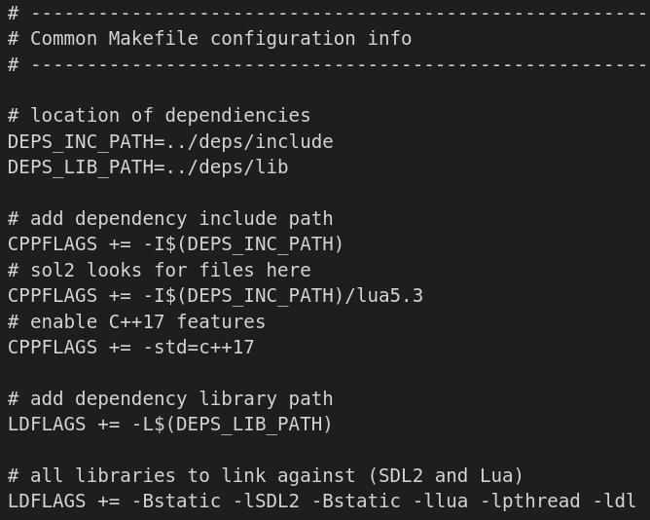
Homework Makefile Structure
Makefile for “game_loop” Example
makedefs for All Examples

Slide 7
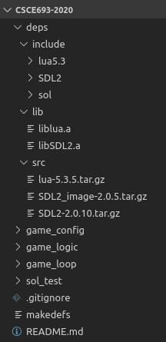
Supplied / Compiled Dependencies
Statically compiled libraries for Lua and SDL2 are stored in the Git repo
This is a bit unusual, as most repos only contain original source code, but it was felt this might make things a bit simpler
Original source code (that was compiled) is included in the “src” directory
sol2 header files are also included

Slide 8
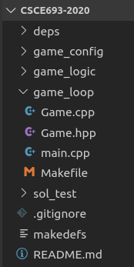
SDL2 Game Loop Example
The game loop example closely mimics the SDL2/C++ Tutorial videos
https://www.youtube.com/watch?v=QQzAHcojEKg&list=PLhfAbcv9cehhkG7ZQK0nfIGJC_C-wSLrx
A couple of changes were made to better initialize variables, etc.

Slide 9
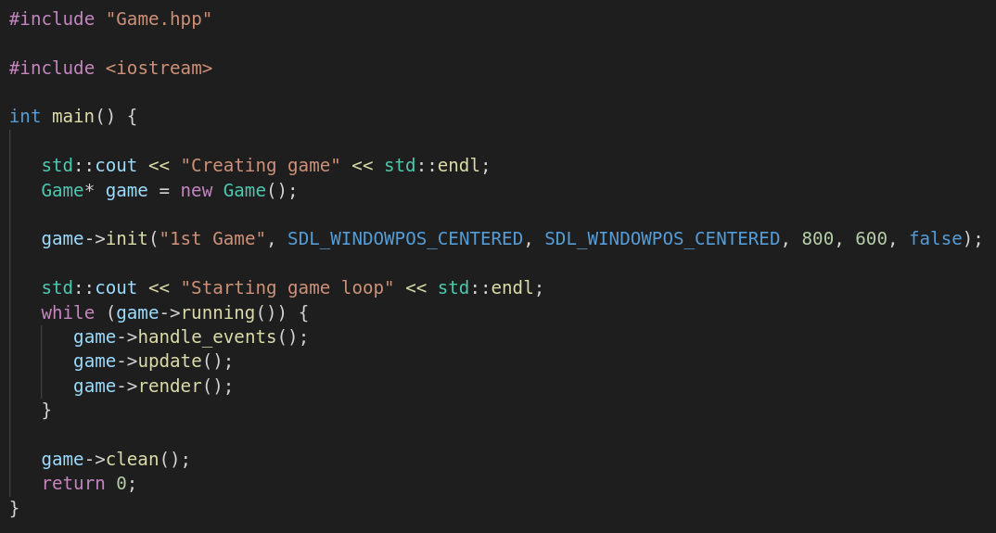
main.cpp

Slide 10
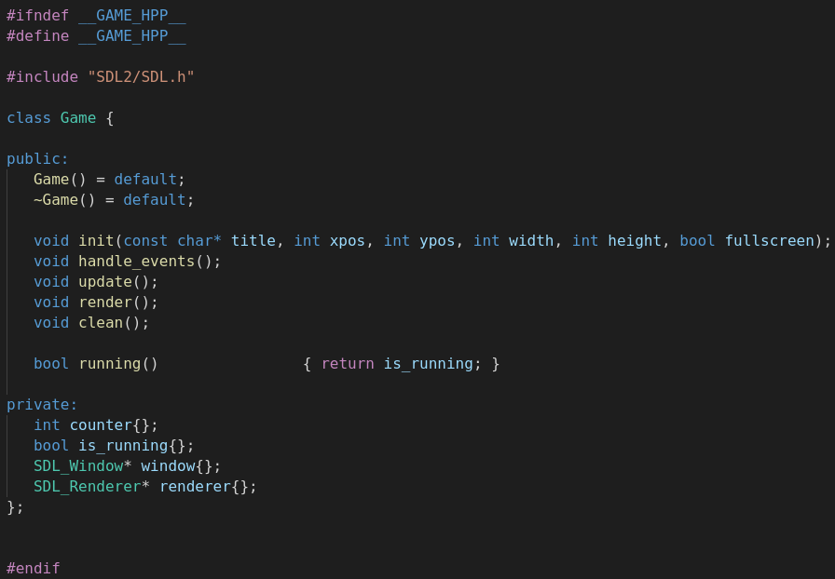
Game.hpp

Slide 11
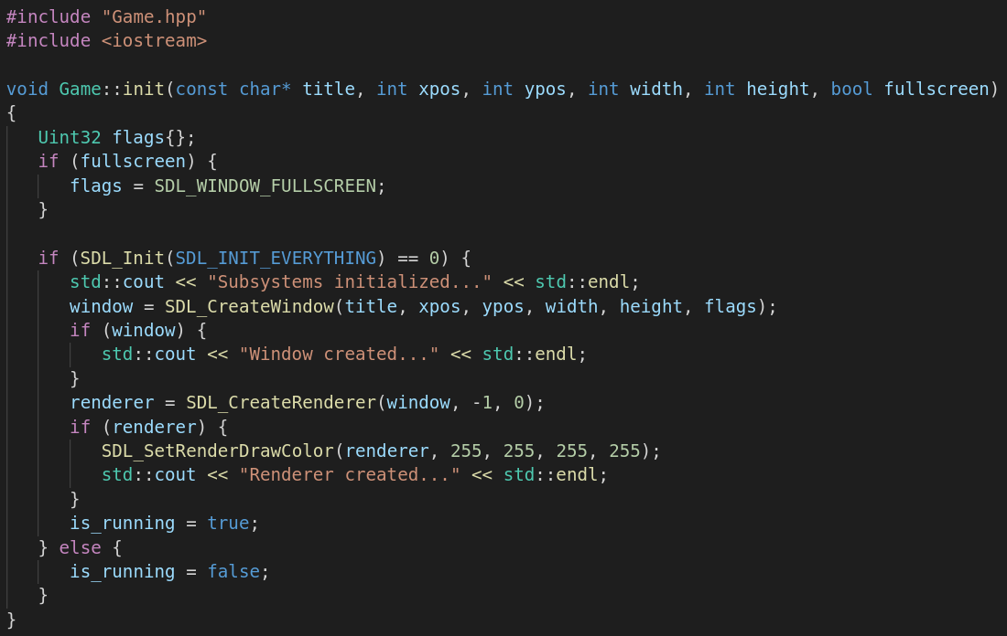
Game.cpp (1)

Slide 12
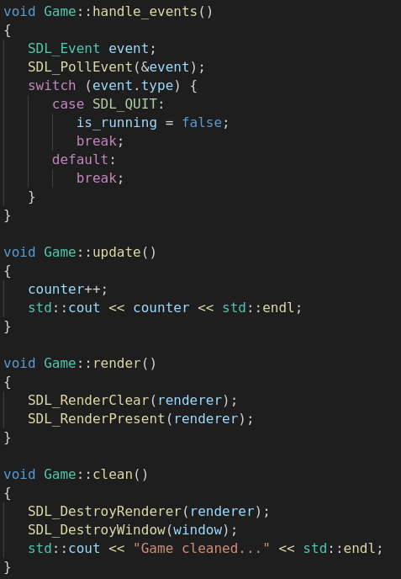
Game.cpp (2)

Slide 13
Next Up!
YouTube tutorial progresses as follows
By default SDL2 can only load bitmap files, not png, jpg, etc…
SDL2_image extension can read many more formats
It also starts creating images using Pyxel Edit: It’s an interesting program, but a bit of a distraction from game engine design principles
Later topics:
Game objects
Entity-Component-System
Tile maps, sprites, map loaders (might side step this… not sure)
2D Vector class
Input
Collision detection and response (might avoid this… again, not sure)
Projectiles
Key desire to mature “engine”, will continuing to extend functionality using Lua-based scripts to define unique behaviors

Slide 14
EOF

