Slide 1
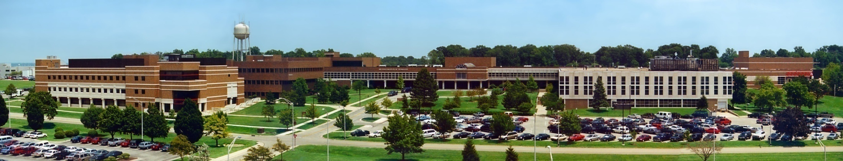
CSCE 693 – Software Evolution
Error Handling
Air Force Institute of Technology
Douglas D. Hodson, PhD
Bldg 640, Room 311C
255-3636 x4719

Slide 2
Error Handling Techniques
Return code
Error (success) indicator parameter
Global variable
Exceptions
Design by contract

Slide 3
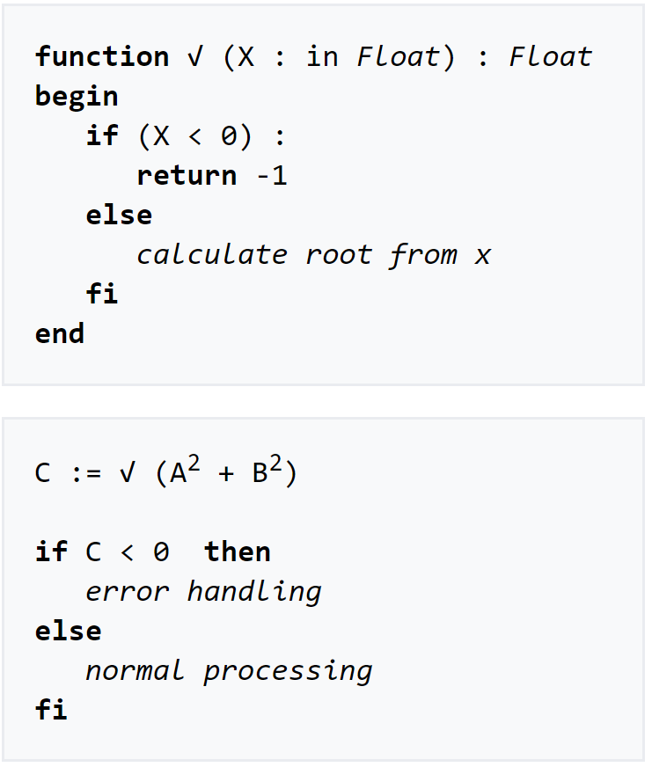
Return Code
This type of error handling works because the return value can be used to indicate an error (anything negative)
Won’t work when all possible return values are a valid result
  Therefore no return value is available as an error indicator

Slide 4
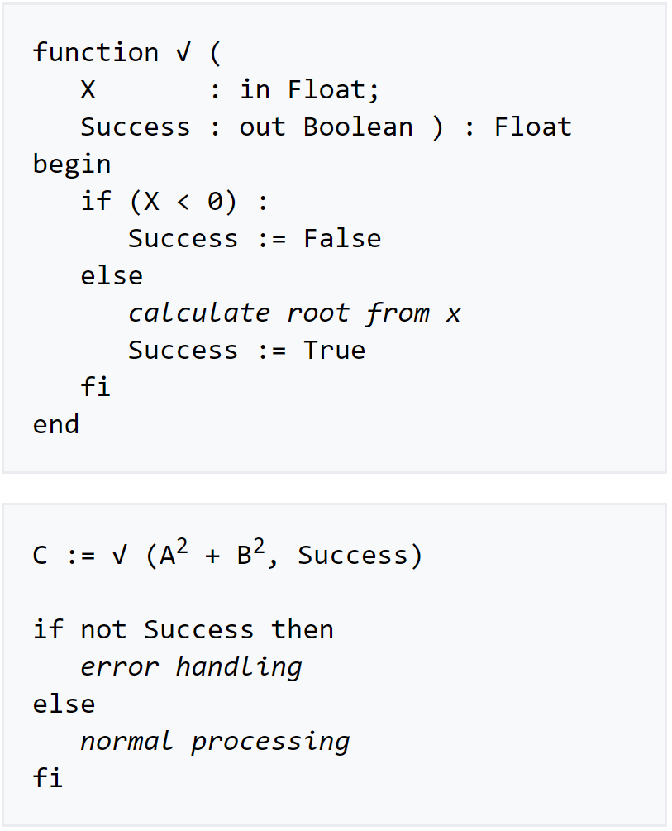
Error (Success) Indicator Parameter
Works, but doesn’t look very nice

Slide 5
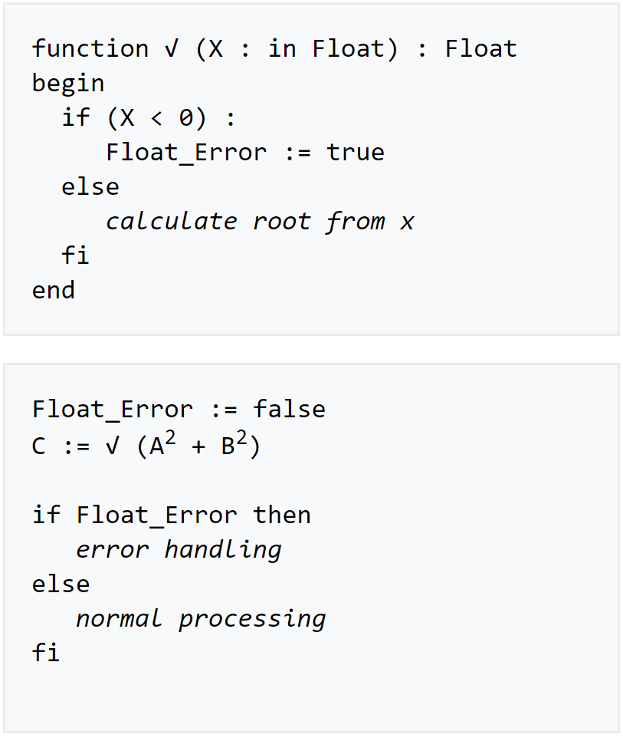
Global Variable
Works, but is problematic
Must choose the place to reset the global value
  Should the callee or the caller do that?
  Not suitable for multithreading

Slide 6
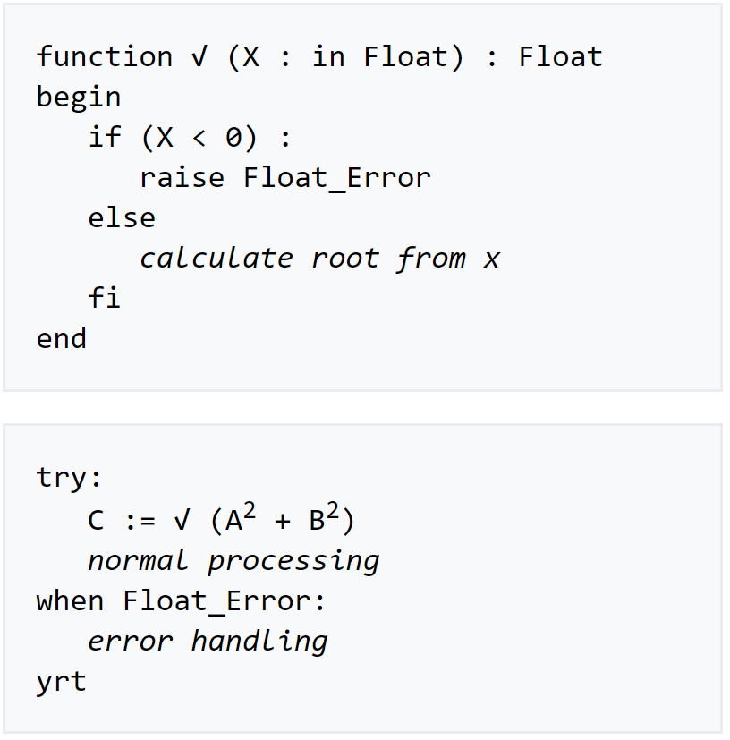
Exceptions
A programming language way to handle errors
  Visual Basic:
  On Error GoTo ...
  Modern OO languages:
  try ... catch
Basic idea is to “register” some part of your program as an error handler to be called whenever an error happens

Slide 7
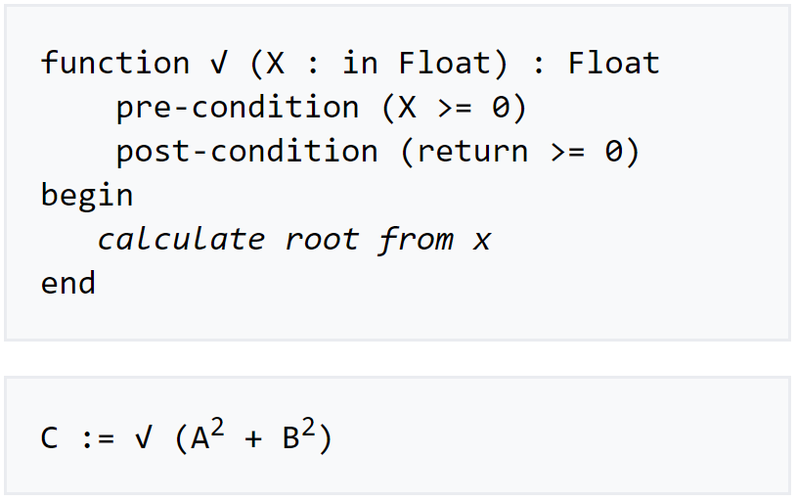
Design by Contract (DbC)
DbC functions must be called with correct parameters
  This is the caller’s part of the contract
  Strong typing is used

Slide 8
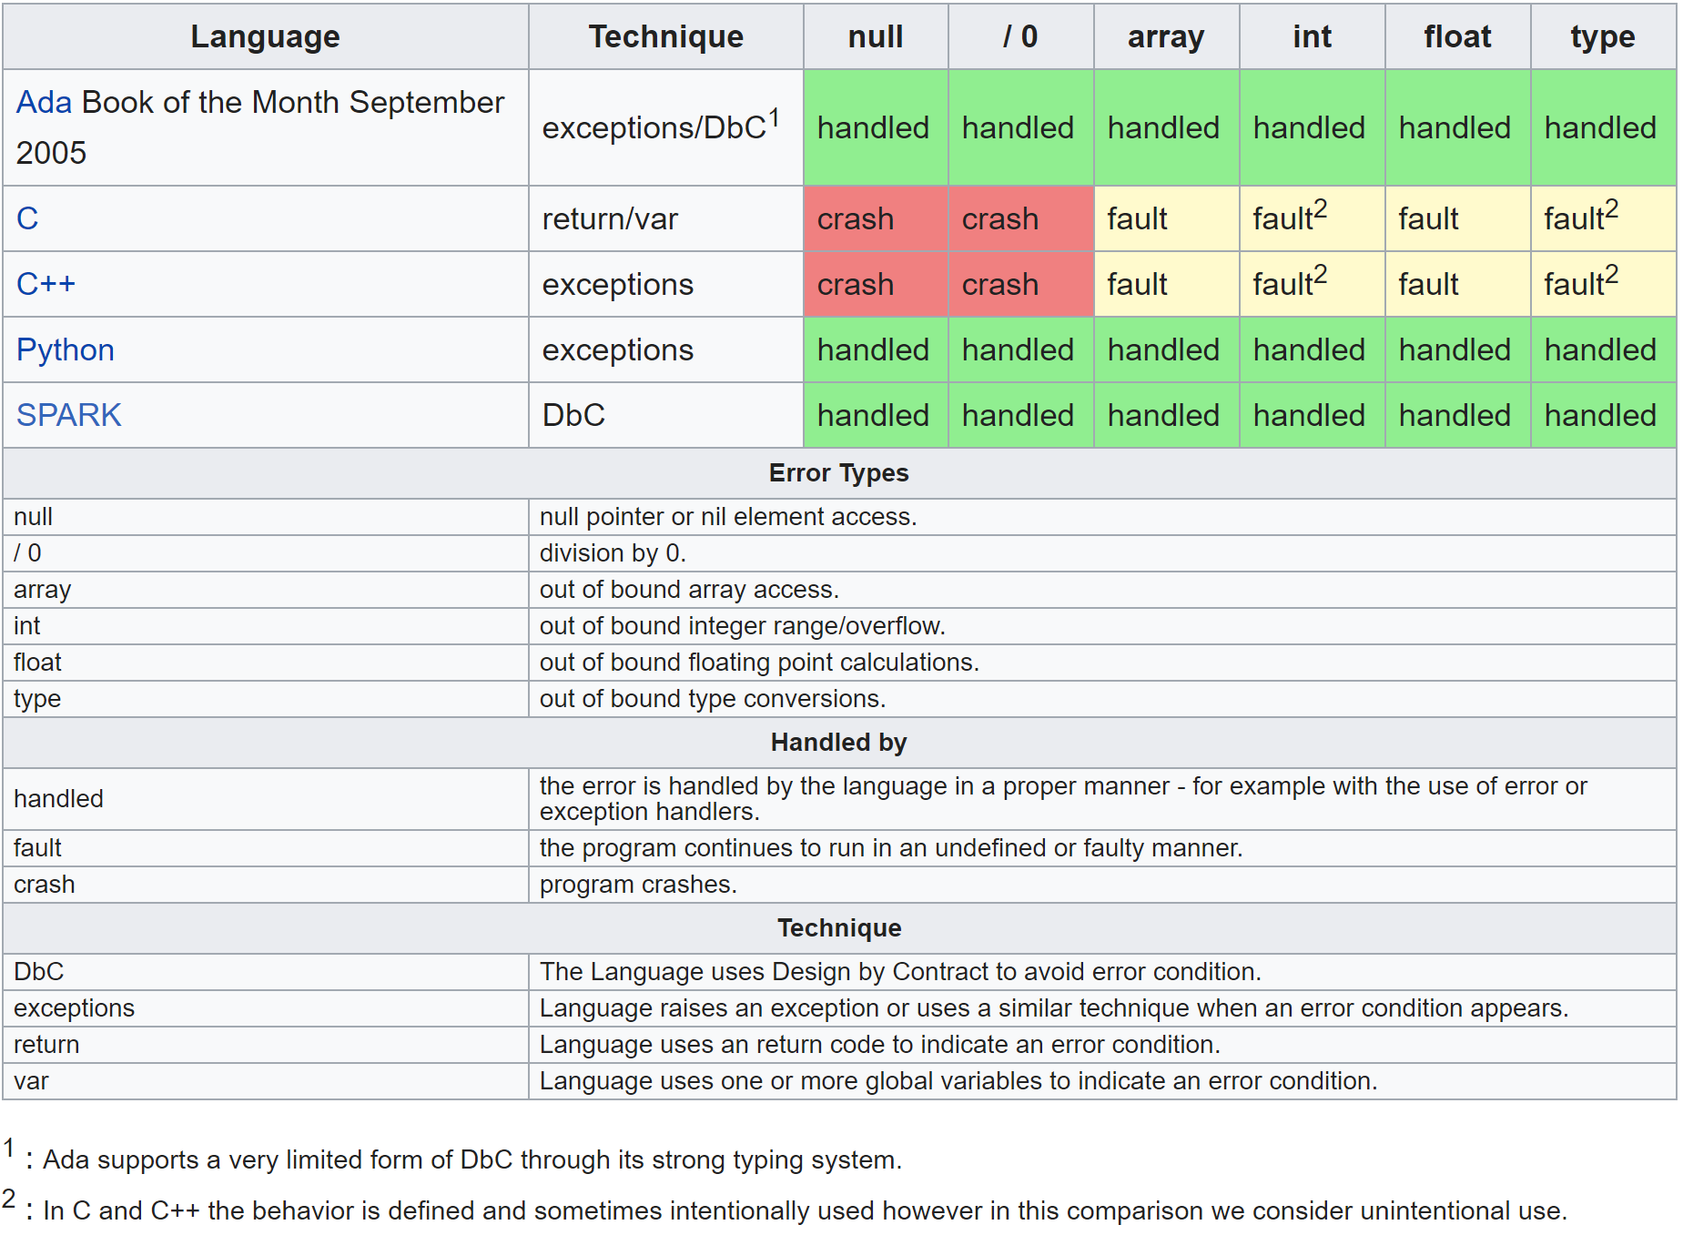
Techniques in Prog Languages

Slide 9
Error Handling in C++

Slide 10
General Error Handling Approach
Considered to be a large and complex topic
  Concerns both language facilities and programming techniques and tools
In C++ the type system is a major tool
  We use existing built-in types as well as design new types appropriate for the application

Slide 11
Error and Exception Handling
The C++ standard library is heterogeneous
  Meaning, it contains software from diverse sources that have different styles of design and implementation
  Error handling and exception handling is a typical example of differences
  Example: string library supports detailed error handling, checking for every possible problem and throwing an exception if it occurs
  Other parts such as the STL prefer speed over safety – they rarely check for logical errors and throw exceptions only if runtime errors occur

Slide 12
Standard Exception Classes
Language support
  Used by language features – e.g., a bad cast (dynamic_cast<>())
Logic errors
  Can usually be avoided because they are inside the scope of the program
Runtime errors
  Caused by a reason that is outside the scope of the program – e.g., not enough memory, etc.

Slide 13
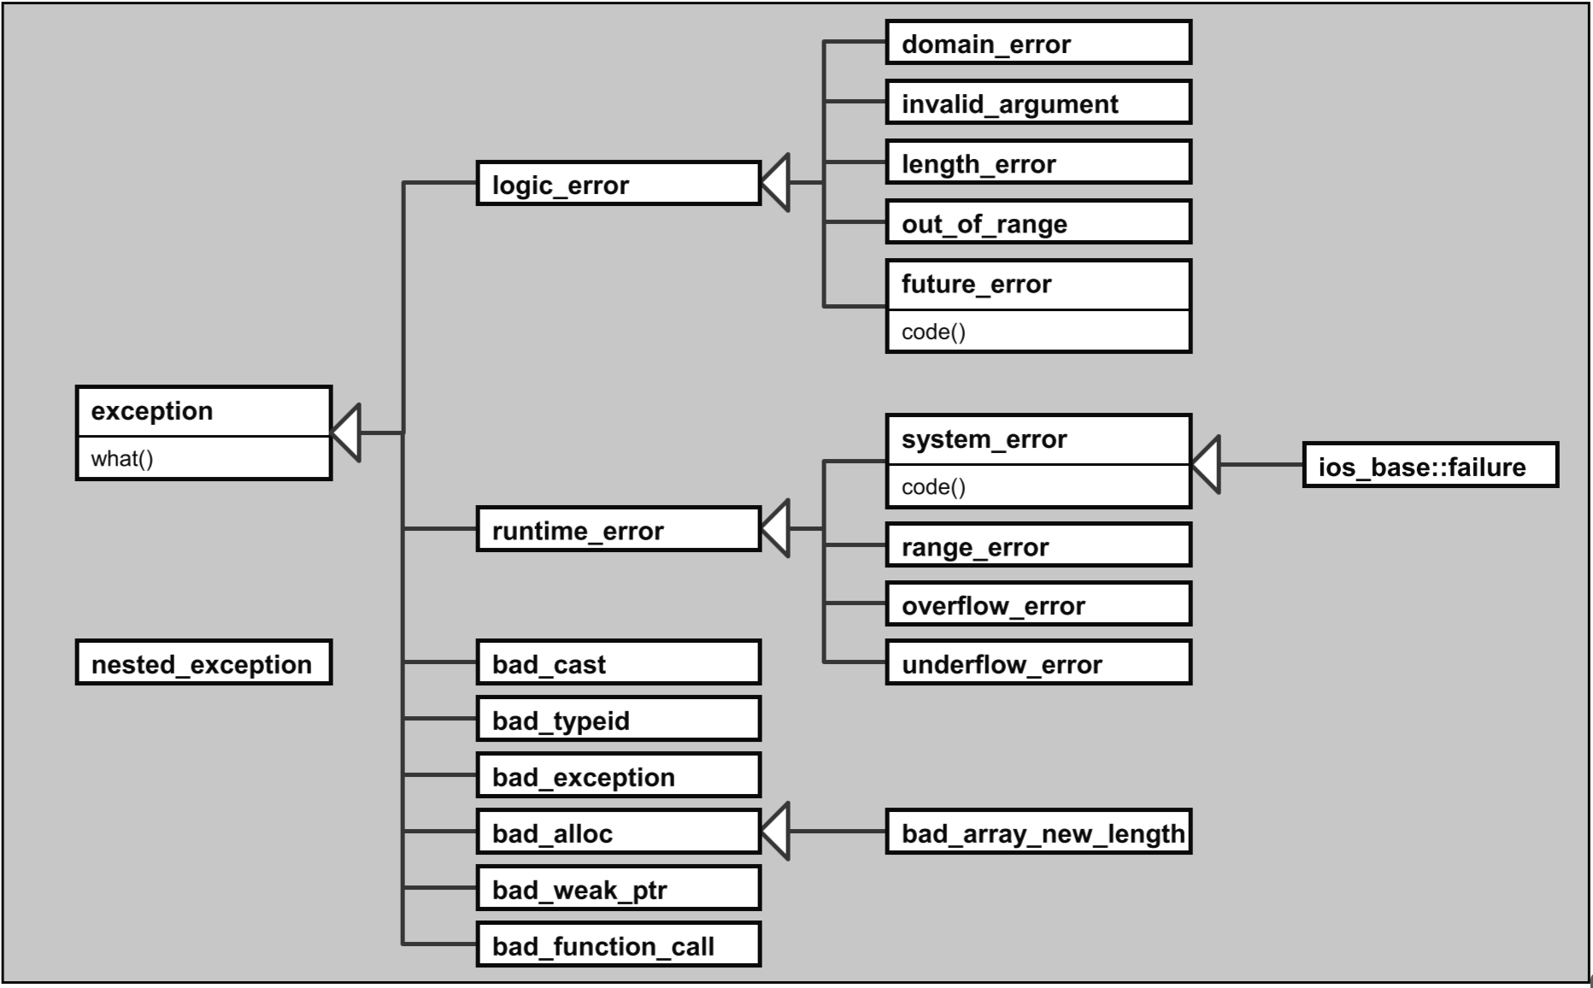
Hierarchy of Standard Exceptions
All exceptions thrown by the language or the library are derived from the base class exception

Slide 14
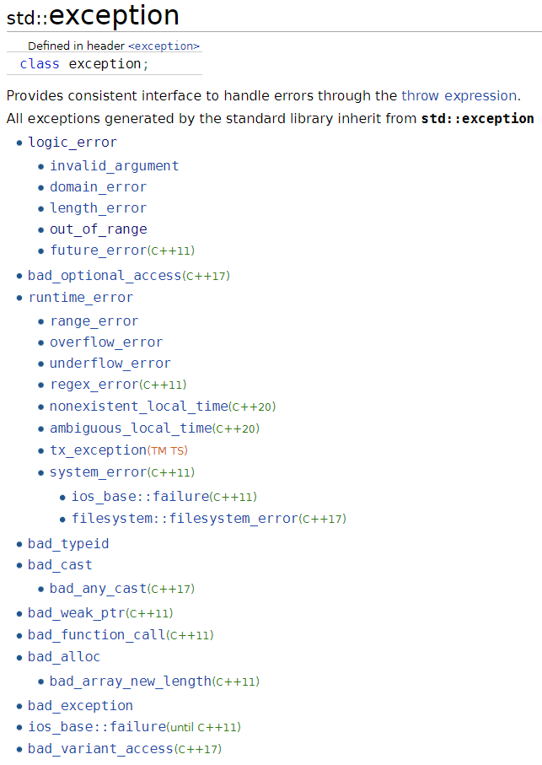
Standard Library Exception Hierarchy

Slide 15
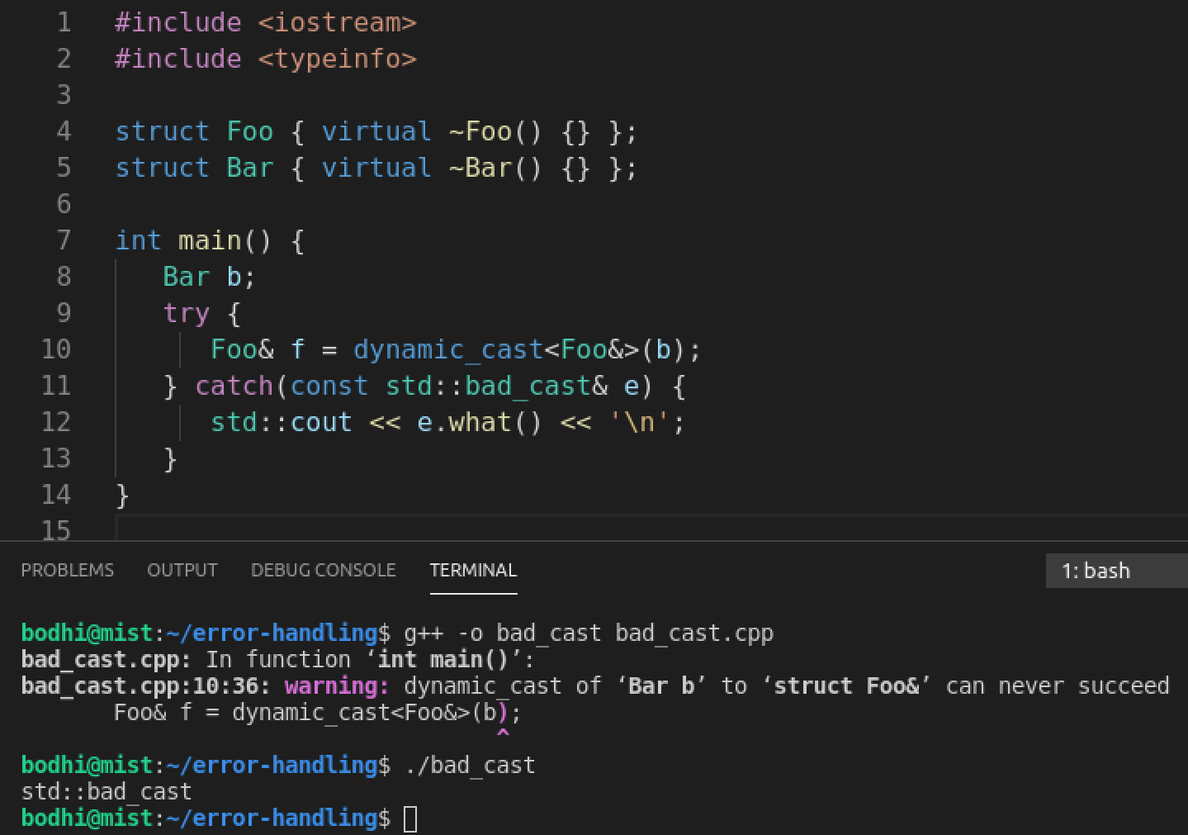
Example: std::bad_cast

Slide 16
Another Example

Slide 17
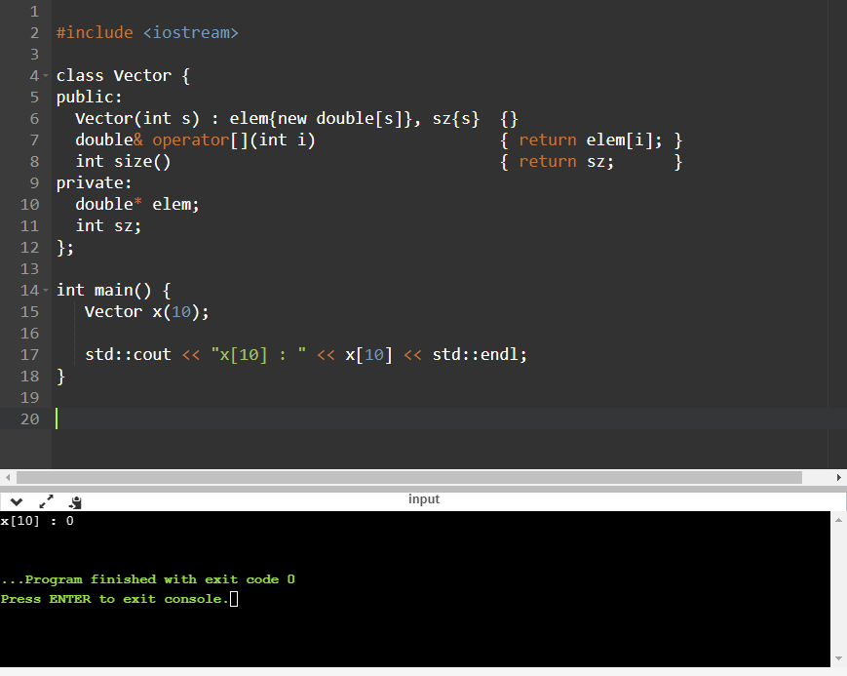
Is there a problem? If so, how should it be addressed?

Slide 18
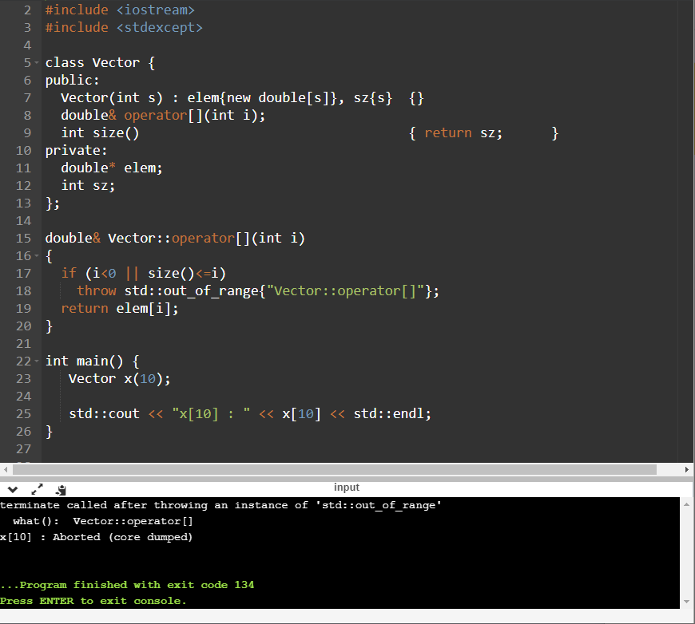
Handle by Exception Example

Slide 19
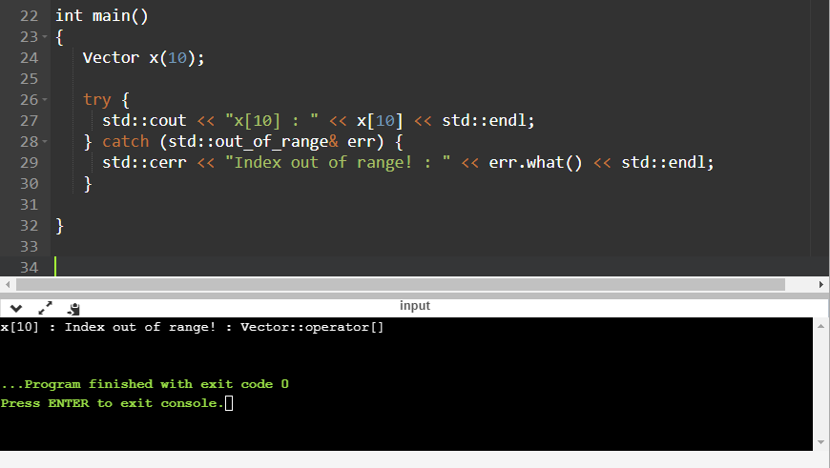
Handling the Exception (Error)
Handler (try-block)
Notice the separation of concerns (where error occurred vs the handling of it)

Slide 20
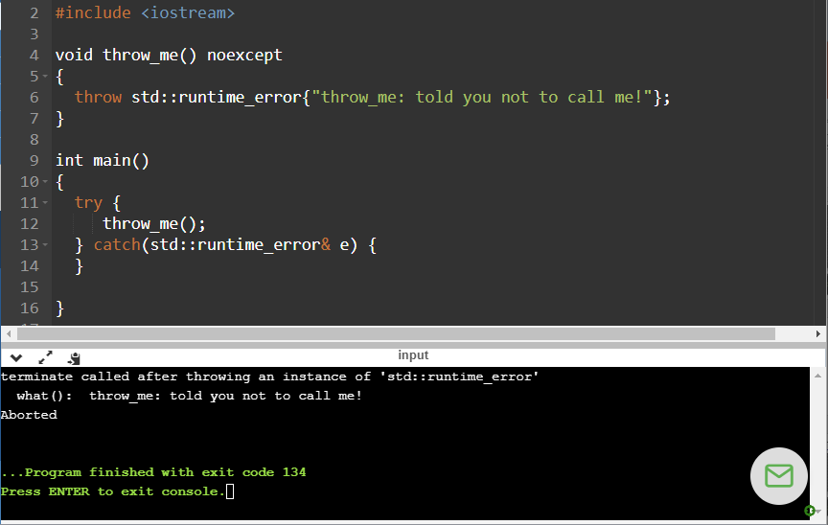
noexcept indicates that function should not throw an exception; if it does, we immediately terminate

Slide 21
What if an Error Occurs in the Constructor?

Slide 22
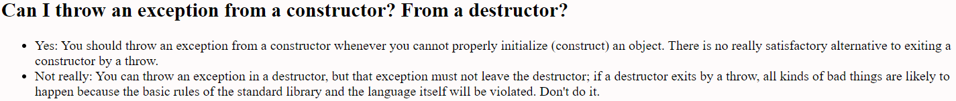
Throw Exception in Constructor!
Reference:
  Bjarne Stroustrup’s C++ Style and Technique FAQ
  http://www.stroustrup.com

Slide 23
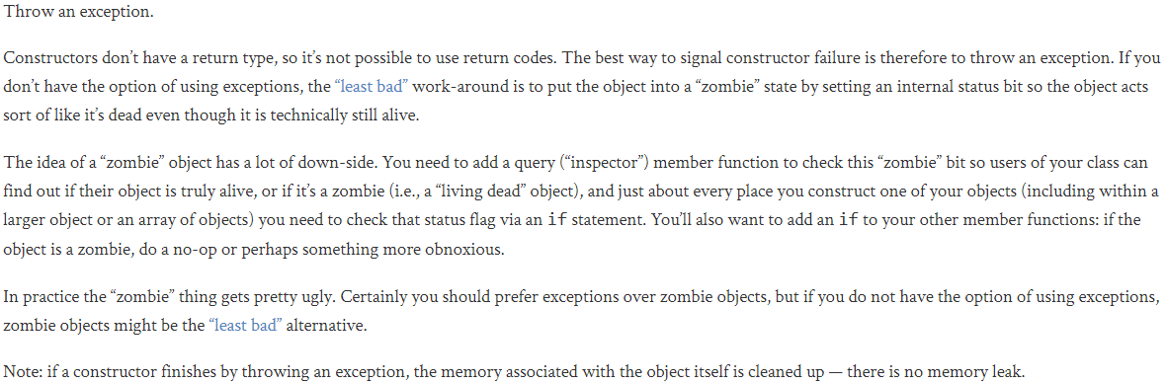
Handling a Constructor that Fails?
Reference: https://isocpp.org

Slide 24
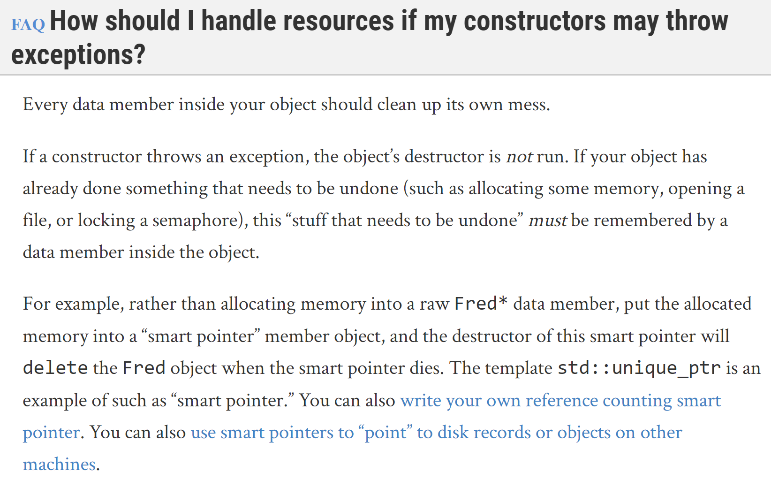
Good advise, but for a C-library, like SDL2, this might not work

Slide 25
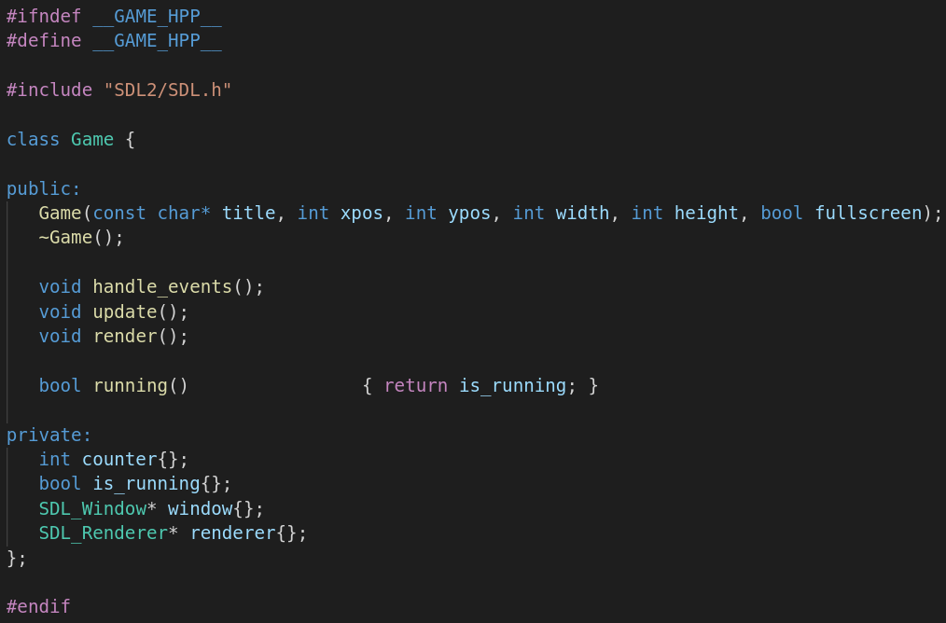
Game.hpp
Tempting to make “window” and “renderer” variables smart pointers, but this might not work – need to handle cleanup the “C” way

Slide 26
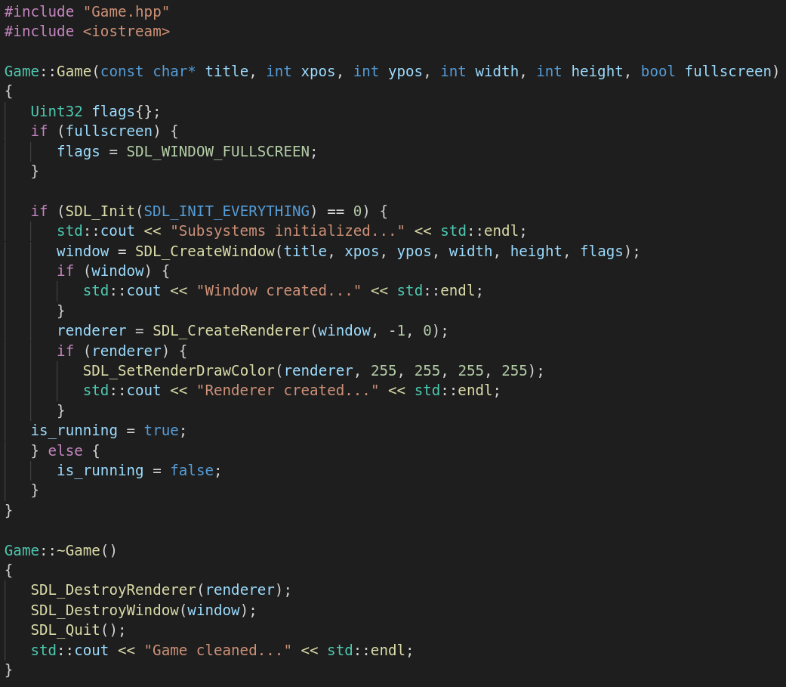
Game.cpp

Slide 27
Error Handling in Lua

Slide 28
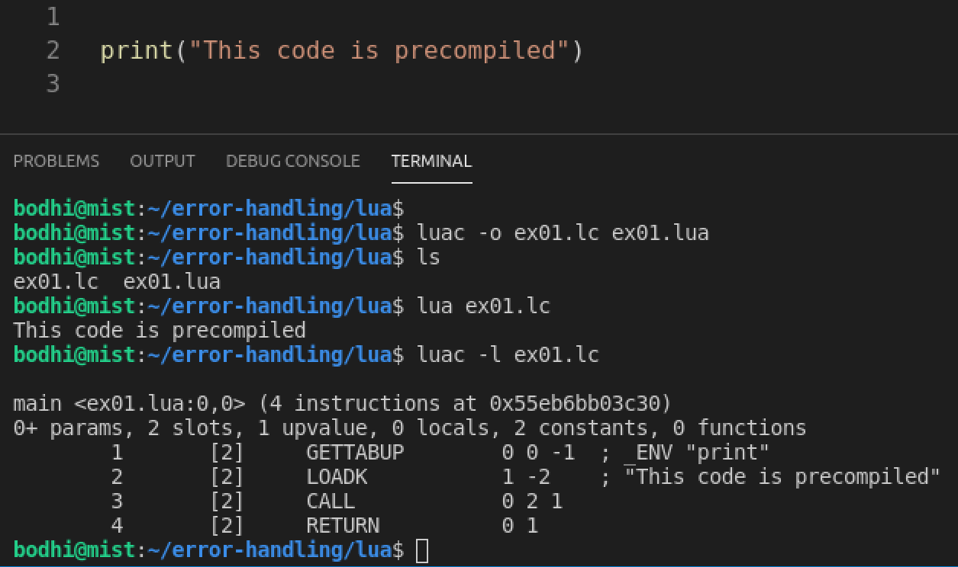
Precompiling Code
Lua precompiles source code before running it
  Called a binary chunk

Slide 29
Considerations
Because Lua is an extension language that is frequently embedded within an application, it cannot simple crash or exit when an error happens
Lua offers ways to handle it

Slide 30
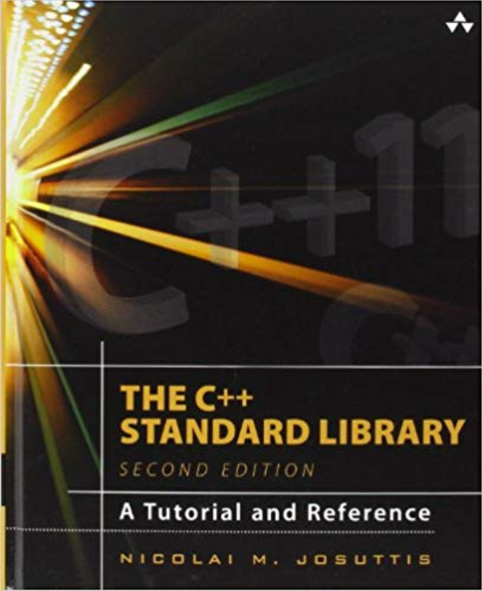
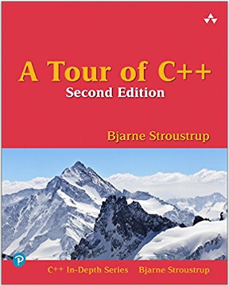
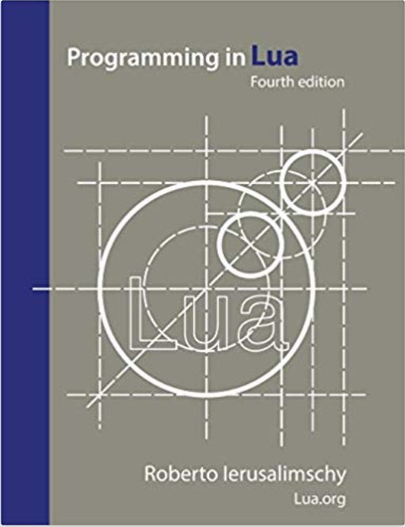
References
Computer Programming/Error Handling
  https://en.wikibooks.org/wiki/Computer_Programming/Error_handling

Slide 31
EOF

