Slide 1
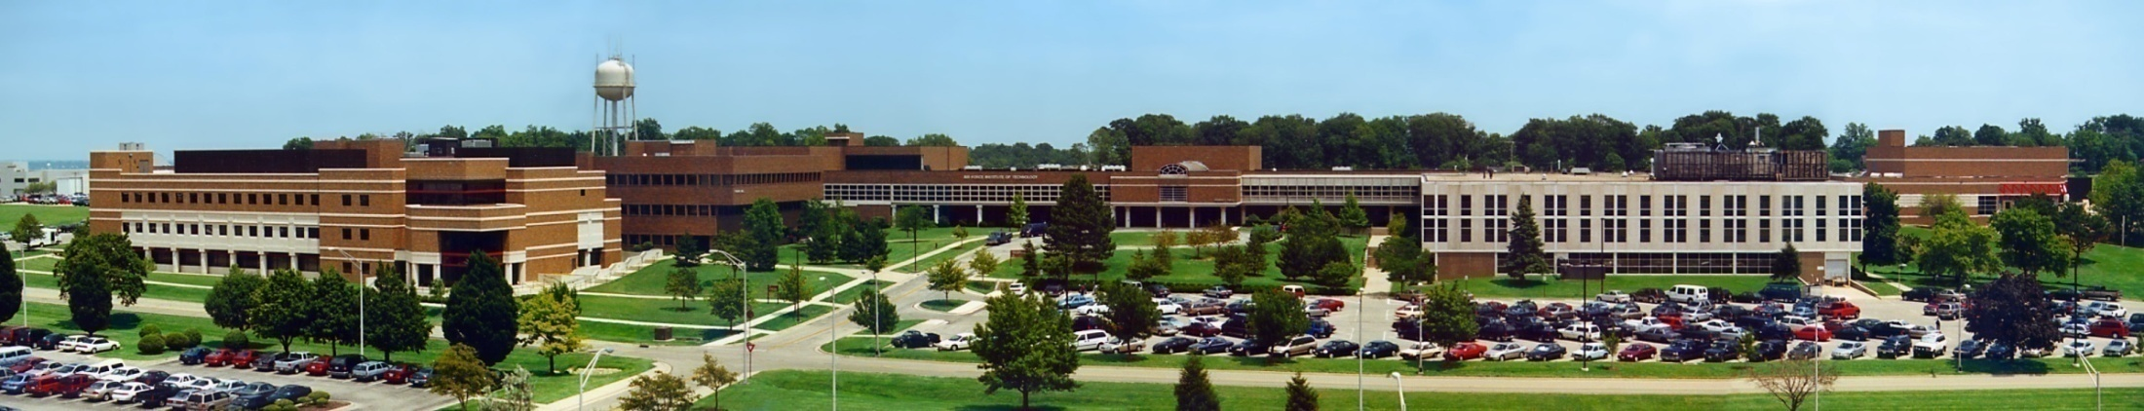
CSCE 693 – Software Evolution C++ Select Topics, Part 1
Air Force Institute of Technology
Douglas D. Hodson, PhD
Bldg 640, Room 311C
255-3636 x4719

Slide 2
Topics
Standard library overview
Standard library <chrono>
Sleeping… delay
Casting
Smart pointers
Containers: map, vector, string

Slide 3
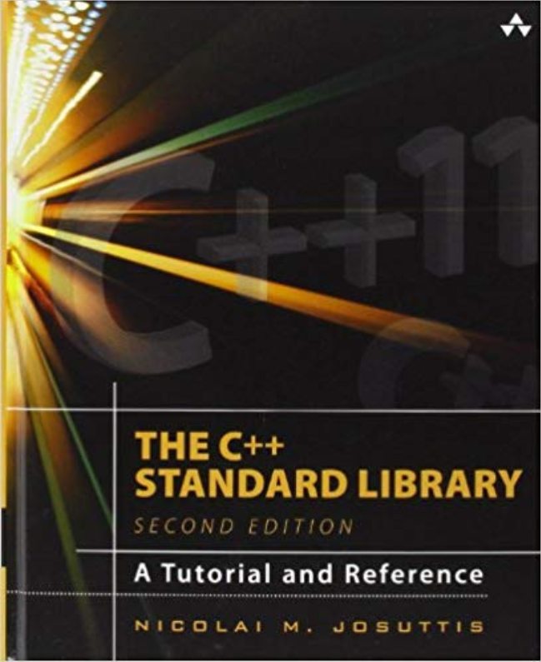
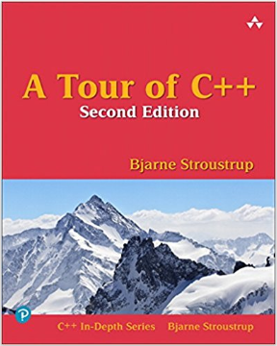
References

Slide 4
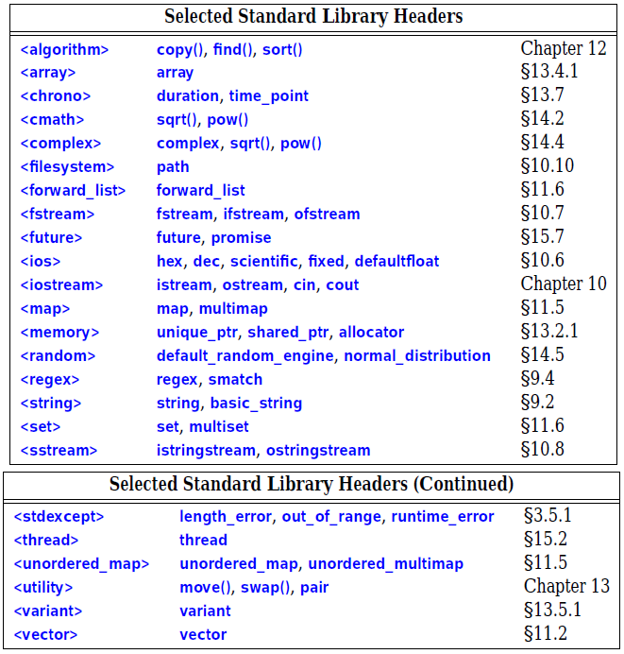
Std Libraries

Slide 5
C++ Duration & Time

Slide 6
Std Library of Interest

Slide 7
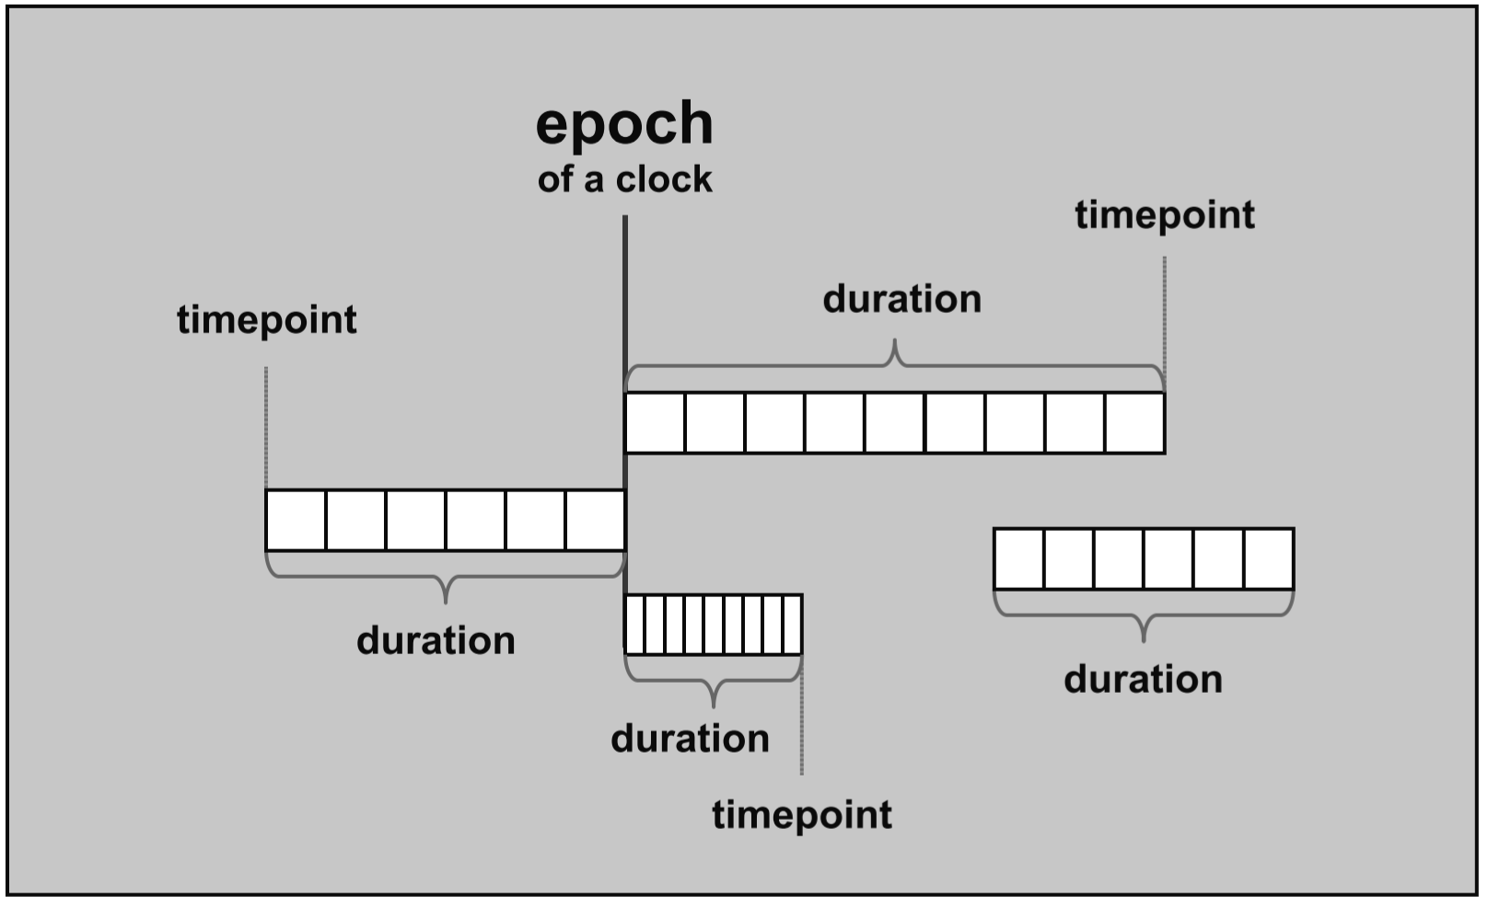
Epoch, Durations, and Timepoints
Library was designed to deal with the fact that timers and clocks might be different on different system and improve their precision over time
Definitions
Duration: a specific number of ticks over a time unit (e.g., 3 minutes is 3 ticks of a “minute”)
Timepoint: a combination of a duration and a beginning of time (a so-called epoch). In other words, a timepoint is defined as a duration before or after an epoch

Slide 8
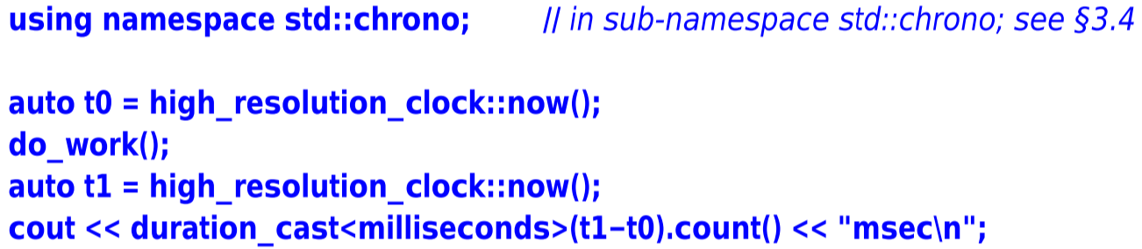
Time
A standard interface to getting time from many different sources
See chapter 13 “Utilities” in section 13.7 “Time”

Slide 9
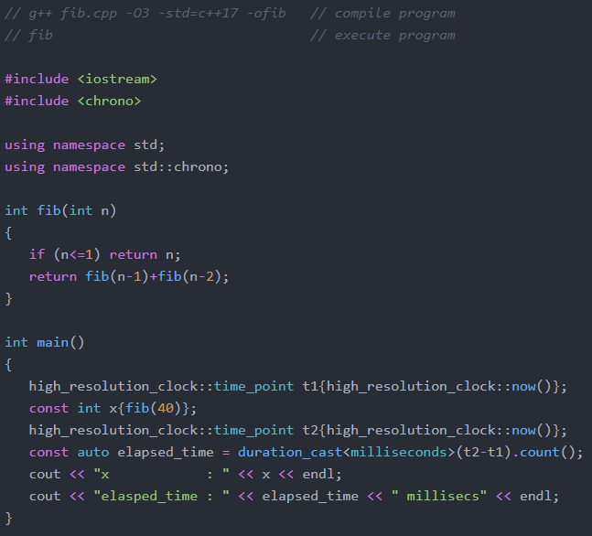
Benchmark: Recursive Fibonacci
C++ Implementation
Calculate the 40th value in sequence and print out result and how much time it took to compute
Elapsed time: 1.6 secs
Note the requirement to explicitly state data types being used… (i.e., statically compiled)

Slide 10
Std Library of Interest

Slide 11
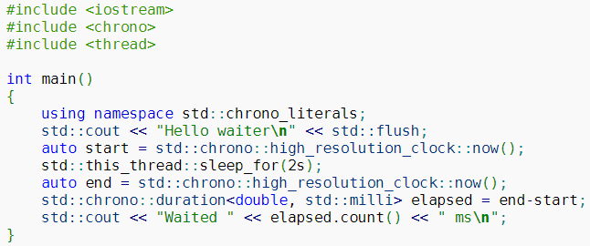
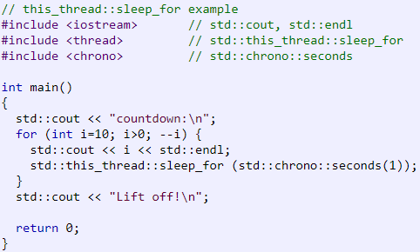
Sleep for Time Span (i.e., Delay)
std::this_thread::sleep_for(duration)

Slide 12
C++ Casting Operations (Language Feature)

Slide 13
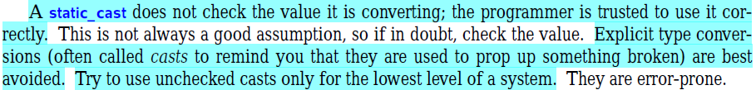
Casting
static_cast<>()
dynamic_cast<>()
const_cast<>()
reinterpret_cast<>()

Slide 14
C++ Smart Pointers

Slide 15
Std Library of Interest

Slide 16
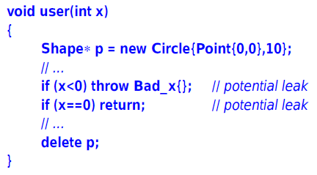
Avoiding Resource Leaks
This will leak unless x is positive
Assigning the result of new to a “naked pointer” is asking for trouble

Slide 17
Smart Pointers
Memory resource managers
“Safe” in the presence of exceptions
std::shared_ptr<>()
std::unique_ptr<>()
std::weak_ptr<>()

Slide 18
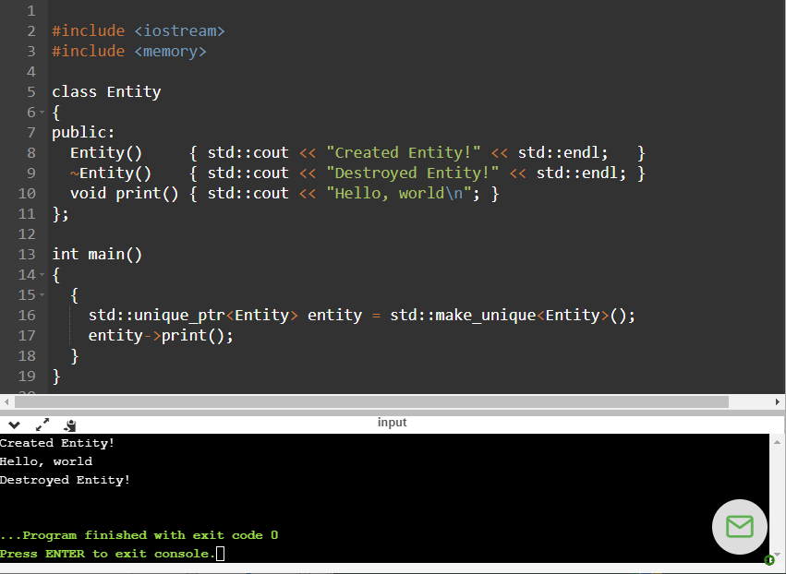
std::unique_ptr<>()

Slide 19
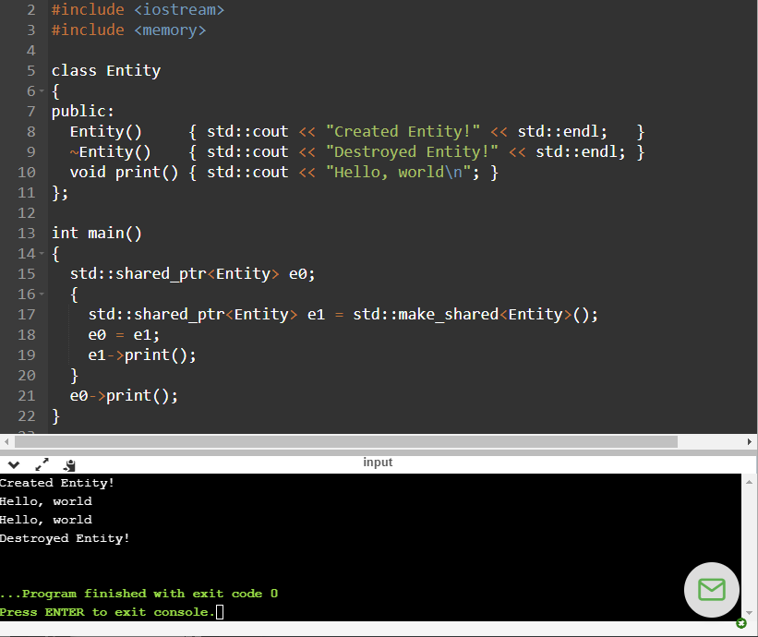
std::shared_ptr<>()
Shared pointer allocates memory for a control block to keep track of object lifetime

Slide 20
C++ Containers

Slide 21
Std Libraries of Interest

Slide 22
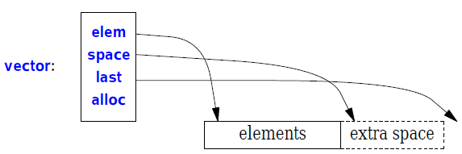
std::vector<>
A sequence of elements of a given type
Stored contiguously in memory
std::vector is implemented so that growing a vector by repeated push_back()s is efficient

Slide 23
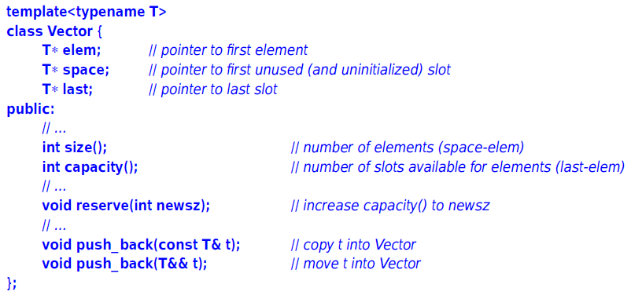
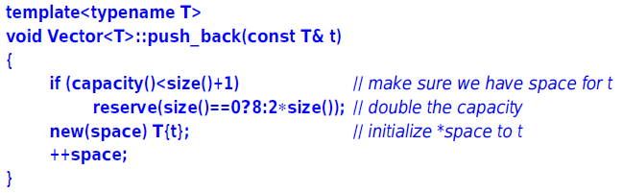
Defined / Implemented

Slide 24
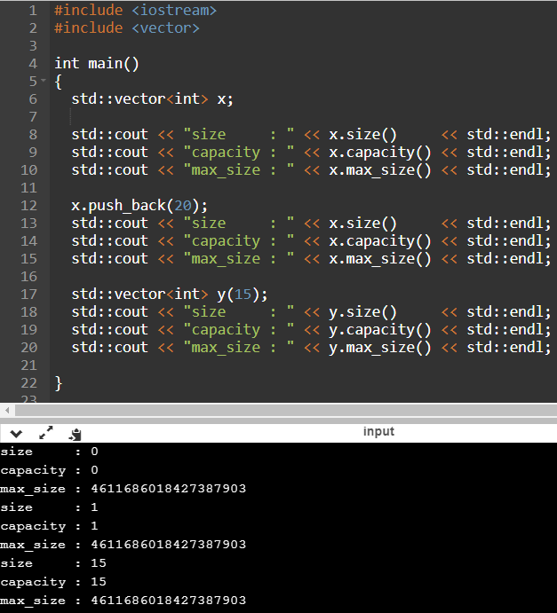

Slide 25
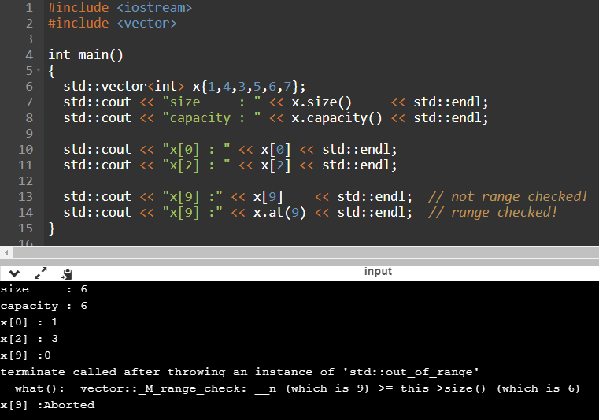
Range Checking / Exceptions!

Slide 26
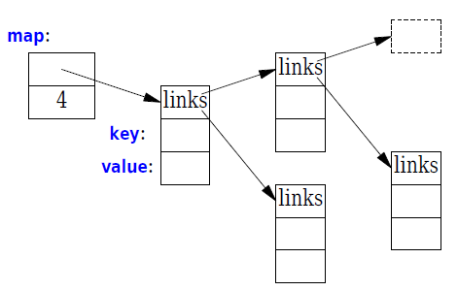
std::map<>
Linear search is inefficient for all but the shortest lists
A map implements a balanced binary search tree (a red-black tree)

Slide 27
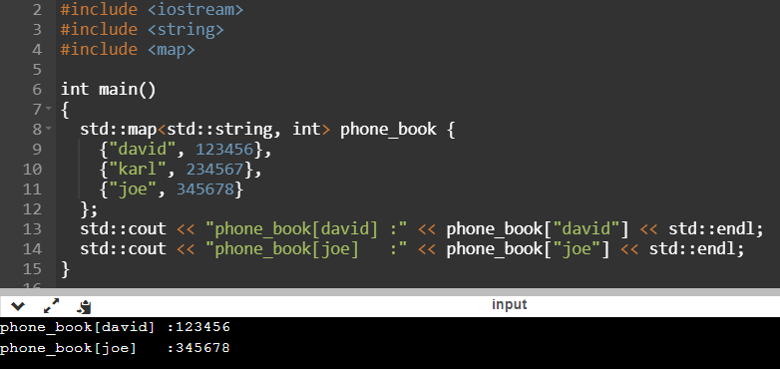
Example

Slide 28
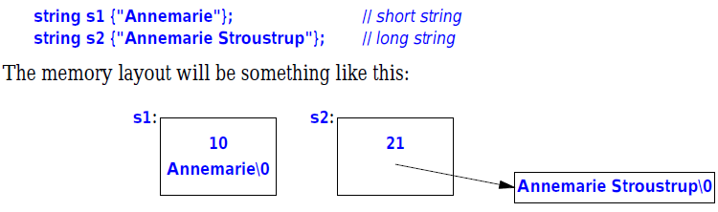
Strings (std::string<>)
Strongly prefer it over “char*” (C-style) strings
Eliminates pointer problems
Implements move constructor – so returning even long strings by value is efficient
Mutable
Implementation: short-string optimization

Slide 29
Strings (std::string<>)
By default, it’s implemented as a sequence of 1 character bytes
But this can be changed to work with any type of character representation (think Unicode)

Slide 30
EOF

