Slide 1

CSCE 693 – Software Evolution GameObject-based Design, Part 1
Air Force Institute of Technology
Douglas D. Hodson, PhD
Bldg 640, Room 311C
255-3636 x4719

Slide 2
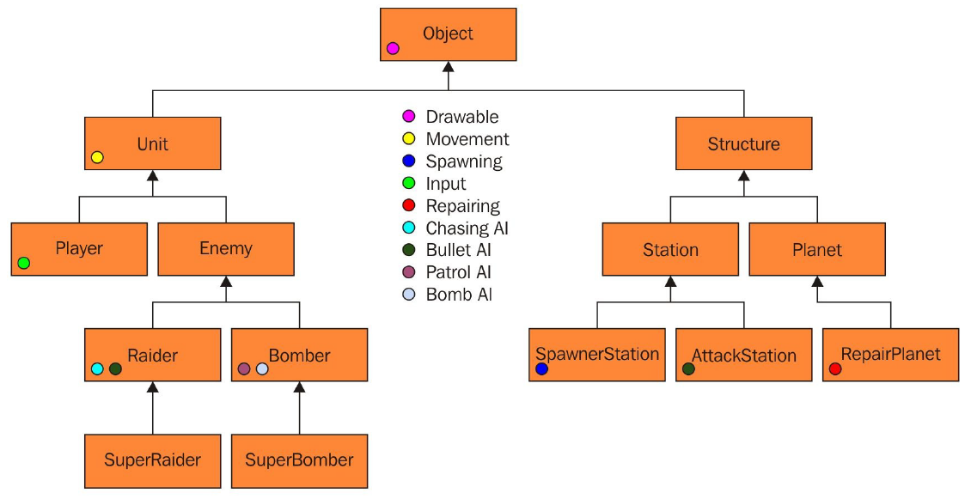
GameObject-based Design
Manageable and sensible initially
This leads to problems... but that's later

Slide 3
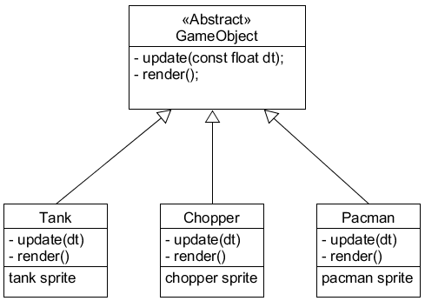
Traditional Deep Hierarchy
GameObject class serves as the root (or top) object - usually, it is abstract

Slide 4
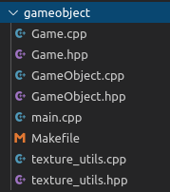
Example Code (An Existing Design)

Slide 5
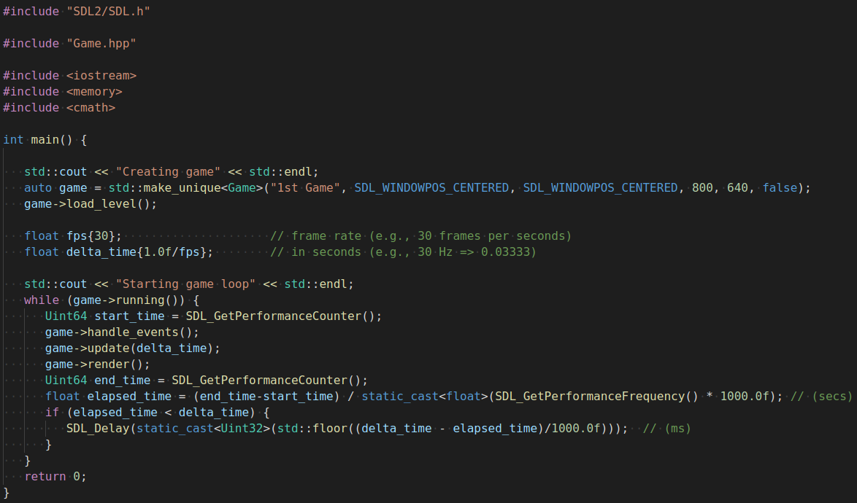
Main Loop (Fixed Frame Rate)

Slide 6
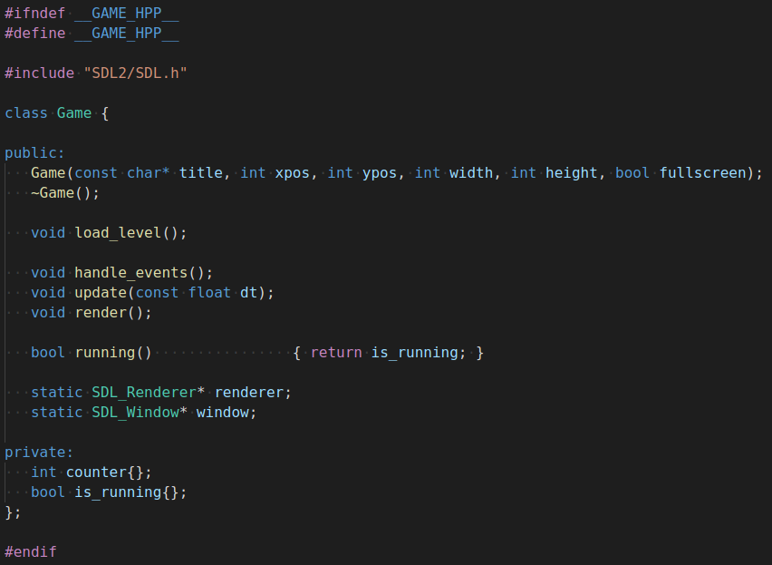
Game.hpp
Declaring these pointers static keeps them accessible from nearly everywhere
Good place to create a list of GameObjects
Most likely std::vector

Slide 7
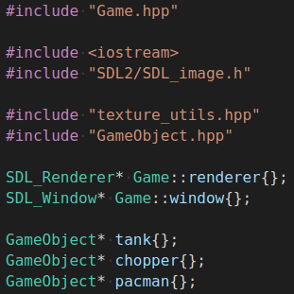
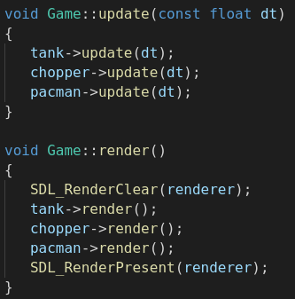
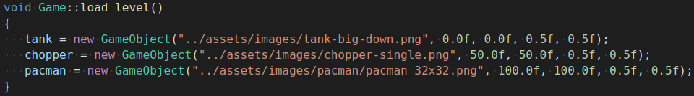
Game.cpp
Issues
GameObject is NOT abstract
Each "GameObject" being explicitly defined
This is NOT a game "engine" - it's a particular game

Slide 8
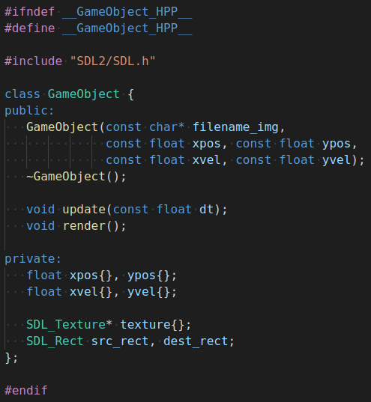
GameObject.hpp
GameObject is NOT abstract - it defines all behavior

Slide 9
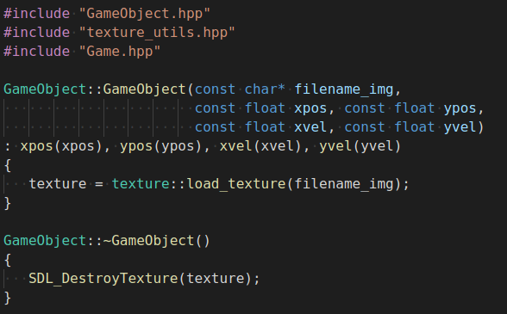
GameObject.cpp
GameObject is NOT abstract
Opportunity for RAII
What happens if texture::load_texture() fails?

Slide 10
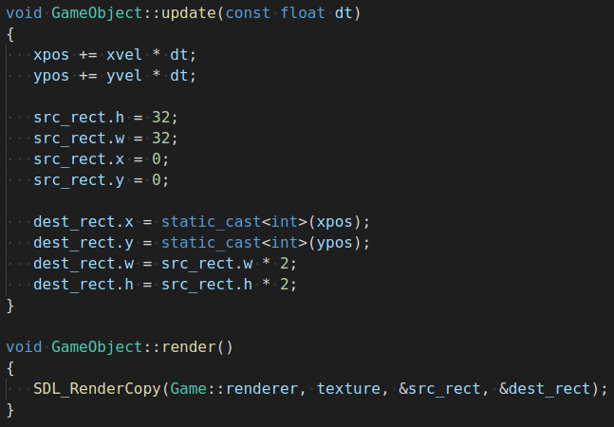
GameObject.cpp
update() moves player and sets up graphics
render() "renders" the texture to screen

Slide 11
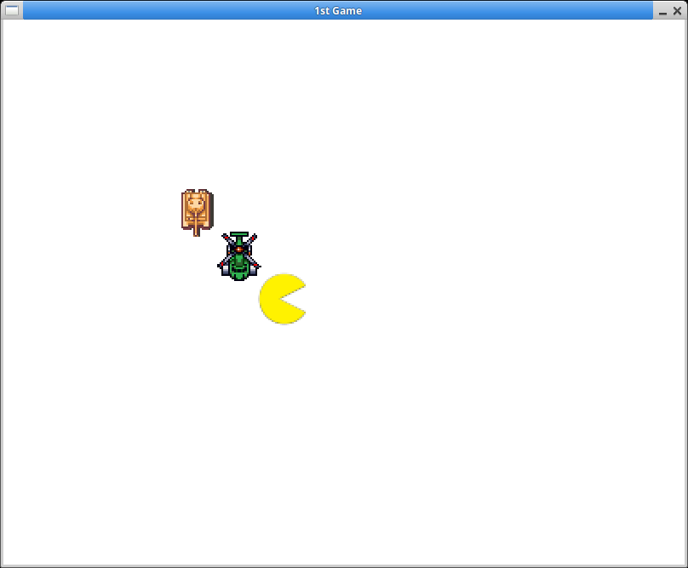
Running Game

Slide 12
Issues to be Discussed / Addressed
GameObject
Needs to be abstract
Specific GameObjects
Need to throw exception asset cannot be loaded
Game object should manage a list (e.g., std::vector) of GameObjects
Be able to add/delete, etc.
Will need to understand std::move()
update() and render() should simply call each GameObjects equivalent methods
GameObjects are not properly deleted when game finishes

Slide 13
Abstract GameObject
Defines interface
No data!
Two abstract methods
update(const float dt)
All GameObjects "move" around in essentially the same way (initial positions and velocity are the only aspects of uniqueness)
render()
All GameObjects are associated with a sprite - this is probably ok for now

Slide 14
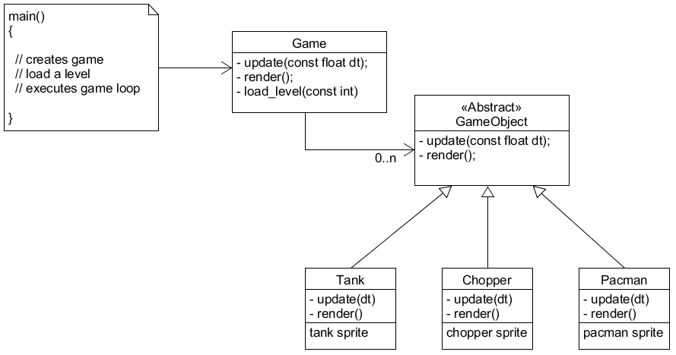
Better Design

Slide 15
EOF

