Slide 1
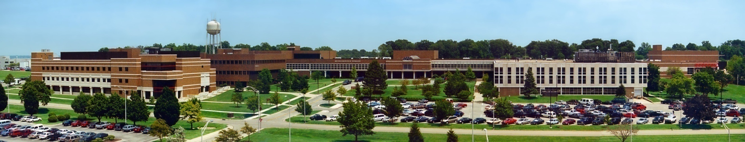
CSCE 693 – Software Evolution
Survey of SDL2
Air Force Institute of Technology
Douglas D. Hodson, PhD
Bldg 640, Room 311C
255-3636 x4719

Slide 2
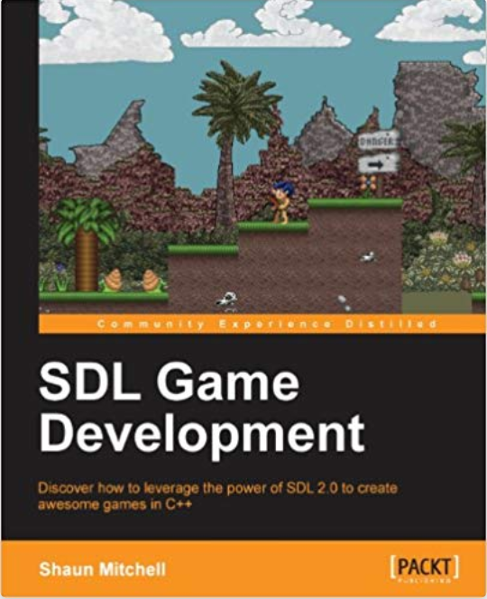
References
C++ Programming (Contents – SDL2)
  https://thenumbat.github.io/cpp-course/index.html
Beginning Game Programming v2.0
  http://lazyfoo.net/tutorials/SDL/
Programming C++11 and SDL2
  http://headerphile.blogspot.com/2014/07/contents-of-this-blog.html

Slide 3
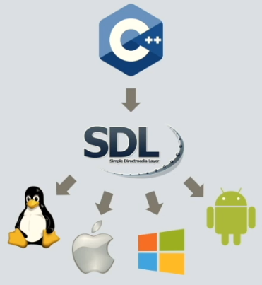
Simple DirectMedia Layer (SDL)
A C-based interface to low level platform functionalities such as audio, keyboard, mouse, joystick, and graphics hardware via OpenGL and DirectX
Abstracts functionality across several platforms
It’s sometimes considered to be the x-platform version of DirectX, as it defines a collection of application programming interfaces (APIs)

Slide 4
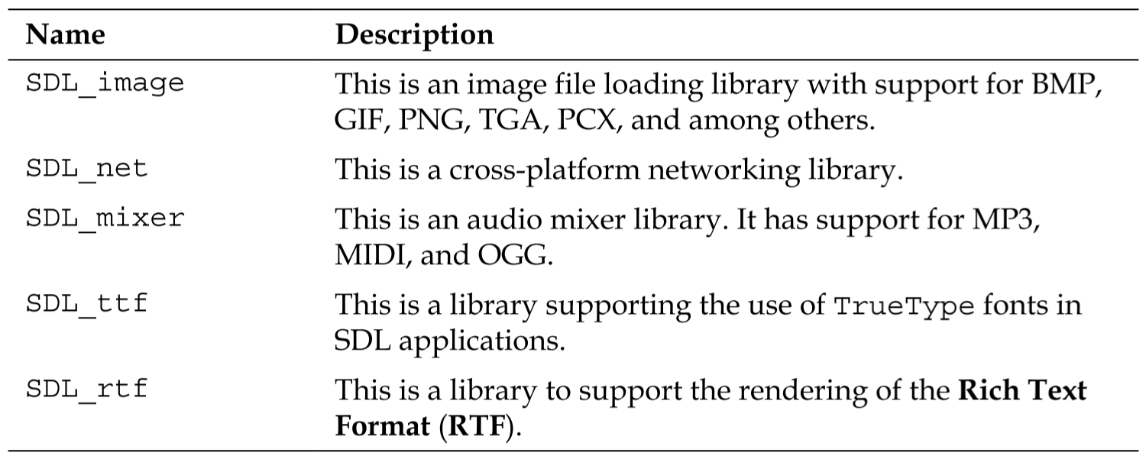
SDL Extensions

Slide 5
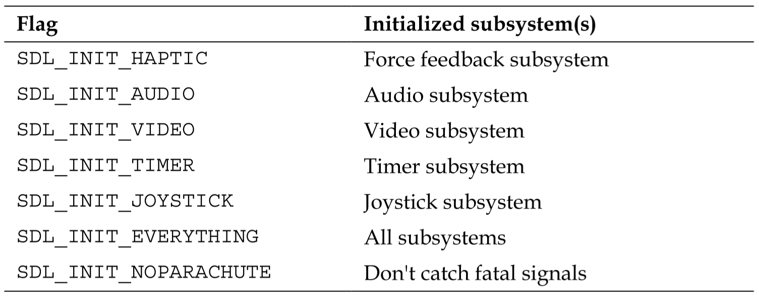
Initialization Flags

Slide 6
Video

Slide 7
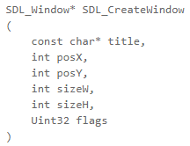
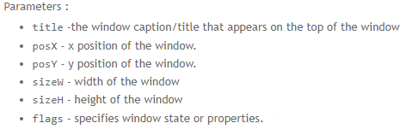
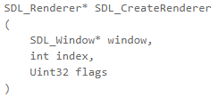
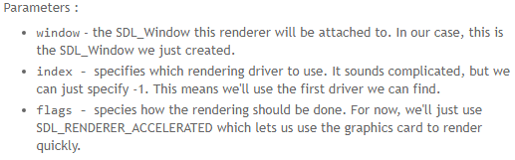
SDL2 Structures
SDL_Window
  This is the physical window you see on your screen. One SDL_Window represents one physical window on your screen. You can have as many SDL_Windows as you like. The structs holds info about the window like position, size, window state and window style
SDL_Renderer
  The SDL_Renderer is basically what you use to render to the screen. The renderer is usually tied to a window. One renderer can only render within one window. The SDL_Renderer also contains info about the rendering itself like hardware acceleration and v-sync prevention.

Slide 8
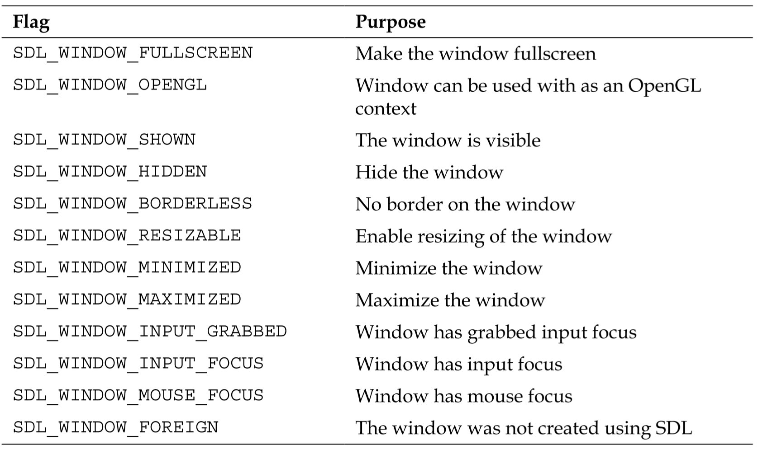
Window Creation Flags

Slide 9
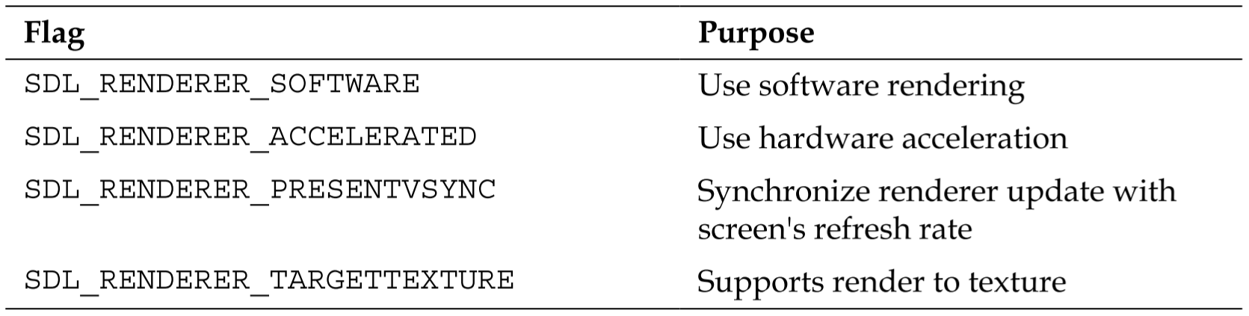
Renderer Creation Flags

Slide 10
Drawing Structures
Two basic structures to draw to the screen
  SDL_Surface
    Contains a collection of pixels and is rendered using software rendering processes (think CPU, not GPU)
    This was part of “old” SDL and was used for everything
    Hold raw data
    Rendering was done via blitting, which means CPU does everything
  SDL_Texture
    Hold “texture” data in an optimized, driver specific representation of the pixel data
    Uses hardware-accelerated rendering (GPU)
Load images into surface, convert to texture
  Surfaces still useful for doing other things not related to rendering

Slide 11
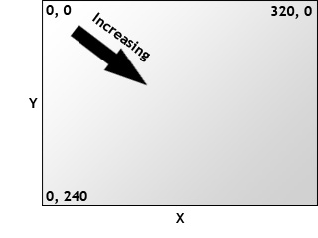
SDL2 Coordinate System
In order to draw something, be it textures or plain rectangles or text or anything, you need a rectangle to specify where to draw it and the size of what you are going to draw
  SDL_Rect contains this information

Slide 12
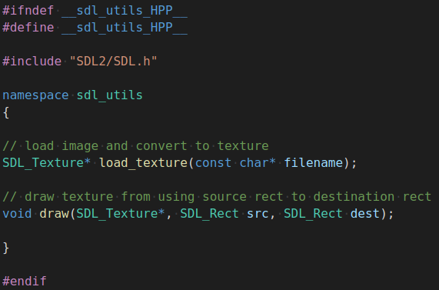
Image/Texture Utilities
Namespace “texture” used to contain a few useful SDL utilities

Slide 13
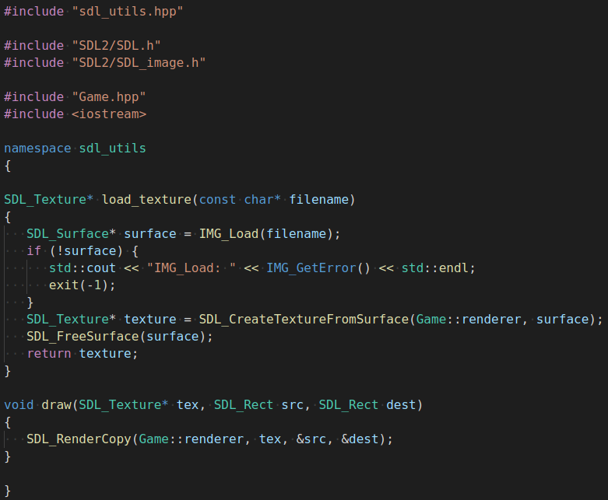
Image/Texture Utilities
Extended version of this function exists to flip, scale and rotate rect
Blitting is similar to hardware-sprite drawing

Slide 14
Some Definitions
Sprite
  An image that is moving related to static images (for example background)
    They are usually planes (rectangles) with texture on it
  An image that can be used as a 2D object, which have coordinates (x,y) and which you can move, destroy or create during a game
Texture
  Is an image, but that can be used to change the appearance of an object (e.g., you can set a texture for the faces of a cube, a layer (like the background) or even a sprite
    Textures are not objects, you can’t move them during the game
  Is a raster image that is to be projected on polygonal object
Frame
  A single image of the game

Slide 15




Animating a Sprite Sheet
Copying bits / pixels
Example sprite sheet
  Animation is six frames long
  Each frame is 128 x 82
  Use of modulo to select frame (transition time = 100ms)

Slide 16
Event-Driven Programming
(Handling Input)

Slide 17
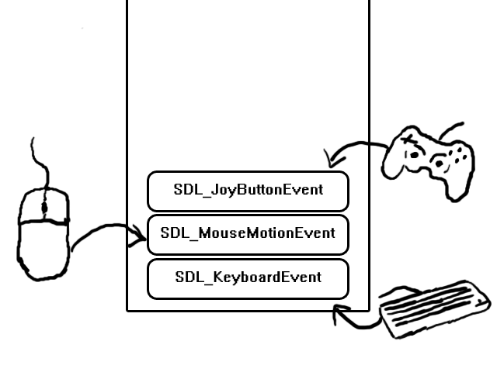
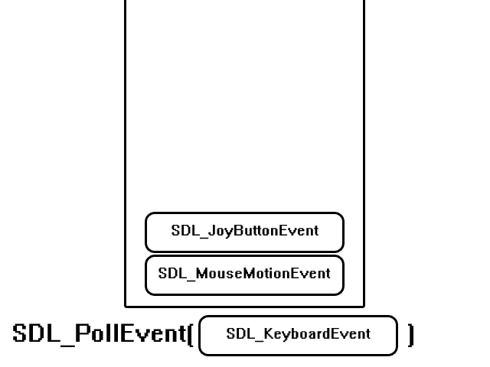
Input Events
When you press a key, move the mouse, or touch a touch screen, you put events onto the event queue
  Queue stores them in the order they occurred
  Use SDL_PollEvent() to retrieve most recent

Slide 18
Events
All events in SDL2 are in the form of a SDL_Event struct
  It’s a huge structure with tons of member variables
  Examples: quit, mouse, keyboard, window (resize, minimize, move, focus,...), phone (touch, scale, flipping,...)
The type of the event is contained in the .event

Slide 19
Event-Driven Input Systems
Joystick/Gampad
  Can be several devices connected
Mouse
  Assume one
Keyboard
  Assume one

Slide 20
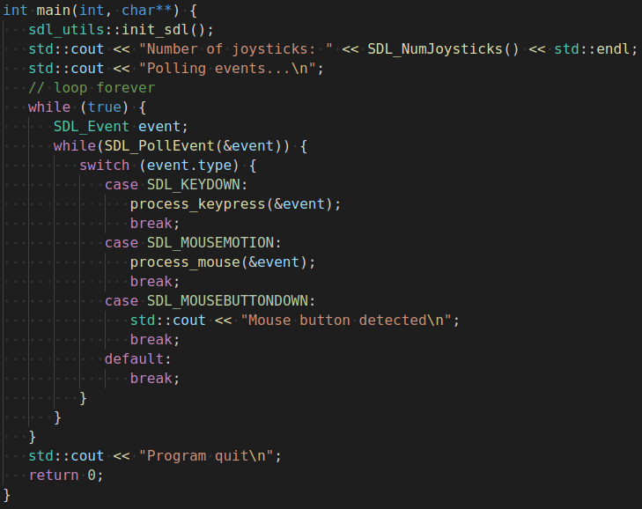
Example Program

Slide 21
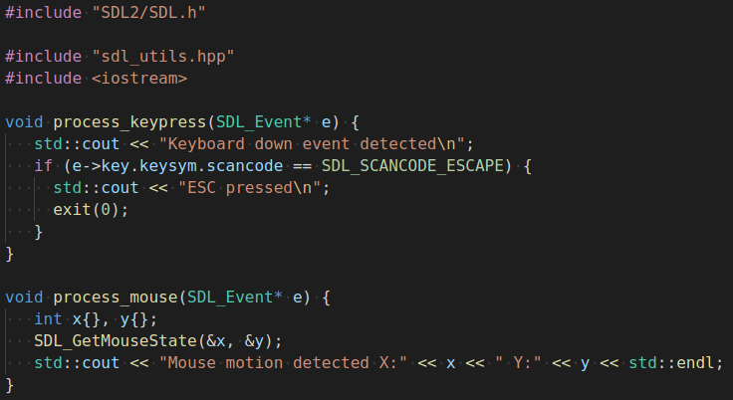
Example Program (2)

Slide 22
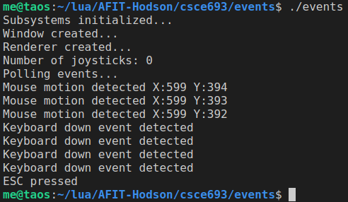
Example Program Output

Slide 23
Creating and Displaying Tile Maps

Slide 24
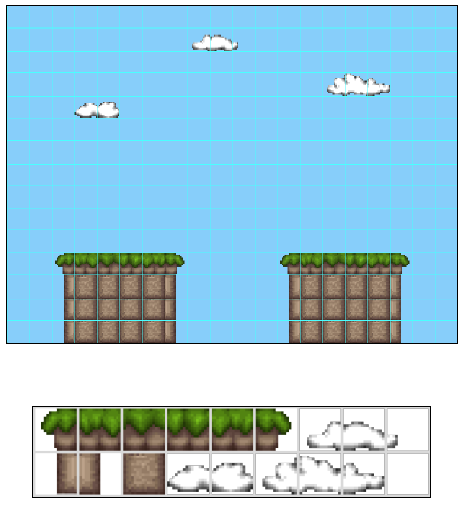
Tile Maps and Tilesets

Slide 25
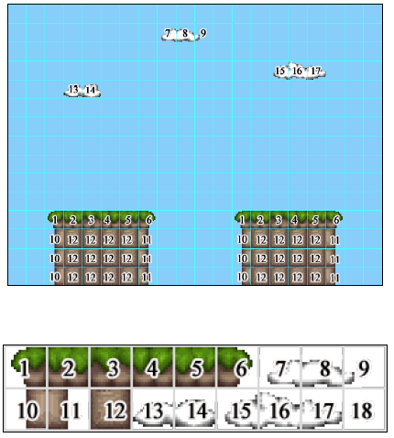
Mapping Tiles to a Tile Map

Slide 26
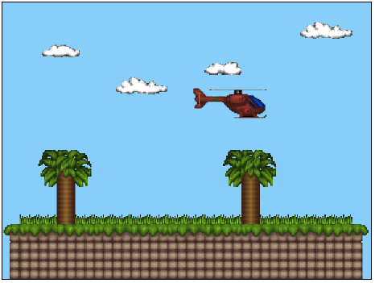
GameObjects on Top of Tile Map

Slide 27
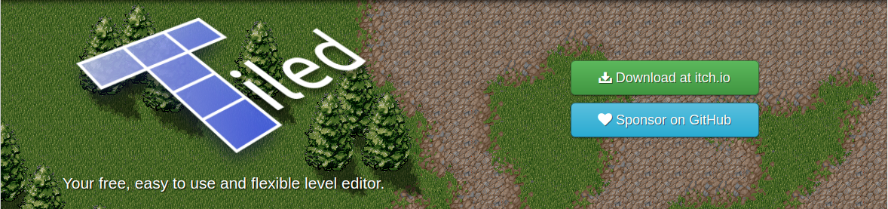
Tile Map Editor
Works for Windows, Linux and Mac

Slide 28
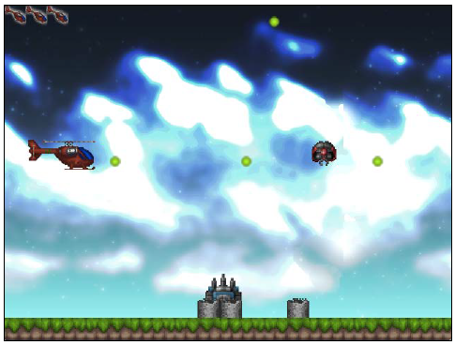
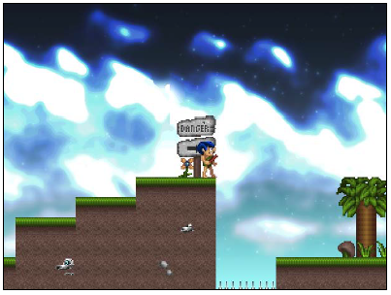
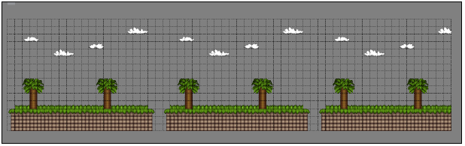
Example Games

Slide 29
EOF

Slide 30
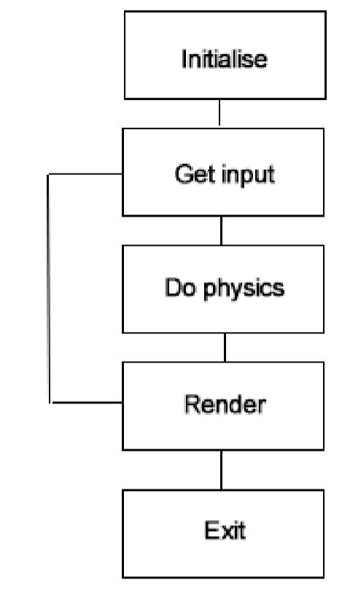
Game Loop

