Slide 1

CSCE 693 – Software Evolution Survey of sol (sol2 v3.0.3)
Air Force Institute of Technology
Douglas D. Hodson, PhD
Bldg 640, Room 311C
255-3636 x4719

Slide 2
sol
Is a C++ / Lua binding library
It is a collection of templates that allow C++ and Lua code to interoperate with each other
Enables “interoperability” between C++ and Lua code, meaning
C++ can set/get variables from Lua
C++ can call Lua functions, Lua can call C++ functions and work with objects
For this next homework all you need is for
C++ to get variables from Lua (variables stored in a list)
No calling of functions either way

Slide 3
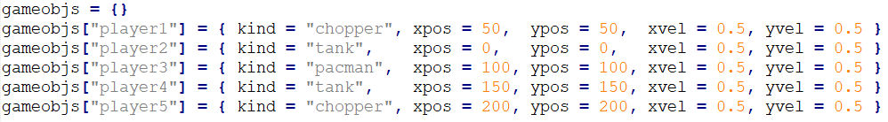
config.lua
A list of game objects
Each item in the list is a key/value pair
The key is a name, the value is a list, where "kind" indicates what type of game object it is

Slide 4
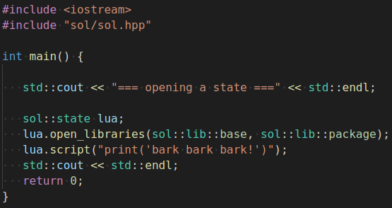
First Example

Slide 5
Error Handling

Slide 6
Configuration and Safety
sol was designed to be correct and fast, and in the pursuit of both uses the regular lua_to{x} functions of Lua rather than the checking versions (lua_check{X}) functions
The API defaults to paranoidly-safe alternatives if you have a #define SOL_ALL_SAFETIES_ON before you include sol, or if you pass the SOL_ALL_SAFETIES_ON define on the build command for your build system
By default, it is off and remains off unless you define this, even in debug mode
Reference: https://sol2.readthedocs.io/en/latest/safety.html

Slide 7
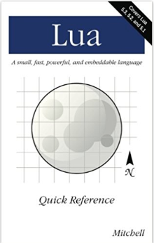
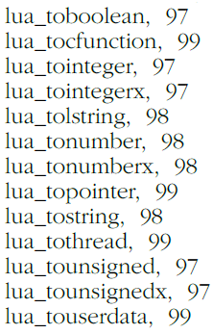
Lua API
Book index indicates lots of lua to functions that return values from the Lua virtual stack (No checking to ensure they are in fact of the correct type)

Slide 8
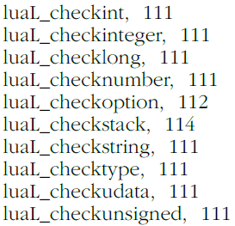
Lua API – Checking Returned Values
Book index indicates lots of lua to functions that check the type of the value returned from the Lua virtual stack

Slide 9
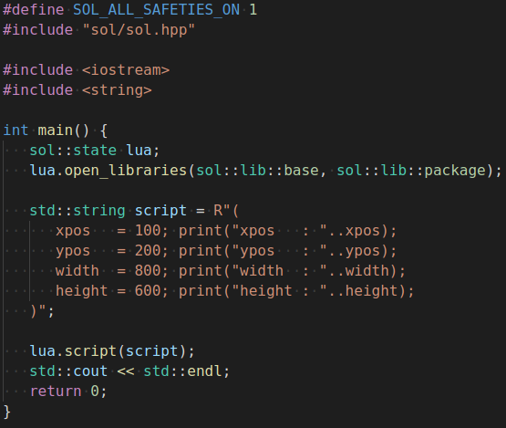
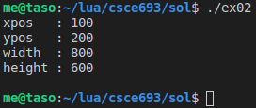
Error Handling
sol webpage provides a detailed explanation of error handling defaults

Slide 10
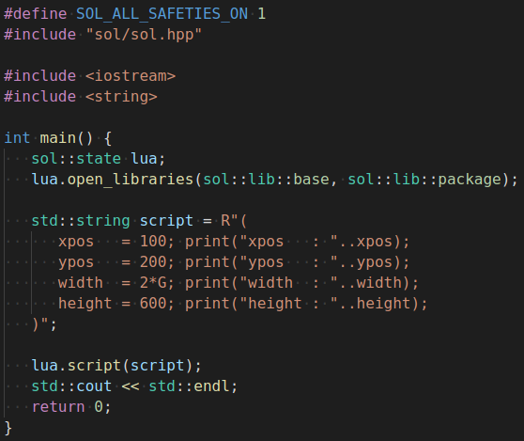
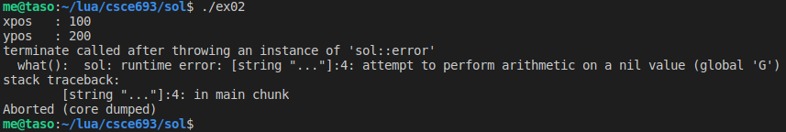

Slide 11
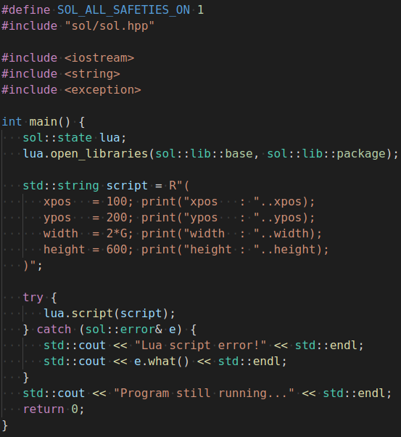
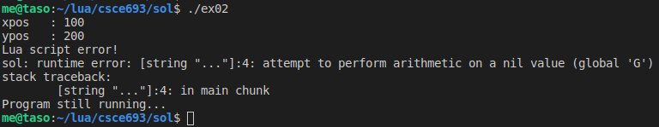

Slide 12
Binding Functionality

Slide 13
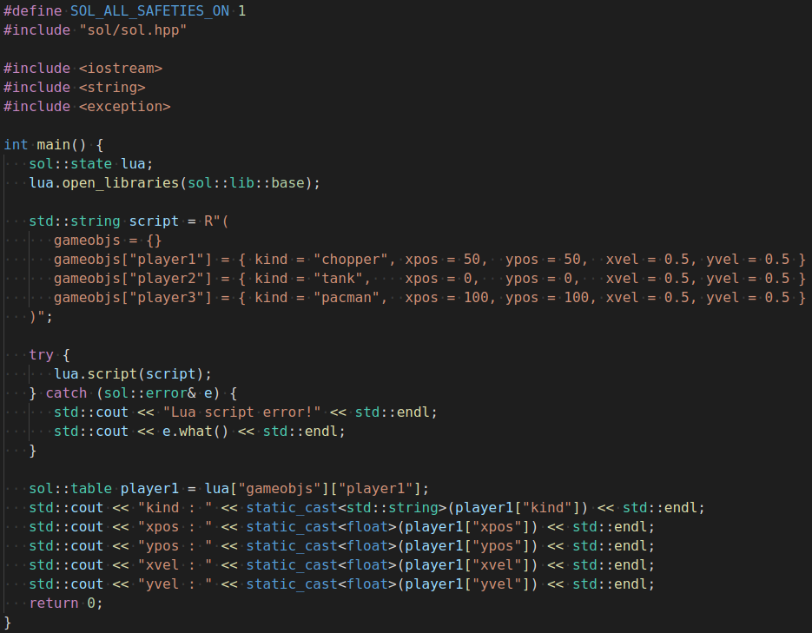
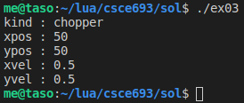
Extracting Data Nested in Tables

Slide 14
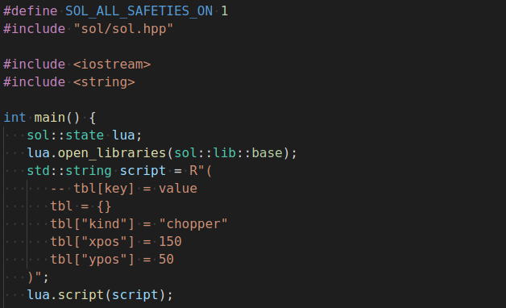
Iterating on a Table

Slide 15

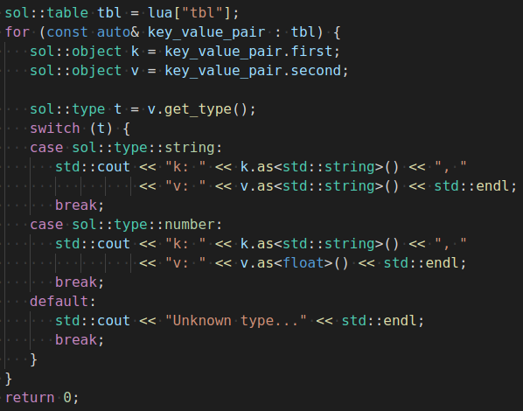
Iterating on a Table

Slide 16
EOF

