Slide 1

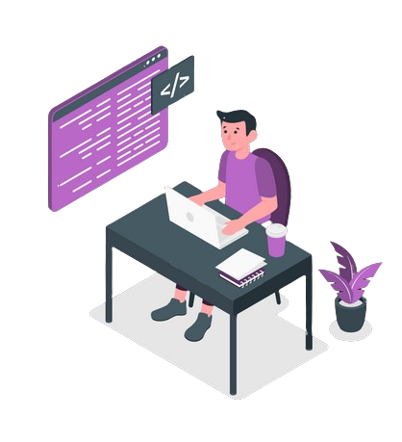
Unveiling My Journey: Crafting a Solo React.js Portfolio Project
Introducing a captivating portfolio project, built using the powerful React.js framework.
ca
by Chadia EL KHARMOUDI

Slide 2



The Team Behind the Project
Developer
Designer
Project Manager
Unfortunately, due to the online nature of the program, I worked on this project independently. While I attempted to find team members to collaborate with, I was unable to do so. Therefore, I undertook all aspects of the project, from conception to implementation, on my own.

Slide 3
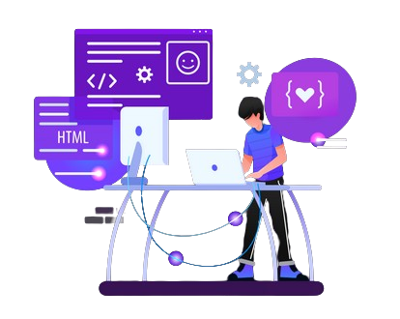
The Story of Inspiration
The inspiration for this project stemmed from my desire to showcase my skills and accomplishments in software engineering through a comprehensive portfolio. I aimed to create a visually appealing and interactive platform using React.js that would not only highlight my technical abilities but also provide visitors with insights into my projects and experiences.

Slide 4
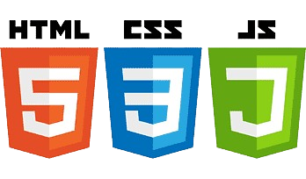

Technology and Architecture
For this project, I chose to use React.js due to its versatility and efficiency in building dynamic user interfaces. React.js component-based architecture allowed me to create modular and reusable components, enhancing the maintainability and scalability of the portfolio. Additionally, I utilized modern web development technologies such as CSS3 and HTML5 to style and structure the application.
Notes:
For this project, I chose to use React.js due to its versatility and efficiency in building dynamic user interfaces. React.js component-based architecture allowed me to create modular and reusable components, enhancing the maintainability and scalability of the portfolio. Additionally, I utilized modern web development technologies such as CSS3 and HTML5 to style and structure the application.

Slide 5
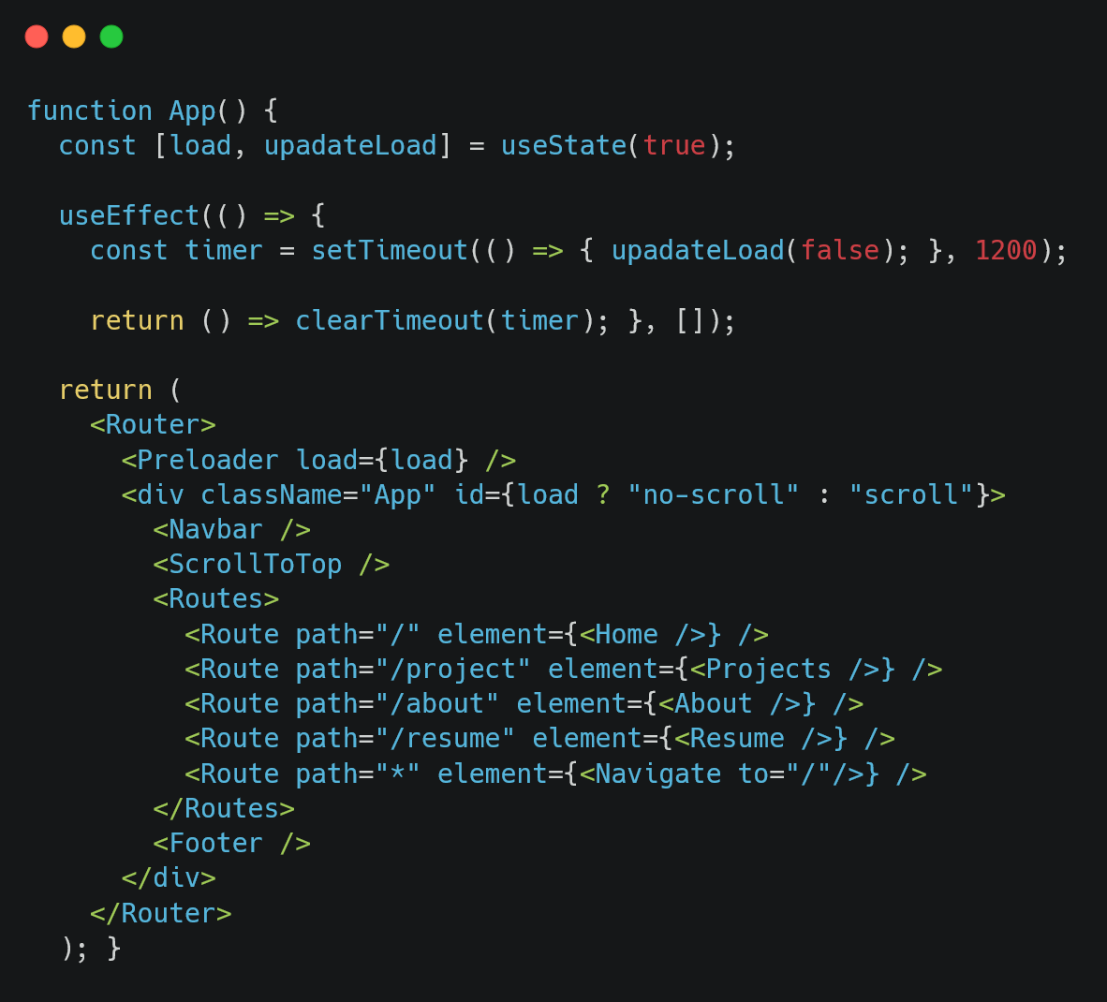
Core Algorithms and Code Snippet

Slide 6
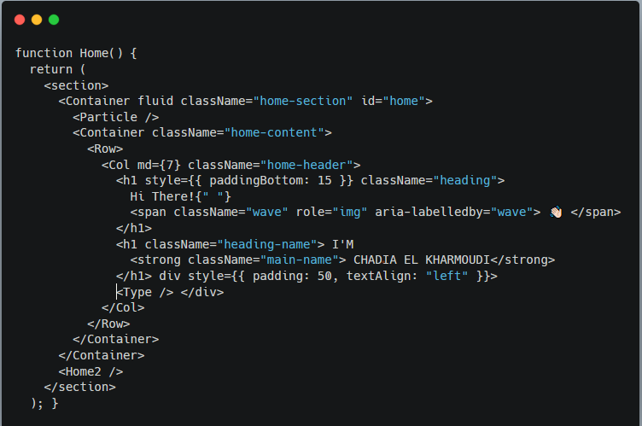
Core Algorithms and Code Snippet

Slide 7
Discussion of Process, Collaboration, and Timeline
1
Planning
Thorough planning and brainstorming to define project scope and objectives.
2
Development
Collaborative development phases, ensuring code synergy and seamless integration.
3
Testing & Deployment
Rigorous testing and efficient deployment, meeting timelines and quality benchmarks.
Notes:
As mentioned earlier, I worked independently on this project. I followed an iterative development process, starting with planning and design, followed by implementation, testing, and deployment. I regularly reviewed and adjusted my timeline to ensure timely completion of milestones. While collaboration was not a factor in this project, I leveraged online resources and documentation to troubleshoot issues and enhance my understanding of React.js.

Slide 8
Challenges Faced
1
implementing responsive design
2
Technical Complexity
One of the main challenges I encountered during the project was implementing responsive design to ensure optimal user experience across various devices and screen sizes.
Dealing with intricate technical hurdles required innovative problem-solving approaches.
Notes:
One of the main challenges I encountered during the project was implementing responsive design to ensure optimal user experience across various devices and screen sizes. Through experimentation and iteration, I successfully implemented media queries and flexible layouts to adapt the portfolio's layout and content based on the viewport size.

Slide 9

Technical Learning Outcomes
Advanced Concepts
Optimized Performance
The project led to the exploration and mastery of advanced programming concepts.
Enhanced knowledge in optimizing code performance for dynamic user experiences.

Slide 10
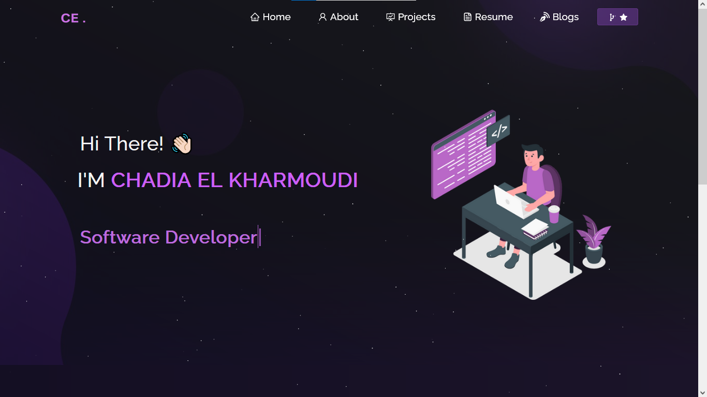

Slide 11
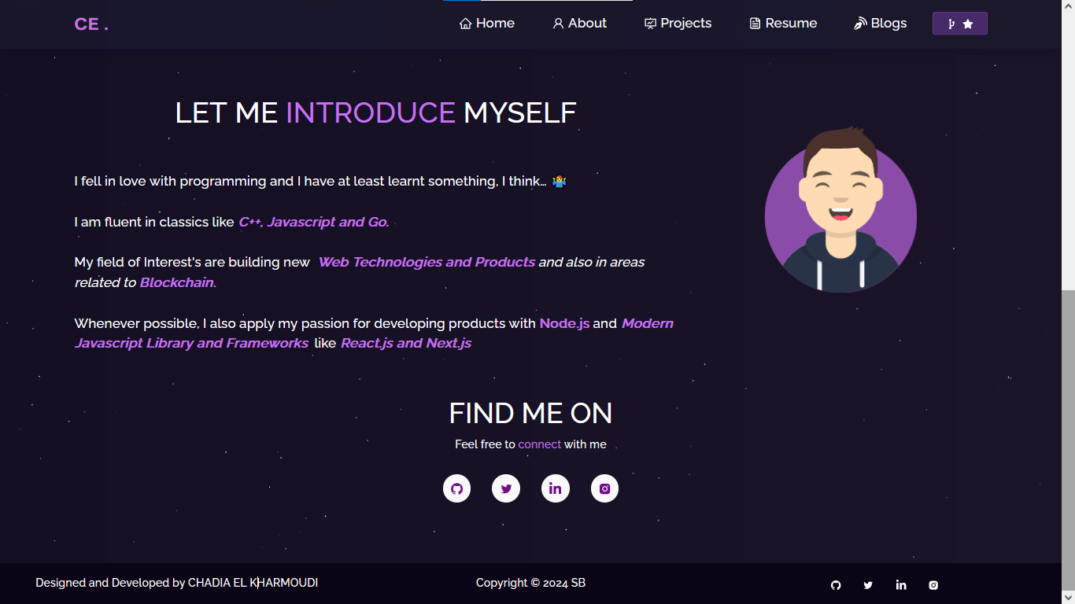

Slide 12
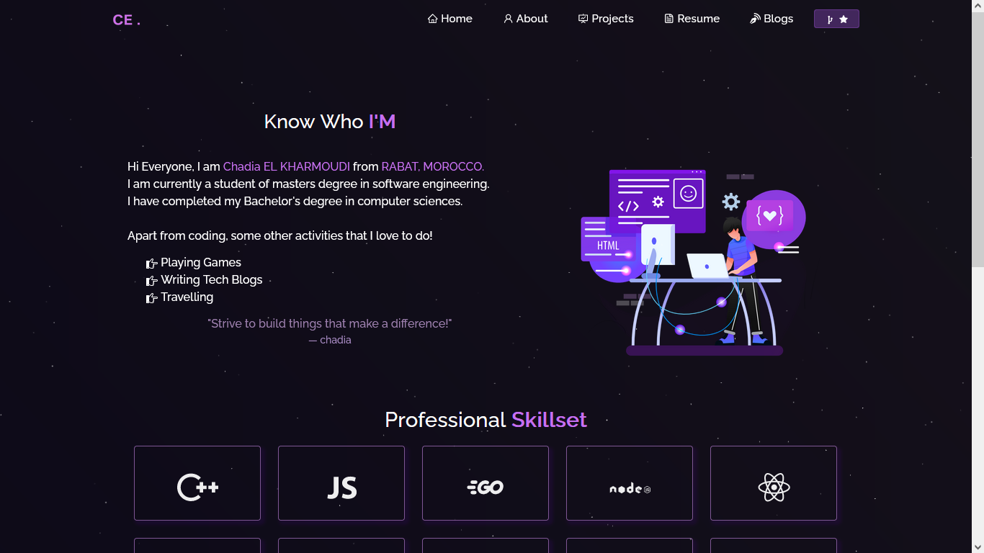

Slide 13
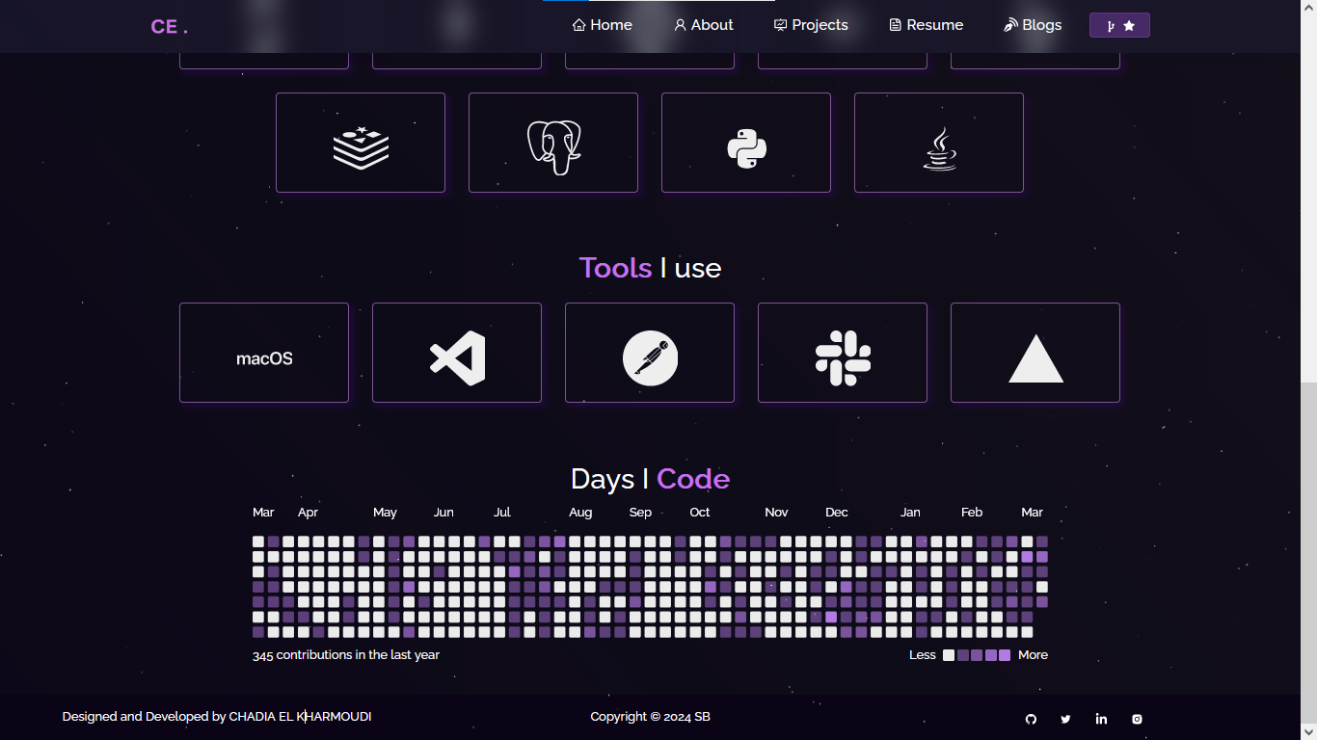

Slide 14
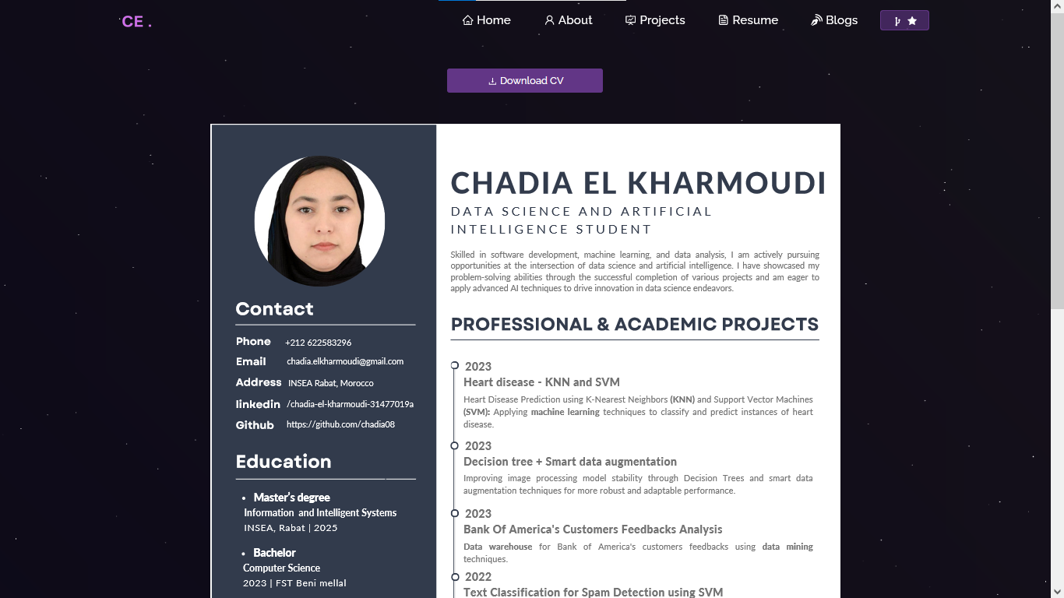

Slide 15
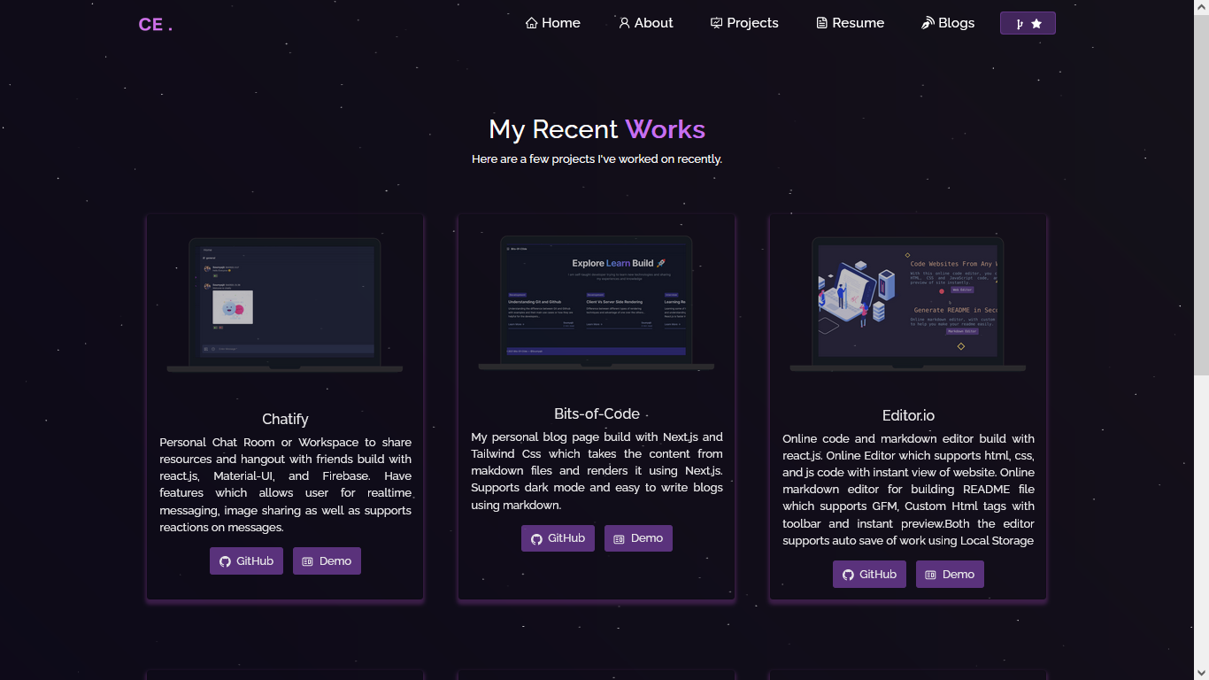

Slide 16
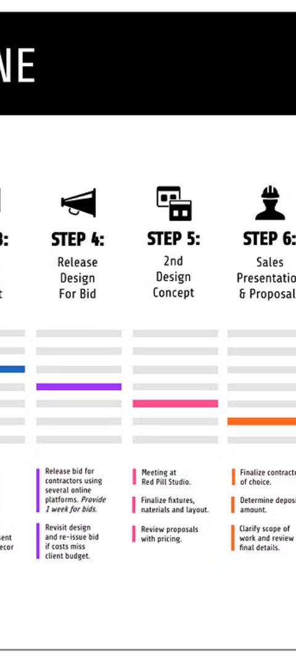
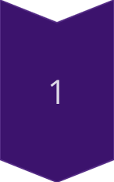
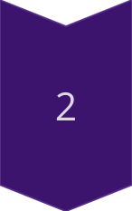

Conclusion and Future Plans
Accomplishments
Reflecting on major accomplishments and significant milestones achieved.
Future Roadmap
Outlining future expansion plans and potential areas for project enhancement.

