Slide 1
Javascript

Slide 2
Javascript Fundamentals
The Building Blocks of JavaScript Programs
Null and Undefined
Objects
Equality

Slide 3
Null and undefined
Null
Primitive type
Represents the absence of the value
Evaluates to false in boolean expressions
Undefined
Primitive type
Represents an unknown value
Returned when a non-existent object property is called
Evaluates to false in boolean expressions

Slide 4
Objects
Everything except string, number, boolean, null or undefined is an object
Objects are collections of properties
Declared with the object literal notation

Slide 5
eqality
Objects are only equal to themself
Primitive are equal if the value match (”cat” === ”cat”)
Two sets of equality operators (== ===)

Slide 6
Javascript Fundamentals
2. Functions
Object parameters are passed by reference
Primitive type parameters are passed by value
Parameters flexibility
No overload

Slide 7
Arguments object
Contains the functions parameters
Indexed like an array
Has a length property

Slide 8
Error handling
Throw an exception when an unusual error condition occurs
Exceptions are thrown using the ’throw’ statement
The exception object can be accessed when the exception is caught
When an exception is thrown within a ’try’ block it can be caught and handled within a ’catch’ block
A ’finally’ block can be used to guarantee execution of some statements, even in the event of an exception

Slide 9
Javascript fundamentals
3. Types and Libraries

Slide 10
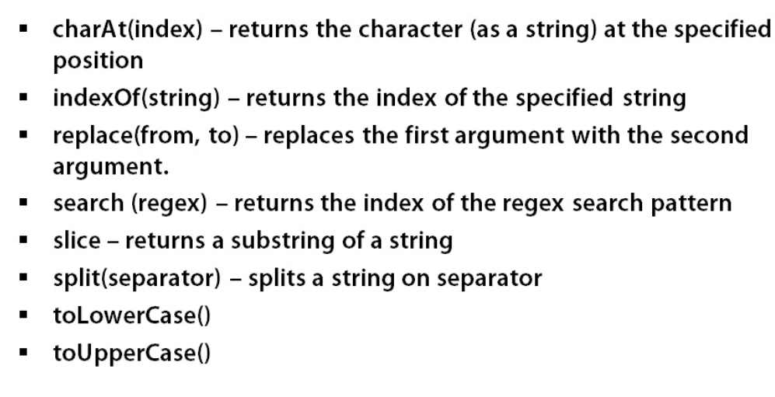
String methods

Slide 11
Number
All numbers are floating point
Standard operators +,-,*,/,%
toFixed(n) – returns the numer to n decimal places

Slide 12
Array
An indexed collection
Can store anything
Declared using the literal [] or new Array()
Push, pop, shift, unshift, slice, splice, concat, join, reverse, sort, every, some,filter, map (117,125)

Slide 13
Regular expressions
A tool for string pattern matching
Used to search, replace and extract parts of strings
Most characters match themselves
Character classes match classes of characters
\w any word character
\d decimal digit
Match a set of characters []
. matches any character
{}quantifies a match ie .{2} matches any 2 characters
()makes a capturing group
Regular expression literal /pattern/
http://www.regexr.com/

Slide 14
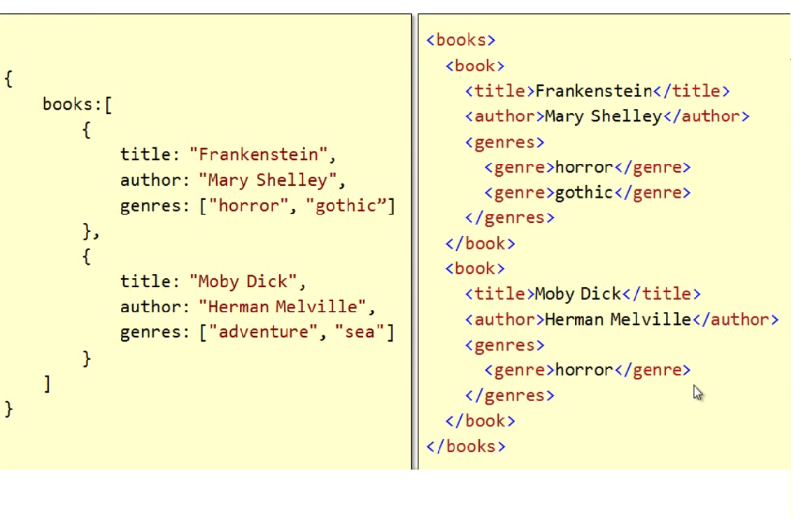
JSON vs XML

Slide 15
Events
Declare it directly in the HTML markup.
Assign the function to the event property of the element object through JavaScript.
Use the newer add and remove methods on the element object to associate event handlers.

Slide 16
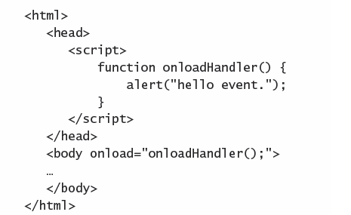
Events- Declarative handling

Slide 17
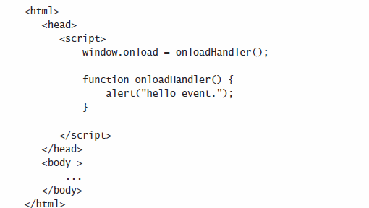
Events- Assignment handling

Slide 18
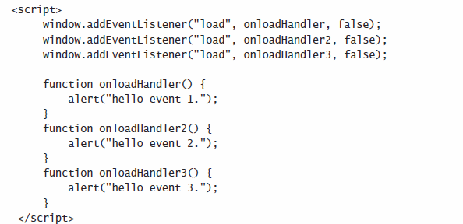
Events- addEventListener and removeEventListener

Slide 19
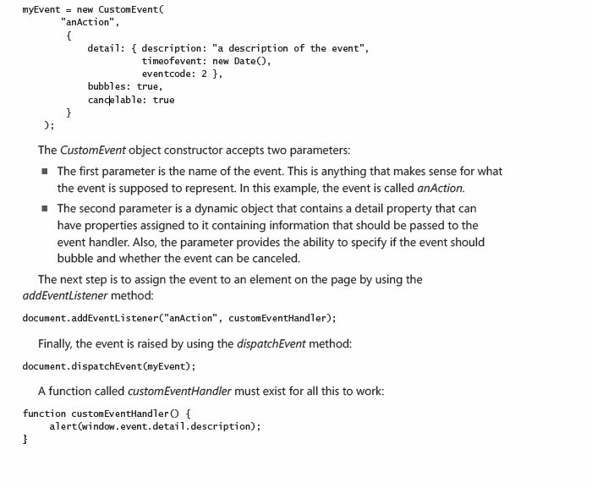
DOM Events & custom events
139-147

