Slide 1
Javascript patterns

Slide 2
Common object patterns
Function argument pattern
Arguments aren’t required like .NET languages
Like all variables in JavaScript arguments are untyped
Unspecified arguments become undefined
Arguments available through arguments object (it’s like array but it’s not array)

Slide 3
Common object patterns
Chaining
Useful for creating fluent APIs for working against a mutable object
Designed around returning the source object
Popularized by jQuery

Slide 4
Common object patterns
Observable properties pattern:
If you’re familiar with C#, think about the INotifyPropertyChanging and INotifyPropertyChanged interface to implement observable properties. Here are some points before we implement observable properties in JavaScript: - Properties implemented as methods - Check the incoming value and decide if you want to update - Return private variable - Store event handlers in an array - Utilise return values to abort the updating proces

Slide 5
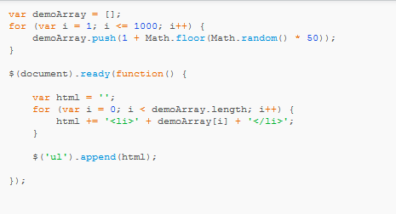
Timer patterns
Asynchronous execution pattern
Browsers are typically single threaded, they either update the UI or executing JavaScript. Long running JavaScript blocks the UI and browser is unresponsive.

Slide 6
Timer patterns
Asynchronous execution pattern
1. There two kinds of timers in JavaScript: setTimeout , setInterval
2. Both take two arguments, a function to invoke and a delay period
3. setTimeout will execute the function once 4. setInterval will execute continuously with the specified delay between each execution 5. Delays < 4ms will be bumped to 4ms

Slide 7
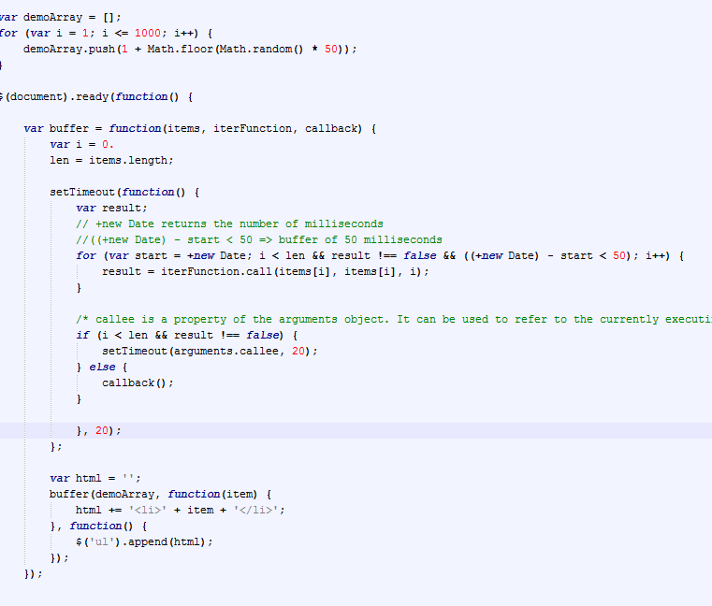
Timer patterns
Asynchronous execution pattern

Slide 8
Timer patterns
Recursive setTimeout pattern
The Recursive setTimeout pattern is most commonly used when we want periodically running a piece of functionality, related to duration (most commonly used to query a data source). This may sounds like what setInterval does, but there is a problem with using setInterval. Because JavaScript is asynchronous, setInterval method actually does not wait for the previous function to finish it's execution before begins the next time period. What if the function was waiting for an AJAX response? Function execution can get out of order. So, the idea is to use setTimeout. setTimeout can ensure order of execution:

Slide 9
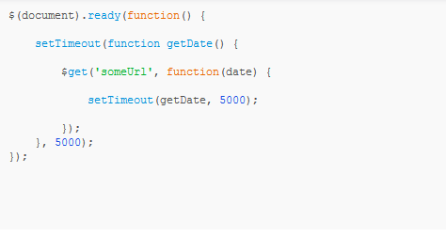
Timer patterns

Slide 10
Deferred and promises
blog.mediumequalsmessage.com/promise-deferred-objects-in-javascript-pt1-theory-and-semantics
http://blog.mediumequalsmessage.com/promise-deferred-objects-in-javascript-pt2-practical-use/
http://joseoncode.com/2011/09/26/a-walkthrough-jquery-deferred-and-promise/
http://jsfiddle.net/fx96rkgs/5

