Slide 1
Structuring javascript code

Slide 2
Prototype pattern
Pros and Cons
Pros:
Leverage JavaScript’s built-in features
Modularize code into re-usable objects
Vars/functions taken out of global namespace
Functions loaded into memory once
Possible to „override” functions through prototyping
Cons:
Contructor separate from prototype definition

Slide 3
Module pattern
Pros:
„Modularize” code into re-usable objects
Variables/functions taken out of global namespace
Expose only public members while hiding private members
Cleaner way to expose public members
Cons
Functions may be duplcated across object in memory when not using singleton
Not easy to extend
Some complain about debugging

Slide 4
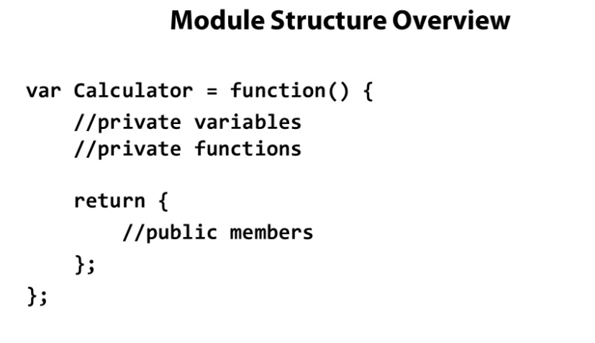

Slide 5
Revealing module pattern
Pros:
„Modularize” code into re-usable objects
Variables/functions taken out of global namespace
Expose only public members while hiding private members
Cons:
Functions may be duplcated across object in memory when not using singleton
Not easy to extend
Some complain about debugging

Slide 6
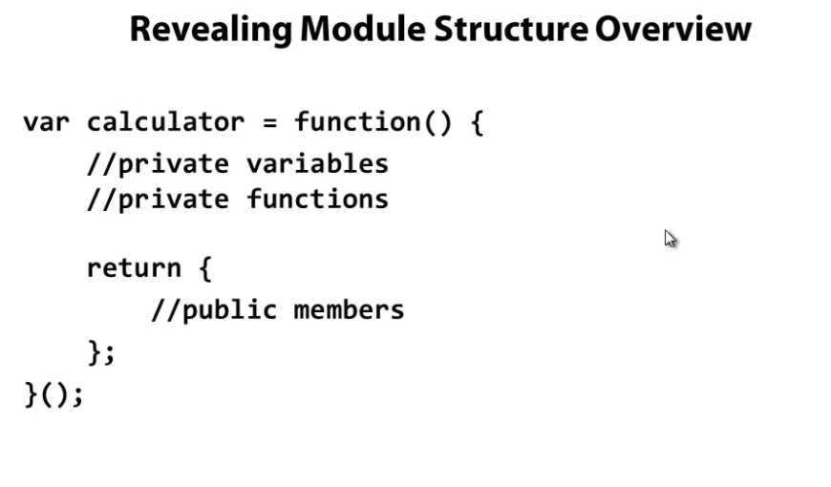

Slide 7
Revealing Prototype Pattern
Pros:
Combine Prototype and Revealing Module Patterns
„Modularize” code into re-usable objects
Variables/functions taken out of global namespace
Expose only public members while hiding private members
Functions loaded into memory once
Extensible
Cons:
Constructor separate from prototype definition

Slide 8
