Slide 1
Unity Pdx
Scriptable Objects
Using Scriptable Objects for Variables, Events and other Fun Stuff
Chad Riddle
Principal Consultant
SoftSource Consulting
chad.riddle@sftsrc.com
https://github.com/chadjriddle/ScriptablesUnityPdx

Slide 2

Overview
Quick Introduction to Scriptable Objects
Not My Ideas
Software Design Concepts
Scriptables as Variables, Events and Systems
Interesting Use Cases I’m Playing With
Bonus – Code Generation

Slide 3
Introduction
What are Scriptable Objects?
Derive from the same base class as MonoBehavior’s
Instances are created, managed and serialized by Unity
Edited and Assignable via the Inspector
Lightweight event model
Live Outside the Scene

Slide 4
Not My Ideas
Richard Fine - Unity Technologies
Unite 2016 - Overthrowing the MonoBehaviour Tyranny in a Glorious Scriptable Object Revolution
https://www.youtube.com/watch?v=6vmRwLYWNRo
Ryan Hipple, Principal Engineer, Schell Games
Unite Austin 2017 - Game Architecture with Scriptable Objects
https://www.youtube.com/watch?v=raQ3iHhE_Kk
Several GitHub repositories already exist including:
https://github.com/Wolar-Games/unity-scriptable-object-variables
https://github.com/sigtrapgames/SmartData

Slide 5
Software Design Concepts
Single Responsibility Principle
  I do one thing and do it well
Dependency Injection
  If I need it then give it to me
Separation of Concerns
  Stay out, I control my bubble
Event Driven Design
  I’ll let you know if something happens
  Throw me the ball, I’m ready

Slide 6
Three Pillars of Ryan Hipple
Keep Things Modular
  Eliminate direct dependencies
  Scenes are clean slates
  Prefabs work on their own
Editable
  Make your games Data-Driven
  Allow run-time changes
  Get comfortable with custom editor
Debuggable
  Create hooks for purposeful debugging
  Build custom gizmos

Slide 7
Scriptable Events
Three parts:
  Game Event (Scriptable Object)
  Game Event Listener (MonoBehaviour)
  Unity Event (just a class)
And a Custom Editor to help with Debugging!

Slide 8
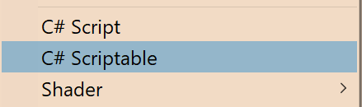
Quick Tip – Scriptable Template
Create a simple ScriptableObject template like:
  using UnityEngine;
  [CreateAssetMenu(menuName = "GameData/#SCRIPTNAME#")]
  public class #SCRIPTNAME# : ScriptableObject
  {}
Save it in (adjust version accordingly):
  C:\Program Files\Unity\Hub\Editor\2018.2.1f1\Editor\Data\Resources\ScriptTemplates
Name it something like:
  82-C# Scriptable-NewScriptableObject.cs.txt
Use it from the Create menu:

Slide 9
Scriptable Variables
Three parts:
  Variable
  Reference
  Reference Custom Property Drawer

Slide 10
Gotcha – Awake()
Awake() is very misunderstood when it comes to ScriptableObjects
In Editor (or Playing from the Editor) Awake() is only called once when the ScriptableObject is create, i.e. when starting the editor or when the script is written.
When running standalone, Awake() is only called once when the game launches
Kind of a Hack in Editor: AutoResetManager

Slide 11
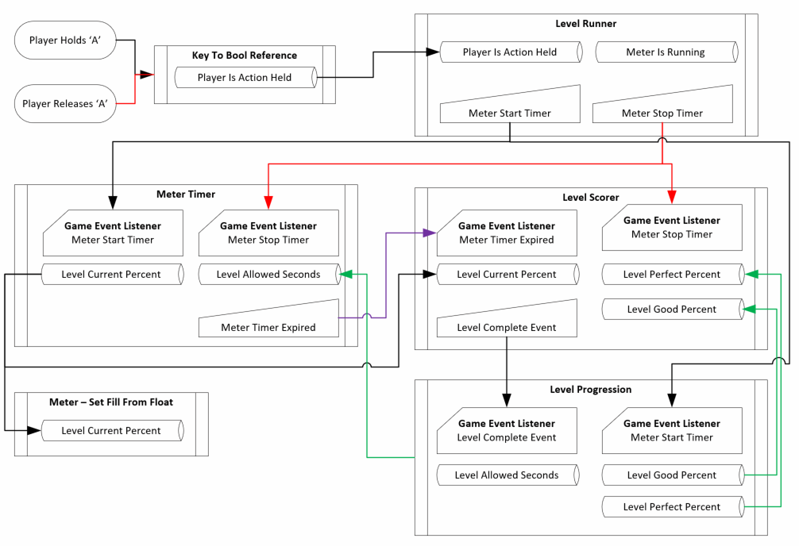
Meter Game Demo

Slide 12
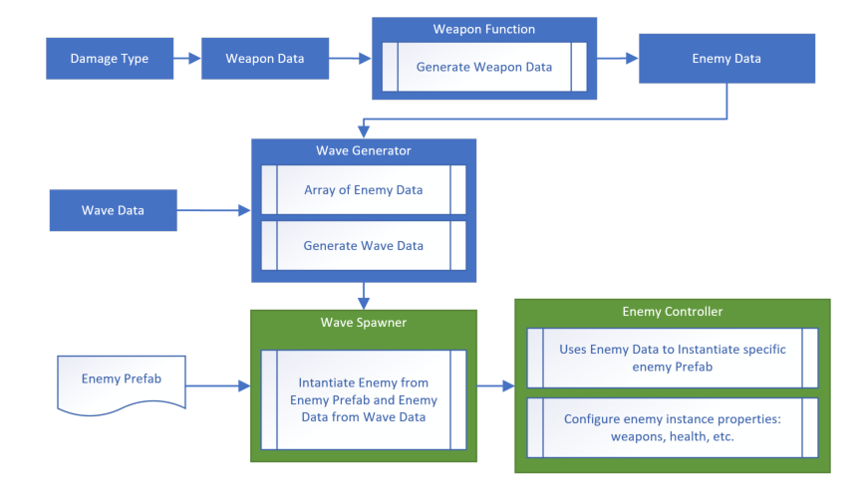
Wave Game Demo

Slide 13
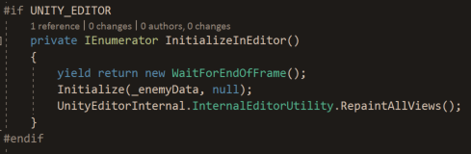
Dynamic – Instantiate & Destroy
Extra steps must be taken with dynamically creating or destroying GameObjects from OnValidate when Editor changes are made.
Specifically, start a coroutine with your logic that executes a the end of the frame.
For examples see Wave Game Demo – EnemyContoller.cs

Slide 14
Code Generation
To fully use the Scriptables pattern for a specific type there are 6 files that need to be created
  Variable, Reference, Reference Editor, Unity Event, Game Event, Game Event Listener
Why do it by hand! We are programmers!

Slide 15
Questions? Comments?

