Slide 1
Building a 32-bit CPU
SimpleRisc five-stage processor: Logisim to FPGA
[Your Name] · EE 312 Computer Hardware Organization
Notes:
Hi, I'm [name]. For this project I designed a 32-bit processor that runs the SimpleRisc instruction set. I built it in Logisim, used it to calculate 10 factorial, and then rebuilt it in Verilog to run on a real FPGA board.

Slide 2
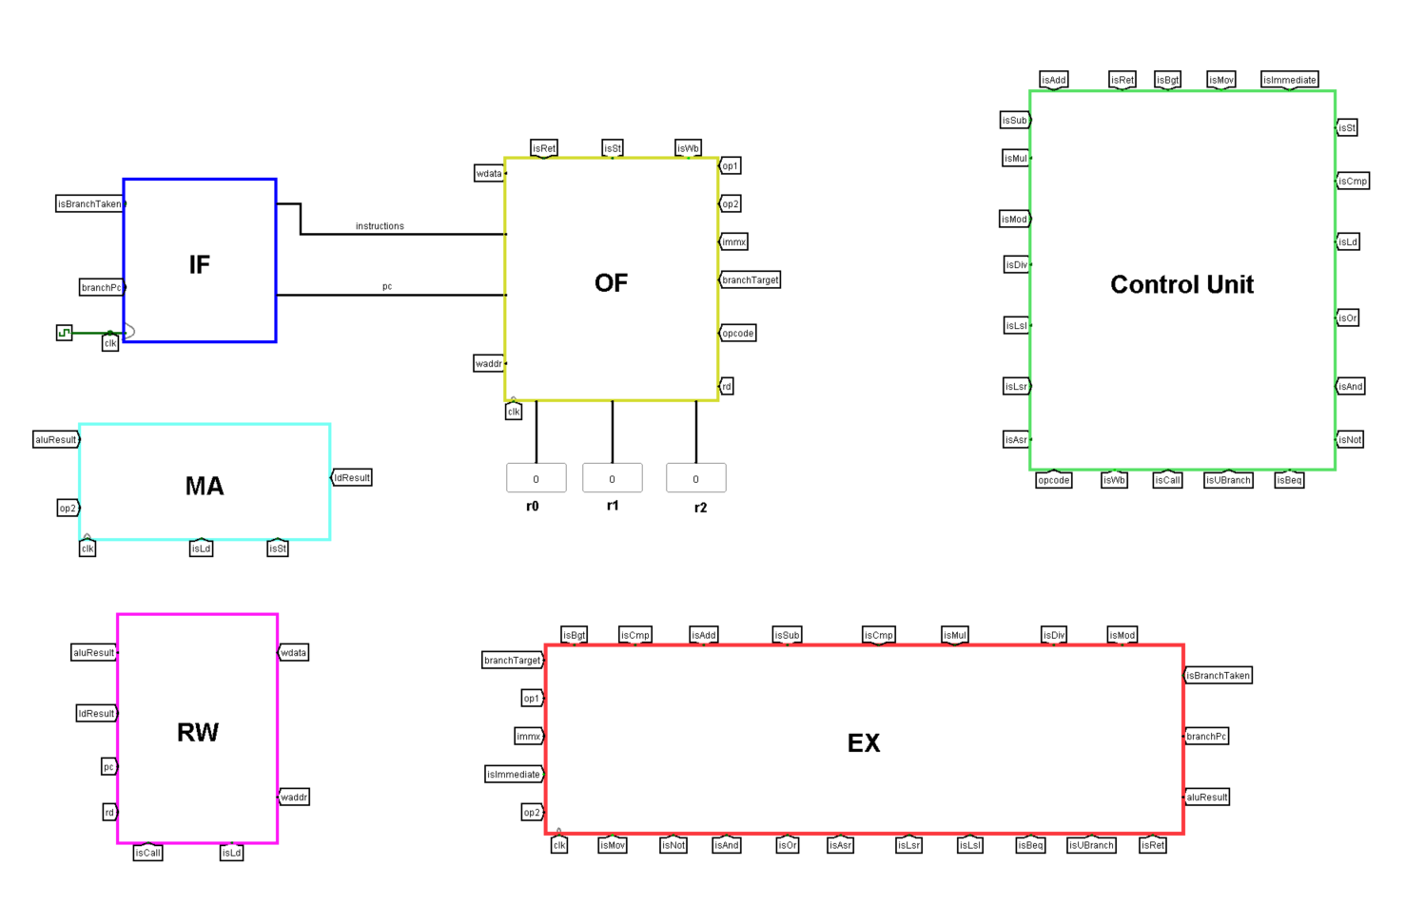
How the CPU works
IF
OF
EX
MA
RW
32
bits per instruction and register
21
SimpleRisc instructions
5
stages, every instruction in one clock cycle
Notes:
The CPU fetches, decodes, and executes one instruction at a time. Every instruction is 32 bits, and SimpleRisc has 21 of them, like add, multiply, load and store. The datapath is split into five stages: fetch, operand fetch, execute, memory access, and register writeback. This is the full CPU in Logisim, with each colored block being one stage.

Slide 3
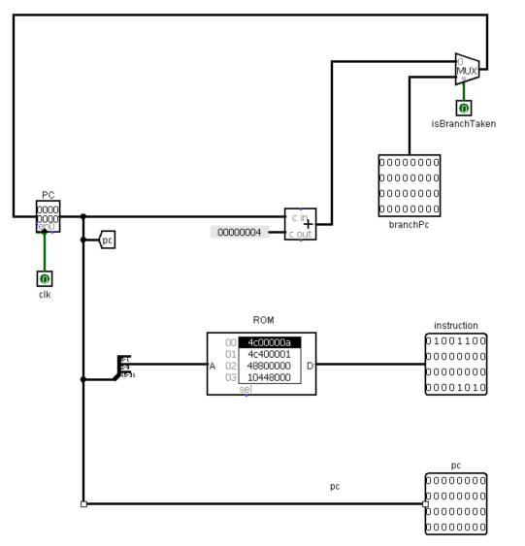
1. Instruction Fetch
IF
OF
EX
MA
RW
The PC holds the address of the current instruction
The ROM sends that instruction on to OF
Next PC = PC + 4, or the branch address when a branch is taken
Notes:
The first stage is instruction fetch. The program counter, or PC, holds the address of the instruction we're on. The ROM, where our program is stored, sends that instruction to the next stage. Since every instruction is 4 bytes, the next one is at PC plus 4, unless a branch says to jump somewhere else.

Slide 4
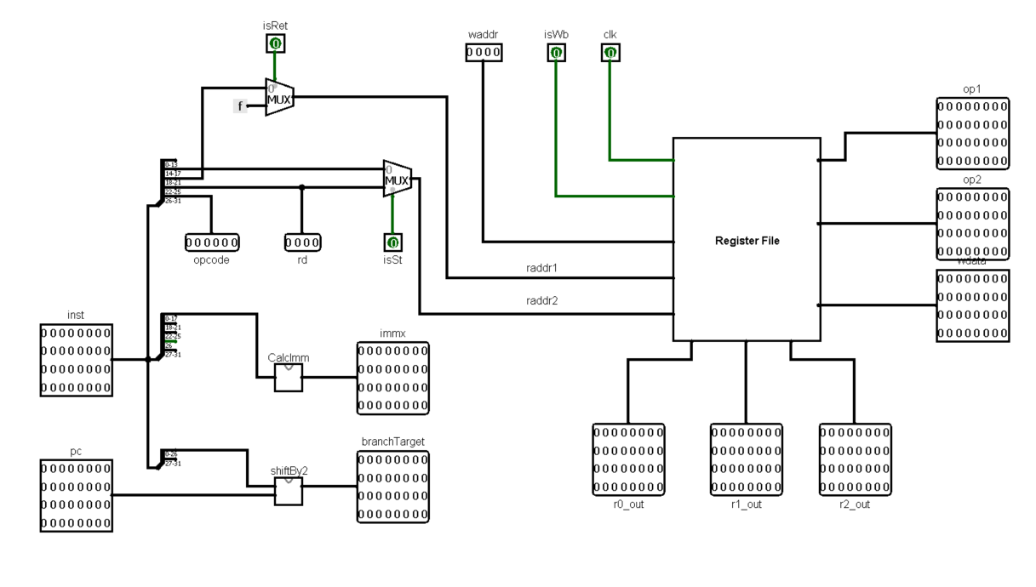
2. Operand Fetch
IF
OF
EX
MA
RW
Splits the 32 bits into fields: opcode, rd, rs1, rs2, immediate
Reads two registers as op1 and op2
Builds the immediate and the branch target
Control unit turns the opcode into signals like isAdd
Notes:
Operand fetch is the busiest stage. It cuts the instruction into its fields, reads the two source registers from the register file, and builds the immediate value and branch target. The opcode goes to the control unit, which turns it into the signals that tell every other stage what to do.

Slide 5
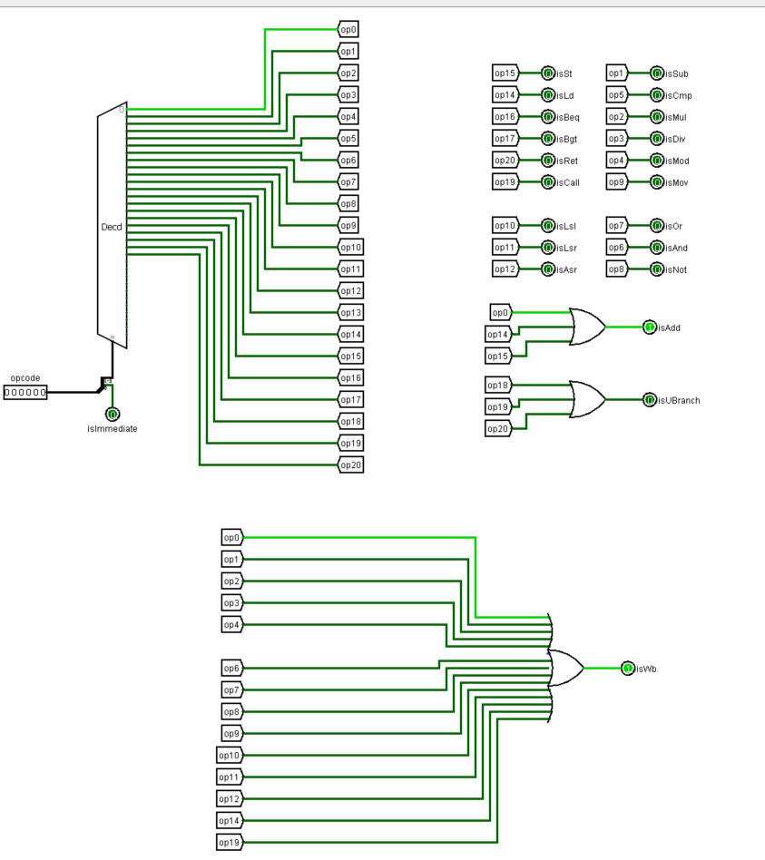
Inside OF: the Control Unit
IF
OF
EX
MA
RW
Input: the 5-bit opcode and the I bit
A decoder turns on one line per instruction (op0 to op20)
Those lines become 22 control signals, like isAdd and isWb
Signals shared by several instructions use an OR gate
Notes:
Inside operand fetch is the control unit. It takes the opcode and runs it through a decoder, which turns on exactly one line for the current instruction. Those lines become the control signals. Some signals belong to one instruction, like isMul. Others are needed by several, like isWb, which is on for every instruction that writes a register, so those are built with OR gates.

Slide 6
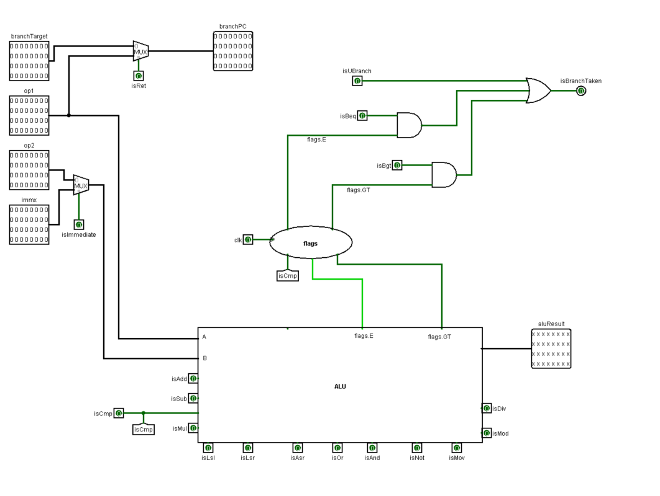
3. Execute
IF
OF
EX
MA
RW
The ALU does the math: add, multiply, compare and more
Input B is a register (op2) or the immediate (immx)
cmp saves the E and GT flags
The branch unit decides: jump or keep going
Notes:
Execute is where the work actually happens. The ALU does the operation the control unit picked. Its second input is either a register or the number from the instruction. A compare saves two flags, equal and greater-than, and the branch unit uses them to decide if the program should jump.

Slide 7
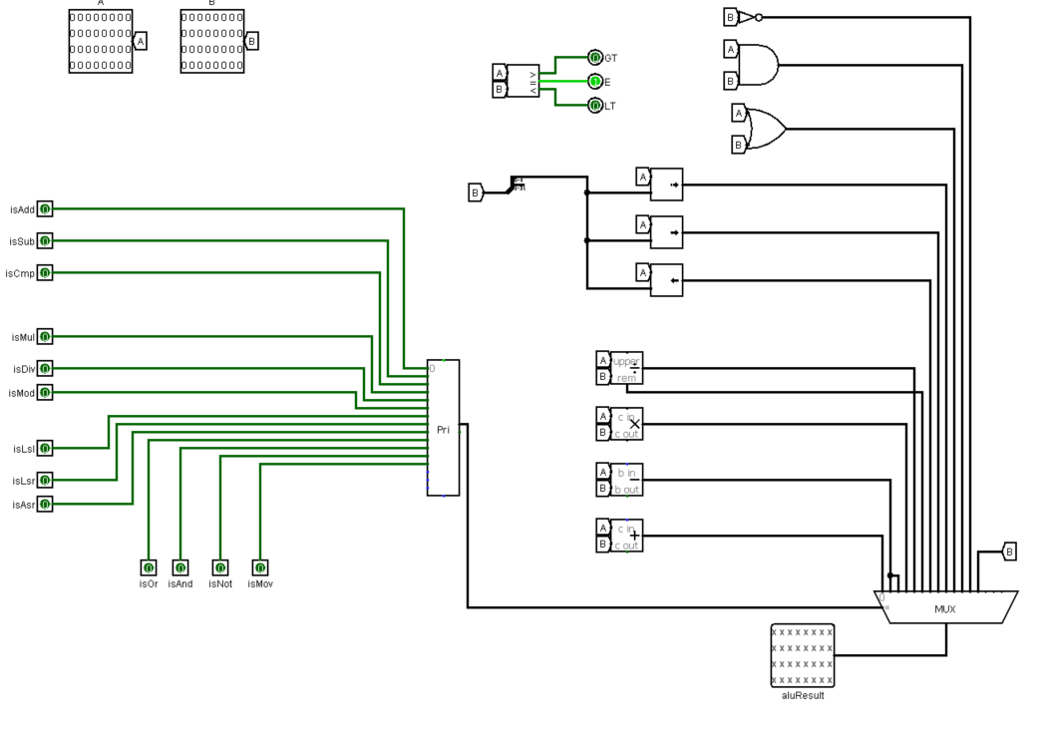
Inside EX: the ALU
IF
OF
EX
MA
RW
Every operation is calculated at the same time
The control signal picks one answer (priority encoder + mux)
A comparator makes the E and GT flags
Out comes aluResult
Notes:
Here's the inside of the ALU. All the operations, add, subtract, multiply, shifts and logic, are calculated at the same time on the two inputs. Then the control signal for the current instruction picks which answer actually comes out, using a priority encoder and a mux. A comparator also produces the equal and greater-than flags that branches use.

Slide 8
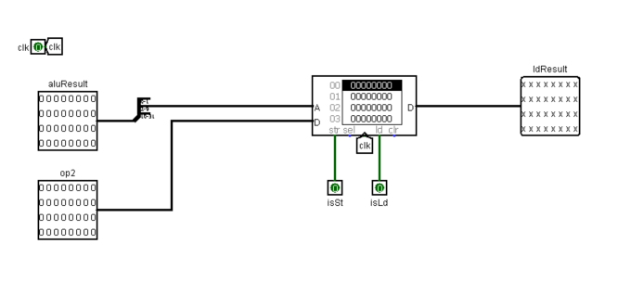
4. Memory Access
IF
OF
EX
MA
RW
Only load and store use this stage
The address comes from the ALU: base register + offset
st writes to RAM, ld reads from it
Notes:
Memory access is simple: only load and store use it. The ALU has already calculated the memory address. A store writes a value into RAM, and a load reads one back out. Every other instruction just passes through.

Slide 9
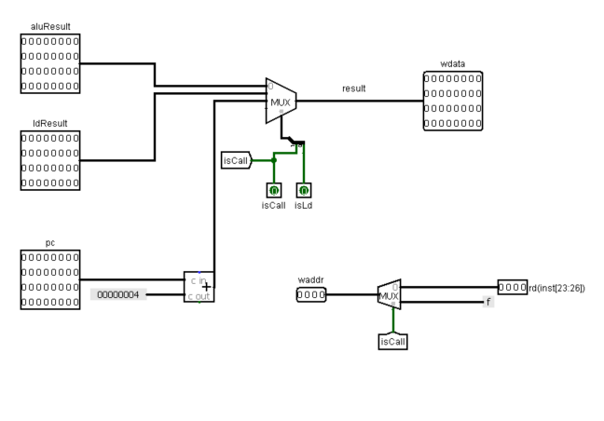
5. Register Writeback
IF
OF
EX
MA
RW
Writes the result into the register file
Picks the ALU result, the loaded value, or PC + 4 for call
isWb decides whether anything is written
Notes:
The last stage writes the result back into a register. A mux picks what to write: the ALU result, a value loaded from memory, or the return address for a function call. If the instruction doesn't write a register, like compare or store, isWb stays off and nothing changes.

Slide 10
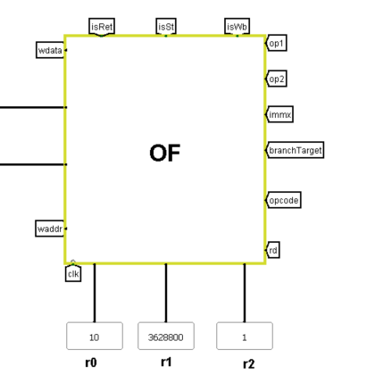
Running 10!
IF
OF
EX
MA
RW
3,628,800
mov r0, 10
mov r1, 1
mov r2, r0
.loop: mul r1, r1, r2
sub r2, r2, 1
cmp r2, 1
bgt .loop
st r1, 5[r2]
b . (halt)
10! computed in register r1
The loop (teal) runs 9 times: multiply, count down, compare, jump back.
Notes:
To test it, we ran a factorial program. It loads 10, then loops: multiply the running answer, count down, compare to 1, and jump back. The loop runs nine times, and at the end register r1 holds 3,628,800, which is 10 factorial. That's the value Logisim shows here.

Slide 11
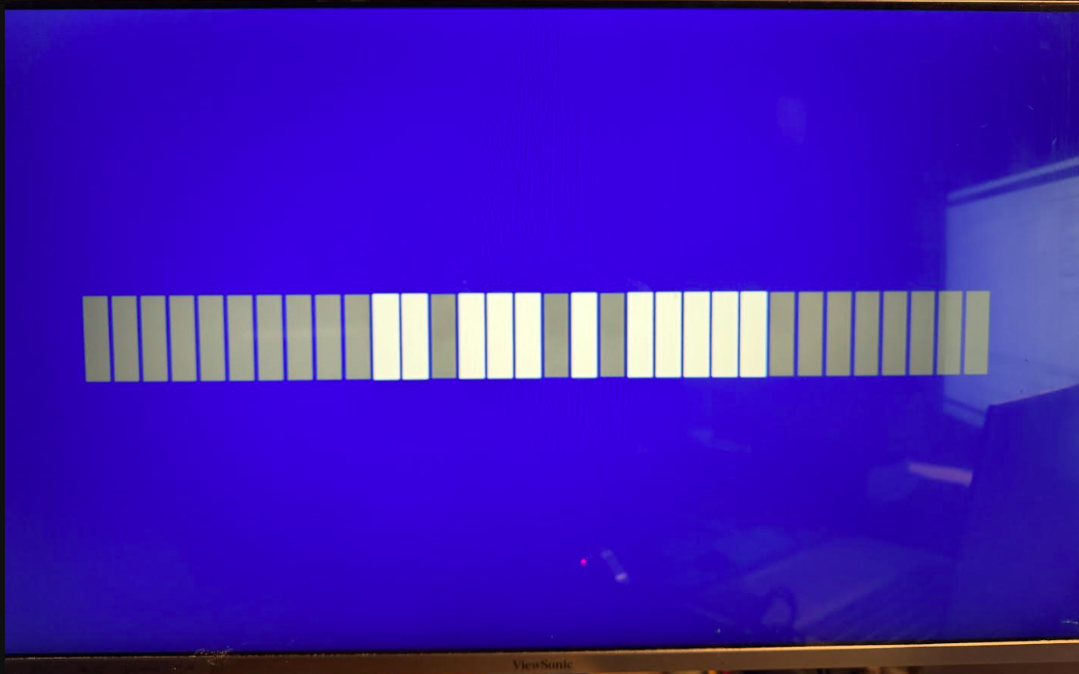
On real hardware: FPGA + HDMI
IF
OF
EX
MA
RW
Rewrote the CPU in Verilog
Ran it on a Zybo FPGA board
Press the button and the program runs
The 32-bit answer shows on the monitor as bars: bright = 1
Notes:
We didn't stop at Logisim. I rewrote the CPU in Verilog and loaded it onto a Zybo FPGA board. When I press the button, it runs the factorial program and shows the 32-bit answer on a monitor over HDMI: each bar is one bit, bright for 1. [Play the demo video here.]

Slide 12
Takeaways
Built a five-stage 32-bit CPU in Logisim
Proved it works: 10! = 3,628,800
Extended to Verilog on a real FPGA with HDMI
Questions?
Notes:
To sum up: we built a working five-stage CPU, proved it by computing 10 factorial, and took it further by running it on real FPGA hardware. A next step would be pipelining, so all five stages work on different instructions at the same time. Thanks, I'm happy to take questions.

