Slide 1

Integration Installation
A guide on how to install
By Ryan

Slide 2


This is the file we will be working with
This is the file you will be installing.
Inside is the Integration_New which you will need to extract.
We will be working with these 3 items.

Slide 3
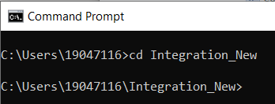


Using CMD
Once you have extracted the file, use command prompt to enter into it.
Once your inside , cd into app and do npm install, it will install all necessary packages
Next do the same with server.

Slide 4
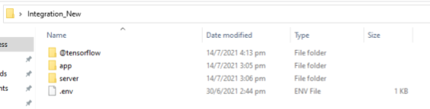
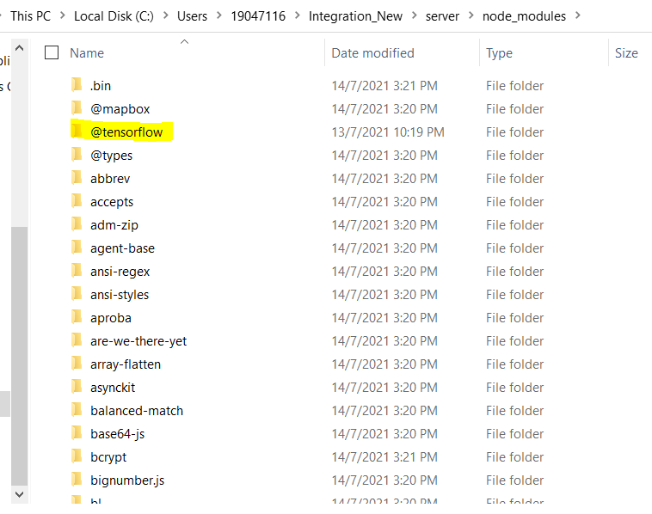
Getting TensorFlow to work
Now you’ll need to cut the @tensorflow from this page and go into server > node_modules
Once you are there, remove the @tensorflow that is currently inside node_modules, and paste the @tensorflow that you had cut previously.

Slide 5
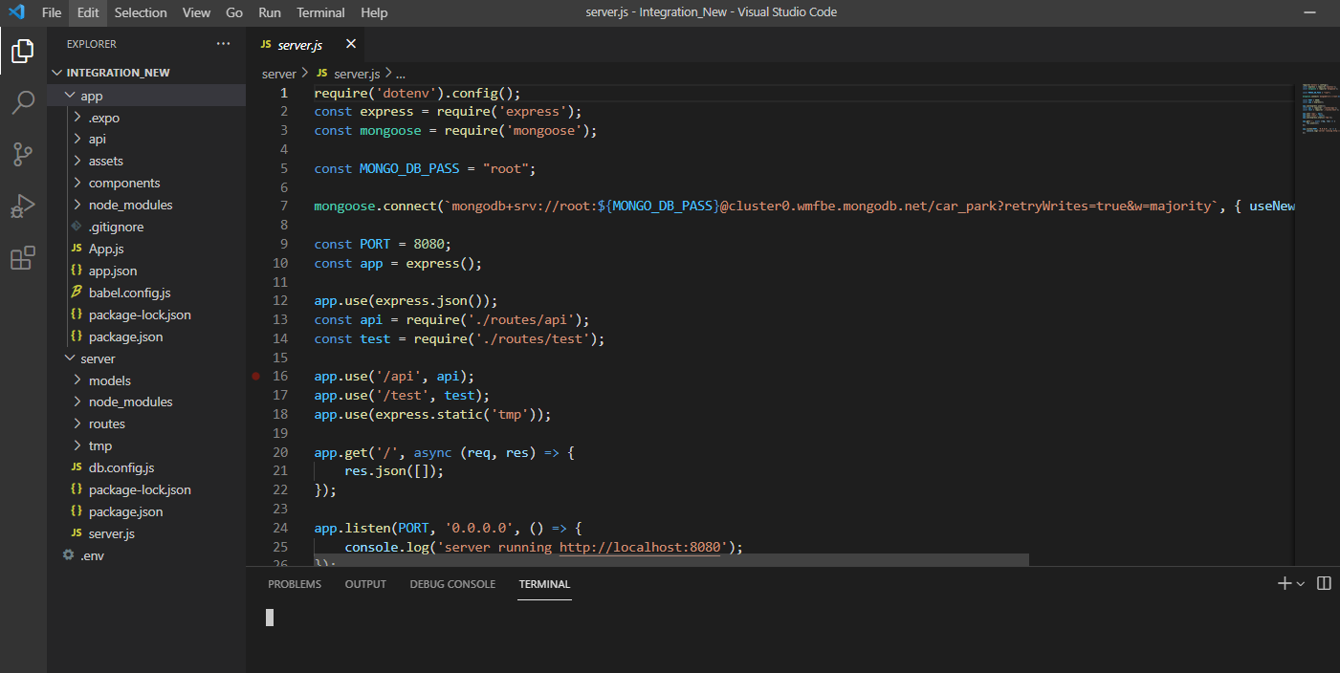
Time to enter the code
Go back to Integration_New and open it with Visual Studio Code.
Everything should be there already, but there is just one more thing.

Slide 6
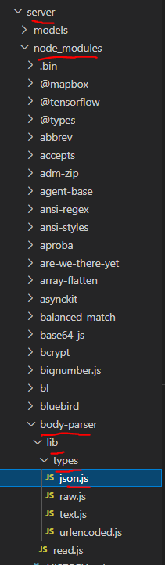


Final Step
The last thing is required to get the facial recognition working.
Under Server > node_modules > body-parser > lib > types > json.js
Find the line with 100kb, and change it to a larger number lik 100000kb

Slide 7
And done!
That’s everything you will need to do to get the code up and running!

