Slide 1
JSOUP
BY
Z, Chad, and Patrick

Slide 2
What is JSOUP
jsoup is a Java library for working with real-world HTML. It provides a very convenient API for extracting and manipulating data, using the best of DOM, CSS, and jquery-like methods.
jsoup implements the WHATWG HTML5 specification, and parses HTML to the same DOM as modern browsers do.

Slide 3
Benefits
scrape and parse HTML from a URL, file, or string
find and extract data, using DOM traversal or CSS selectors
manipulate the HTML elements, attributes, and text
clean user-submitted content against a safe white-list, to prevent XSS attacks
output tidy HTML

Slide 4
History
written in 2009 by Jonathan Hedley
"to deal with all varieties of HTML found in the wild; from pristine and validating, to invalid tag-soup."

Slide 5
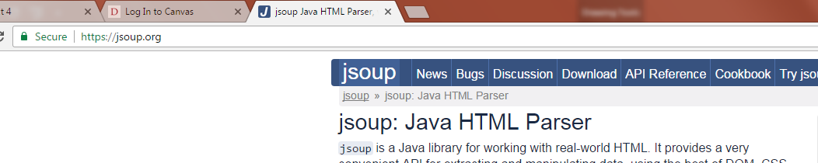
Downloading J-SOUP
Go to https://jsoup.org/

Slide 6
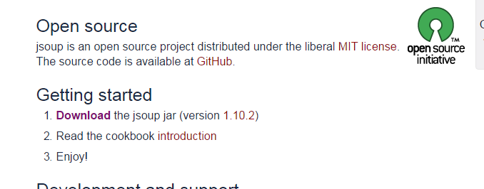
Scroll Down and Click Download

Slide 7

JSOUP in Eclipse
Open Eclipse
Right Click on your project.
Click “Properties”

Slide 8
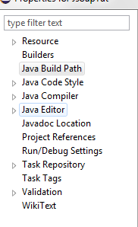
JSOUP in Eclipse pt. 2
Click on Java Build Path

Slide 9
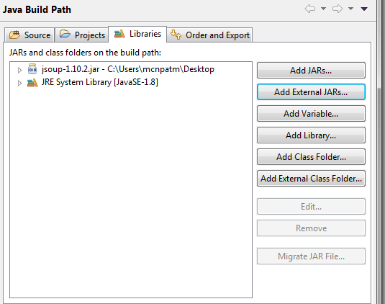
JSOUP in Eclipse pt. 3
Click “Add external JAR”

Slide 10
JSOUP in Eclipse pt. 4
Navigate to were you saved the JSOUP file.
Press “Open”
Then “Okay”

Slide 11
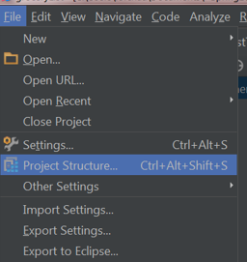
JSOUP in Intellij
Open the program you want to install Jsoup in
Click…File > Project Structure

Slide 12
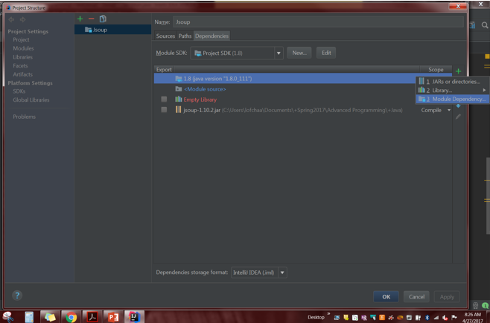
JSOUP in Intellij pt. 2
In Project Settings (on the left) Click…Modules > Dependencies
Click the "+" sign > Jars and directories

Slide 13
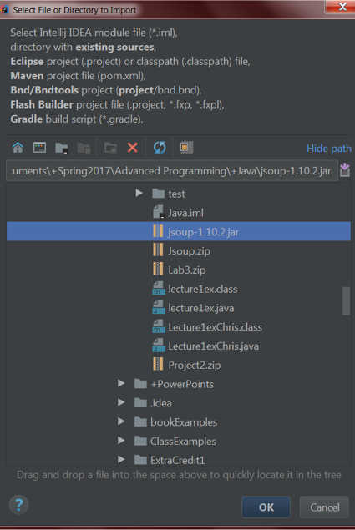
JSOUP in Intellij pt. 3
Select the jar file from the tree
Click… OK and click OK again

Slide 14
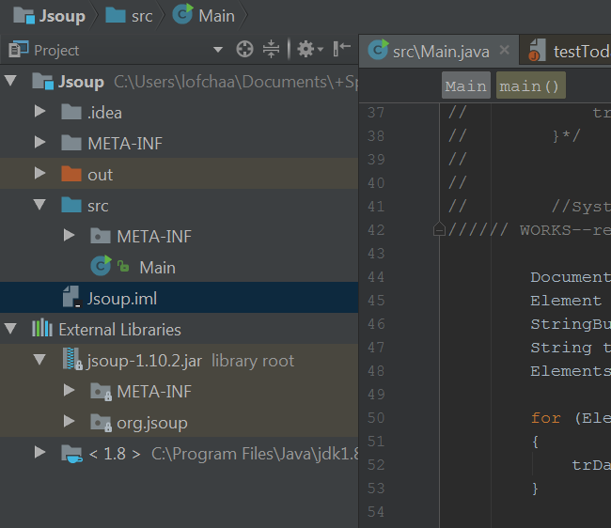
JSOUP in Intellij pt. 4
You can view the jar file in the "External Libraries" folder.

Slide 15

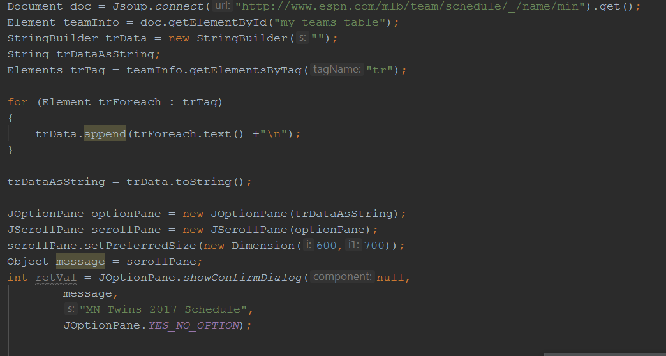

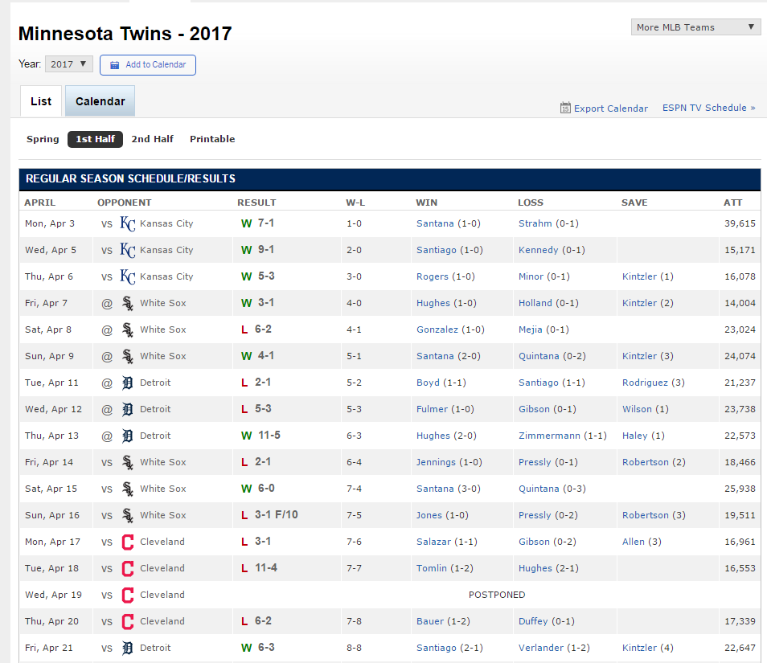
Sample program
Tell it what url to use
Tell it what elements to use
Add scraped data to your
String/stringBuilder
Output new data

Slide 16
Creating a .jar File
Open the project you would like to create the .jar from
Click…File > Project Structure

Slide 17
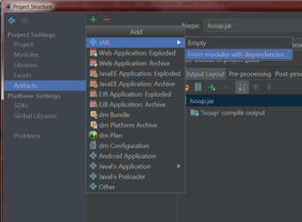
Creating a .jar File pt. 2
In Artifacts (on the left) Click the "+" sign
Add JAR
Select From modules with dependencies

Slide 18
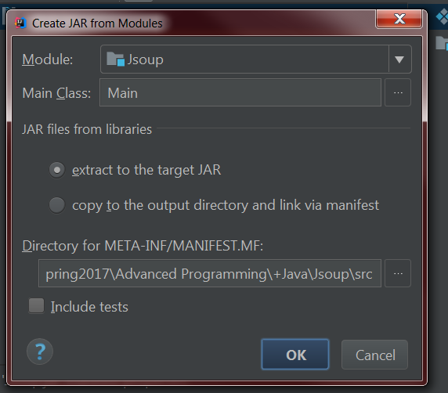
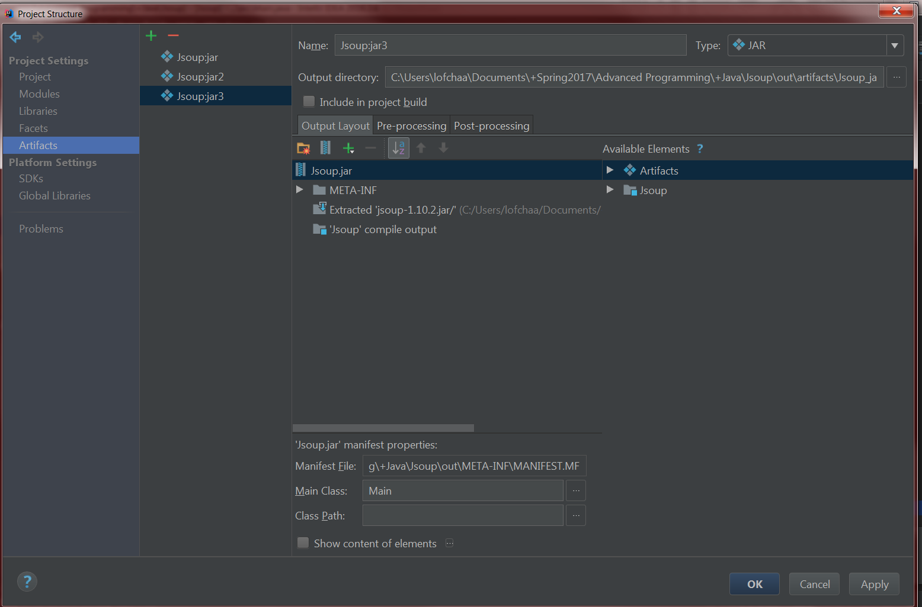
Creating a .jar File pt. 3
Click the ellipsis next to Main Class
Select your class and click 'OK‘
Select the jar file in the tree and click create manifest
Choose a location in the directory and click 'OK'

Slide 19
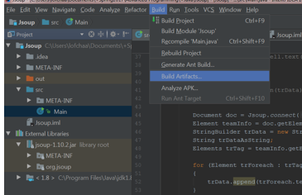
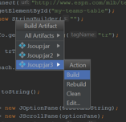
Creating a .jar File pt. 4
Click…Navigate > Build Artifact
Click...Build

Slide 20
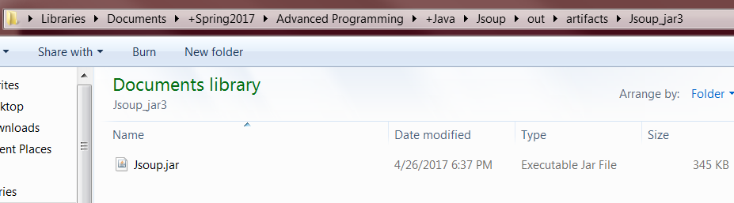
Creating a .jar File pt. 5
In file explorer, navigate to the folder you created the .jar file in
Copy paste it anywhere

Slide 21
Questions?
In file explorer, navigate to the folder you created the .jar file in
Copy paste it anywhere

