Slide 1
Android Development
Chad Maughan
January 28, 2012

Slide 2
Introduction
Chad Maughan
http://chadmaughan.com
@chadmaughan (blue birdie)

Slide 3
Goals
Familiarize yourself with the Android stack and development environment
Provide sample code for now and later
Have fun!

Slide 4
Books
Android in Action, Third Edition
W. Frank Ableson; Robi Sen; Chris King; C. Enrique Ortiz
Pro Android 3
Satya Komatineni; Dave MacLean; Sayed Y. Hashimi
Learning Android
Marko Gargenta
Professional Android 2 Application Development
Reto Meier

Slide 5
Other Resources
http://developer.android.com
http://vkedco.blogspot.com
http://code.chadmaughan.com
http://github.com/chadmaughan

Slide 6
System requirements
http://developer.android.com/sdk/requirements.html
Windows XP/Vista/7, Mac OS X >= 10.4.8, Linux
JDK and Java Runtime Environment (JRE) >= 5
Eclipse >= 3.4, including the JDT and Web Tools Platform, which are included in the Eclipse installation package
ADT plug-in for Eclipse

Slide 7
JDK
Check version with
$ java -version
java version "1.6.0_29"
Java(TM) SE Runtime Environment (build 1.6.0_29-b11-402-11M3527)
Java HotSpot(TM) 64-Bit Server VM (build 20.4-b02-402, mixed mode)
Download:
http://www.oracle.com/technetwork/java/javase/downloads/index.html

Slide 8
Git (optional)
http://git-scm.com/download
Other installation
Debian based Linux
apt-get install git
OS X (with Homebrew)
brew install git
Windows Help
http://help.github.com/win-set-up-git/
Tutorial
http://rogerdudler.github.com/git-guide/

Slide 9
Setup & Installation
Following guide on Android Developer site
http://developer.android.com/sdk/installing.html
Steps:
Eclipse
Android SDK (Starter Package)
ADT Plugin
Add platforms and components

Slide 10
1 - Eclipse
Current version: Indigo 3.7.1
Download:
http://eclipse.org/downloads/
“Eclipse Classic” recommended version
Recommended Plugins (Eclipse Marketplace)
EGit
Maven Integration for Eclipse
Spring Tools (STS)

Slide 11
2 - Android SDK
Download at
http://developer.android.com/sdk/
Windows
Recommended installer checks for Java and installs if necessary
Note installation location (needed later)

Slide 12
3 - Eclipse ADT Plugin
Instructions
http://developer.android.com/sdk/eclipse-adt.html#installing
Help > Install New Software
Name: Android Plugin (or whatever)
Site: https://dl-ssl.google.com/android/eclipse/
Choose top “Developer Tools” plugin (so that all sub options are selected)

Slide 13
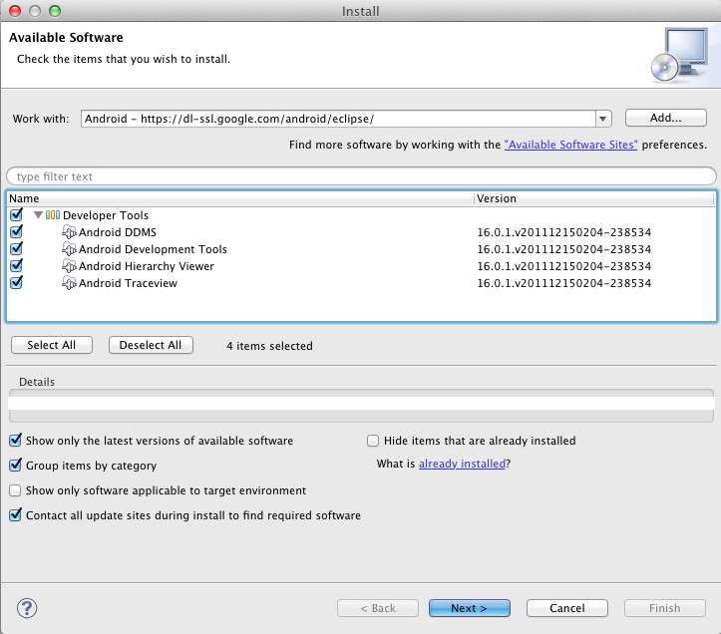
3 - Eclipse ADT Plugin

Slide 14
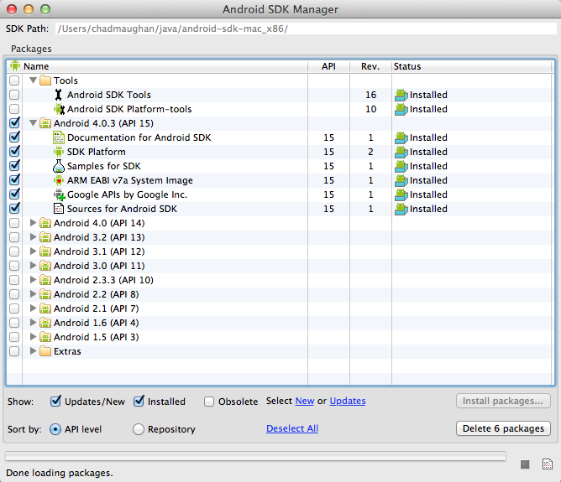
4 – Install Platform
Versions, tools, add-ons separated into installable components

Slide 15
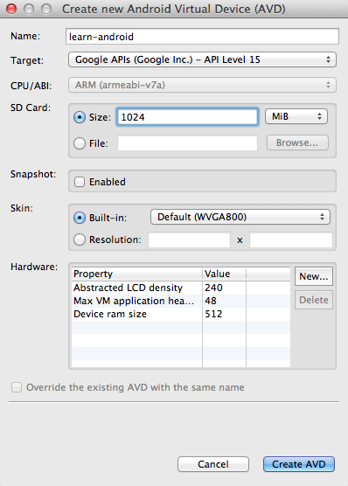
Create Virtual Device
Call the device whatever you’d like
Choose the target of Google APIs Level 15
You can also choose Android 4.0.3 API Level 15 (doesn’t include maps, etc)
SD card required for external storage, etc

Slide 16
Android Platform
Android is a software environment built for mobile devices. It’s not a hardware platform. Android includes a Linux kernel-based OS, a rich UI, end-user applications, code libraries, application frameworks, multimedia support, telephone functionality and more.

Slide 17
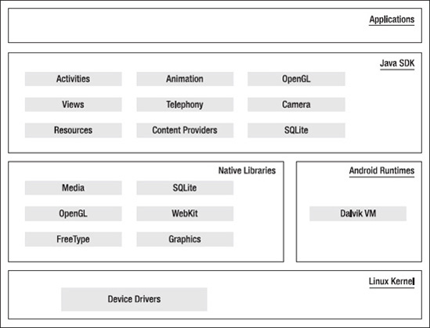
Android Stack
Source: Pro Android 3

Slide 18
Key Components
View
Activity
Service
BroadcastReciever
ContentProvider
AndroidManifest.xml

Slide 19
View
All UI controls, including the layout classes are derived from class View
A View is assigned to an activity
A widget is a view object for interaction
Comprehensive list at android.widget
Can be declared programmatically (in code) or declaratively (in XML)
A ViewGroup is a special view that can have children

Slide 20
Layouts
All layouts are subclasses of ViewGroup
XML layouts are compiled into a View resource in /res/layout directory
R.layout.main_layout
setContentView(R.layout.main_layout);
On problems
Clean project
Right click, then Android Tools -> Fix Project Properties
Tutorial: Hello, Views

Slide 21
Example Layout XML
<?xml version="1.0" encoding="utf-8"?> <LinearLayout xmlns:android="http://schemas.android.com/apk/res/android" android:layout_width="fill_parent" android:layout_height="fill_parent" android:orientation="vertical" > <TextView android:id="@+id/text" android:layout_width="wrap_content" android:layout_height="wrap_content" android:text="Hello, I am a TextView" /> <Button android:id="@+id/button" android:layout_width="wrap_content" android:layout_height="wrap_content" android:text="Hello, I am a Button" /> </LinearLayout>

Slide 22
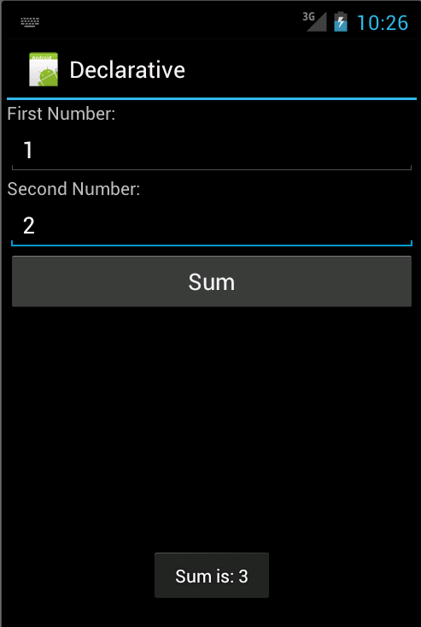
Lab 1

Slide 23
Activities
Activity = Screen
Allows interaction (via interface)
Application usually consists of multiple activities
Two important methods to implement
onCreate(Bundle)
onPause()
Developer Guide
http://developer.android.com/guide/topics/fundamentals/activities.html

Slide 24
Application Manifest
android:name only required attribute
<manifest ... > <application ... > <activity android:name=".MainActivity" /> ... </application ... > ... </manifest >

Slide 25
Intents
Used to start another activity
Intent intent = new Intent(Intent.ACTION_SEND); intent.putExtra(
Intent.EXTRA_EMAIL,recipients); startActivity(intent);

Slide 26
Start for a result
To receive a result from a started activity
Intent intent = new Intent(
Intent.ACTION_PICK, Contacts.CONTENT_URI);
startActivityForResult(
Intent, PICK_CONTACT_REQUEST);
To receive a result from a started activity
onActivityResult(
int requestCode, int resultCode, Intent data)

Slide 27
Intent Filter
Allows other applications to activate your Activity
Three “tests”
Action
Category
Data
<activity android:name=".MainActivity”> <intent-filter> <action android:name="android.intent.action.MAIN" /> <category android:name="android.intent.category.LAUNCHER" /> <data android:mimeType="audio/mpeg" android:scheme="http” /> </intent-filter> </activity>

Slide 28
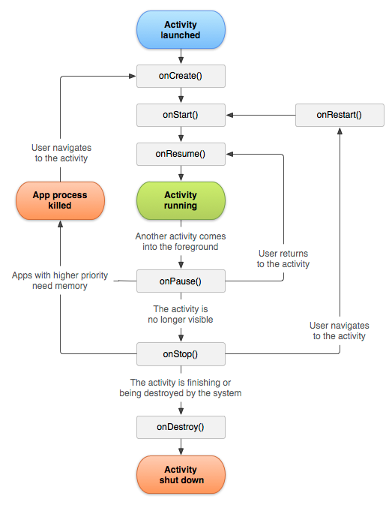
Activity Lifecycle

Slide 29
Activity States
Essentially three states
Resumed (running)
Paused
Another activity has focus, but not obscured
Stopped
Totally obscured, in “background”
Can be “finish()-ed” or killed

Slide 30
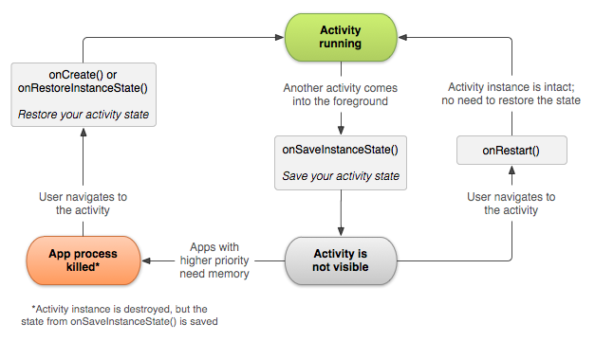
Saving Activity State

Slide 31
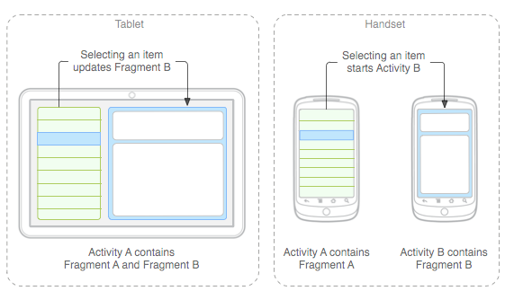
Fragments
Introduced in Android 3.0
More flexible UI for larger screens (tablets)

Slide 32
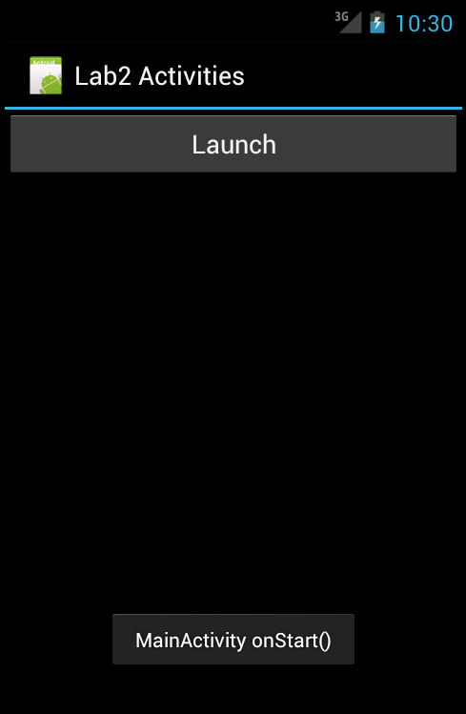
Lab 2
Activity Lifecycle, Intents and passing data between activities

Slide 33
Menus
Three types of application menus
Options
Context
Submenu

Slide 34
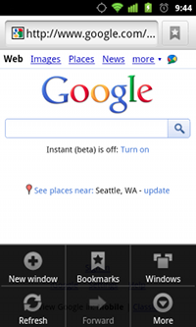
Options
Appear when you touch the menu button
Android 3.0 (API 11) and later allow ActionBar

Slide 35
Context Menu
Floating list of menu items when the user touches and holds a view that is registered to provide a context menu

Slide 36
Submenu
Floating list displayed when Options menu has a nested menu

Slide 37
Creating a Menu
Define in XML
<menu xmlns:android=”
http://schemas.android.com/apk/res/android"> <item android:id="@+id/new_game" android:icon="@drawable/ic_new_game" android:title="@string/new_game" /> <item android:id="@+id/help" android:icon="@drawable/ic_help" android:title="@string/help" /> </menu>

Slide 38
Creating a Menu (cont.)
Inflate in code
@Override public boolean onCreateOptionsMenu(Menu menu){ MenuInflater inflater = getMenuInflater(); inflater.inflate(R.menu.game_menu, menu); return true; }

Slide 39
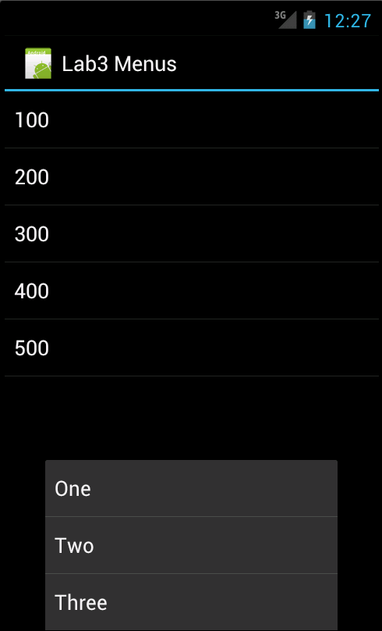
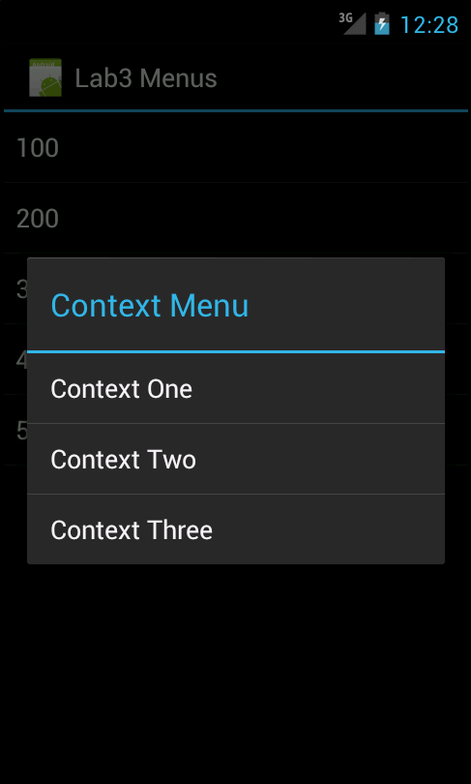
Lab 3

Slide 40
Data Storage
Android provides multiple storage options:
Shared Preferences
Internal Storage
External Storage
SQLite Database
Network Connection

Slide 41
Shared Preferences
Save and retrieve persistent key-value pairs of primitive data types
Data will persist across user sessions (even if your application is killed)
Not to be used to store “user preferences”
Multiple files: getSharedPreferences()
Single file: getPreferences()
Write with: SharedPreferences.Editor

Slide 42
Internal Storage
Store files on device’s internal storage
Files saved are private by default
MODE_PRIVATE, MODE_APPEND, MODE_WORD_READABLE, MODE_WORLD_WRITEABLE
Cache files with getCacheDir()
Android deletes when space is low
Static files in res/raw directory
Access w/ openRawResource()

Slide 43
External Storage
getExternalFilesDir() while specifying “type”
DIRECTORY_ALARM, DIRECTORY_DCIM, DIRECTORY_DOWNLOADS, DIRECTORY_MOVIES, DIRECTORY_MUSIC, DIRECTORY_NOTIFICATIONS, DIRECTORY_PICTURES, DIRECTORY_PODCASTS, DIRECTORY_RINGTONES
Allows media scanner to find files
Hide with .nomedia file in directory
getExternalCacheDir()
deleted when uninstalled, we manage other times
User can “disappear” your files being dumb

Slide 44
SQLite
Created databases are private to application, but available to all classes
SQLiteOpenHelper
Manage creation and version management
SQLiteQueryBuilder()
Cursor
Connect from host computer
$ adb -s <emulator serial number> shell
#sqlite3 <dbname>
sqlite> .exit

Slide 45
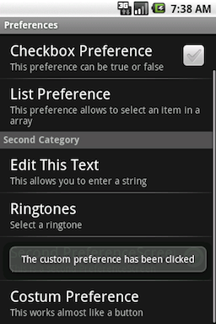
PreferenceActivity
Makes storing user application data easy
5 different preference views
CheckBoxPreference
ListPreference
EditTextPreference
RingtonePreference
Preference (custom)
Source: http://www.kaloer.com/android-preferences

Slide 46
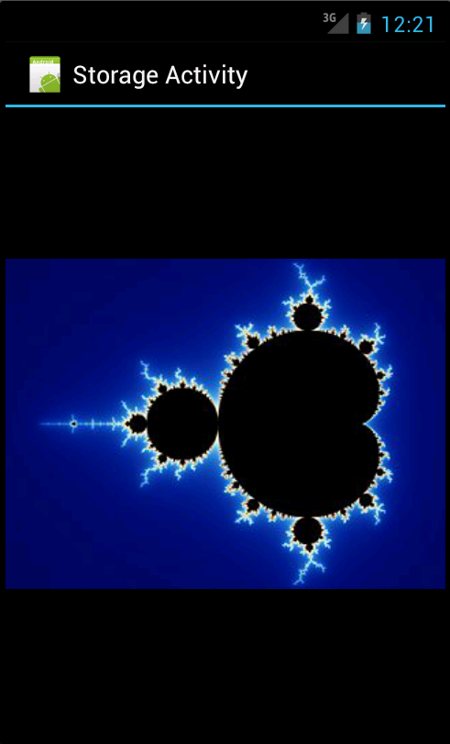
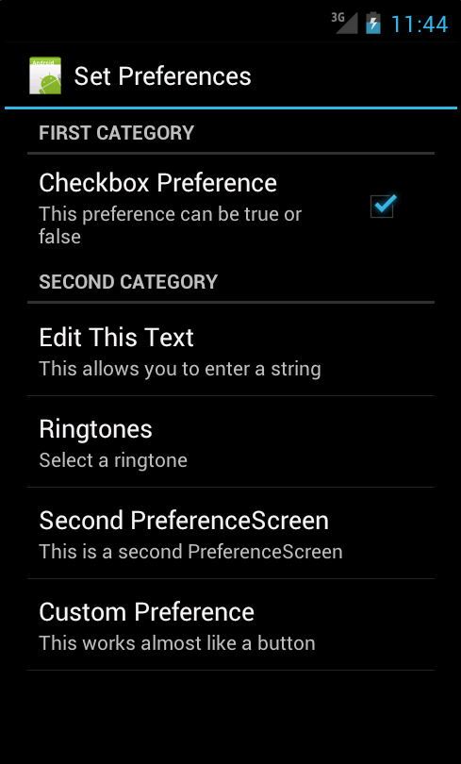
Lab 4

Slide 47
Location, Location, Location
MapView
MapActivity
Geocoder

Slide 48
Get API Key
http://code.google.com/android/maps-api-signup.html
keytool -list -alias androiddebugkey -keystore ”/full/path/learn-android/debug.keystore" -storepass android -keypass android
androiddebugkey, Sep 4, 2011, PrivateKeyEntry,
Certificate fingerprint (MD5): 70:3C:3D:A9:52:2B:73:9E:E1:81:B4:DD:B9:5B:F6:F8

Slide 49
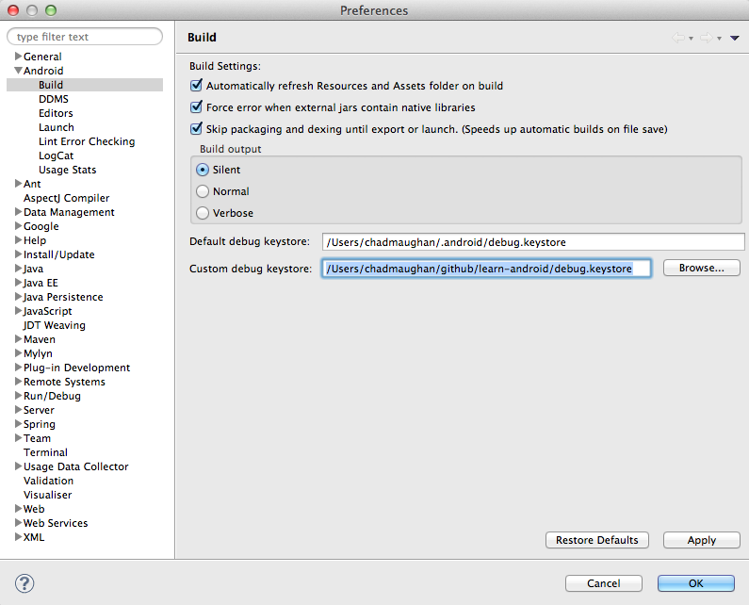
Use Debug Keystore

Slide 50
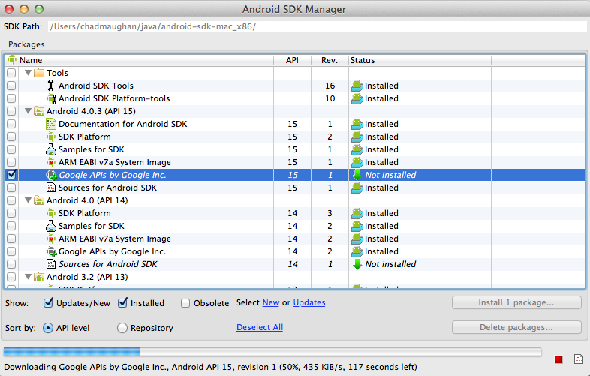
Install APIs

Slide 51
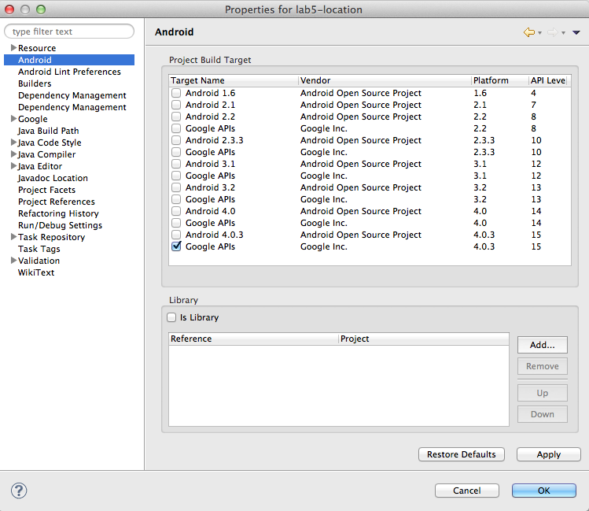
Change Build Target

Slide 52
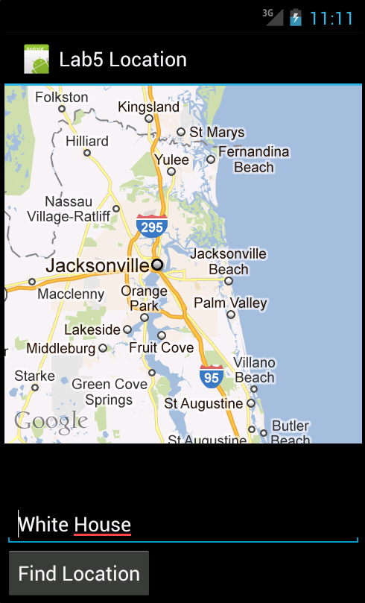
Lab 5

