Slide 1


Slide 2
About Me
Chad Maughan
@chadmaughan
http://chadmaughan.com

Slide 3
Git
Check your installation
$ git --version
git version 1.7.12.2
Download http://git-scm.com/downloads
Linux (Debian based)
apt-get install git
OSX
brew install git
Windows
Download, click stuff, confirm security exceptions, etc.

Slide 4
Node
Check your installation
$ node --version
v0.8.11
Download http://nodejs.org/download/
Linux (Debian based)
apt-get install node
OSX
brew install node
Windows
download binaries, click more stuff, confirm, etc

Slide 5
Code
Download the sample app
$git clone https://github.com/chadmaughan/learn-angular

Slide 6
Differently “Open”
Hosted separately at https://angularjs.org
(not https://developers.google.com)
Code on Github
(not https://developers.google.com)

Slide 7
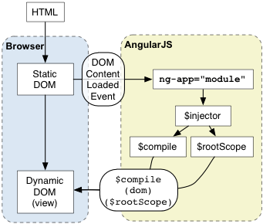
Overview

Slide 8
Angular Namespace
To prevent accidental name collision, Angular prefixes names of objects which could potentially collide with $.
Please do not use the $ prefix in your code as it may accidentally collide with Angular code.

Slide 9
Directives
Teach your HTML new tricks!
Become reusable components
Camel Case -> Snake Case
<div ng-controller="Ctrl1">
Hello <input ng-model='name'>
<span ng:bind="name"></span>
<span ng_bind="name"></span>
<span ng-bind="name"></span>
<span data-ng-bind="name"></span>
<span x-ng-bind="name"></span>
</div>

Slide 10
HTML Compiler
Parsed into DOM
needs to be valid HTML (unlike other templating solutions)
Traverses the DOM and matches directives
Link template with scope
Setup watches

Slide 11
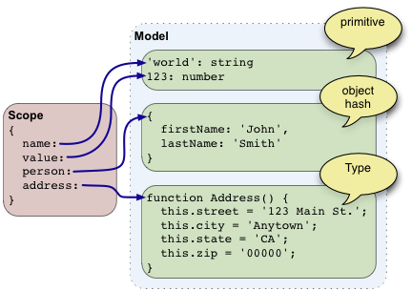
Model (M of MVC)

Slide 12
Scope
Data model
Glue between controllers and views
Execution context for expressions
Be nested to allow isolation of application components
Provide watches for model mutation

Slide 13
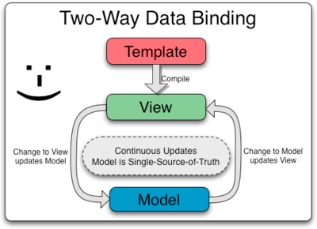
Data Binding
Model is “single source of truth”
When model changes, view updates
No DOM manipulation necessary

Slide 14
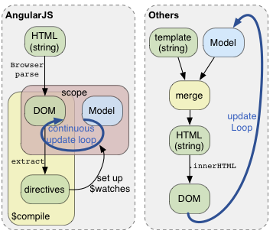
View (V of MVC)

Slide 15
Templates
It is the static DOM, containing HTML, CSS, and angular-specific elements and angular-specific element attributes.
Contains:
Directives
Markup (i.e. - {{ … }})
Filter
Form controls

Slide 16
Expressions
Processed by $parse
Used with {{ expression }}
{{ 1 + 2 }}
{{ hello }}
No control flow
Not JS expression
i.e. doesn’t use eval()

Slide 17
Filters
Formats data for display to the user
Chain filters
{{ name | uppercase }}
Available filters
json, lowercase, uppercase, currency, number, date,

Slide 18
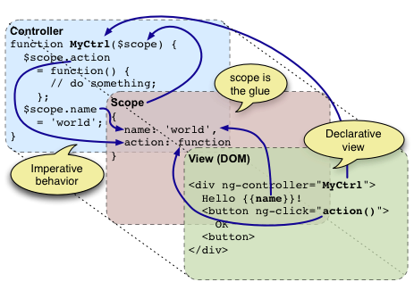
Controller (C of MVC)

Slide 19
Controllers
Add in js/controllers.js
Only business logic for associated view
Keep small
Move complex stuff to services

Slide 20
Controller DON’TS
Any kind of DOM manipulation
Input formatting (use form controls instead)
Output filtering (use filters instead)
Run stateless or stateful code shared across controllers (use services instead)
Instantiate or manage the life-cycle of other components (for example, to create service instances).

Slide 21
Services
Instantiated “lazily”
Are application singletons
Add in js/services.js
Register with $provide
$provide.factory('serviceId', function() {
// return function that constructs
});

Slide 22
Dependency Injection
Law of Demeter – Principle of Least Knowledge
Three ways to get a dependency
The dependency can be created, typically using the new operator.
The dependency can be looked up by referring to a global variable.
The dependency can be passed in to where it is needed.

Slide 23
Injecting a Dependency
Due to dynamic nature of JS, controllers explicitly identify dependencies
myCtrl.$inject = [‘$location’]
// typically done by bootstrapping
var injector = angular.injector(‘myMod’);
var greeter = injector.get('greeter');

Slide 24
Routes
Maps URLs to controllers and views (partials)
Examples:
$routeProvider.when('/states', {templateUrl:'partials/states.html', controller:StateListCtrl});
$routeProvider.otherwise({redirectTo:'/states'});

Slide 25
Unit Testing
Dependency injection helps immensely
Not required, but tutorial uses Jasmine BDD
Example
it('should set value of order model', function() {
expect(scope.order).toBe('age');
});

Slide 26
Questions
Minification
Pre-compilation of HTML partials
Integration with other popular libraries
jQuery
Require.js
Stylus
Other testing tools
Buster.js
Touch devices

Slide 27
Seed App
Application skeleton contains all libraries and gets you up to speed quickly
Download
git clone https://github.com/angular/angular-seed
Run
node scripts/web-server.js

Slide 28
Let’s Build
Download the sample app
$git clone https://github.com/chadmaughan/learn-angular

